Slide 1
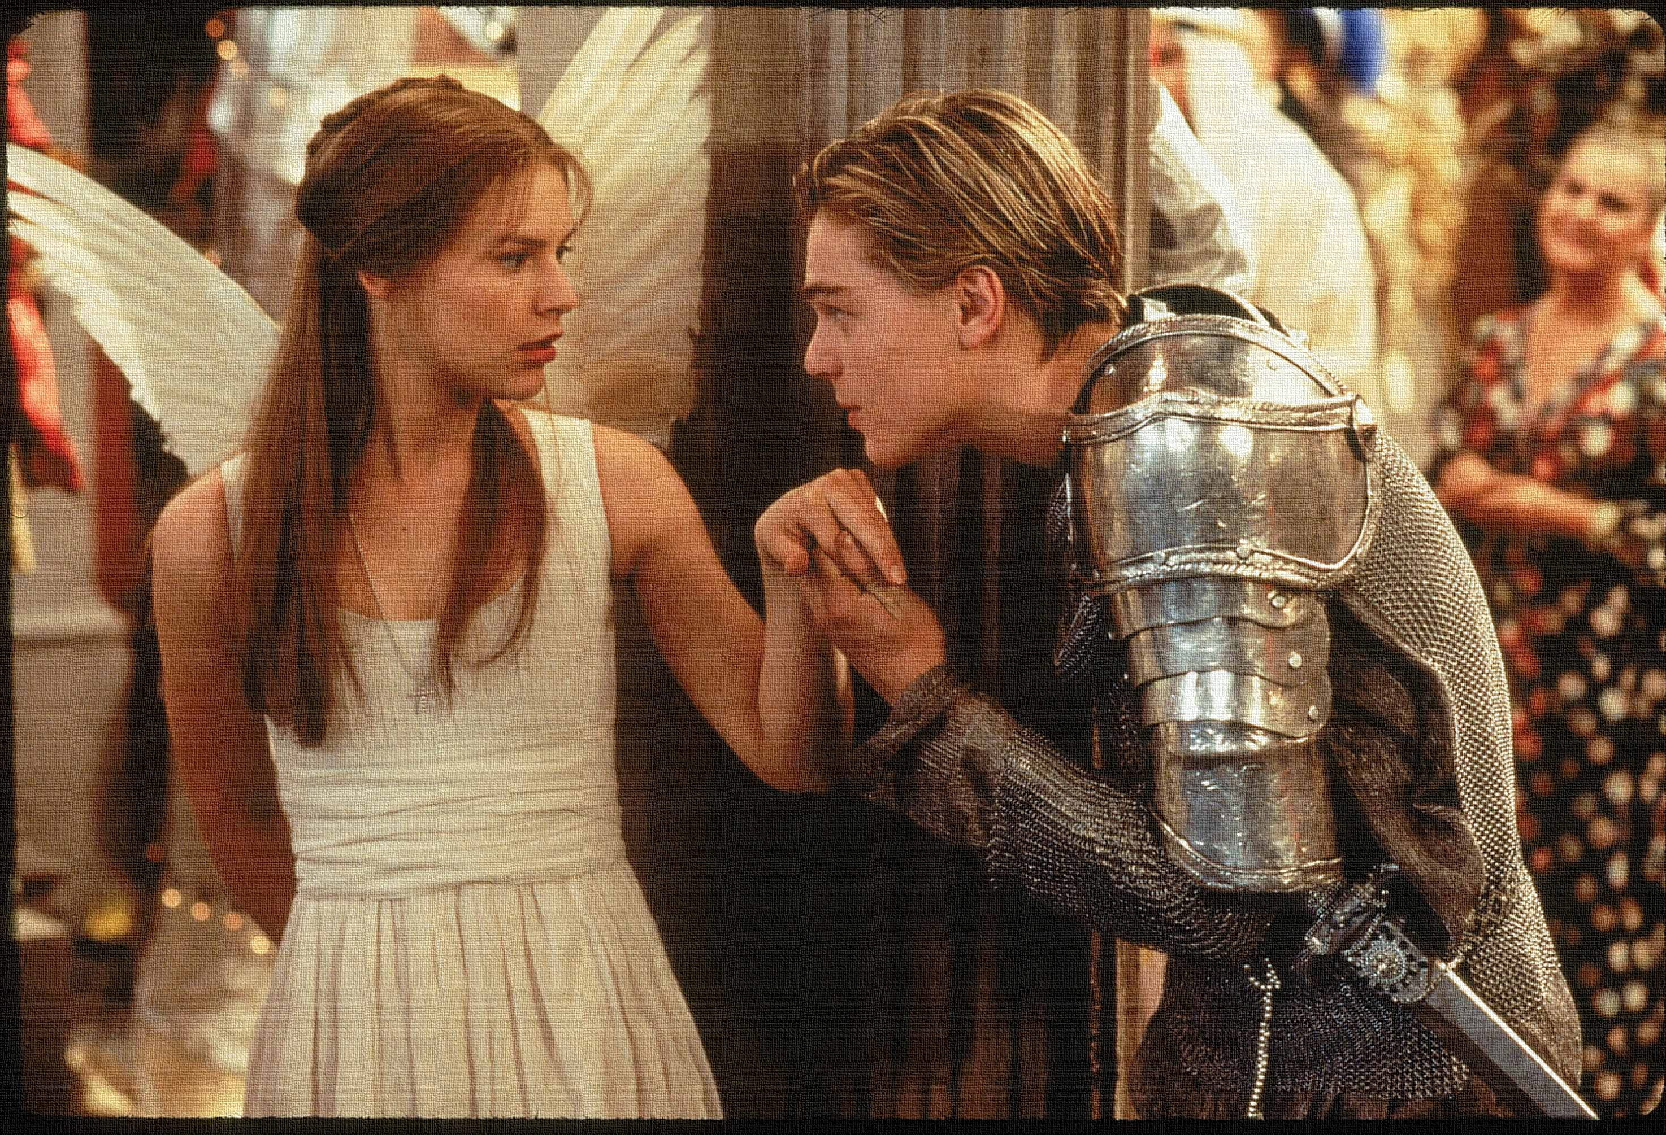
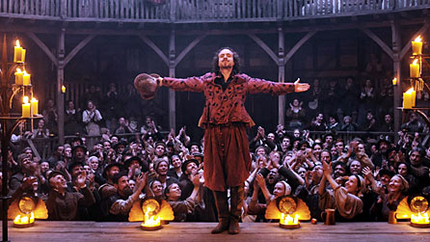
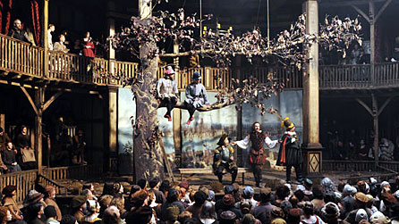
What can you remember about Romeo and Juliet? – Characters? Themes? Acts (what happens)? Sequence of events? Historical/social context?
Thinking Task
Learning Objective:
AO3: Show understanding of the relationships between texts and the contexts in which they were written.

Slide 2
Read the keywords and match their definition: Write them in your books
Prologue
The thing that forms the setting for an event, statement, or idea.
Context
a separate introductory section of a literary, dramatic, or musical work.
Unlocking vocabulary
Rhythm/ Rhyme
a strong, regular repeated pattern of movement or sound.
Stanza
A unit of pronunciation having one vowel sound.
A group of lines forming the basic recurring metrical unit in a poem; a verse.
Syllable

Slide 3
Answers!
Context
The thing that forms the setting for an event, statement, or idea.
Prologue
a separate introductory section of a literary, dramatic, or musical work.
Unlocking vocabulary
Rhythm/ Rhyme
a strong, regular repeated pattern of movement or sound.
Stanza
A unit of pronunciation having one vowel sound.
A group of lines forming the basic recurring metrical unit in a poem; a verse.
Syllable

Slide 4
What does the prologue help the audience understand about the beliefs of the characters/ world of the play?
What does it suggest about the thoughts and feelings of the audience at the time?
PROLOGUE Two households, both alike in dignity, In fair Verona, where we lay our scene, From ancient grudge break to new mutiny, Where civil blood makes civil hands unclean. From forth the fatal loins of these two foes A pair of star-cross'd lovers take their life; Whole misadventured piteous overthrows Do with their death bury their parents' strife. The fearful passage of their death-mark'd love, And the continuance of their parents' rage, Which, but their children's end, nought could remove, Is now the two hours' traffic of our stage; The which if you with patient ears attend, What here shall miss, our toil shall strive to mend.
Is it down to fate that Romeo and Juliet end up dead or something else?
Mastery
Who is most to blame for their deaths and why?
Learning Objectives:
AO1: Maintain a critical style and develop an informed personal response.
AO3: Show understanding of the relationships between texts and the contexts in which they were written.

Slide 5
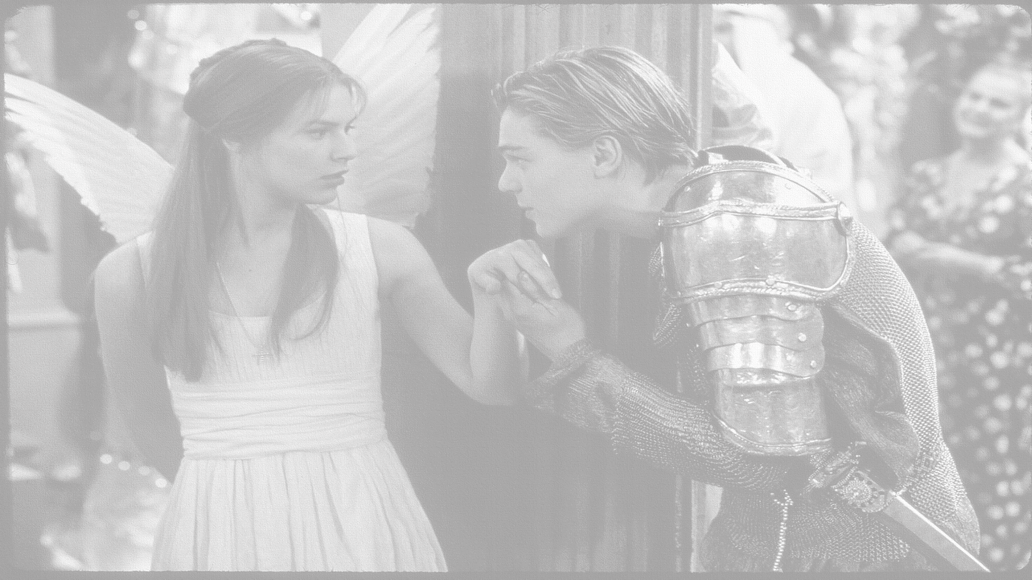
Describe the story of the prologue. What happens, what do you think and feel about being told the main events in the play and why?
Consider:
The structure of the prologue – sonnet form – use of iambic pentameter – Greek chorus. What does it suggest about the play and the main characters?
Two households, both alike in dignity, In fair Verona, where we lay our scene, From ancient grudge break to new mutiny,
Where civil blood makes civil hands unclean. From forth the fatal loins of these two foes A pair of star-cross'd lovers take their life; Whole misadventured piteous overthrows Do with their death bury their parents' strife. The fearful passage of their death-mark'd love, And the continuance of their parents' rage, Which, but their children's end, nought could remove, Is now the two hours' traffic of our stage; The which if you with patient ears attend, What here shall miss, our toil shall strive to mend.
Mastery
The families.
Explain how (with quotes) both families could be blamed for the untimely deaths of Romeo and Juliet?
Theme Links – What are your top 3 theme links for the play thinking about the prologue and why?

