Slide 1
SECTION B Language Paper 1 LO: To explore ways to be creative in your writing. ST: I can effectively use as many techniques as possible.

Slide 2
Writing – 40 marks – 25%
1 extended writing question – 24 marks for content – 16 marks for technical accuracy.
In section B, you will be asked to write a 450-600 word piece of creative prose, inspired by the topic that you have responded to in section A. This will allow you to demonstrate your narrative and descriptive skills in response to ONE of FOUR different titles.

Slide 3
Assessment Objectives
Annotate around your handout
AO5: Communicate clearly, effectively and imaginatively, selecting and adapting tone, style and register for different forms, purposes and audiences. Organise information and ideas, using structural and grammatical features to support coherence and cohesion of texts
AO6: Candidates must use a range of vocabulary and sentence structures for clarity, purpose and effect, with accurate spelling and punctuation. (This requirement must constitute 20% of the marks for each specification as a whole.)

Slide 4
What makes a good description/ narrative?
Mind map your ideas.
Description/ narrative

Slide 5
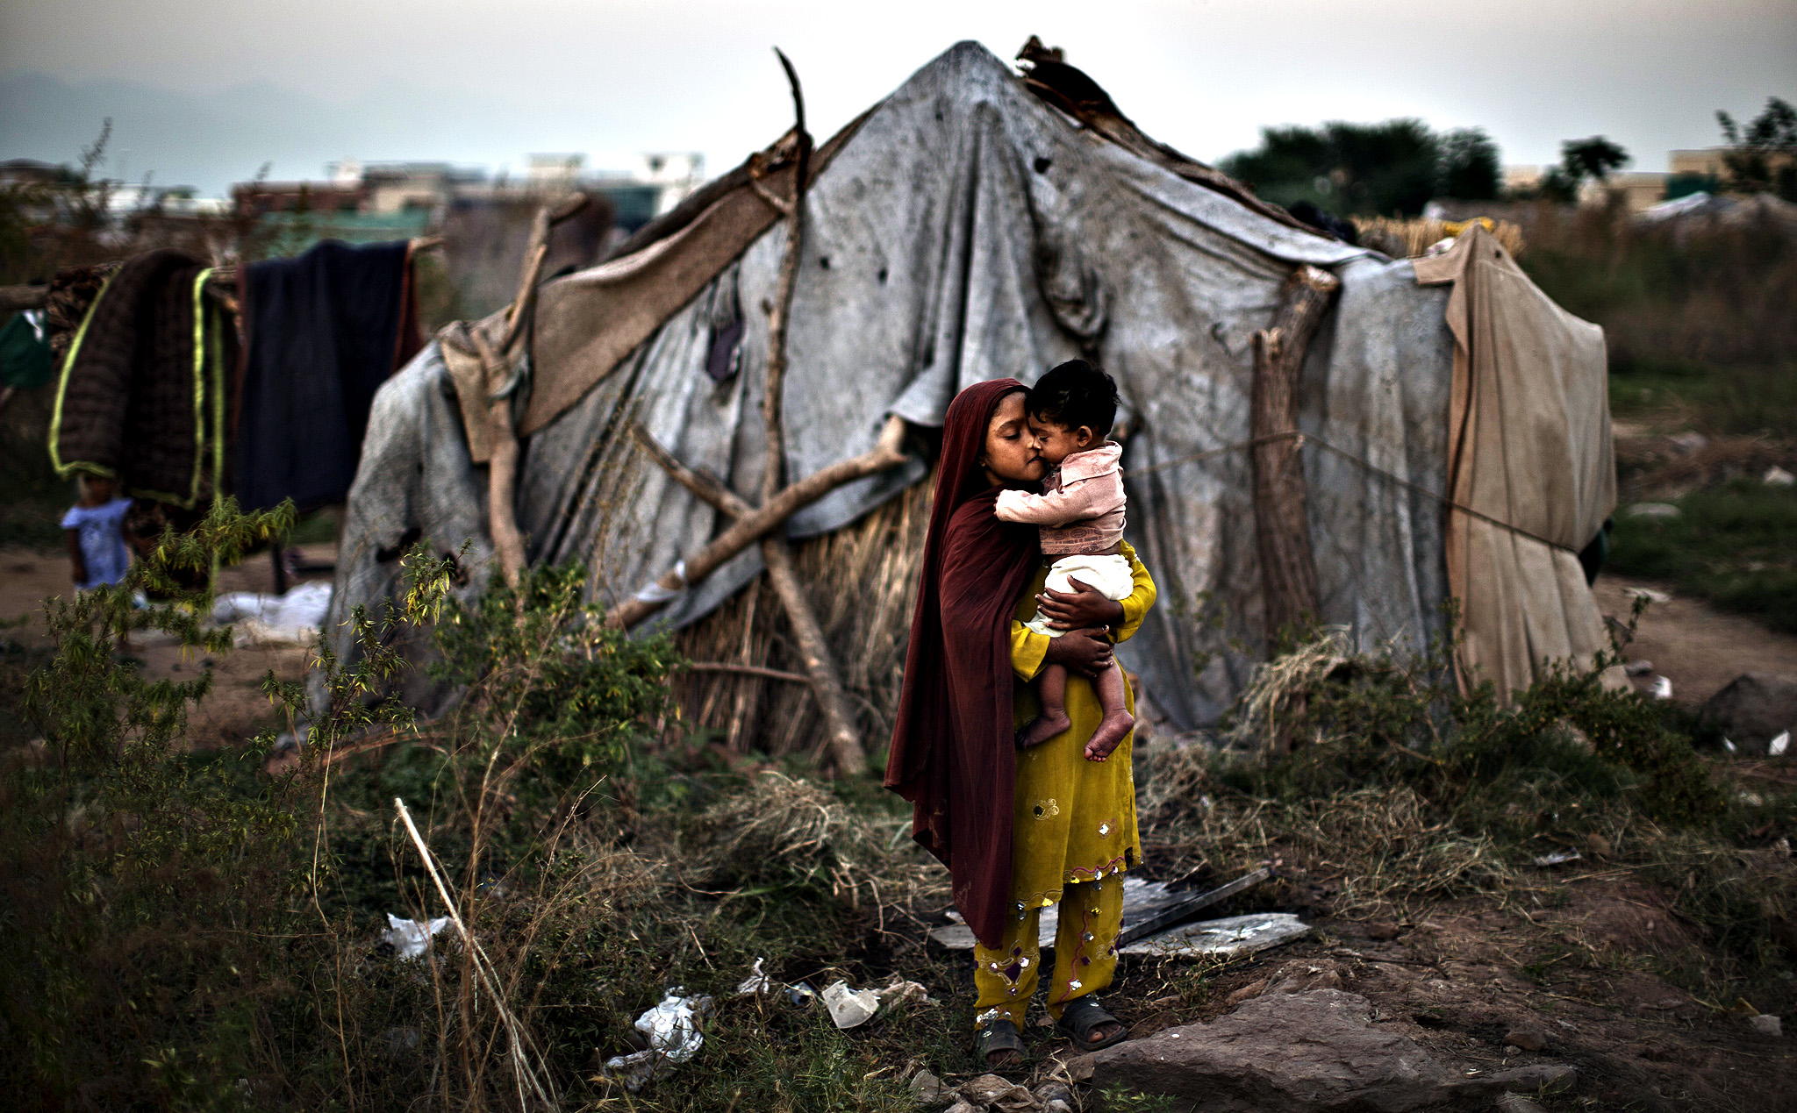
Poverty
Think of a photograph that you are trying to bring to life!
How could you bring this image to life?
The aim is to get the reader to feel like they are there and that they can picture every detail.
Think about the following:
Colour
Smells
Sounds
Sights
Textures
Small details
Similes
Metaphors
Weather
Emotions
Using Imagery

Slide 6
Poverty
The dry, crumbling ground was littered with scraps of white paper which had been scorched by the hot sun. Yellow strands of singed grass poked out of the ground here and there and overall, the landscape was barren and oppressive.
Their home, if you could call it that, consisted of gnarled branches of dry wood tied together with rope and string topped with various scraps of faded fabric.

Slide 7
Using your image annotate ideas around it. Write 2-3 descriptive paragraphs using as many techniques as possible. Make sure you use a range of sentence structures for effect.

Slide 8
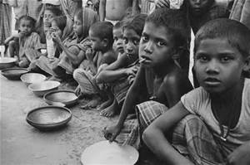
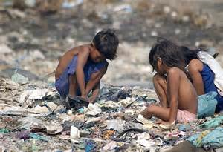
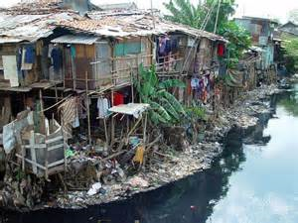
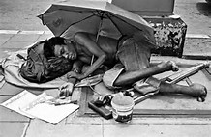
Choose ONE image to describe.

