Slide 1
An introduction to Language Paper 2

Slide 2
Thinking task: use this image to recall your prior knowledge.

Slide 3
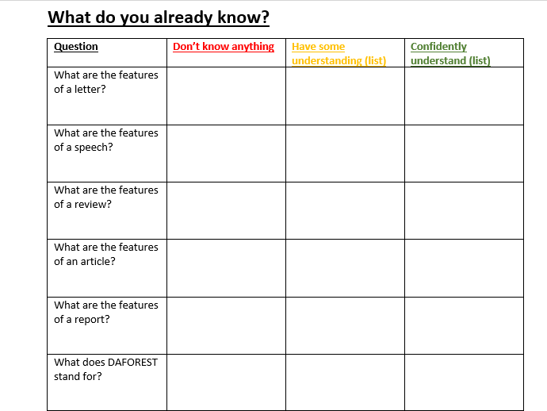
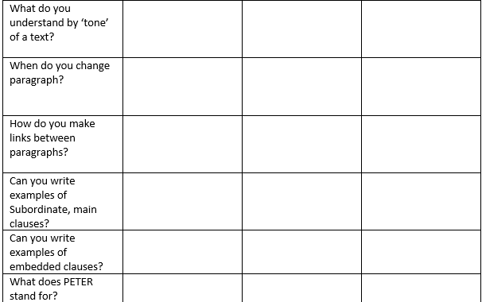
Thinking task: use this image to recall your prior knowledge.
Notes:
I like bananas and I like grapes.
Main clause connective main clause
After she picks me up, Mum is taking me to buy shoes.
Subordinate clause main clause
I first met her in Paris where | lived as a small child.
Main clause connective subordinate clause
Mrs Weatherhead, who is an English teacher, drives a Mini.
Subject embedded clause

Slide 4
The form of Component 2
It is worth 60% of your Language GCSE
What will the exam look like?
The exam will be 2 hours long. You should spend an HOUR on the READING section of the paper, and then an HOUR on the WRITING section. Time management is very important if you are going to collect as many marks as you can, so keep an eye on the clock, or wear a watch and time yourself!

Slide 5
Let’s talk through the paper!
A. READING SECTION – 40 MARKS (1 HOUR)
19th and 21st Century Non-Fiction
You will be given a 19th century non-fiction text alongside a text on the same theme from the 21st century. You will then have a series of questions to answer. As the exam is worth 40 marks, each 10 mark question should take you 15 minutes. Manage your time carefully here!
B. WRITING SECTION – 40 MARKS (1 HOUR)
Transactional/Persuasive Writing
In this section you will be completing TWO pieces of transactional/persuasive writing. They should take 30 minutes each. For each question, 12 marks are awarded for communication and organisation; 8 marks are awarded for vocabulary, sentence structure, punctuation and spelling. Think about the form, purpose and audience for your writing. You should aim to write about 300-400 words for each task.
30% of your exam
30% of your exam

Slide 6
Reading section A
30%
TWO non-fiction texts to read ( approx. one A4 size).
6 questions to answer
2 questions linking to each source
1 synthesis and 1 comparative
Time recommended: 10 minutes reading – 50 minutes answering questions
40 Marks
Synthesis is to combine the ideas/elements to form a connected whole idea.

Slide 7
Writing section B
TWO non-fiction writing tasks (e.g. write a letter, report, interview, speech/talk etc. for a specific purpose, audience, format).
Time recommended: 30 minutes per writing task – 5 minutes planning – 25 minutes writing
You must answer BOTH questions.
40 Marks

Slide 8
A1
AO1 –
Identify and interpret explicit and implicit information and ideas
Select and synthesise evidence from different texts
*Synthesising involves combining ideas from a range of sources in order to group and present common ideas or arguments.
*Unlike summarising and paraphrasing, which only uses one author's ideas at a time, synthesising combines ideas from more than one text or source.
Exam skills – Identifying explicit information (3 marks – 5 minutes)
What does this mean?
Three comprehension questions
Selecting evidence
Short answer one line answer or quote
Let’s practise!
Read the next short extracts and answer the THREE comprehension questions below.

Slide 9
Read this extract:
On February 6th, 1668, the Queen Catherine of England, wife of King Charles II, was a very unhappy woman, and like many miserable wives before and since she gave a dinner party to try to forget for an evening the neglect and unkindness of her spouse.
Those were not the days when a telephone call to a first-class hotel was effort enough to produce a meal to be remembered by emperors. Every dish, flavouring and sauce had to be prepared at home, and, except for spices, lemons and oranges, to be grown at home.
The storage room of an ordinary house was as big as its kitchen, which, in those days, meant as large a shelf-space as a county grocer’s shop today. Imagine the tremendous stores the Royal cook must have had at his disposal, for he rarely had less than a hundred guests at the Royal table, while his under-cooks had often a thousand retainers to cater for.
Jane Purves, ‘The Queen’s Dinner’, in The Women’s Magazine Annual, 1935
Who was Queen Catherine married to? [1 mark]
How was Queen Catherine treated by her husband? [ 1 mark]
How big was the food storage facility in an ordinary house? [1 mark]
Answers:
The queen was married to King Charles II
The queen was neglected and treated unkindly by her spouse.
The storage room was as big as its kitchen.

Slide 10
Read this extract:
Life isn’t fair, awful things happen to blameless people, but then just occasionally the universe seems to get it right. Matthew Thomas a 38-year-old former high school teacher is the sort of gentle, hard-working, thoughtful human for whom you wish nothing less than, well, a million-dollar book deal. A reward he won after spending a decade writing We Are Not Ourselves, his first novel, an epic tale of family life written in the most un-epic of circumstances.
‘We were in a one-bedroom apartment,’ he explains. ‘The kids were in the bedroom, my wife in the bed on the other side of the room and I’d be at the kitchen table late at night trying to work under a lamp very close to the table.’ Hermione Hobey, ‘I learned how to be a person writing this thing,’ The New Review, The Observer, 2014
What did Matthew Thomas do for his former profession? [1 mark]
How much was his book deal worth? [1 mark]
When did Matthew Thomas do his writing? [1 mark]
Answers:
He was a former teacher
It was worth a million pounds.
He worked writing late at night.

Slide 11
Women repulsed by lice and fleas less likely to find beards attractive - study
Whether facial hair boosts men’s pulling power or is a turnoff has long been a matter of contention.
Previous research from the same team found women rate bearded men as a better bet for a long-term relationship. Prince Harry sports one, Justin Trudeau has recently grown one, and Brian Blessed’s is almost its own being. But are beards attractive? As the old adage goes: “Depends on the man, depends on the beard.”
Now researchers have found there might be another factor: whether a potential partner fears there might be something living in it.
Scientists say women who are more repulsed by the idea of lice, fleas, ticks and other such ectoparasites, are less likely to find beards attractive, possibly because such pests might carry diseases.
“This is likely to be the case for the majority of our evolutionary past,” said Anthony Lee, of the University of Stirling, a co-author of the study. “In modern times, with increased grooming and overall better hygiene, this link between hairiness and carrying ectoparasites may no longer exist, but the evolved tendency may still persist.”
Whether facial hair boosts men’s pulling power or is a turnoff has long been a matter of contention, but previous research from the same team found women rate bearded men as a better bet for a long-term relationship.
(a)What do women rate men with a beard better for? [1 mark]
(b) What types of creatures may live in a beard? [1 mark]
(c) Where does the idea of beards carrying ectoparasites come form? [1 mark]
Answers:
They be a better bet for a long-term relationship.
Lice, fleas, ticks and ectoparasites may be found in a beard.
The idea that beards may carry ectoparasites comes form our evolutionary past.

Slide 12
From the archive, 19 November 1987: Fire sweeps King's Cross tube tunnels
Firemen hunt tunnels for survivors as smoke traps dozens in an escalator fire at King's Cross underground station.
Twenty-seven people died last night and dozens were taken to hospital after breathing in smoke after fire broke out under an escalator inside King's Cross underground station in central London.
Late last night more people were trapped underground. Police and firemen were searching the tunnels.
More than 150 firefighters and 30 engines were involved in what the fire brigade described as the most serious incident in recent years.
Eight of those taken to hospital were understood to be seriously ill.
Rescuers used lighting equipment borrowed from television camera crews, but almost two hours after the blaze started they were unable to get more than a few yards into the station.
Transport police and firemen moved towards the station along Underground tunnels but the smoke prevented them getting through.
A Transport Police spokesman said: 'There are dozens of tunnels under there.'
Underground trains were kept running through the station to increase ventilation.
The escalator that caught fire served the Piccadilly line. Five Underground lines intersect at the station, one of the biggest junctions on the system.
The injured were taken to University College Hospital and the Middlesex Hospital, both half a mile away, and to St Bartholomews in the City.
(a)What did the fire brigade describe the incident as? [1 mark]
(b) How many people were taken to hospital understood to be seriously ill? [1 mark]
(c) How many underground lines intersect at King’s Cross? [1 mark]
Answers:
The fire brigade described it as the most serious incident in recent years.
Eight people were taken to hospital seriously ill.
There are five underground lines that intersect at King’s Cross underground station.

Slide 13
Dickens describes the blacking-warehouse to his biographer.
The blacking-warehouse was the last house on the left-hand side of the way, at old Hungerford Stairs. It was a crazy, tumble-down old house, abutting of course on the river, and literally overrun with rats.
Its wainscoted rooms, and its rotten floors and staircase, and the old grey rats swarming down in the cellars, and the sound of their squeaking and scuffling coming up the stairs at all times, and the dirt and decay of the place, rise up visibly before me, as if I were there again. The counting-house was on the first floor, looking over the coal-barges and the river. There was a recess in it, in which I was to sit and work.
My work was to cover the pots of paste-blacking; first with a piece of oil-paper, and then with a piece of blue paper; to tie them round with a string; and then to clip the paper close and neat, all round, until it looked as smart as a pot of ointment from an apothecary’s shop.
When a certain number of grosses of pots had attained this pitch of perfection, I was to paste on each a printed label, and then go on again with more pots. Two or three other boys were kept at similar duty down-stairs on similar wages. One of them came up, in a ragged apron and a paper cap, on the first Monday morning, to show me the trick of using the string and tying the knot. His name was Bob Fagin; and I took the liberty of using his name, long afterwards, in Oliver Twist.
– John Forster, The Life of Charles Dickens
(a)Where was the blacking-warehouse positioned at Hungerford Stairs? [1 mark]
(b) What was the last procedure Dickens had to do in his work? [1 mark]
(c) Where did Dickens get the name from for his novel, Oliver Twist? [1 mark]
Answers:
The blacking-warehouse was positioned on the left-handside of the way at Hungerford Stairs.
The last procedure was to clip the paper close and neat.
Dickens got the name from a boy he worked with called Bob Fagin.

