Slide 1
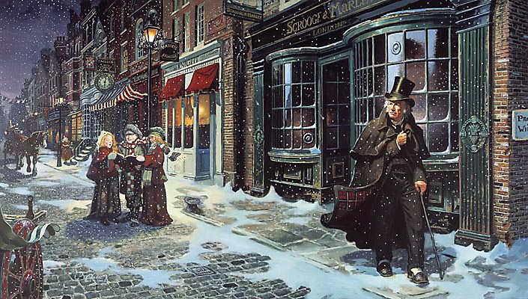
sso
LESSON ONE

Slide 2
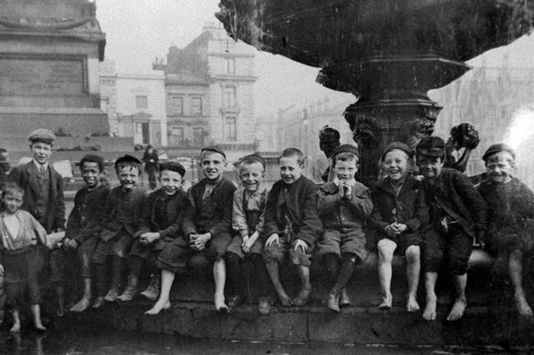
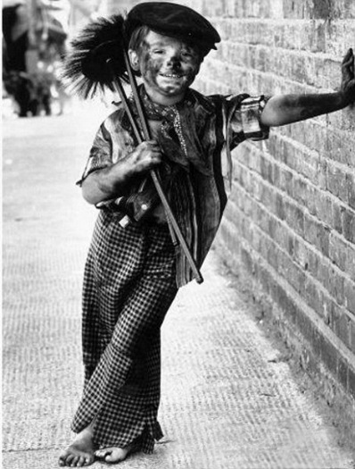
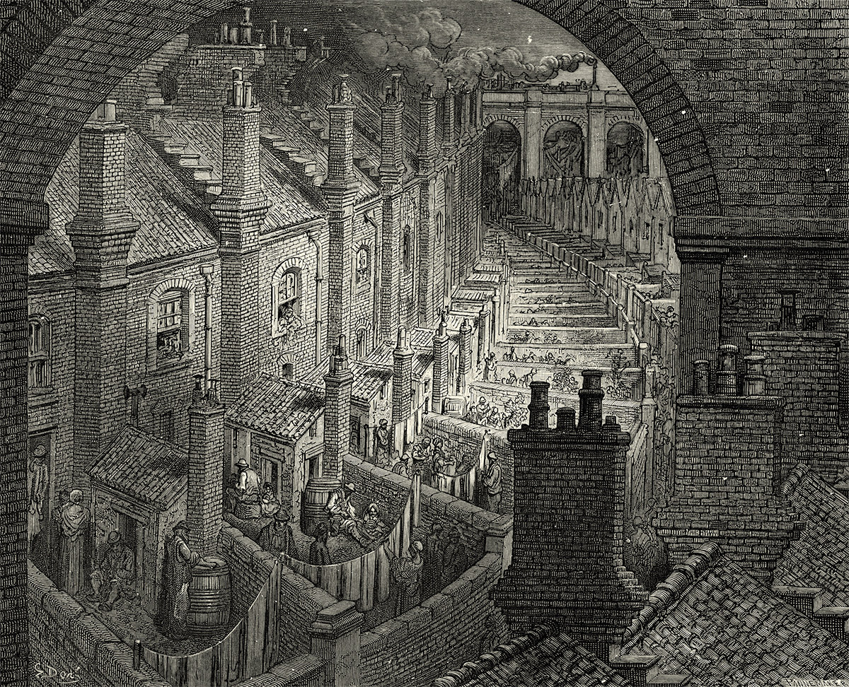
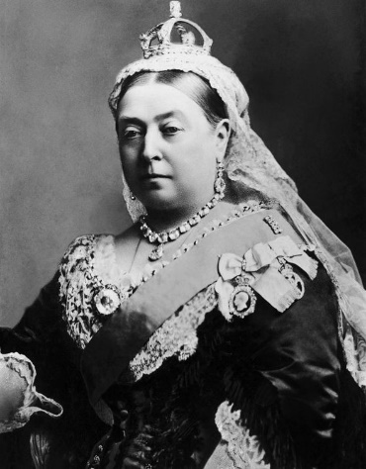
sso
AO3:
Social/Historical
Context
A Christmas Carol: Context
How you think these pictures relate to ‘A Christmas Carol’.
What themes or ideas do you think the novel will explore and why?
Do Now
Today’s key questions:
Can I confidently explain what is meant by CONTEXT?
Can I discuss the context of ‘A Christmas Carol’ and how societal issues inspired Dickens to write his novel?
Can I explain how a writer uses language to convey key ideas?

Slide 3
sso
THE EXAM
This unit will prepare you for the ‘A Christmas Carol’ question in your GCSE Literature exam.
The question will require you to analyse the extract but also to comment on the novel as a whole. Any part of the novel could be given as an extract so it is important you know the text very well as you will not have it with you in the exam.
Learning Content
AO2: Analyse the language, form and structure used by a writer to create meanings and
effects, using relevant subject terminology where appropriate.
AO1: Read, understand and respond to texts. Students should be able to:
• maintain a critical style and develop an informed personal response
• use textual references, including quotations, to support and illustrate
interpretations.
AO3: Show understanding of the relationships between texts and the contexts in which they were written.

Slide 4
sso
AO3:
Social/Historical
Context
YOUR TASK
What was life like in Victorian Prisons?
What was the Poor Law?
How was the Poor Law amended?
Why did Charles Dickens decide to write A Christmas Carol?
How did employers treat their workers?
How did people view poor people at the time?
Comprehension
Today’s key questions:
Can I confidently explain what is meant by CONTEXT?
Can I discuss the context of ‘A Christmas Carol’ and how societal issues inspired Dickens to write his novel?
Can I explain how a writer uses language to convey key ideas?

Slide 5
sso
AO3:
Social/Historical
Context
YOUR TASK
Define the following terms and explain how they relate to ‘A Christmas Carol’:
Political diatribe
2. Allegory
3. Zeitgeist
Unlocking Vocabulary
Today’s key questions:
Can I confidently explain what is meant by CONTEXT?
Can I discuss the context of ‘A Christmas Carol’ and how societal issues inspired Dickens to write his novel?
Can I explain how a writer uses language to convey key ideas?

Slide 6
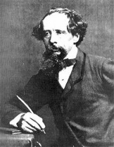
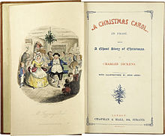
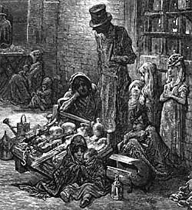
sso
AO3:
Social/Historical
Context
YOUR TASK
https://www.youtube.com/watch?v=cTHAN3_P7uE
To consolidate your knowledge from the Quiz, Quiz Trade task, watch the video from the British Library.
Divide your page up into FOUR and give them the headings like the grid on the right.
Add any notes from the quiz and the video onto this page.
Listen carefully! Be prepared to share your ideas.
Dicken’s Life
The Novel
Mastery
Victorian Society
Why did Dickens
write the novel?
Today’s key questions:
Can I confidently explain what is meant by CONTEXT?
Can I discuss the context of ‘A Christmas Carol’ and how societal issues inspired Dickens to write his novel?
Can I explain how a writer uses language to convey key ideas?

Slide 7
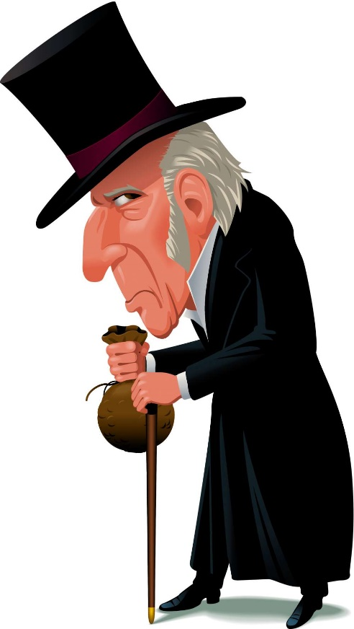
sso
AO1:
Read/Understand/
Respond
YOUR TASK: CONSIDER THE FOLLOWING
Read from the beginning to ‘…what the knowing ones call ‘nuts’ to Scrooge’. Stick Scrooge in your books and consider the following questions.
What are your first impressions of Scrooge and why?
Find quotations that discuss Scrooge and coldness.
What is Scrooge’s attitude towards Christmas? Find a quotation to back up your ideas.
Reading Activity
What is Scrooge’s attitude towards others? Find quotations to support your points!
Find a quote that shows Scrooge’s isolation?
Today’s key questions:
Can I confidently explain what is meant by CONTEXT?
Can I discuss the context of ‘A Christmas Carol’ and how societal issues inspired Dickens to write his novel?
Can I explain how a writer uses language to convey key ideas?

Slide 8
sso
AO2:
Analyse Language/
Form/Structure
YOUR TASK
How is Scrooge presented in this extract?
How does it link to what we know about the context of the novella?
Oh! But he was a tight-fisted hand at the grind- stone, Scrooge! a squeezing, wrenching, grasping, scraping, clutching, covetous, old sinner! Hard and sharp as flint, from which no steel had ever struck out generous fire; secret, and self-contained, and solitary as an oyster. The cold within him froze his old features, nipped his pointed nose, shrivelled his cheek, stiffened his gait; made his eyes red, his thin lips blue and spoke out shrewdly in his grating voice. A frosty rime was on his head, and on his eyebrows, and his wiry chin. He carried his own low temperature always about with him; he iced his office in the dogdays; and didn't thaw it one degree at Christmas.
External heat and cold had little influence on Scrooge. No warmth could warm, no wintry weather chill him. No wind that blew was bitterer than he, no falling snow was more intent upon its purpose, no pelting rain less open to entreaty. Foul weather didn't know where to have him. The heaviest rain, and snow, and hail, and sleet, could boast of the advantage over him in only one respect. They often "came down" handsomely, and Scrooge never did.
Nobody ever stopped him in the street to say, with gladsome looks, "My dear Scrooge, how are you? When will you come to see me?" No beggars implored him to bestow a trifle, no children asked him what it was o'clock, no man or woman ever once in all his life inquired the way to such and such a place, of Scrooge. Even the blind men's dogs appeared to know him; and when they saw him coming on, would tug their owners into doorways and up courts; and then would wag their tails as though they said, "No eye at all is better than an evil eye, dark master!"
Mastery
Today’s key questions:
Can I confidently explain what is meant by CONTEXT?
Can I discuss the context of ‘A Christmas Carol’ and how societal issues inspired Dickens to write his novel?
Can I explain how a writer uses language to convey key ideas?

Slide 9
sso
YOUR TASK
AO1/AO2/AO3
How does Dickens use language to present Scrooge?
Have I…
made a clear point?
used quotations to back up my ideas?
explained why Dickens has made certain language choices?
included a point regarding the social/historical context?
P: Scrooge is clearly an isolated when Dickens first introduces him to readers.
E: He is described as “solitary as an oyster”.
T: This simile
E: suggests he _____________________________________
By using the word “oyster”, Dickens implies _______
R: The reader’s first impression is_____________________
Mastery
Today’s key questions:
Can I confidently explain what is meant by CONTEXT?
Can I discuss the context of ‘A Christmas Carol’ and how societal issues inspired Dickens to write his novel?
Can I explain how a writer uses language to convey key ideas?

Slide 10
sso
TO FINISH
How does Dickens use language to present Scrooge during Stave One?
Has my partner…
made a clear point?
used quotations to back up my ideas?
explained why Dickens has made certain language choices?
included a point regarding the social/historical context?
Swap books with your partner and read through their answer.
Write a WHAT WENT WELL and an EVEN BETTER IF for their response.
EBI: EBI:
Neater handwriting See if you can add another point
Make better points Use quotations (3-5 words)
Peer Assessmnet
Today’s key questions:
Can I confidently explain what is meant by CONTEXT?
Can I discuss the context of ‘A Christmas Carol’ and how societal issues inspired Dickens to write his novel?
Can I explain how a writer uses language to convey key ideas?

Slide 11
sso

Slide 12
sso
RESOURCES

Slide 13
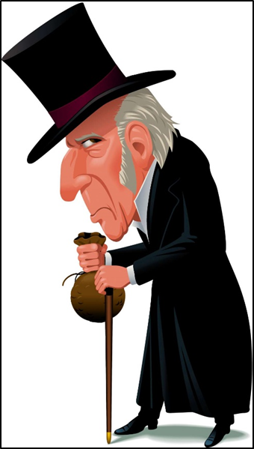
sso

