Slide 1
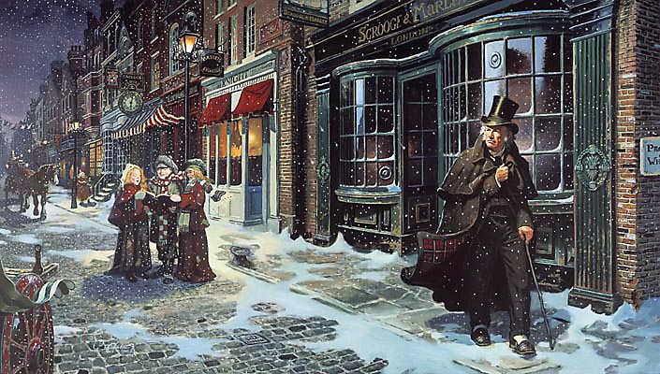
sso
LESSON ONE

Slide 2
sso
THE EXAM
This unit will prepare you for the ‘A Christmas Carol’ question in your GCSE Literature exam.
The question will require you to analyse the extract but also to comment on the novel as a whole. Any part of the novel could be given as an extract so it is important you know the text very well as you will not have it with you in the exam.
AO1: Read, understand and respond to texts. Use textual references, including quotations, to support ideas.
AO2: Analyse language, form and structure using the correct subject terminology.
AO3: Show an understanding of the relationships between texts and the contexts in which they were written.

Slide 3
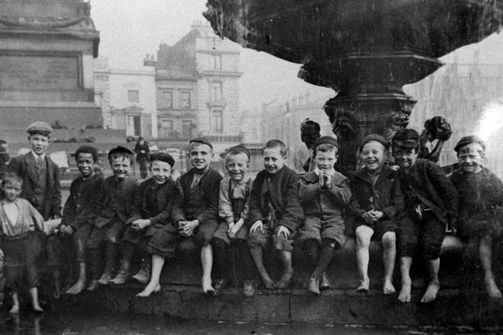
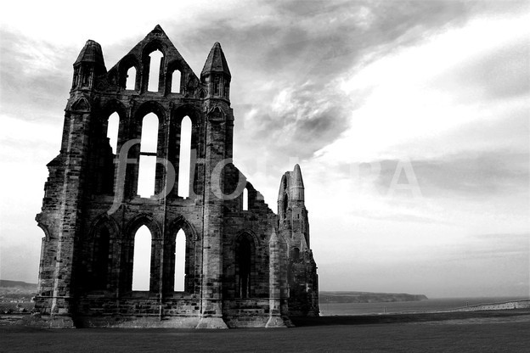
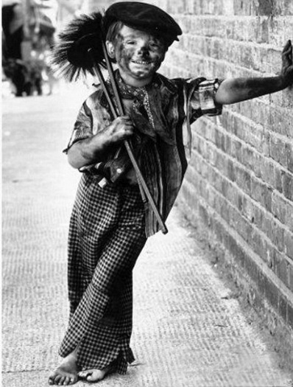
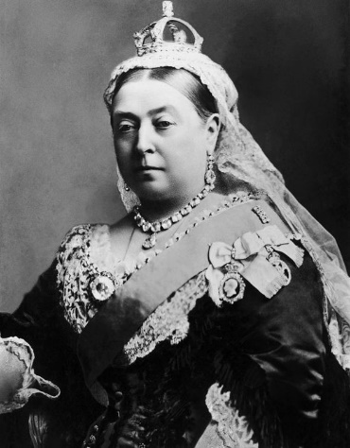
sso
AO3:
Social/Historical
Context
YOUR STARTER
On your tables, discuss how you think these pictures relate to ‘A Christmas Carol’.
What themes or ideas do you think the novel will explore and why?
EXTRA
CHALLENGE
Define the following:
CONTEXT
What do you think this word means?
How are the pictures on the right part of the novel’s social and historical context?
Today’s key questions:
Can I confidently explain what is meant by CONTEXT?
Can I discuss the context of ‘A Christmas Carol’ and how societal issues inspired Dickens to write his novel?
Can I explain how a writer uses language to convey key ideas?

Slide 4
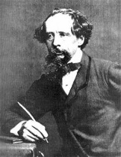
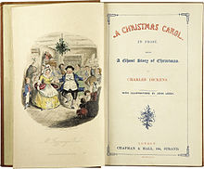
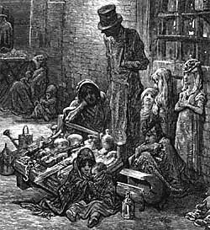
sso
AO3:
Social/Historical
Context
https://www.youtube.com/watch?v=cTHAN3_P7uE&feature=emb_logo
Watch the video from the British Library.
Divide your page up into FOUR and give them the headings like the grid on the right.
Add any notes from the quiz and the video onto this page.
Listen carefully! Be prepared to share your ideas.
Dicken’s Life
The Novel
Victorian Society
Why did Dickens
write the novel?
Today’s key questions:
Can I confidently explain what is meant by CONTEXT?
Can I discuss the context of ‘A Christmas Carol’ and how societal issues inspired Dickens to write his novel?
Can I explain how a writer uses language to convey key ideas?

Slide 5
sso
YOUR TASK
Stick Dickens’ message into your books and consider the following questions. Answer as annotations.
What do you think is meant by the ‘Ghost of an Idea?’
What is the effect of the word ‘haunt’? What is Dickens saying will haunt his readers?
I have endeavoured in this Ghostly little book, to raise the Ghost of an Idea, which shall not put my readers out of humour with themselves, with each other, with the season, or with me. May it haunt their houses pleasantly, and no one wish to lay it.
Their faithful Friend and Servant,
C. D.
What does Charles Dickens mean when he says his idea will ‘not put my readers our of humour with themselves’?
Why do you think Dickens describes himself as a ‘servant’ to the reader?
What do you think Charles Dickens’ message is here?
Today’s key questions:
Can I confidently explain what is meant by CONTEXT?
Can I discuss the context of ‘A Christmas Carol’ and how societal issues inspired Dickens to write his novel?
Can I explain how a writer uses language to convey key ideas?

Slide 6
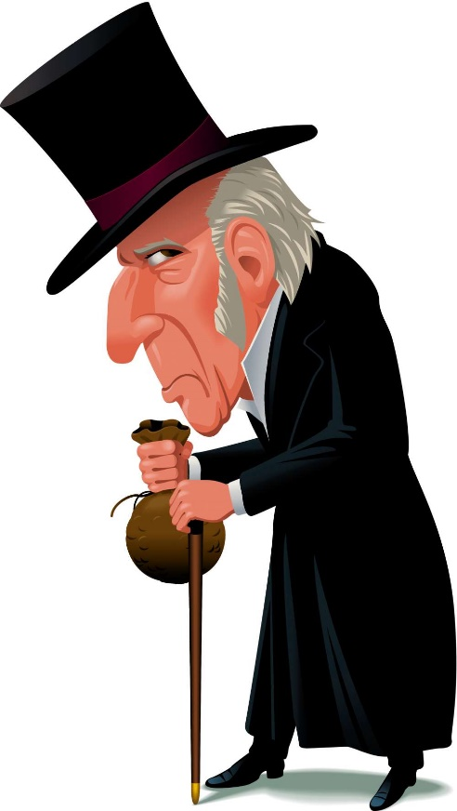
sso
AO1:
Read/Understand/
Respond
YOUR TASK: CONSIDER THE FOLLOWING
Read from the beginning to ‘…what the knowing ones call ‘nuts’ to Scrooge’. Stick Scrooge in your books and consider the following questions.
What are your first impressions of Scrooge and why?
Find quotations that discuss Scrooge and coldness. Can you make any links between Scrooge and the cold?
What is Scrooge’s attitude towards others? Find quotations to support your points!
What is Scrooge’s attitude towards Christmas? Find a quotation to back up your ideas.
EXTRA CHALLENGE:
Can you relate Scrooge to any of the HISTORICAL issues we have discussed today?
Why do you think Dickens spends so much time emphasising Scrooge’s isolation? What is the point?
Today’s key questions:
Can I confidently explain what is meant by CONTEXT?
Can I discuss the context of ‘A Christmas Carol’ and how societal issues inspired Dickens to write his novel?
Can I explain how a writer uses language to convey key ideas?

Slide 7
sso
AO2:
Analyse Language/
Form/Structure
Analyse Dickens’ description of Scrooge using the correct subject terminology. Answer as annotations around the extract.
In your answers, consider:
Dickens’ purpose
Social/historical context points
Language devices
Word Classes
ALL can attempt analysis of the RED terms.
SOME can attempt analysis of the GREEN terms.
YOUR TASK
Oh! But he was a tight-fisted hand at the grind- stone, Scrooge! a squeezing, wrenching, grasping, scraping, clutching, covetous, old sinner! Hard and sharp as flint, from which no steel had ever struck out generous fire; secret, and self-contained, and solitary as an oyster. The cold within him froze his old features, nipped his pointed nose, shrivelled his cheek, stiffened his gait; made his eyes red, his thin lips blue and spoke out shrewdly in his grating voice. A frosty rime was on his head, and on his eyebrows, and his wiry chin. He carried his own low temperature always about with him; he iced his office in the dogdays; and didn't thaw it one degree at Christmas.
External heat and cold had little influence on Scrooge. No warmth could warm, no wintry weather chill him. No wind that blew was bitterer than he, no falling snow was more intent upon its purpose, no pelting rain less open to entreaty. Foul weather didn't know where to have him. The heaviest rain, and snow, and hail, and sleet, could boast of the advantage over him in only one respect. They often "came down" handsomely, and Scrooge never did.
Nobody ever stopped him in the street to say, with gladsome looks, "My dear Scrooge, how are you? When will you come to see me?" No beggars implored him to bestow a trifle, no children asked him what it was o'clock, no man or woman ever once in all his life inquired the way to such and such a place, of Scrooge. Even the blind men's dogs appeared to know him; and when they saw him coming on, would tug their owners into doorways and up courts; and then would wag their tails as though they said, "No eye at all is better than an evil eye, dark master!"
NOT SURE WHERE TO BEGIN?
Today’s key questions:
Can I confidently explain what is meant by CONTEXT?
Can I discuss the context of ‘A Christmas Carol’ and how societal issues inspired Dickens to write his novel?
Can I explain how a writer uses language to convey key ideas?

Slide 8
sso
YOUR TASK
AO1/AO2/AO3
How does Dickens use language to present Scrooge during Stave One?
Have I…
made a clear point?
used quotations to back up my ideas?
explained why Dickens has made certain language choices?
discussed the effect of these language choices?
discussed multiple interpretations of my ideas?
included a point regarding the social/historical context?
HOW DO I START?
Scrooge is clearly an isolated and afflicted character when Dickens first introduces him to readers. Dickens goes some way to emphasise Scrooge’s disconsolate attitude, especially where he writes, ‘…’ Perhaps Dickens is trying to… Furthermore, …
CAN YOU INCLUDE THE FOLLOWING TERMS?
Political diatribe
Allegory/Allegorical
Miserly
Zeitgeist
Today’s key questions:
Can I confidently explain what is meant by CONTEXT?
Can I discuss the context of ‘A Christmas Carol’ and how societal issues inspired Dickens to write his novel?
Can I explain how a writer uses language to convey key ideas?

Slide 9
sso
TO FINISH
How does Dickens use language to present Scrooge during Stave One?
Has my partner…
made a clear point?
used quotations to back up their ideas?
explained why Dickens has made certain language choices?
discussed the effect of these language choices?
discussed multiple interpretations of their ideas?
included a point regarding the social/historical context?
Swap books with your partner and read through their answer.
Write a WHAT WENT WELL and an EVEN BETTER IF for their response.
EBI: EBI:
Neater handwriting See if you can add another point
Make better points Use quotations (3-5 words)
Today’s key questions:
Can I confidently explain what is meant by CONTEXT?
Can I discuss the context of ‘A Christmas Carol’ and how societal issues inspired Dickens to write his novel?
Can I explain how a writer uses language to convey key ideas?

Slide 10
sso

Slide 11
sso
RESOURCES

Slide 12
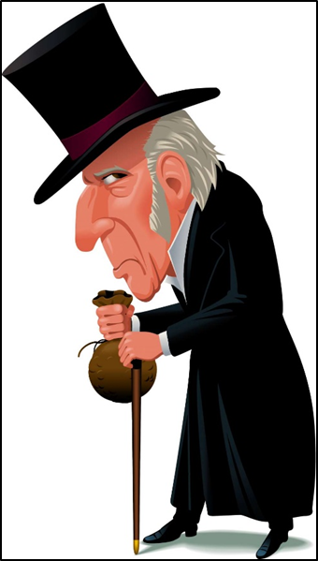
sso

Slide 13
I have endeavoured in this Ghostly little book, to raise the Ghost of an Idea, which shall not put my readers out of humour with themselves, with each other, with the season, or with me. May it haunt their houses pleasantly, and no one wish to lay it.
Their faithful Friend and Servant,
C. D.
I have endeavoured in this Ghostly little book, to raise the Ghost of an Idea, which shall not put my readers out of humour with themselves, with each other, with the season, or with me. May it haunt their houses pleasantly, and no one wish to lay it.
Their faithful Friend and Servant,
C. D.
I have endeavoured in this Ghostly little book, to raise the Ghost of an Idea, which shall not put my readers out of humour with themselves, with each other, with the season, or with me. May it haunt their houses pleasantly, and no one wish to lay it.
Their faithful Friend and Servant,
C. D.
I have endeavoured in this Ghostly little book, to raise the Ghost of an Idea, which shall not put my readers out of humour with themselves, with each other, with the season, or with me. May it haunt their houses pleasantly, and no one wish to lay it.
Their faithful Friend and Servant,
C. D.

