Slide 1
Learning content
LO: To write an effective persuasive speech using specific linguistic techniques. ST: I can confidently use form, structure and purpose.

Slide 2
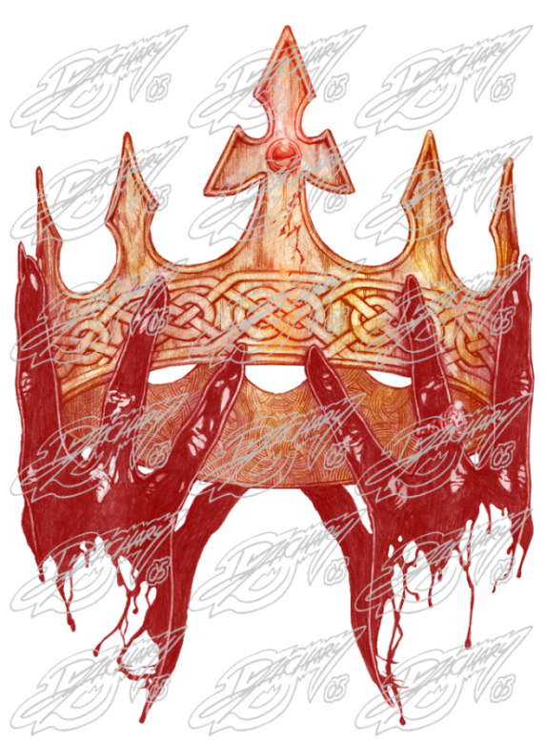
Starter: Who do you blame?
DO NOW!
King Duncan was murdered by the hand of Macbeth, but who can truly be blamed?
Macbeth was ambitious and had “dark and deep desires.”
Lady Macbeth manipulated her husband and planned the murder.
The Witches influenced Macbeth and set events in motion.
Who do you blame? Write your thoughts on the Post-It note and stick it to the whiteboard.
You must say - why?
Notes:
Feedback the different ideas and record them on the board to help as a planning stage. You could ask students to fill out a 3 column table with their different ideas????

Slide 3
Match the word to the definition.
Unlocking vocabulary
_____________ a movement of part of the body, especially a hand or the head, to express an idea or meaning.
___________ cause (someone) to believe firmly in the truth of something.
__________ good at getting someone to do or believe something through reasoning.
___________ an argument or set of reasons put forward to oppose an idea or theory developed in another argument.
Counter-argument Gesture
Convince Persuasive

Slide 4
Answers! Please give yourself a tick
Unlocking vocabulary
Gesture a movement of part of the body, especially a hand or the head, to express an idea or meaning.
Convince cause (someone) to believe firmly in the truth of something.
Persuasive good at getting someone to do or believe something through reasoning.
Counter-argument an argument or set of reasons put forward to oppose an idea or theory developed in another argument.

Slide 5
Persuasive Speech
Mastery
Working in pairs or individually. With your partner, write a persuasive speech, in the back of your book or on paper, that argues for who you blame for the death of King Duncan. Be ready to deliver your speech at the end of the lesson!
Include some of the following persuasive devices:
Emotive language, textual evidence, direct address, rhetorical question, rule of three, repetition, short sentences and counter argument.
Use the correct layout and pay attention to SPaG!
Year 8, I am here today to tell you who was really to blame for the death of king Duncan. Firstly, let me recap events and then I will put my case forward….

Slide 6
Plenary: The Debate
Mastery
I want to hear at least one argument for each character. Listen closely to the pair speaking, as I may ask you to explain the persuasive devices they used or to counter argue their point of view!
Include some of the following persuasive devices:
Emotive language, textual evidence, direct address, rhetorical question, rule of three, repetition, short sentences and counter argument.
Class Vote:
Which pair had the most persuasive argument?
Who is to blame for the death of King Duncan?

Slide 7
Extension task
Extension task: Write a cloze passage for the final act. This will demonstrate your knowledge of the chronological order of events.
Notes:
This could be used as a final homework task.

Slide 8
Notes:
Printable resource for students.

