Slide 1
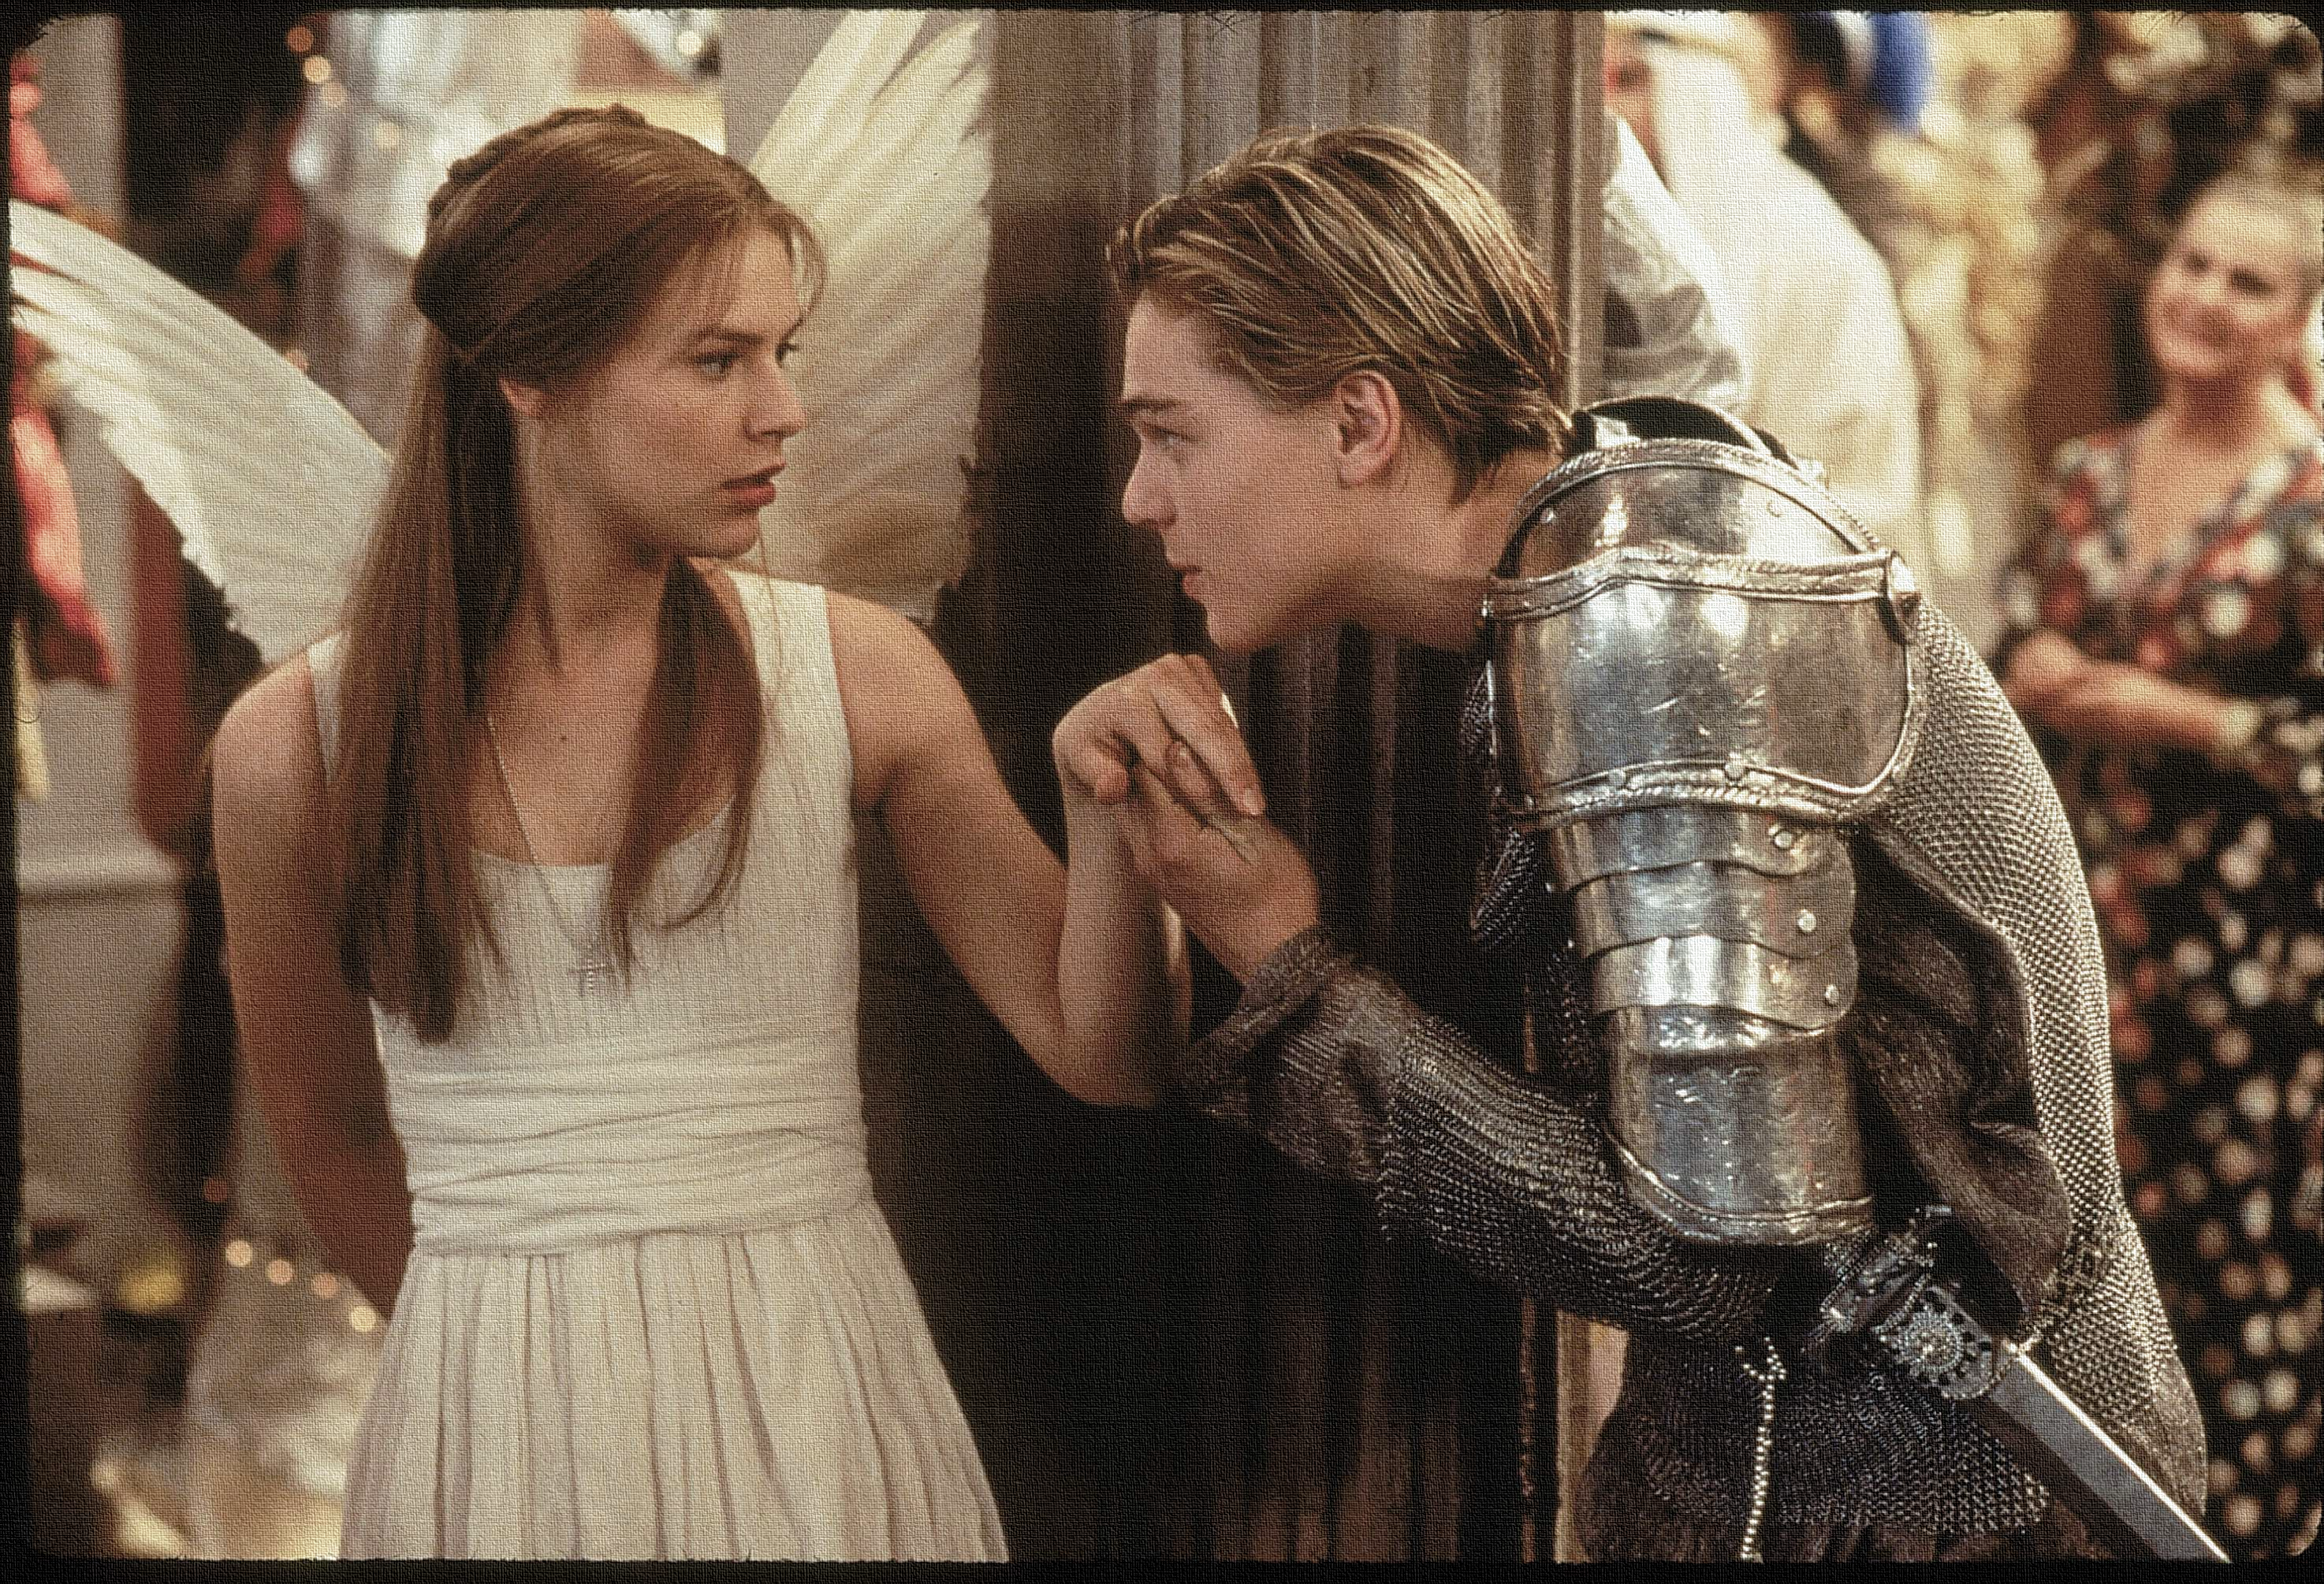
Key Words:
Chaos
Contrast
Panic
Peace
Eternity
Paramour
Lesson 16: Act 5, Scene 3.
The final scene.
Success Criteria:
To explore the final scene and the lovers’ deaths.
To explore Shakespeare’s use of timing and hope.
To write an extended exam style response.
‘Romeo + Juliet’
Learning Objective:
AO1: maintain a critical style and develop an informed personal response.

Slide 2
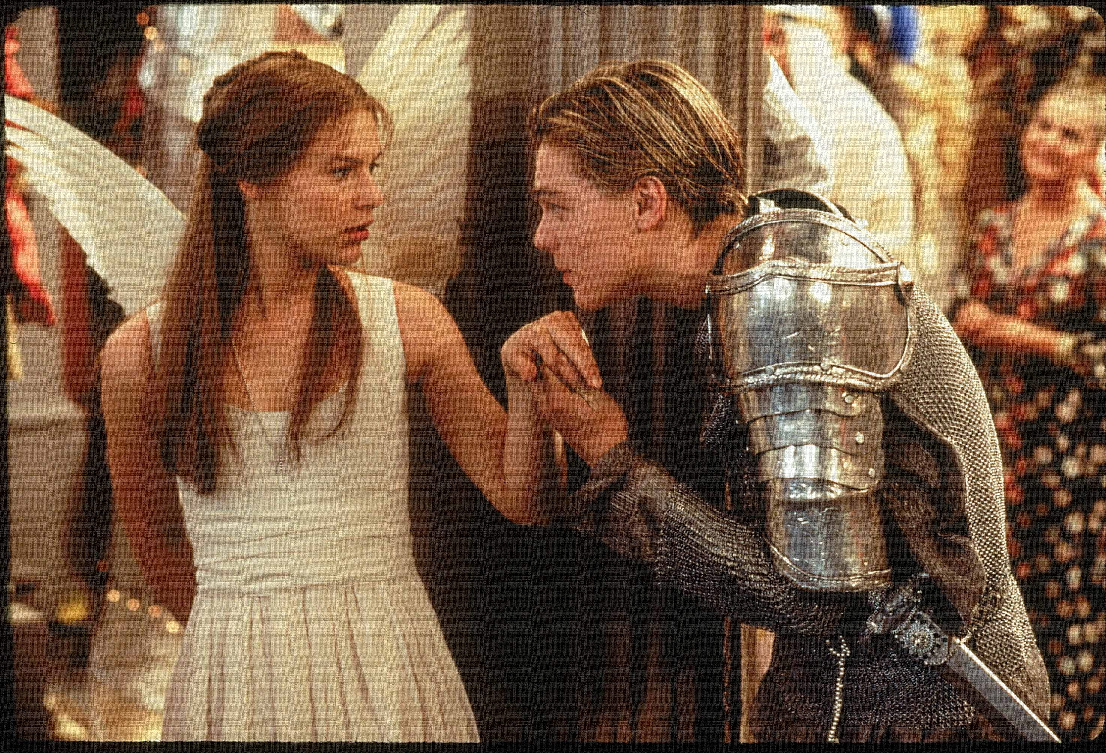
Write today’s date - Monday, 01 June 2020 and today’s title – Romeo and Juliet Revision in your book
Let’s read!
Act 5 scene 3
Paris:
Page:
Romeo:
Balthasar:
Friar Lawrence:
Juliet:
1st Watchman:
2nd Watchman:
3rd Watchman:
Prince:
Capulet:
Lady Capulet:
Montague:
Key themes:
FATE
LOVE
CONFLICT
Do Now
As we read identify where the themes are shown in the text. BE READY TO FEED BACK!
Learning Objectives:
AO1: use textual references, including quotations, to support and illustrate interpretations.
AO2: Analyse the language used by a writer to create meanings and effects.

Slide 3
Read the keywords and match their definition: Write them in your books
Paramour
a lover, especially the illicit partner of a married person.
chaos
complete disorder and confusion.
contrast
Unlocking vocabulary
eternity
the state of being strikingly different from something else in juxtaposition or close association.
infinite or unending time.
panic
sudden uncontrollable fear or anxiety, often causing wildly unthinking behaviour.
Notes:
For lower ability students see print off in resources to help with copying out.

Slide 4
Read the keywords and match their definition: Write them in your books
Paramour
a lover, especially the illicit partner of a married person.
chaos
complete disorder and confusion.
contrast
Unlocking vocabulary
eternity
the state of being strikingly different from something else in juxtaposition or close association.
infinite or unending time.
panic
sudden uncontrollable fear or anxiety, often causing wildly unthinking behaviour.
Notes:
For lower ability students see print off in resources to help with copying out.

Slide 5
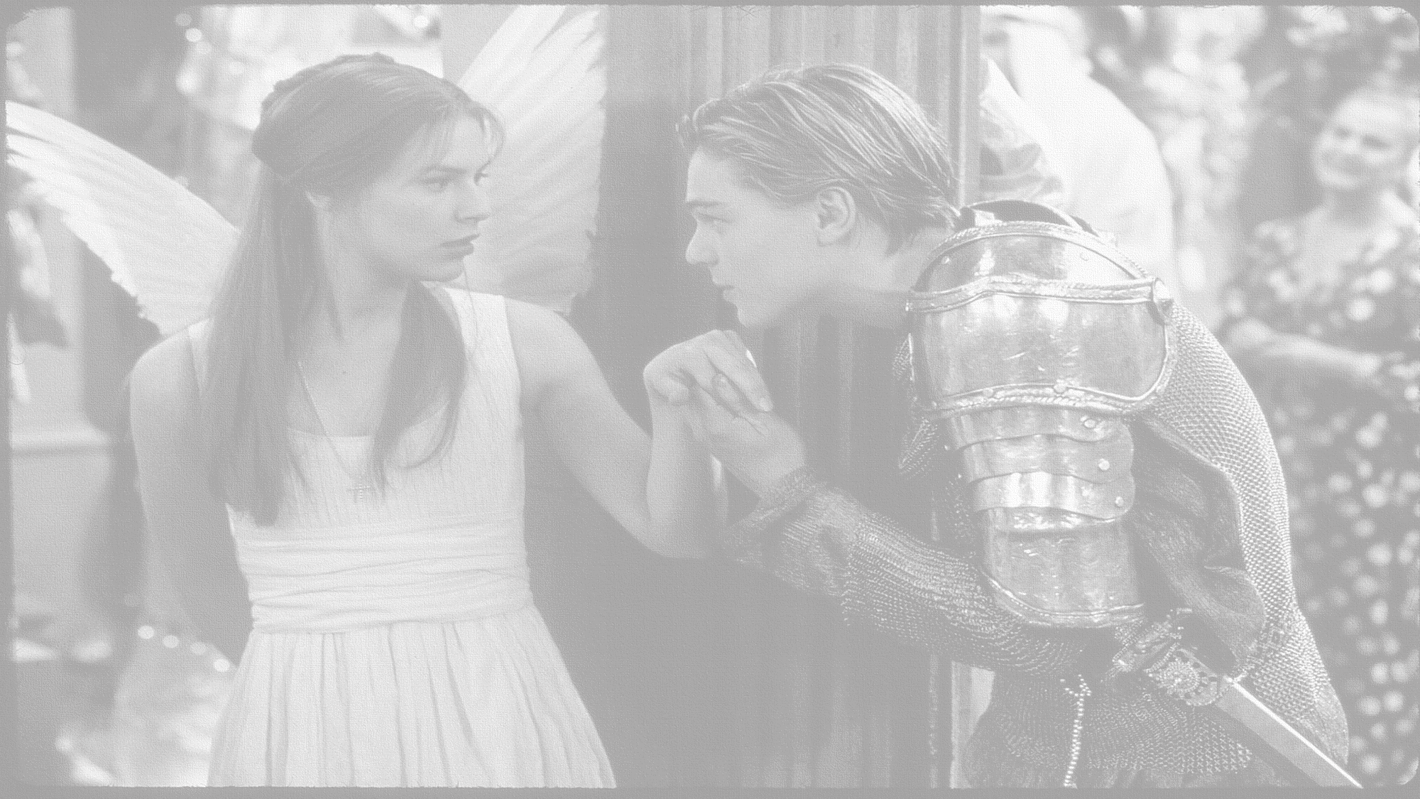
How does Shakespeare present the final scene?
In this lesson you will be mastering the following:
To explore the final scene and the lovers’ deaths.
To explore Shakespeare’s use of timing and hope.
To write an extended exam style response.
Learning Content
Notes:
This – as with all aspects of the lesson – can be edited to suit your group.

Slide 6
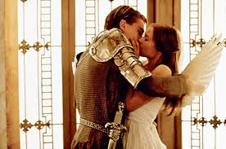
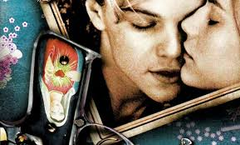
Fate and Fortune
A reminder:
Fate is the idea that people’s lives are destined to end up at a certain place in a certain way, all according to the stars and how they are aligned at birth.
Shakespeare’s view differed a little from most of society; he believed that people ended up in a certain place and time by predestination, but he believed that they made choices themselves that lead to their fate.
Shakespeare agreed with the common Elizabethan notions for predestination, but he also thought Aristotle was right in saying that fate was also determined by a person’s ‘fatal flaw’. According to Aristotle, every character and person supposedly has a fatal flaw, and it is the errors resulting from this flaw that shapes their future.
Checking understanding
Hamartia = a fatal flaw leading to the downfall of a tragic hero or heroine.
Learning Objectives:
AO1: use textual references, including quotations, to support and illustrate interpretations.
AO2: Analyse the language used by a writer to create meanings and effects.

Slide 7
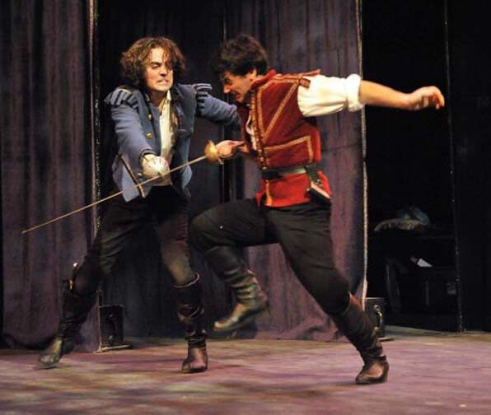
Task:
Why does Shakespeare introduce a fight and the death of Paris at the start of this scene?
The scene in which Paris confronts Romeo at the mouth of Juliet’s tomb is entirely Shakespeare’s invention- it did not happen in his main source, a poem by Arthur Brooke published in 1562. Consider the possible explanations of Shakespeare creating this episode. Debate the significance of Shakespeare’s choice.
Shakespeare developed the character of Paris as a conventionally acceptable lover to contrast with Romeo, so they needed to fight it out!
Thinking task
This episode enabled Shakespeare to show Romeo being emotionally generous to a rival so that we regret his death even more.
Learning Objectives:
AO1: use textual references, including quotations, to support and illustrate interpretations.
AO2: Analyse the language used by a writer to create meanings and effects.

Slide 8
Task: Look at lines 45 to 48 – re-read them.
Use these key ideas to aid your discussion:
Focus on decay and death
Connotations of feeding
Symbolism of “dearest morsel of the earth”
Challenge 1: Consider the methods used by Shakespeare in the phrase “”I’ll cram thee with more food.”
Challenge 2: what semantic field is used by the playwright?
How might an audience react to the powerful image of the vault’s opening as a mouth?
Mastery
Learning Objectives:
AO1: use textual references, including quotations, to support and illustrate interpretations.
AO2: Analyse the language used by a writer to create meanings and effects.

Slide 9
Task: Look at lines 60 to 63– re-read them.
What do you notice about the verbs Romeo uses in lines 60 to 63?
Write a PETER about how language is used by Shakespeare to show Romeo’s reluctance to fight Paris.
“Think upon these gone, / Let them affright thee. I beseech thee, youth, / Put not another sin upon my head/ By urging me to fury. O be gone!”
Mastery
Sentence starters that focus on the writer’s methods!
Shakespeare’s verb choices show…
Shakespeare uses imperative verbs to show Romeo’s desperation when he uses…
The playwright uses the phrase “affright” and “think” to refer to those that have died. The effect of this is…
Learning Objectives:
AO1: use textual references, including quotations, to support and illustrate interpretations.
AO2: Analyse the language used by a writer to create meanings and effects.

Slide 10
Task: Look at lines 74 to 87– re-read them.
Romeo asks himself a series of questions. What is the impact of these questions? Which question has the biggest impact on the audience?
Mastery
Why do writers use question marks?
To engage the audience
To make the audience answer the question
To show Romeo’s uncertainty
To represent Romeo’s moral conscience
To show that the play is building towards a resolution and that these questions will be answered later on in the scene.
Learning Objectives:
AO1: use textual references, including quotations, to support and illustrate interpretations.
AO2: Analyse the language used by a writer to create meanings and effects.

Slide 11
Transform:
The Ending so that Juliet wakes. How would this change the play?
Laying PARIS in the tomb
How oft when men are at the point of death Have they been merry! which their keepers call A lightning before death: O, how may I Call this a lightning? O my love! my wife! Death, that hath suck’d the honey of thy breath, Hath had no power yet upon thy beauty: Thou art not conquer’d; beauty’s ensign yet Is crimson in thy lips and in thy cheeks, And death’s pale flag is not advanced there. Tybalt, liest thou there in thy bloody sheet? O, what more favour can I do to thee, Than with that hand that cut thy youth in twain To sunder his that was thine enemy? Forgive me, cousin! Ah, dear Juliet, Why art thou yet so fair? shall I believe That unsubstantial death is amorous, And that the lean abhorred monster keeps Thee here in dark to be his paramour? For fear of that, I still will stay with thee; And never from this palace of dim night Depart again: here, here will I remain With worms that are thy chamber-maids; O, here Will I set up my everlasting rest, And shake the yoke of inauspicious stars From this world-wearied flesh. Eyes, look your last! Arms, take your last embrace! and, lips, O you The doors of breath, seal with a righteous kiss A dateless bargain to engrossing death! Come, bitter conduct, come, unsavoury guide! Thou desperate pilot, now at once run on The dashing rocks thy sea-sick weary bark! Here’s to my love!
Drinks
O true apothecary! Thy drugs are quick. Thus with a kiss I die.
Consider:
The reactions of the Friar, The Prince and the Capulets and Montagues. Are they shocked?
How does it mend the rift?
Consolidate understanding
Synthesise:
Your thoughts and feelings about the deaths of the characters. ~ Who is to blame for the tragic ending?
Discuss:
The clues in the scene that Juliet is alive. Think about all the examples of dramatic irony in here:

Slide 12
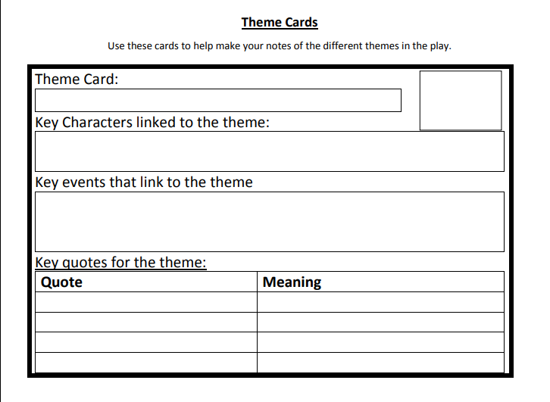
Create ‘Theme’ cards for each of the themes in the play.
Love
Honour
Extension
Death & violence
Individuals against society
Fate
Men and women
Learning Objective:
AO1: maintain a critical style and develop an informed personal response.
Notes:
This can be done in the back of their books or give them squares of sugar /card paper

Slide 13
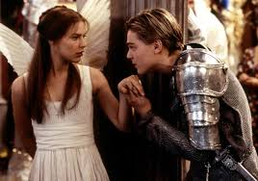
Homework
Write a front page news article reporting on the events of Act 5 scene 3.
Homework
Notes:
Homework is optional - Print off this slide to give out as homework.

