Slide 1
Learning content
LO: To explore the deterioration of Lady Macbeth. ST: I can examine the use of language to create meaning.

Slide 2
Write an acrostic for LM. Think about words and phrases that you would use to describe her, what you know about her, key quotations and how women of the 1600s behaved.
DO NOW!
L
A
D
Y
M
A
C
B
E
T
H

Slide 3
Match the word to the definition.
Unlocking vocabulary
_____________ causing or characterized by extreme distress or sorrow.
________ disintegrate or be destroyed.
__________ used for emphasis, especially to express anger or frustration AND/ OR condemned by God to suffer eternal punishment in hell.
____________ diminish in strength or quality; deteriorate.
Decline Damned
Unravel Tragic

Slide 4
Answers! Please give yourself a tick
Unlocking vocabulary
Tragic causing or characterized by extreme distress or sorrow.
Unravel disintegrate or be destroyed.
Damned used for emphasis, especially to express anger or frustration AND/ OR condemned by God to suffer eternal punishment in hell.
Decline diminish in strength or quality; deteriorate.

Slide 5
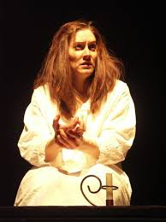
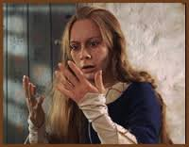
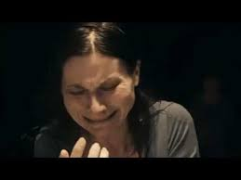
Task: Use your image of Lady Macbeth to record ways that she has changed. Her physical decline and her mental decline, use quotations to reinforce your ideas.
Reading task
Read Act V Scene 1

Slide 6
Key quotes!
Mastery
‘Yet here’s a spot.’
‘I tell you yet again, Banquo’s buried; he cannot come out on’s grave.’
‘What, will these hands ne’er be clean?’
‘To bed . To bed; there’s a knocking at the gate.’
‘Out, damned spot! Out, I say!’
Here’s the smell of the blood still; all the perfumes of Arabia will not sweeten this little hand. O.O.O.
‘Yet who would have thought the old man to have had so much blood in him?’
Notes:
Annotate with students – language and structural devices.

Slide 7
Macbeth Act V Scene 2 & 3
Consolidating knowledge
Read both these acts.
Summarise what has happened in both of these scenes.
Macbeth dominates this scene. He speaks using imperatives, what effect does this have on the audience?
What is Macbeth obsessed by?

Slide 8
Act V Scene 4, 5 and 6
Consolidating knowledge
How is Macbeth’s dependence on the prophecies shown?
How is Macbeth shown to be becoming more desperate? Are the prophecies starting to unravel?
Do you think the supernatural is felt in this scene?
Contrast the deaths of Lady Macbeth and Lady Macduff and their husbands reactions – what does this show us about their characters?
The final scene allows Shakespeare to show Macbeth’s complete belief in the Witches – Despite how changed Macbeth was by the witches what does Shakespeare allow Macbeth to retain?
Answer in FULL sentences
Notes:
These are fairly short scenes so should be read quite quickly.

Slide 9
Notes:
Printable slide

