Slide 1
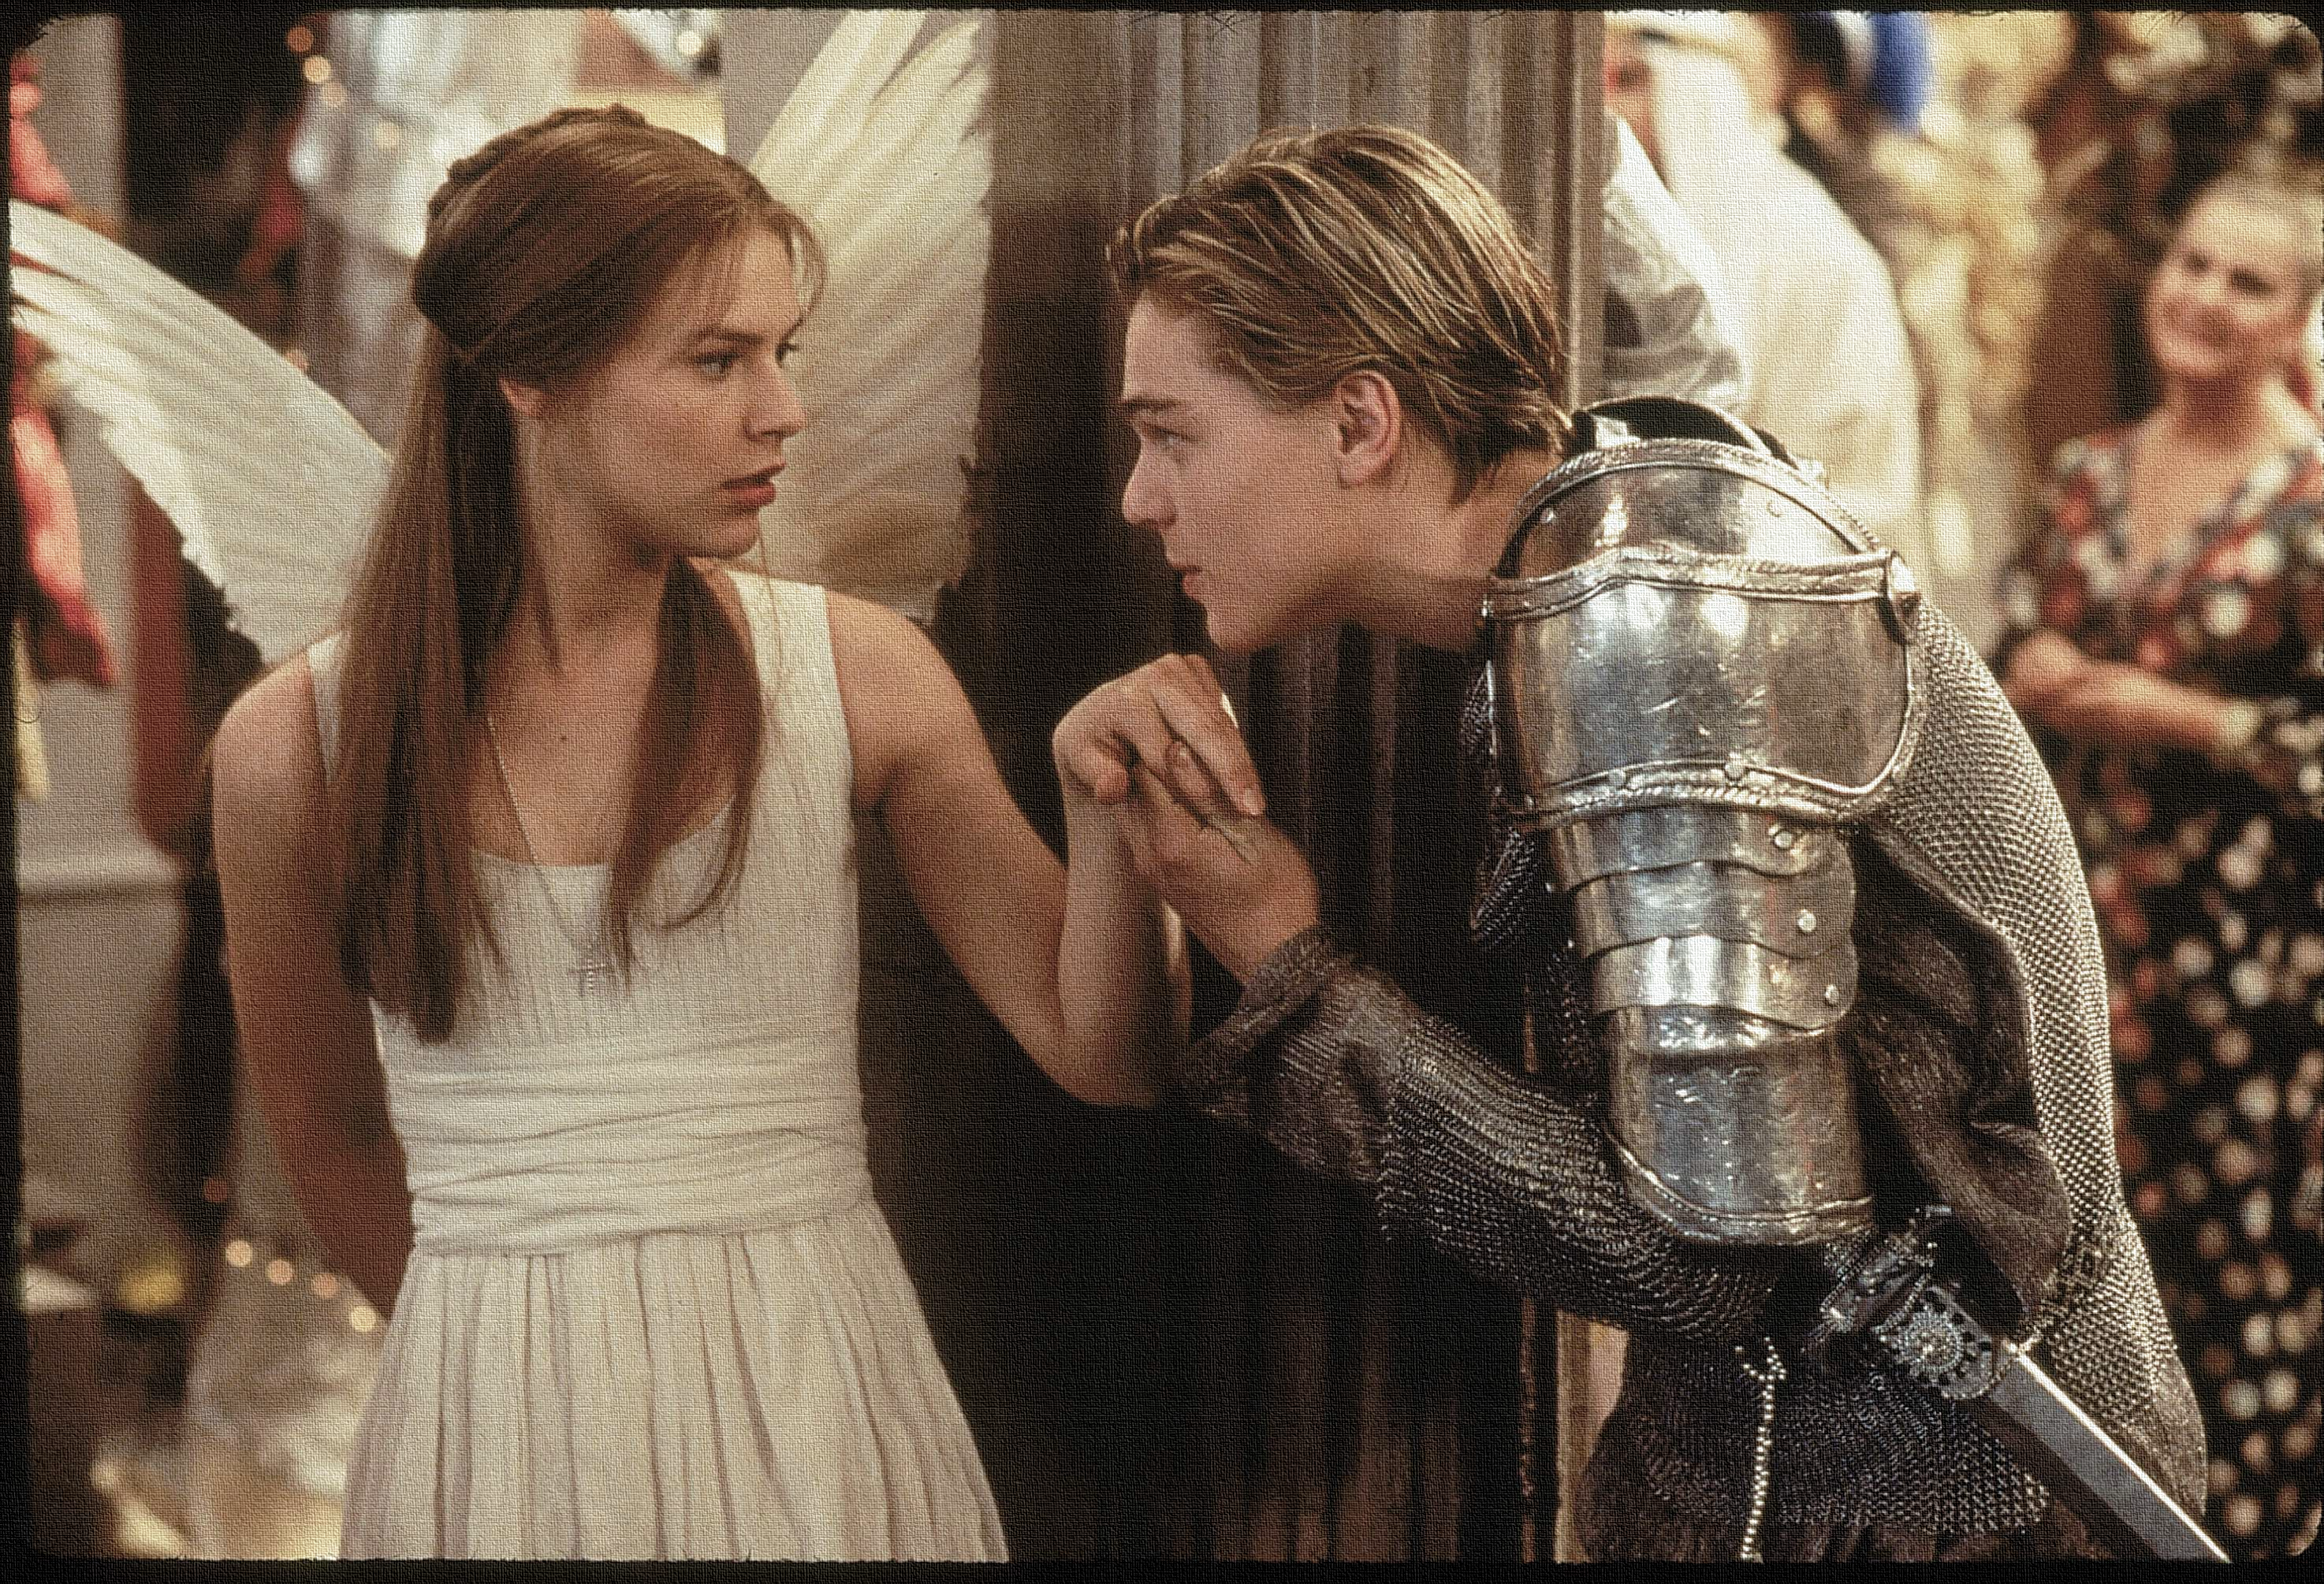
Key Words:
Impulsive
Human nature
Apothecary
Foreshadow
Fate
motive
monlogue
Lesson 15: Act 5, Scene 1.
Romeo thinks Juliet is dead.
Success Criteria:
To identify Romeo's impulsive nature and how fate is against them both.
To explore the reactions and motives of characters.
To write an extended exam style response.
‘Romeo + Juliet’
Learning Objective:
AO1: maintain a critical style and develop an informed personal response.

Slide 2
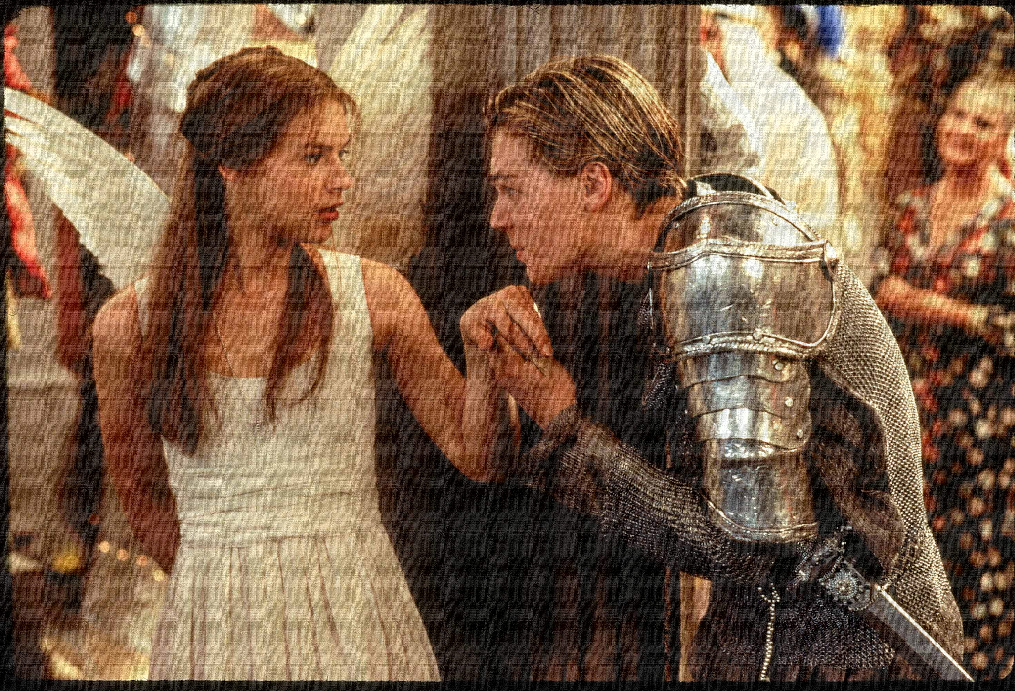
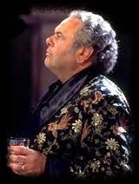
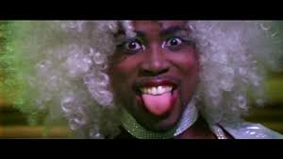
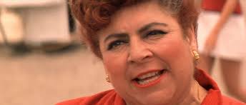
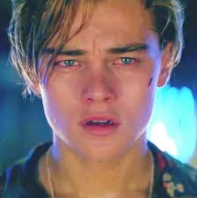
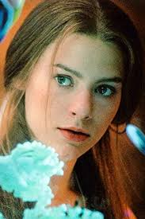
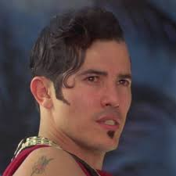
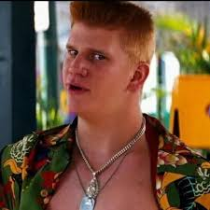
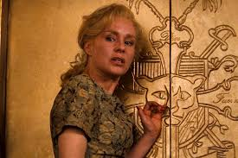
Write today’s date - Monday, 01 June 2020 and today’s title – Romeo and Juliet Revision in your book
Lord Capulet
Nurse
Mercutio
Juliet
Romeo
Part fools put up your swords – you know not what you do.
O me! What fray was here? Yet tell me not, for I have heard it all.
His name is Romeo, and a Montague, The only son of your great enemy.
O wilt thou leave me so unsatisfied?
Romeo, the love I bear thee can afford no better term than this: thou art a villain.
A plague a’both your houses! They have made worms’ meat of me.
O swear not by the moon, th’inconstant moon, that monthly changes in her circled orb…
I beg for justice, which thou, Prince, must give: Romeo slew Tybalt, Romeo must not live.
Hang thee, young baggage, disobedient wretch! I tell thee what: get thee to church ‘Thursday, or never after look me in the face.
Do Now: Match the quote to the character!
Tybalt
Benvolio
Learning Objective:
AO1: maintain a critical style and develop an informed personal response.
Lady Capulet
Notes:
Benvolio, Romeo, Nurse, Romeo, Tybalt, Mercutio, Juliet, Lady Capulet, Lord Capulet,

Slide 3
Read the keywords and match their definition: Write them in your books
Impulsive
acting or done without forethought.
fate
the development of events outside a person's control, regarded as predetermined by a supernatural power.
monologue
Unlocking vocabulary
Human nature
a reason for doing something.
a long speech by one actor in a play
motive
The general psychological characteristics, feelings, and behavioural traits of humankind.
Notes:
For lower ability students see print off in resources to help with copying out.

Slide 4
ANSWERS!
Impulsive
acting or done without forethought.
fate
the development of events outside a person's control, regarded as predetermined by a supernatural power.
monologue
Unlocking vocabulary
Human nature
a reason for doing something.
a long speech by one actor in a play
The general psychological characteristics, feelings, and behavioural traits of humankind.
motive
Notes:
For lower ability students see print off in resources to help with copying out.

Slide 5
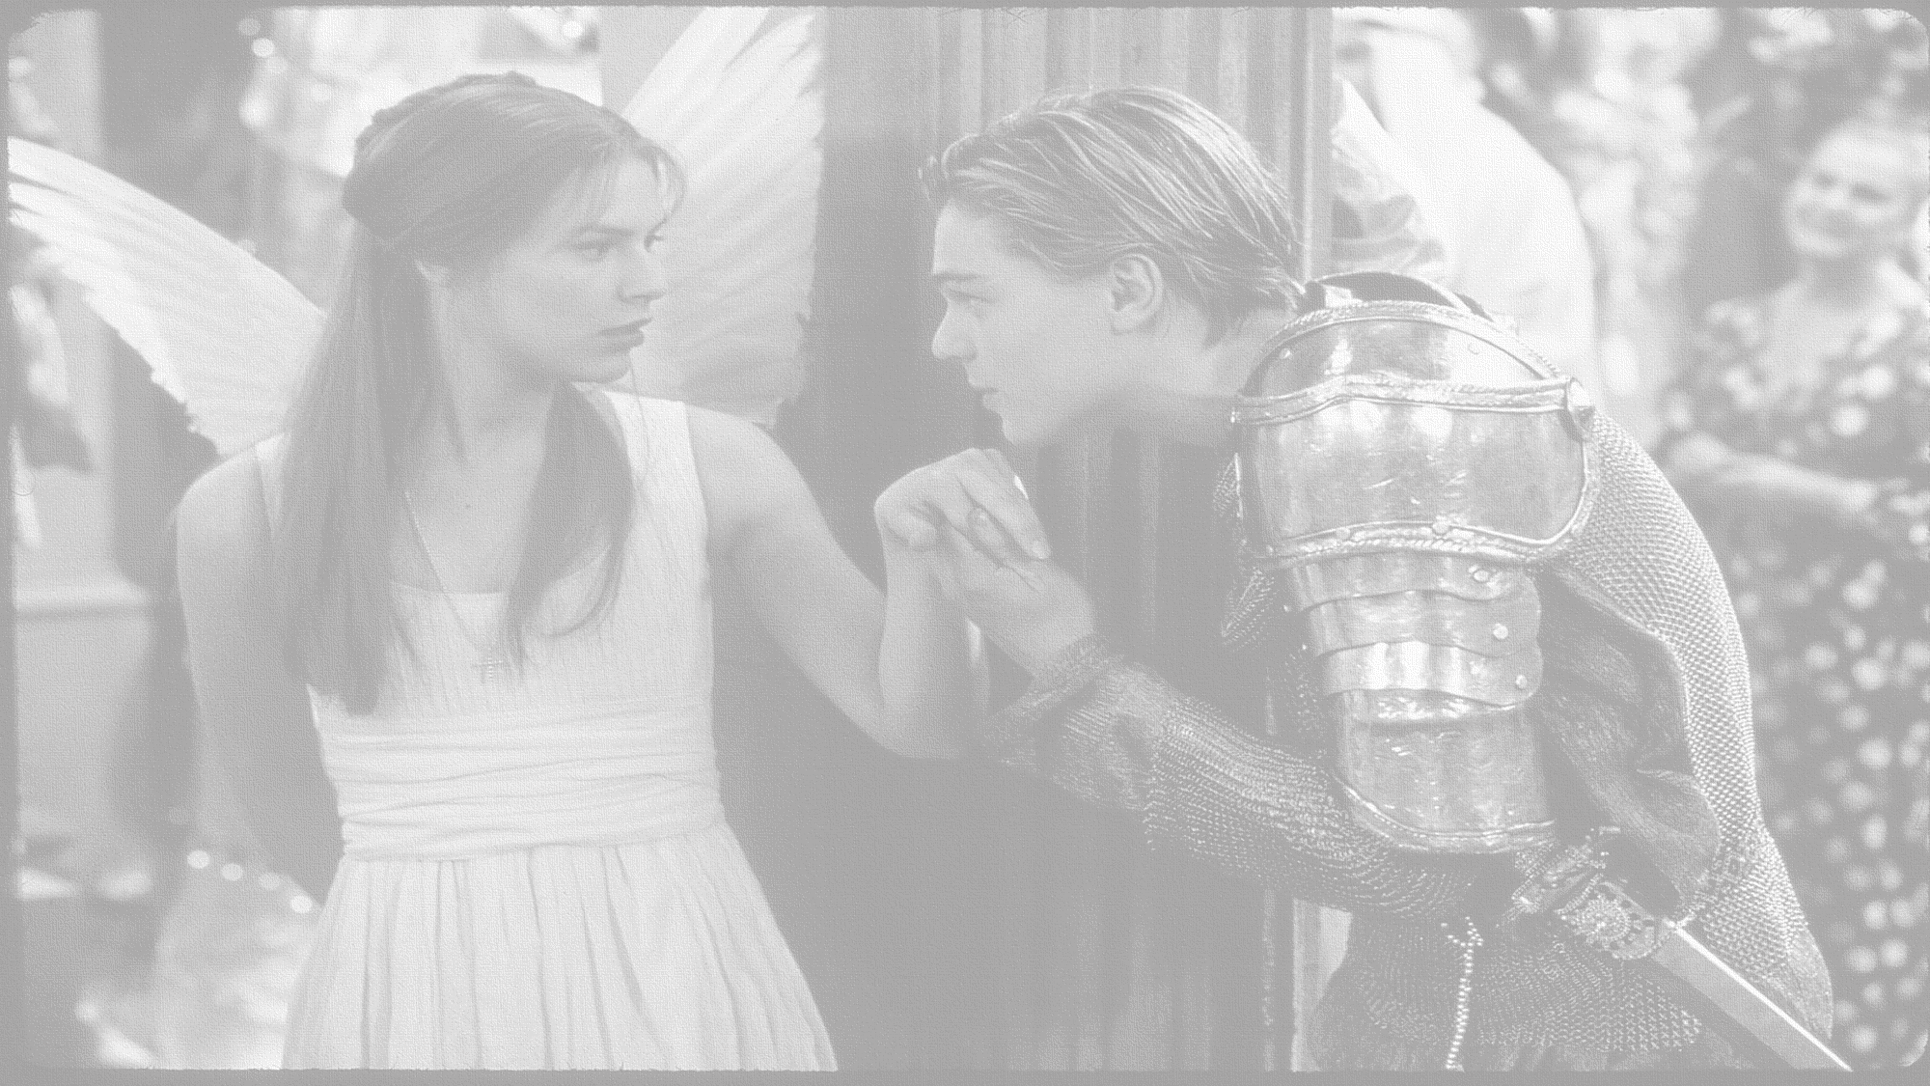
How does Shakespeare present Romeo’s reaction to the discovery of Juliet’s death?
In this lesson you will be mastering the following:
To identify Romeo's impulsive nature and how fate is against them both.
To explore the reactions and motives of characters.
To write using extended challenge grids to consolidate understanding.
Learning Content
Notes:
This – as with all aspects of the lesson – can be edited to suit your group.

Slide 6
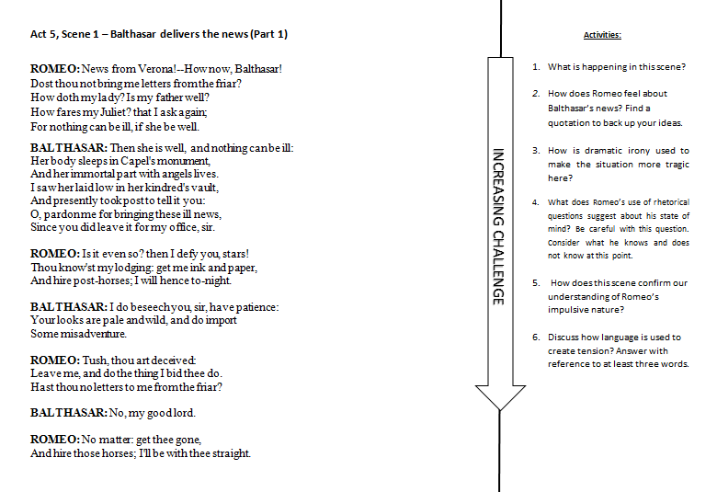
Mastery
Notes:
This can be done independently or as a class – with feedback given and each question worked through – up to you.
Ask students to choose their own THREE quotes to learn in preparation for exam.

Slide 7
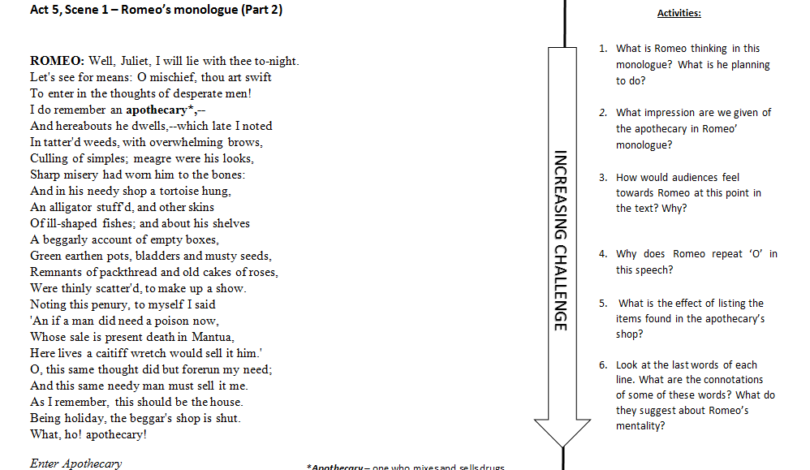
Mastery
Notes:
This can be done independently or as a class – with feedback given and each question worked through – up to you.
Ask students to choose their own THREE quotes to learn in preparation for exam.

Slide 8
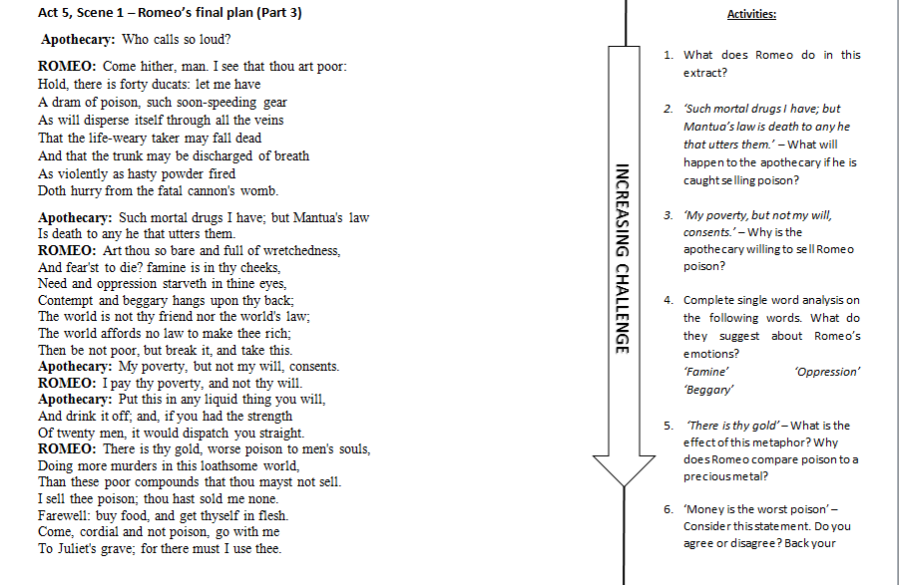
Mastery
Notes:
This can be done independently or as a class – with feedback given and each question worked through – up to you.
Ask students to choose their own THREE quotes to learn in preparation for exam.

Slide 9
Let’s read!
Act 5 scene 2
Friar Lawrence:
Friar John:
Consolidation of learning
Shakespeare’s techniques: By putting these two very short scenes between long ones makes it seem like things are happening very quickly. This makes it seem like everything is getting out of control. It will raise the audience's tension levels and they will become anxious.
Learning Objectives:
AO1: use textual references, including quotations, to support and illustrate interpretations.
AO2: Analyse the language used by a writer to create meanings and effects.

Slide 10
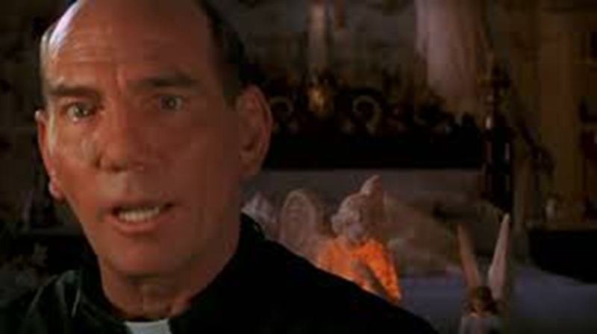
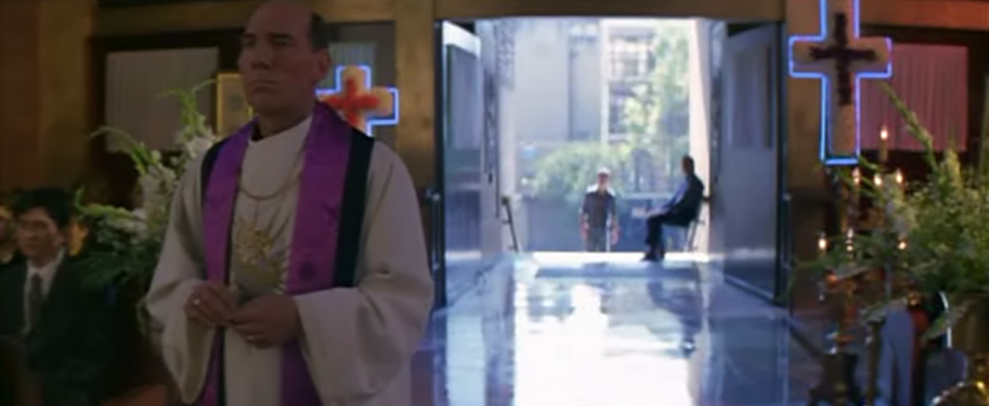
How far can Friar Lawrence be blamed for the tragedy? DISCUSS
Can there be a balanced and critical argument?
Extension
Learning Objective:
AO1: maintain a critical style and develop an informed personal response.
Notes:
Ask students to write a for and against essay.

Slide 11
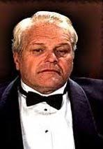
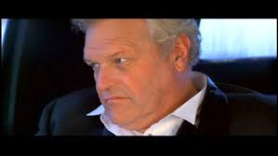
Homework
In Act 5, scene 3 Romeo writes a letter to his father and gives it to Balthasar to deliver. Write the letter as if you were Romeo. What would you include?
Homework
Notes:
Homework is optional - Print off this slide to give out as homework.

