Slide 1
Learning content
LO: To use the Jacobean tragedy as a basis for a narrative.
ST: I can use my knowledge so far and be creative with my imagination.

Slide 2
Starter: Cloze Summary (Act 4)
DO NOW!
The three witches are producing a potion filled with evil ingredients. Before Macbeth arrives, they show the audience how his reputation has changed by saying “_________________ this way comes”. Macbeth demands to know the future as he feels insecure and that he has a tenuous grip on his kingdom. He drinks the witches’ brew and is given __________________.
Firstly, an armoured head warns Macbeth to ___ ____________, the Thane of Fife. Secondly, a blood child reveals that “none of women born shall harm Macbeth.” Finally, a child with a crown and tree branch explains that Macbeth will remain undefeated until “_______________ travels to Dunsinane.” Macbeth feels relieved, but asks the witches for information on Banquo’s children becoming kings – the witches refuse any further information but show Macbeth ____________ with Banquo’s ghost, before they disappear.
Macduff leaves Scotland and goes to England to help plan an invasion to take the country back from Macbeth. After the witches’ prophecies, Macbeth sends a murderer to kill Macduff and his family. Macduff finds out the truth in England and is furious – he is desperate for ___________ and is tested by Malcolm, who wants to ensure that he is loyal and just.
The three witches are producing a potion filled with evil ingredients. Before Macbeth arrives, they show the audience how his reputation has changed by saying “something wicked this way comes”. Macbeth demands to know the future as he feels insecure and that he has a tenuous grip on his kingdom. He drinks the witches’ brew and is given three warnings.
Firstly, an armoured head warns Macbeth to beware Macduff, the Thane of Fife. Secondly, a blood child reveals that “none of women born shall harm Macbeth.” Finally, a child with a crown and tree branch explains that Macbeth will remain undefeated until “Birnam Wood travels to Dunsinane.” Macbeth feels relieved, but asks the witches for information on Banquo’s children becoming kings – the witches refuse any further information but show Macbeth eight kings with Banquo’s ghost, before they disappear.
Macduff leaves Scotland and goes to England to help plan an invasion to take the country back from Macbeth. After the witches’ prophecies, Macbeth sends a murderer to kill Macduff and his family. Macduff finds out the truth in England and is furious – he is desperate for revenge and is tested by Malcolm, who wants to ensure that he is loyal and just.

Slide 3
Match the word to the definition.
Unlocking vocabulary
_____________ description and explanation of an idea.
________ a spoken or written account of connected events; a story.
__________ the pervading tone or mood of a place, situation, or creative work.
____________ the final part of a play, film, or narrative in which the strands of the plot are drawn together and matters are explained or resolved.
Denouement Atmosphere
Narrative Exposition

Slide 4
Answers! Please give yourself a tick
Unlocking vocabulary
Exposition description and explanation of an idea.
Narrative a spoken or written account of connected events; a story.
Atmosphere the pervading tone or mood of a place, situation, or creative work.
Denouement the final part of a play, film, or narrative in which the strands of the plot are drawn together and matters are explained or resolved.

Slide 5
Narrative Writing
Reading task
I will be marking to this criteria!
Write a short story that is related to Macbeth.
Assessment Criteria:
First person – create a distinct voice
Describe the setting & relate it to the situation
Use a variety of sentence types, lengths and openings
Use imagery
Use a variety of senses to create an atmosphere
Show, don’t tell
Story Ideas:
Turn one of the key scenes into prose – Macbeth in the battle, Macbeth meeting the witches, the murder, etc…
Or
Use one of the settings we have read about (Inverness castle, the heath, the thunder and Lightning, the banqueting hall etc.) and add a scene that isn't in the play but adds to the atmosphere.
Set the narrative in one scene to focus the action!

Slide 6
Read the example narrative set at the beginning of the play when Macbeth and Banquo fight against the Norwegian army.
Mastery
Fog swirled through the trees behind us. A crow cawed relentlessly in the distance. And time seemed to sit motionless as we waited for the order. Glancing along the line of soldiers, I could see the fixed expressions of determination. Fading light made shadows swirl and shift – a grey light enveloped the battle weary faces. The odd glint of silver, the bevelled edge of sword catching the last rays of light as it shifted in a grasping hand. At the foot of each soldier a battered shield: dented, scratched, gouged, rested on the sodden earth.
Looking to my left I watched Macbeth flex his right hand, unfurling tense fingers, only to tighten again on the hilt of his sword with renewed strength. Next to him Banquo shifted his weight form left to right, he nodded imperceptibly to Macbeth and raised his index finger to his lips – a deathly hush fell over us. Holding my breath, I gripped my sword and shifted my shield to positon. Suddenly the sky split open with a streak of yellow lightning and a crash of thunder roared above us.
‘FORWARD! FORWARD!’ Macbeth’s fierce battle cry bellowed. A moving tide of muscle cannoned from the safety of the tree line. I was running towards the Norwegian army. Sword raised, shield poised, a growling snarl emanated from my throat as I swung my blade at the enemy.
Identify language techniques used. How does it create tension? Atmosphere? Mood? Tone? What type of sentences does it use why are they effective? HOW CAN IT BE IMPROVED?
What could happen next? Would it focus on the battle? Would the weather get worse? Would this soldier survive? Would he rescue someone?
There is a need for imagination when writing a narrative BUT also an idea of plot development!
Notes:
Lower ability students could use this as their start of their narrative and they carry it on??

Slide 7
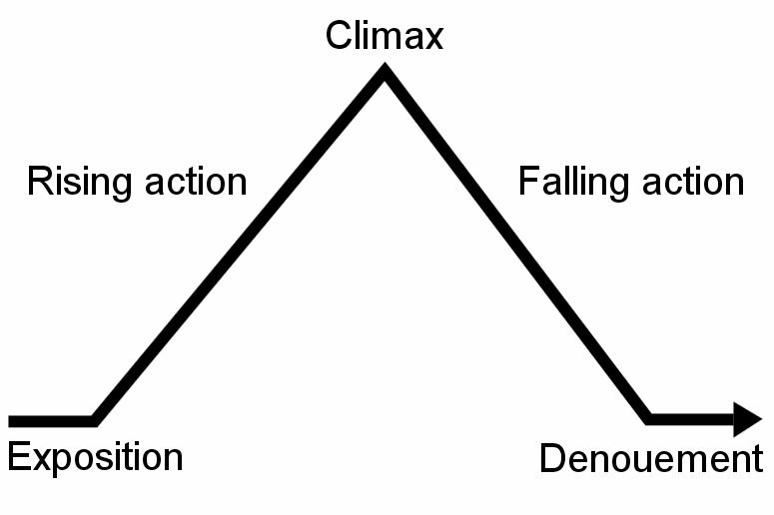
Plan your ideas along a plot line in your books.
Mastery
Notes:
Ask students to draw this narrative arc in their books and add their ideas along the line.

Slide 8
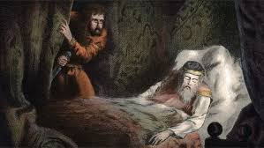
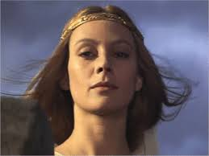
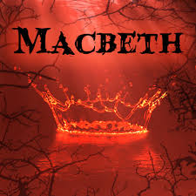
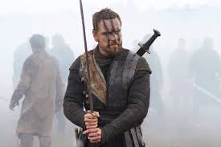
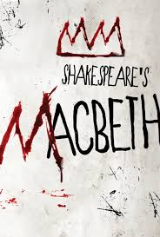
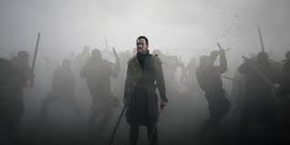
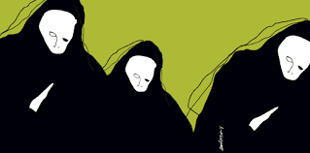
Task: Write your opening paragraph. This will be continued tomorrow.
Mastery
Notes:
Two slides use as you wish

Slide 9
Task: Finish your short story that is related to Macbeth.
Mastery
Notes:
Two slides use as you wish

Slide 10
Extension task: Design a front cover and write a blurb for your narrative.
Extension task
Notes:
This could be used as a homework task???

Slide 11
Notes:
Printable slide for students.

