Slide 1
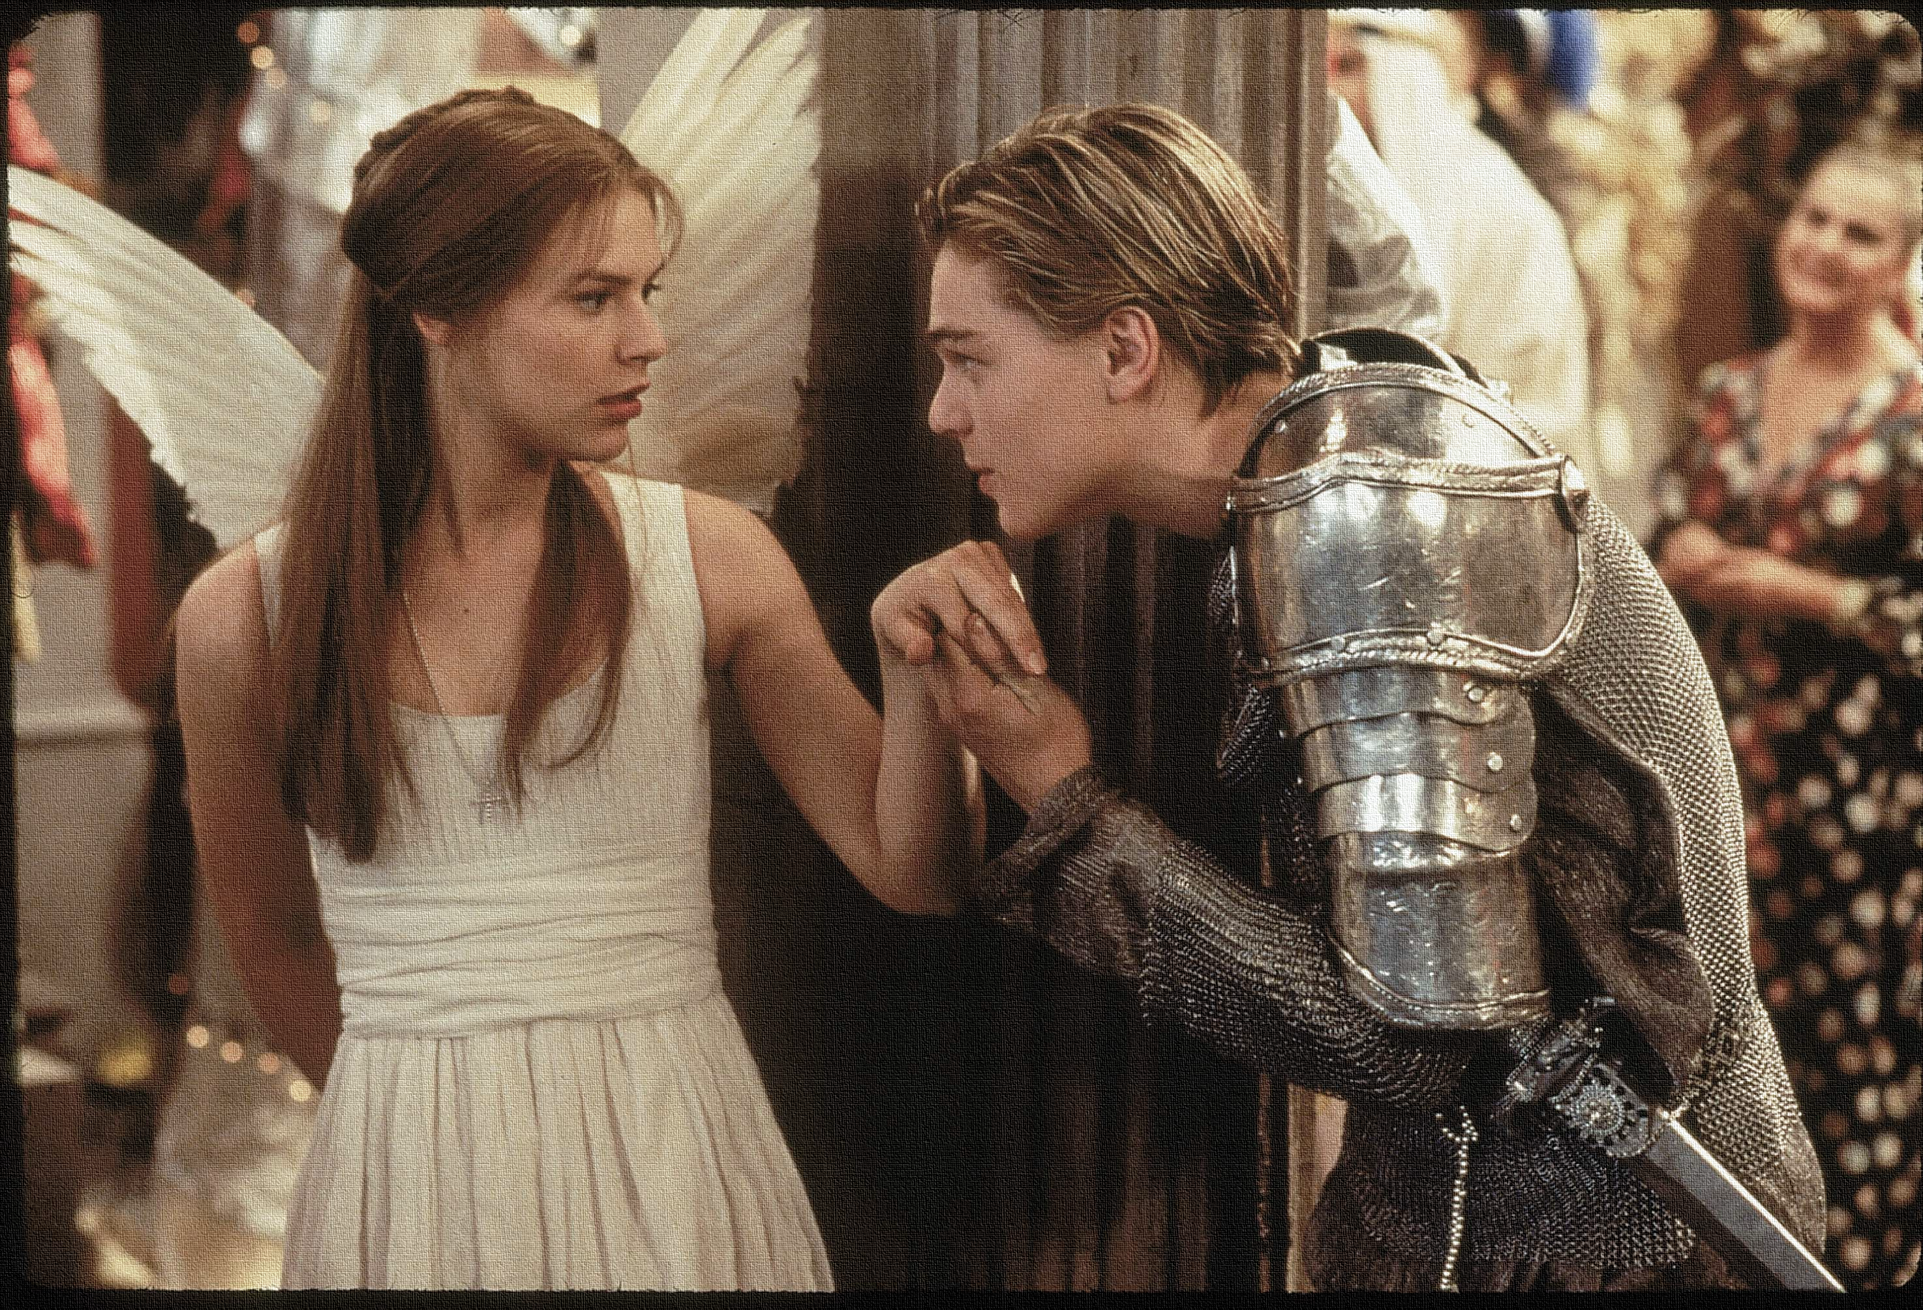
Key Words:
Soliloquy
Mood
Gruesome imagery
Uncertainty
Tragedy
Lesson 14: Act 4, Scene 3, 4 and 5.
Juliet’s last soliloquy and the discovery of her death.
Success Criteria:
To identify Juliet’s fears and the reaction of her parents.
To explore the reactions and motives of characters.
To write an extended exam style response.
‘Romeo + Juliet’
Learning Objective:
AO1: maintain a critical style and develop an informed personal response.

Slide 2
Write today’s date - Friday, 27 March 2020 and today’s title – Romeo and Juliet Revision in your book
Let’s read!
Act 4 scene 3, 4 & 5 [up to line 95]
Friar Lawrence:
Juliet:
Lady Capulet:
Capulet:
Servingman:
Nurse:
Paris:
Friar Lawrence:
Do Now
Learning Objective:
AO2: Analyse the language and structure used by a writer to create meanings and effects, using relevant subject terminology where appropriate.

Slide 3
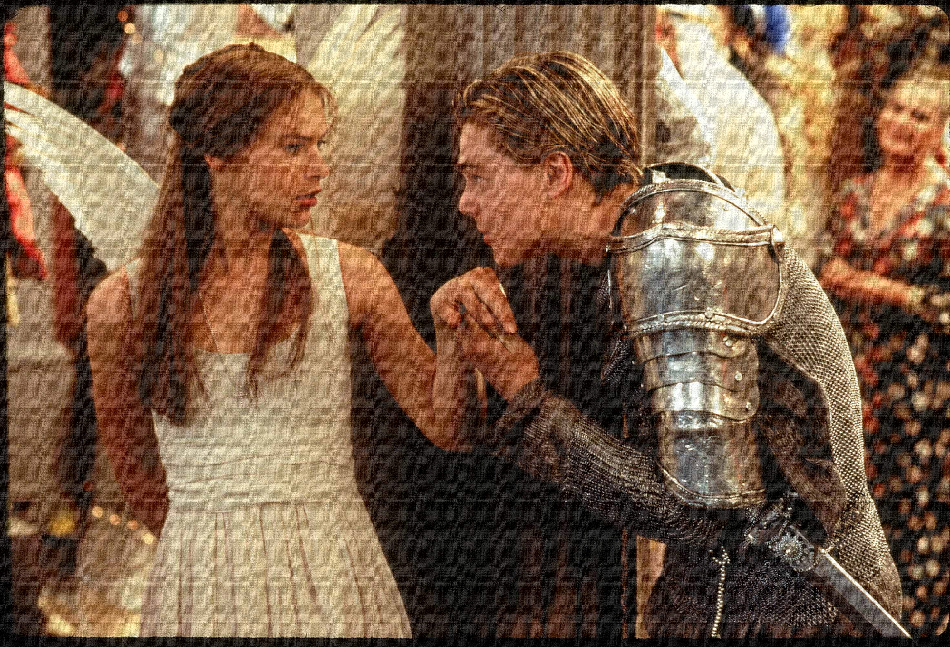
Read the keywords and match their definition: Write them in your books
soliloquy
an act of speaking one's thoughts aloud
mood
the atmosphere or pervading tone of something.
uncertainty
Unlocking vocabulary
Gruesome imagery
Images causing repulsion or horror; grisly.
the state of being uncertain
a play dealing with tragic events and having an unhappy ending, especially one concerning the downfall of the main character.
tragedy
Notes:
For lower ability students see print off in resources to help with copying out.

Slide 4
Read the keywords and match their definition: Write them in your books
soliloquy
an act of speaking one's thoughts aloud
mood
the atmosphere or pervading tone of something.
uncertainty
Unlocking vocabulary
Gruesome imagery
Images causing repulsion or horror; grisly.
the state of being uncertain
a play dealing with tragic events and having an unhappy ending, especially one concerning the downfall of the main character.
tragedy
Notes:
For lower ability students see print off in resources to help with copying out.

Slide 5
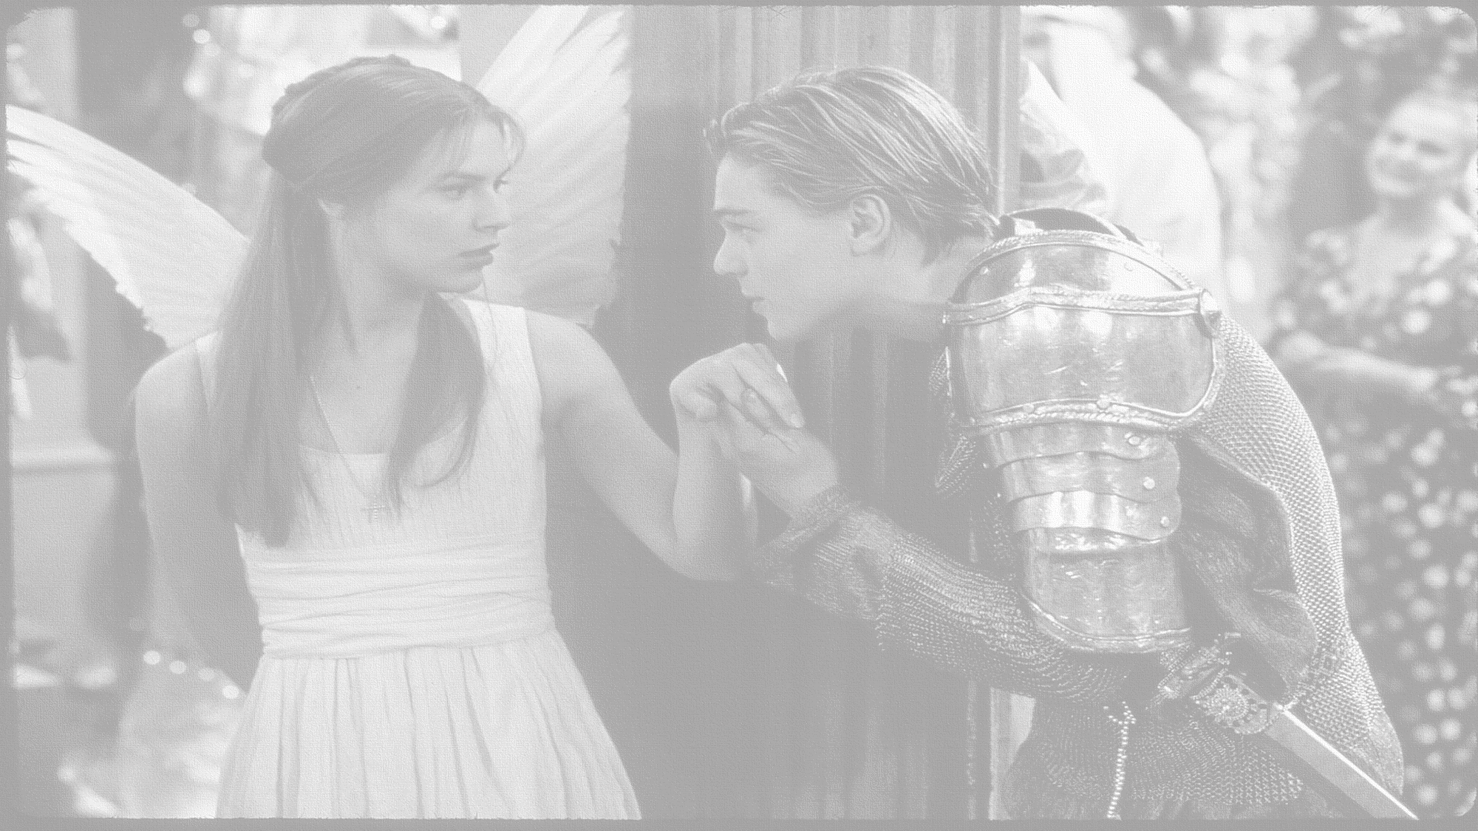
How does Shakespeare present Juliet’s last soliloquy and the discovery of her death?
In this lesson you will be mastering the following:
To identify Juliet’s fears and the reaction of her parents.
To explore the reactions and motives of characters.
To write an extended exam style response.
Learning Content
Notes:
This – as with all aspects of the lesson – can be edited to suit your group.

Slide 6
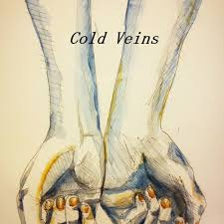
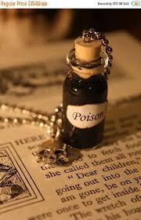
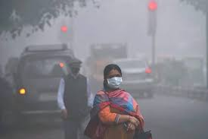
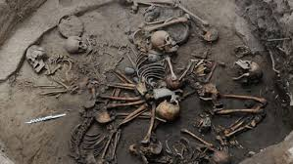
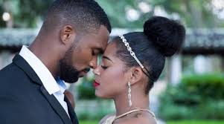
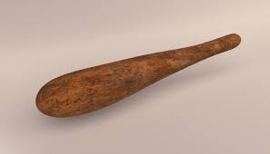
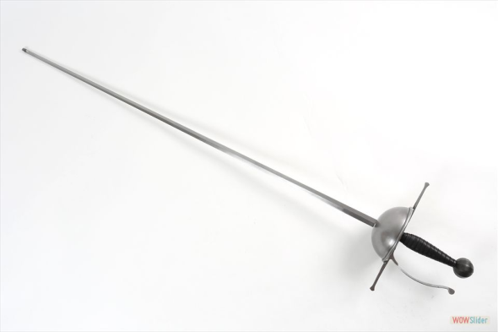
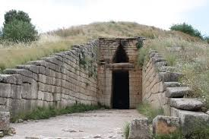
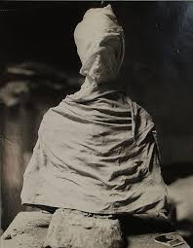
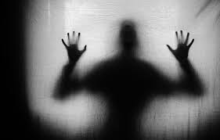
Mastery
Romeo & Juliet Act 4 Scene 3 Images Task –
Step1. Match a quotation from Juliet’s soliloquy on page 69 lines 14 - 59 to each of the images above.
Step 2. Annotate meanings/ connotations and ‘explode’ each quote to identify language techniques and word types in at least SIX of these quotations.
THEN answer this question: “How does Shakespeare present Juliet’s fears of taking the potion?
Notes:
This slide can be printed off – stick across a double page an annotate around.
STEP 3 task: can be the extended piece of writing or they can finish this for H/W many options/tasks to choose from.

Slide 7
Checking understanding

Slide 8
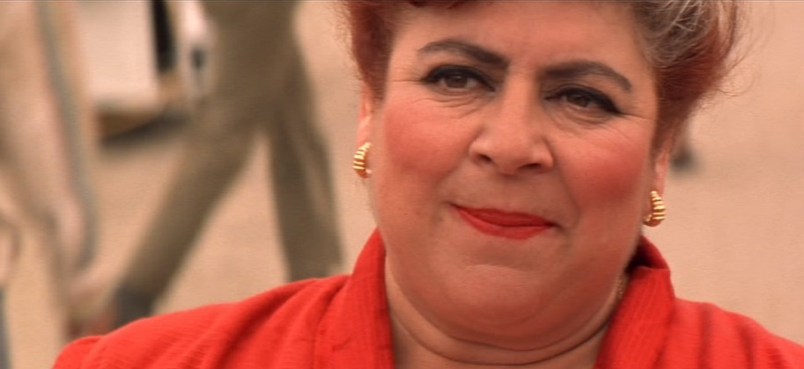
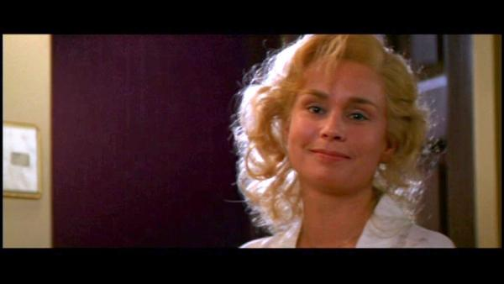
How did they react? Did any of their reactions surprise you?
Use a quotation and explain your reaction to it.
Did anybody’s reaction surprise you? Give reasons.
Thinking task
Learning Objective:
AO1: maintain a critical style and develop an informed personal response.

Slide 9
Let’s look at Lord Capulet’s reaction more in-depth...
[Act 4, scene 5, line 22- 64]
Quotation AO1: use textual references, including quotations | Meaning AO1: support and illustrate interpretations. | Effect AO2: Analyse the language and structure used by a writer to create meanings and effects. | Language AO2: Analyse the language used by a writer to create meanings and effects. | Context AO3: Show understanding of the contexts in which the play was written.
Mastery
Learning Objective:
AO1: maintain a critical style and develop an informed personal response.
Notes:
You can use this independent work for the essay style question: How does Shakespeare present the character of Lord Capulet in Act 4, scene 5?

Slide 10
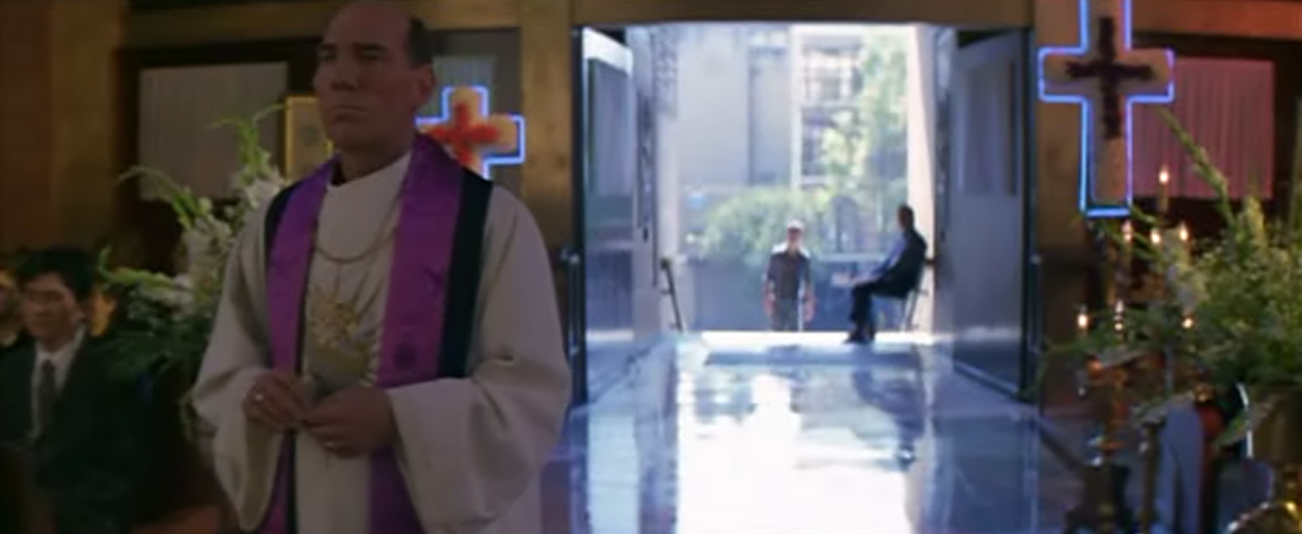
How does the Friar try to make the Capulets feel about Juliet’s death?
What could these last two lines be referring to?
FRIAR
The most you sought was her promotion,
For ’twas your heaven she should be advanced.
And weep ye now, seeing she is advanced
Above the clouds, as high as heaven itself?
Oh, in this love, you love your child so ill
That you run mad, seeing that she is well.
Extension
Is the Friar the honourable and trustworthy man Juliet claims him to be?
Learning Objective:
AO1: maintain a critical style and develop an informed personal response.

Slide 11
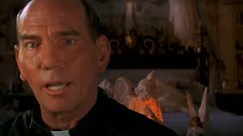
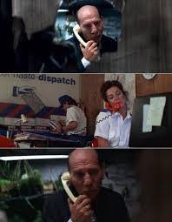
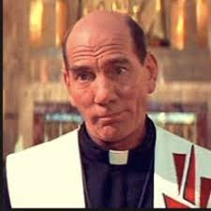
Homework
Write the letter to Romeo as if you were Friar Lawrence.
Include:
Details of the plan; events; timescale;
Hopes and fears.
Homework
Notes:
Homework is optional - Print off this slide to give out as homework.

