Slide 1
Learning content
LO: To explore the downfall of Macbeth. ST: I can analyse the language used by Shakespeare.

Slide 2
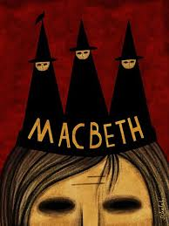
5 to make you think! Who, What, When, Why, Where ?
DO NOW!
Who took control at the banquet and asked the Thanes to leave?
What did Macbeth see floating in the air before he committed regicide?
When did Donalbain and Malcolm leave Macbeth’s castle?
Why did Macbeth have Banquo murdered?
Where is Macbeth’s castle?

Slide 3
Match the word to the definition.
Unlocking vocabulary
_____________ Having the courage and spirit of a lion.
________ a ghost or ghostlike image of a person.
__________ a loss of power, prosperity, or status.
____________ a mark, sign, or word that indicates, signifies, or is understood as representing an idea, object, or relationship.
Downfall Symbolise
Apparition Lion-mettled

Slide 4
Answers! Please give yourself a tick
Unlocking vocabulary
Lion-mettled having the courage and spirit of a lion.
Apparition a ghost or ghostlike image of a person.
Downfall a loss of power, prosperity, or status.
Symbolise a mark, sign, or word that indicates, signifies, or is understood as representing an idea, object, or relationship.

Slide 5
Let’s read Act 4 scene 1 –lines 47-155
Reading task
First Witch
Second Witch
Third Witch
Macbeth
First Apparition
Second Apparition
Third Apparition
Lennox

Slide 6
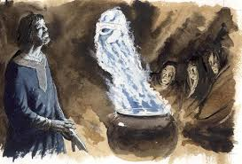
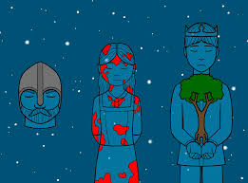
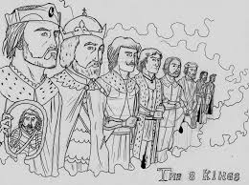
Writing task:
Mastery
In your own words write down what each apparition told Macbeth.
What will be his downfall?
What do the apparitions symbolise?

Slide 7
What tells us of Macbeth's downfall?
Mastery
First apparition
Macbeth, Macbeth, Macbeth: Beware Macduff,
Beware the Thane of Fife. Dismiss me. Enough.
Analyse this quotation for structure. Now write a PEA paragraph. Answering the question: What methods does Shakespeare use to show Macbeth’s downfall?
Notes:
Students will need help analysing the structural devices used by Shakespeare – annotate with them.

Slide 8
Plenary: Swap with a peer and highlight the point, evidence and explain. What went well? Even better if.
Consolidating knowledge

Slide 9
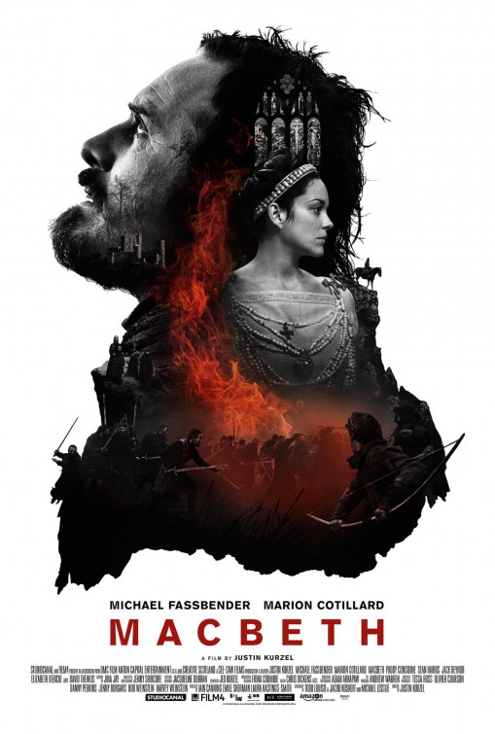
Plenary: The Film
We are going to watch what we have read so far.
Warning: do not be a passive viewer – think about decisions the director and actors have made in this version of the play.
Notes:
Use a clip from any copy of Macbeth to show the prophesy.

Slide 10
Notes:
Printable resource for students.

