Slide 1
Lesson 13: Huxley and Orwell
LO: To explore the rise of the Dystopia following WW2.

Slide 2
starter
Write a definition for the word ‘Dystopia’.
Create a list of novels/movies/tv that use Dystopian Worlds. How are they dystopian?
Do Now
LO: To explore the rise of the Dystopia following WW2.
Notes:
Give thinking time, then feedback

Slide 3
What does DYSTOPIA mean?
An imagined place or state in which everything is unpleasant or bad, typically a totalitarian or environmentally degraded one.
Check Understanding
Suggestions of DYSTOPIAN worlds?
LO: To explore the rise of the Dystopia following WW2.

Slide 4
Match the vocabulary to the correct definitions.
A political or social philosophy advocating the freedom of the individual.
That has been forbidden; banned.
A country in which power is held by elected representatives.
Learning by hearing while asleep or under hypnosis.
Offering nothing that is stimulating or challenging; bland.
Unlocking Vocabulary
Prohibited Liberalism Hypnopaedia Democracy Vapid
LO: To explore the rise of the Dystopia following WW2.
Notes:
Can be printed for students

Slide 5
Check your answers
Liberalism: A political or social philosophy advocating the freedom of the individual.
Prohibited: That has been forbidden; banned.
Democracy: A country in which power is held by elected representatives.
Hypnopaedia: Learning by hearing while asleep or under hypnosis.
Vapid: Offering nothing that is stimulating or challenging; bland.
Answers
LO: To explore the rise of the Dystopia following WW2.

Slide 6
Add to you timeline
George Orwell ‘Nineteen Eighty-Four’ (1949)
Ancient Literature
Middle Ages/ Renaissance
The Georgians & Victorians
The Twentieth Century
Representing change
Draw It
Aldous Huxley ‘Brave New World’ (1931)
Today’s primary text is Aldous Huxley’s ‘Brave New World’, published 1931. Today’s secondary text is George Orwell’s ‘Nineteen Eighty-Four’, published in 1949.
LO: To explore the rise of the Dystopia following WW2.

Slide 7
ww2
Contextual Information
LO: To explore the rise of the Dystopia following WW2.
Notes:
Discuss video after showing – effect on the world. https://www.youtube.com/watch?v=tQZnHjUOA2Q

Slide 8
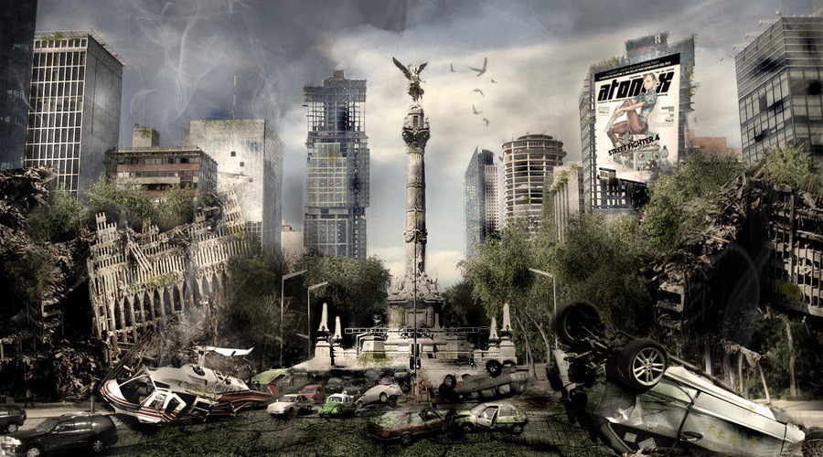
Ww2 – The Impact
How could the figures of Hitler & Stalin be linked to Dystopian fiction?
What other concerns were created by WW2? How do these link in to Dystopian fiction too?
Checking Understanding
LO: To explore the rise of the Dystopia following WW2.
Notes:
Could discuss nuclear bombing, concentration camps etc

Slide 9
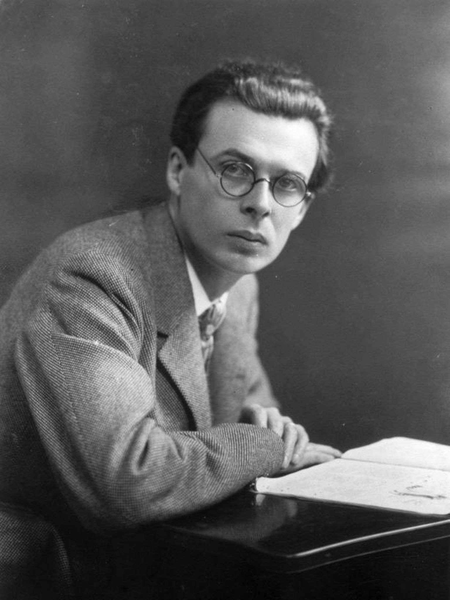
ALDOUS HUXLEY
Aldous Huxley (1894 –1963) was an English writer, novelist, philosopher. Huxley was a humanist, pacifist, and satirist. He was nominated for the Nobel Prize in Literature in seven different years.
Huxley had deeply felt apprehensions about the future the developed world might make for itself. From these, he made some warnings in his writings and talks
On 21 October 1949, Huxley wrote to George Orwell, congratulating him on "how fine and how profoundly important the book is". In his letter to Orwell, he predicted:
‘Within the next generation I believe that the world's leaders will discover that infant conditioning and narco-hypnosis are more efficient, as instruments of government, than clubs and prisons, and that the lust for power can be just as completely satisfied by suggesting people into loving their servitude as by flogging them and kicking them into obedience’.
In 1953, Huxley applied for United States citizenship and presented for examination. Huxley refused to bear arms for the US and would not state that his objections were based on religious ideals.
Contextual Information
LO: To explore the rise of the Dystopia following WW2.

Slide 10
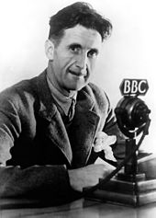
George Orwell
George Orwell (1903 –1950)was an English novelist, essayist, journalist, and critic. His work is often about the awareness of social injustice, opposition to totalitarianism, and outspoken support of democratic socialism.
Whilst Orwell was well known for his literary criticism, poetry and fiction, before all of that he was a soldier. Orwell served in Burma and Spain during their civil wars. Due to the conditions of his lungs, he served on the Home Front during WW2. In August 194 he was taken on full-time by the BBC's Eastern Service. He supervised cultural broadcasts to India to counter propaganda from Nazi Germany designed to undermine Imperial links. He was horrified by the impact of this.
Nineteen Eighty-Four is often compared to Brave New World by Aldous Huxley; both are powerful dystopian novels warning of a future world where the state machine exerts complete control over social life.
Contextual Information
LO: To explore the rise of the Dystopia following WW2.

Slide 11
How are these 2 texts the same/different?
What sort of things do they change about our current society?
How could this be linked to WW2?
What do they suggest about governments and leaders?
Do you think there is any similarity between how things are in these dystopias and our current political climate?
Reading Activity
LO: To explore the rise of the Dystopia following WW2.
Notes:
Try hands down questioning or notes in book – would be a powerful discussion here, esp newspeak and the inability to feel because the words don’t exist

Slide 12
Writing to argue – PICK 1
Can you still feel things if there are no words to explain how you feel? Explain your answer, using 1 quote from ‘Nineteen Eighty-Four’
Huxley writes ‘as though men were more than physico-chemically equal’. Do you agree that is the only way in which humans are equal? Explain your response
‘The dystopia is a direct response to the impact of Hitler’s totalitarian rise’. How far do you agree? Explain your answer.
Mastery
LO: To explore the rise of the Dystopia following WW2.

Slide 13
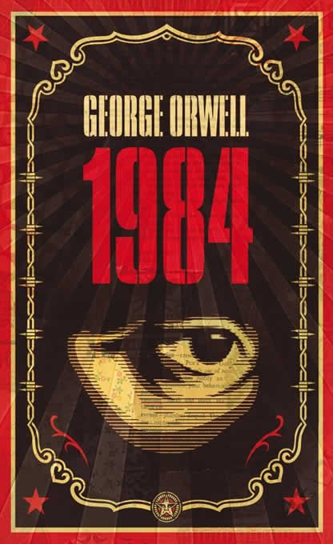
POST IT plenary
How relevant are these 2 texts in today’s world?
Checking Understanding
LO: To explore the rise of the Dystopia following WW2.

Slide 14
Newspeak
Orwell was sure that the decline of a language had political and economic causes. Although he had no solid proof, he presumed that the languages of countries under dictatorships, such as the Soviet Union or Germany, had deteriorated under their respective regimes.
To illustrate this idea that language can corrupt thought and that totalitarian systems use language to restrict, rather than broaden, ideas, Orwell created Newspeak, the official language of Oceania. Without a word for freedom, for example, the concept of freedom cannot exist.
Extension Task
Challenge Idea:
Do you think we are currently suffering a deterioration of language?
How have things like the internet/social media/emojis impacted on language?
Apart from ‘freedom’ what other words do you think Big Brother would have removed? Explain why.
What sort of words would still be essential to Newspeak? Explain your choices.
LO: To explore the rise of the Dystopia following WW2.

