Slide 1
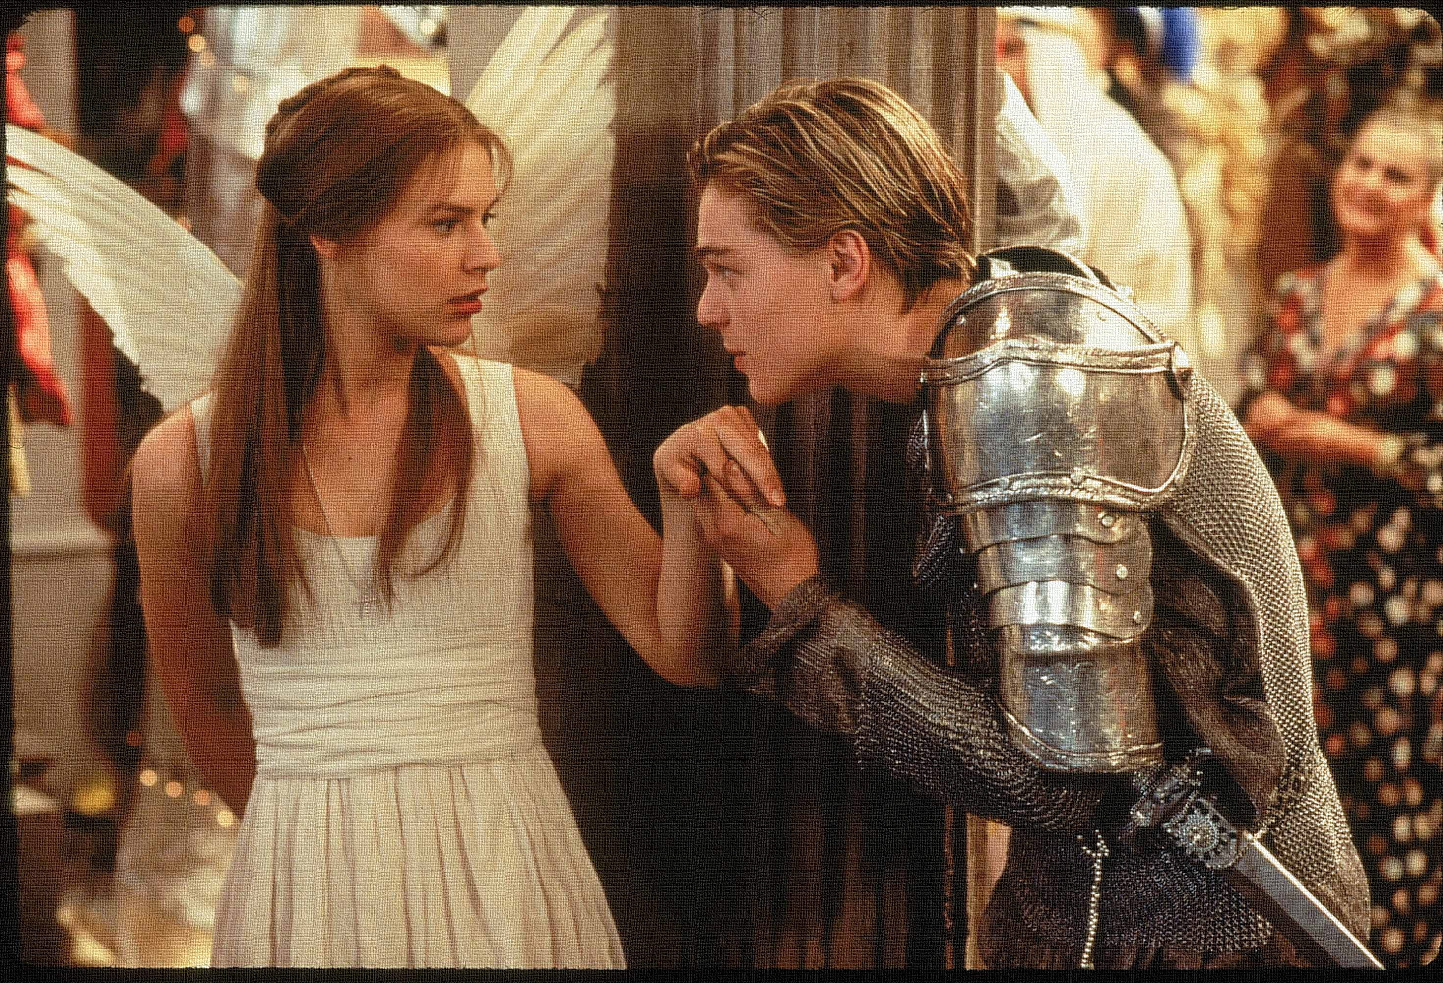
Key Words:
Anger
Disobedience
Sympathy
Symbolism
decree
Lesson 12: Act 3, Scene 5
Juliet’s refusal to marry and Lord Capulet’s reaction.
Success Criteria:
To explore how Shakespeare uses the patriarchal rule to raise tension.
To explain how Shakespeare uses techniques to create tension.
To re-cap and revise the events so far.
‘Romeo + Juliet’
Learning Objective:
AO2: Analyse the language and structure used by a writer to create meanings and effects, using relevant subject terminology where appropriate.

Slide 2
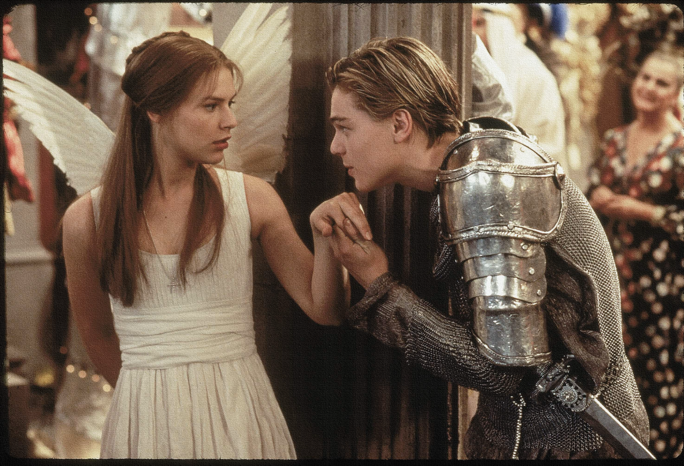
Write today’s date - Friday, 27 March 2020 and today’s title – Romeo and Juliet Revision in your book
Let’s read!
Act 3 scene 5
Romeo:
Juliet:
Lady Capulet:
Lord Capulet:
Nurse:
Do Now
Learning Objective:
AO2: Analyse the language and structure used by a writer to create meanings and effects, using relevant subject terminology where appropriate.
Notes:
This could be followed with the film clip to aid consolidation of tension.

Slide 3
Read the keywords and match their definition: Write them in your books
disobedience
failure or refusal to obey rules or someone in authority.
a strong feeling of annoyance, displeasure, or hostility.
anger
sympathy
Unlocking vocabulary
symbolism
feelings of pity and sorrow for someone else's misfortune.
the use of symbols to represent ideas or qualities.
an official order that has the force of law.
decree
Notes:
For lower ability students see print off in resources to help with copying out.

Slide 4
ANSWERS!
disobedience
failure or refusal to obey rules or someone in authority.
a strong feeling of annoyance, displeasure, or hostility.
anger
sympathy
Unlocking vocabulary
symbolism
feelings of pity and sorrow for someone else's misfortune.
the use of symbols to represent ideas or qualities.
an official order that has the force of law.
decree

Slide 5
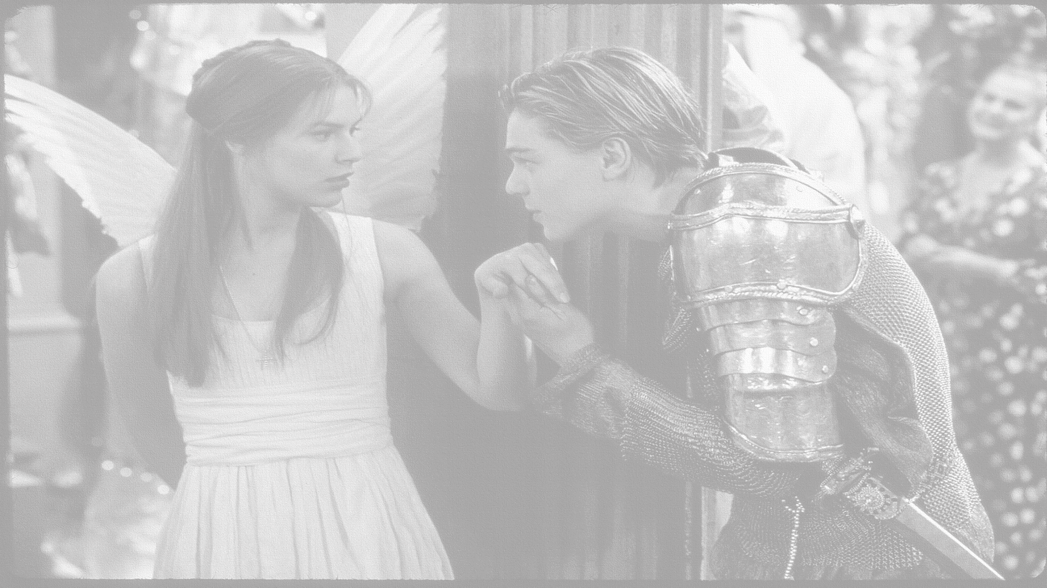
How does Shakespeare show Juliet’s refusal to marry and Lord Capulet’s reaction?
In this lesson you will be mastering the following:
To explore how Shakespeare uses the patriarchal rule to raise tension.
To explain how Shakespeare uses techniques to create tension.
To re-cap and revise the events so far.
Learning Content
Notes:
This – as with all aspects of the lesson – can be edited to suit your group.

Slide 6
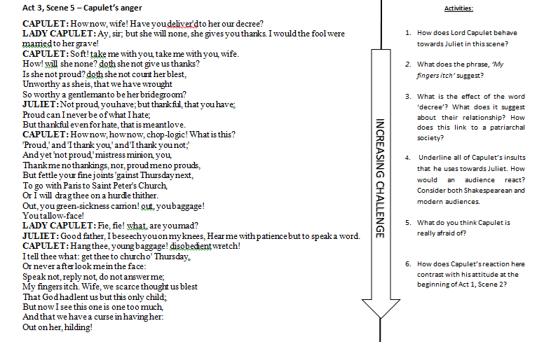
Mastery
Notes:
Activity 6 should be used as an essay style question for students to use comparative critical thinking skills. Model on board how to approach thinking – or use next slide as a scaffolding aid.

Slide 7
Act 3, Scene 5 VERSUS Act 1, scene 2
Act 3, scene 5 |  | Act 1, scene 2
Quote | What it tells us | Quote | What it tells us
“How! Will she none? Doth she not give us thanks?” | LC is confused and does not understand why Juliet is not complying with his wishes. The series of rhetorical questions reinforce his bewilderment and the short staccato sentence structure creates a sharp pace and raises tension. | “My child is yet a stranger in the world; She hath not seen the change of fourteen years” | LC believes his daughter is too young to marry and she has not lived or experienced life yet.
Consolidating learning
Learning Objective:
AO2: Analyse the language and structure used by a writer to create meanings and effects, using relevant subject terminology where appropriate.

Slide 8
Extension task
Notes:
Get next THREE slides printed off in colour and laminate – students to choose ONE task!

Slide 9
Extension task
Modal auxiliary verb: used to express: ability, possibility, permission or obligation.

Slide 10
Extension task

Slide 11
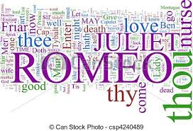
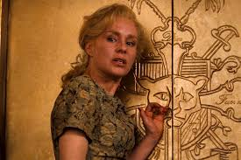
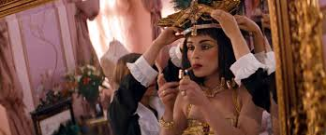
Homework
Create a collage for Lady Capulet:
Use –
Symbols
Images
Words and phrases
Quotes
Colours
Different fonts
Homework
Notes:
Homework is optional - Print off this slide to give out as homework.

