Slide 1
Learning content
LO: To examine the change in character in Act 3, scene 4.
ST: I can close read an extract and comment on Shakespeare’s use of language.

Slide 2
Word association: Write an acrostic for the words below.
DO NOW!
M
A
C
B
E
T
H
T
R
A
G
E
D
Y

Slide 3
Match the word to the definition.
Unlocking vocabulary
_____________ the development of events outside a person's control, regarded as predetermined by a supernatural power.
________ be a warning or indication of (a future event).
__________ a feeling of having committed wrong or failed in an obligation.
____________ disrupt the normal functioning of.
Guilt Disordered
Foreshadow Fate

Slide 4
Answers! Please give yourself a tick
Unlocking vocabulary
Fate the development of events outside a person's control, regarded as predetermined by a supernatural power.
Foreshadow be a warning or indication of (a future event).
Guilt a feeling of having committed wrong or failed in an obligation.
Disordered disrupt the normal functioning of.

Slide 5
Thinking task: What is an apparition?
Reading task
Let’s read Scene 4

Slide 6
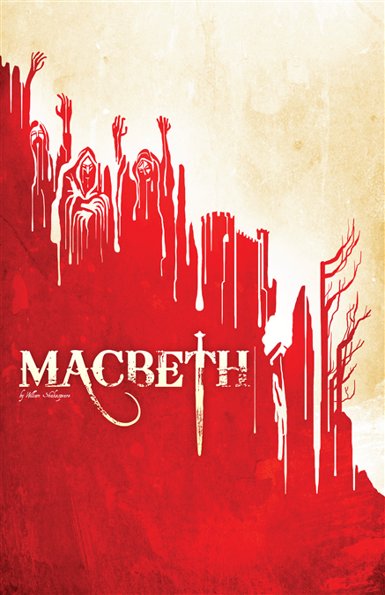
Key Quotation: Make Notes
Consolidating knowledge
“It will have blood they say – blood will have blood.”
Macbeth is clearly feeling guilt about the murders
The second part of the sentence is needed to qualify the first – Macbeth’s mind is disordered
This phrase foreshadows the end of the play – Macduff’s revenge
Macbeth’s fate seems out of his hands at this point (typical of tragedies)
This is another example of PTSD

Slide 7
Mastery
Context Question: Act 3, Scene 4
What do we learn about the characters in this extract?
MACBETH
Which of you have done this?
LORDS
What, my good lord?
MACBETH
Thou canst not say I did it: never shake Thy gory locks at me.
ROSS
Gentlemen, rise: his highness is not well.
LADY MACBETH
Sit, worthy friends: my lord is often thus, And hath been from his youth: pray you, keep seat; The fit is momentary; upon a thought He will again be well: if much you note him, You shall offend him and extend his passion: Feed, and regard him not. Are you a man?
MACBETH
Ay, and a bold one, that dare look on that Which might appal the devil.
LADY MACBETH
O proper stuff! This is the very painting of your fear: This is the air-drawn dagger which, you said, Led you to Duncan. O, these flaws and starts, Impostors to true fear, would well become A woman's story at a winter's fire
Notes:
Annotate with students.

Slide 8
What do we learn about the characters in this scene?
Find evidence for the following:
Macbeth is shocked by the appearance of the ghost
Macbeth feels guilty about Banquo’s murder
Lady Macbeth asks everyone to ignore her husband
Lady Macbeth calls Macbeth a coward
Macbeth thinks the image of Banquo is extremely scary
Lady Macbeth thinks her husband is afraid

Slide 9
What do we learn about the characters in this scene?
Now write up each in a PEA paragraph:
Example:
Macbeth is shocked by the appearance of the ghost. He says "Which of you have done this?” At first, he thinks that it is a trick and cannot be real. He is asking a question which shows that he is not sure about what is happening.

Slide 10
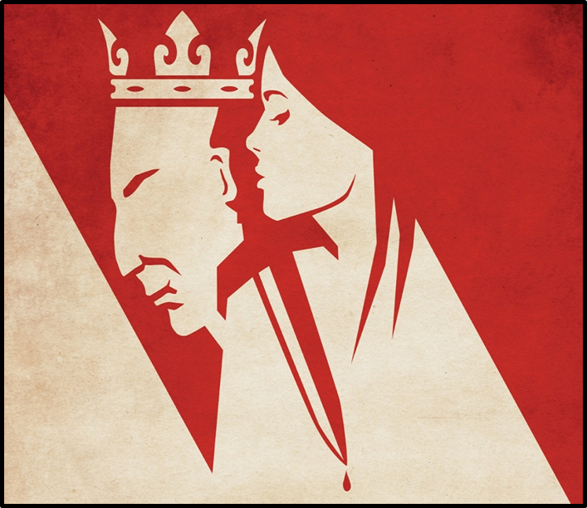
Plenary
Consolidating knowledge
Make a prediction on what you think will happen next.

Slide 11
Notes:
Printable resource

