Slide 1
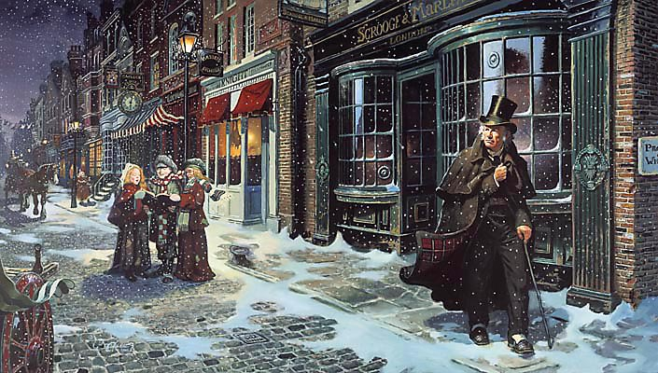
sso
STAVE 5
Greed is a large theme of the novel. Label the characters who exhibit greed and those who shun money and all its evils. Is the story evenly divided between the two?
What do your findings tell you about the novel and Dickens’ purpose?
Do Now
Today’s key questions:
Can I consider and discuss the ALLEGORICAL aspects of ‘A Christmas Carol?’
Can I explain how a writer uses language to convey key ideas?
Can I consider and discuss Dickens’ overall message of the novel? What is his purpose and how has he achieved it?

Slide 2
sso
MATCH THE VOCABULARY TO THEIR DEFINITIONS
notably or brilliantly outstanding because of dignity or achievements or actions
showing a casual and cheerful indifference considered to be cold-hearted or improper.
someone who breeds or sells poultry (birds such as chickens)
make (a doubt, feeling, or belief) disappear
paid or rewarded (someone) for effort or work
DISPELLED ILLUSTRIOUS POULTERER RECOMPENSED BLITHE
Unlocking Vocabulary
Today’s key questions:
Can I consider and discuss the ALLEGORICAL aspects of ‘A Christmas Carol?’
Can I explain how a writer uses language to convey key ideas?
Can I consider and discuss Dickens’ overall message of the novel? What is his purpose and how has he achieved it?

Slide 3
sso
CHECK YOUR ANSWERS:
ILLUSTRIOUS: notably or brilliantly outstanding because of dignity or achievements or actions
BLITHE: showing a casual and cheerful indifference considered to be cold-hearted or improper.
POULTERER: someone who breeds or sells poultry (birds such as chickens)
DISPELLED: make (a doubt, feeling, or belief) disappear
RECOMPENSED: paid or rewarded (someone) for effort or work
Answers
Today’s key questions:
Can I consider and discuss the ALLEGORICAL aspects of ‘A Christmas Carol?’
Can I explain how a writer uses language to convey key ideas?
Can I consider and discuss Dickens’ overall message of the novel? What is his purpose and how has he achieved it?

Slide 4
sso
STAVE 5: The End Of It
Read the whole of Stave 5.
Reading Activity
Today’s key questions:
Can I consider and discuss the ALLEGORICAL aspects of ‘A Christmas Carol?’
Can I explain how a writer uses language to convey key ideas?
Can I link my ideas to the social and historical context of ‘A Christmas Carol’?

Slide 5
sso
DISCUSS THIS
How do these similes contrast each other and demonstrate the nature of Scrooge’s change?
“solitary as an oyster”
“hard and sharp as flint”
Speaking & Listening
“merry as a schoolboy”
“light as a feather”
How else do we know that Scrooge is a changed man? Which words and phrases would you pick out? Write them down in your books. Look for language devices Dickens uses to help present this change in Scrooge.
Today’s key questions:
Can I consider and discuss the ALLEGORICAL aspects of ‘A Christmas Carol?’
Can I explain how a writer uses language to convey key ideas?
3. Can I consider and discuss Dickens’ overall message of the novel? What is his purpose and how has he achieved it?

Slide 6
YOUR TASK
YOUR QUESTION
HOW DO I START?
How does Dickens show Scrooge’s change of heart in this section?
At the beginning of the novel, Dickens presents Scrooge as … and … . However, by the end of Scrooge’s experience with the ghosts, he is a … man.
Dickens compares Scrooge’s new feelings to that of a child when he says, ‘… .’ This simile suggests ...
Scrooge’s happiness is further emphasised when…
It is interesting to note that Dickens uses the same language devices to portray Scrooge as a redeemed man as he does to portray him as miserly and wicked. The simile, ‘solitary as an oyster’ changes to ‘merry as a schoolboy.’ The noun, ‘schoolboy’ holds connotations of…
Furthermore, …
Mastery
WHAT SHOULD MY WORK LOOK LIKE?
Today’s key questions:
Can I consider and discuss the ALLEGORICAL aspects of ‘A Christmas Carol?’
Can I explain how a writer uses language to convey key ideas?
3. Can I consider and discuss Dickens’ overall message of the novel? What is his purpose and how has he achieved it?

Slide 7
sso
YOUR TASK: ROMANCE AND REALISM
EXTRA LEVEL OF CHALLENGE
Romantic: features of literature that may be seen as fantasy – clearly not likely to happen in reality
Realism: literature that aims to capture the actual image of society through words
‘A Christmas Carol’ combines romance and realism to present a tale that is both an enjoyable Christmas fantasy, and a reminder of the harsh realities of society at the time
Make a list of elements of the text that may be seen as ROMANTIC and others that fall under the category of REALISM.
How does Dickens combine elements of ROMANCE and REALISM to achieve his purpose?
Mastery
Today’s key questions:
Can I consider and discuss the ALLEGORICAL aspects of ‘A Christmas Carol?’
Can I explain how a writer uses language to convey key ideas?
3. Can I consider and discuss Dickens’ overall message of the novel? What is his purpose and how has he achieved it?

Slide 8
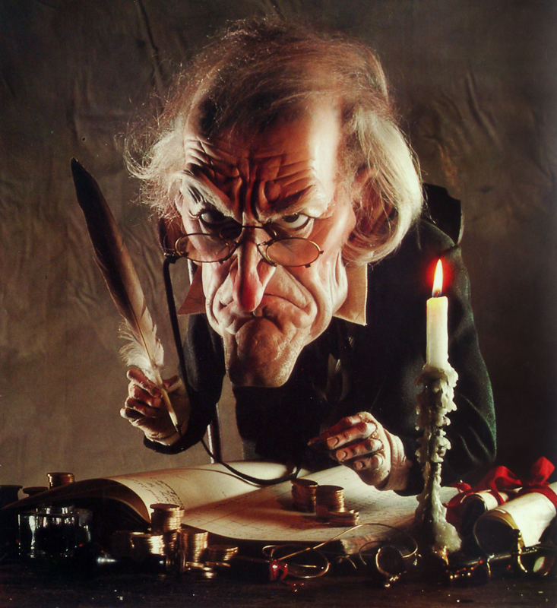
sso
WHY DOES SCROOGE CHANGE?
He changes because he selfishly wants to avoid dying alone and forgotten.
He changes because he genuinely wants to improve life for others.
Mastery
He changes because he is fearful of his predicted afterlife.
He changes because he feels guilty about his past actions and wants to alleviate this guilt.
Once you have discussed these ideas, find evidence for the suggestions above and write them down as quotations in your books. Can you think of any other reasons as to why Scrooge may have changed?

