Slide 1
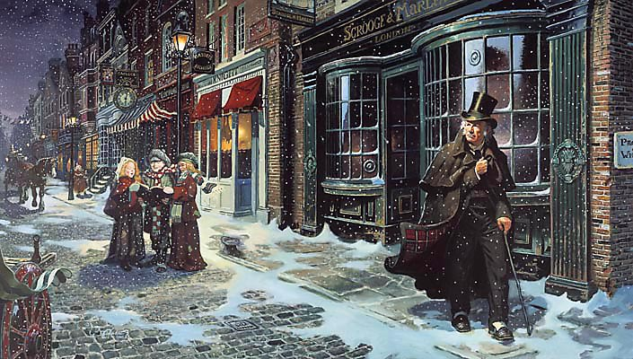
sso
STAVE 5
Greed is a large theme of the novel. Write down a list of characters who exhibit greed and a list of those who don’t care about money. Is the story evenly divided between the two?
What do your findings tell you about the novel and Dickens’ purpose?
Do Now
Today’s key questions:
Can I consider and discuss the ALLEGORICAL aspects of ‘A Christmas Carol?’
Can I explain how a writer uses language to convey key ideas?
Can I consider and discuss Dickens’ overall message of the novel? What is his purpose and how has he achieved it?

Slide 2
sso
STAVE 5: The End Of It
Read the whole of Stave 5.
Reading Activity
Today’s key questions:
Can I consider and discuss the ALLEGORICAL aspects of ‘A Christmas Carol?’
Can I explain how a writer uses language to convey key ideas?
Can I link my ideas to the social and historical context of ‘A Christmas Carol’?

Slide 3
sso
DISCUSS THIS
How do these similes contrast each other and demonstrate the nature of Scrooge’s change?
“solitary as an oyster”
Checking Unerstanding
“merry as a schoolboy”
Today’s key questions:
Can I consider and discuss the ALLEGORICAL aspects of ‘A Christmas Carol?’
Can I explain how a writer uses language to convey key ideas?
3. Can I consider and discuss Dickens’ overall message of the novel? What is his purpose and how has he achieved it?

Slide 4
How does Dickens show Scrooge’s change of heart in this section?
At the beginning of the novel, Dickens presents Scrooge as ………….. and ………….. .
However, by the end of Scrooge’s experience with the ghosts, he is a …….… man.
Dickens compares Scrooge’s new feelings to that of a child when he says,
‘………………………………………………………………………. .’
This simile suggests ...
Mastery
Today’s key questions:
Can I consider and discuss the ALLEGORICAL aspects of ‘A Christmas Carol?’
Can I explain how a writer uses language to convey key ideas?
3. Can I consider and discuss Dickens’ overall message of the novel? What is his purpose and how has he achieved it?

Slide 5
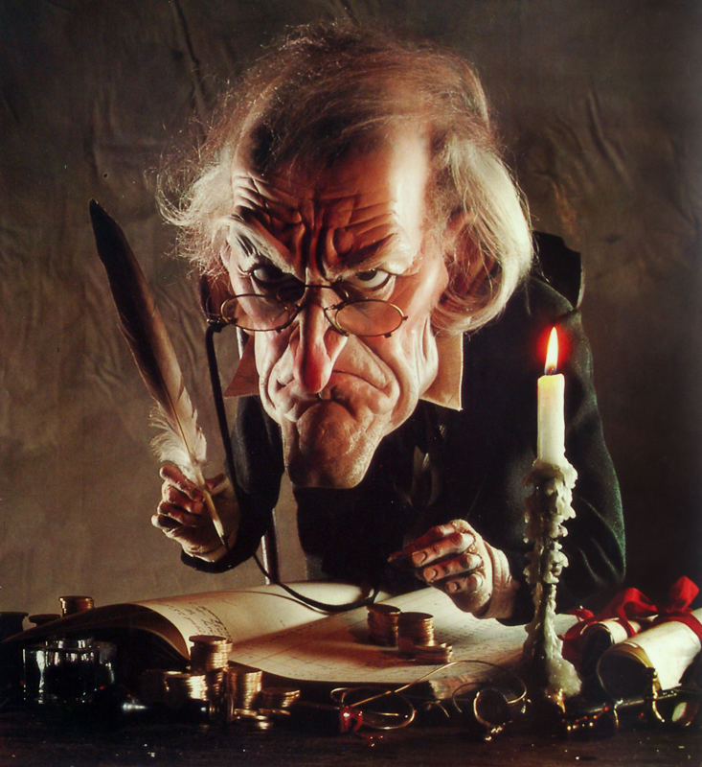
sso
WHY DOES SCROOGE CHANGE?
He changes because he selfishly wants to avoid dying alone and forgotten.
He changes because he genuinely wants to improve life for others.
Mastery
He changes because he is fearful of his predicted afterlife.
He changes because he feels guilty about his past actions and wants to get rid of this guilt.
Which of these ideas do you agree with most? Explain why.

