Slide 1
Lesson 11: f. Scott Fitzgerald
LO: To understand lifestyle post WW1 in America & its impact on literature

Slide 2
starter
What do you think life was like post WW1?
Do Now
LO: To understand lifestyle post WW1 in America & its impact on literature.

Slide 3
Match the vocabulary to the correct definitions.
Fancifully varied in colour and decoration.
Rather fat or of heavy build.
A body of people engaged in a particular activity.
A roofed platform along the outside of a house, level with the ground floor.
A dish served as an appetiser, usually before the main meal.
Wasteful and lavish extravagance.
Unlocking Vocabulary
Corps Hors-d’oeuvre Harlequin Veranda Prodigality Stouter
LO: To understand lifestyle post WW1 in America & its impact on literature.
Notes:
Can be printed for students.

Slide 4
Match the vocabulary to the correct definitions.
Fancifully varied in colour and decoration.
Rather fat or of heavy build.
A body of people engaged in a particular activity.
A roofed platform along the outside of a house, level with the ground floor.
A dish served as an appetiser, usually before the main meal.
Wasteful and lavish extravagance.
Unlocking Vocabulary
Corps Hors-d’oeuvre Harlequin Veranda Prodigality Stouter
LO: To understand lifestyle post WW1 in America & its impact on literature.
Notes:
Can be printed for students.

Slide 5
Check your answers:
Harlequin: Fancifully varied in colour and decoration.
Stouter: Rather fat or of heavy build.
Corps: A body of people engaged in a particular activity.
Veranda: A roofed platform along the outside of a house, level with the ground floor.
Hors-d’oeuvre: A dish served as an appetiser, usually before the main meal.
Prodigality: Wasteful and lavish extravagance.
Answers
LO: To understand lifestyle post WW1 in America & its impact on literature.

Slide 6
Pre starter new time period!
Read through the introduction to the section and make notes on the questions.
Be ready to feedback!
Contextual Information
LO: To understand lifestyle post WW1 in America
& its impact on literature.

Slide 7
timeline
F. Scott. Fitzgerald ‘The Great Gatsby’ (1925)
Ancient Literature
Middle Ages/ Renaissance
The Georgians & Victorians
The Twentieth Century
Representing change
Draw It
Today’s primary text is ‘The Great Gatsby’ by F. Scott Fitzgerald. Written in 1925, it discusses the New York’s rich elite at their peak before the Wall Street Crash in 1929.
LO: To understand lifestyle post WW1 in America & its impact on literature.

Slide 8
Life in Europe/America post ww1
Europe
Flu Outbreak Germany bankrupt and loses most of it’s territory after signing Treaty of Versailles Ethnic groups suffering Jews blamed for German loss Britain broke from funding war High levels of inflation across Europe France struggling to become socialist
USA
Stocks up Production up Recognised as a new world power
prohibition
Contextual Information
LO: To understand lifestyle post WW1 in America & its impact on literature.
Notes:
Watch video on prohibition

Slide 9
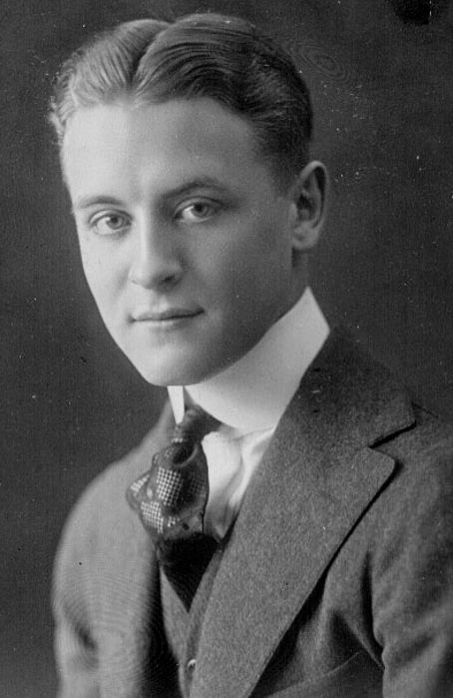
F SCOTT FITZGERALD
F Scott Fitzgerald is one of the most famous American writers who focused much of his writing on the luxury Jazz Age in America.
He did not achieve much success in his lifetime but was well known in literary circles which included writers such as Ernest Hemingway (who we will be looking at in the next lesson).
Fitzgerald was well known for his drinking abilities and died at the age of 44 due to his alcoholism.
Contextual Information
LO: To understand lifestyle post WW1 in America
& its impact on literature.

Slide 10
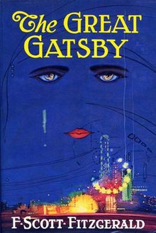
Read the extract
Highlight and annotate: 1. Language devices and their effect 2. Punctuation and its effect
Make notes on:
1. How you, as a modern reader, feel about this extract 2. How you think a European, post war, would feel about this extract
Reading Activity
LO: To understand lifestyle post WW1 in America & its impact on literature.
Notes:
Extract to annotate on slides 10-12

Slide 11
Highlight and annotate: 1. Language devices and their effect 2. Punctuation and its effect Make notes on: 1. How you, as a modern reader, feel about this extract 2. How you think a European, post war, would feel about this extract
At least once a fortnight a corps of caterers came down with several hundred feet of canvas and enough colored lights to make a Christmas tree of Gatsby’s enormous garden. On buffet tables, garnished with glistening hors-d’oeuvre, spiced baking hams crowded against salads of harlequin designs and pastry pigs and turkeys bewitched to a dark gold. In the main hall a bar with a real brass rail was set up, and stocked with gins and liquors and with cordials so long forgotten that most of his female guests were too young to know one from another.
Mastery
LO: To understand lifestyle post WW1 in America & its impact on literature.

Slide 12
Highlight and annotate: 1. Language devices and their effect 2. Punctuation and its effect Make notes on: 1. How you, as a modern reader, feel about this extract 2. How you think a European, post war, would feel about this extract
By seven o’clock the orchestra has arrived, no thin five-piece affair, but a whole pitful of oboes and trombones and saxophones and viols and cornets and piccolos, and low and high drums. The last swimmers have come in from the beach now and are dressing upstairs: the cars from New York are parked five deep in the drive, and already the halls and salons and verandas are gaudy with primary colors and hair bobbed in strange new ways, and shawls beyond the dreams of Castile. The bar is in full swing, and floating rounds of cocktails permeate the garden outside, until the air is alive with chatter and laughter, and casual innuendo and introductions forgotten on the spot, and enthusiastic meetings between women who never knew each other’s names.
Mastery
LO: To understand lifestyle post WW1 in America & its impact on literature.

Slide 13
Highlight and annotate: 1. Language devices and their effect 2. Punctuation and its effect Make notes on: 1. How you, as a modern reader, feel about this extract 2. How you think a European, post war, would feel about this extract
The lights grow brighter as the earth lurches away from the sun, and now the orchestra is playing yellow cocktail music, and the opera of voices pitches a key higher. Laughter is easier minute by minute, spilled with prodigality, tipped out at a cheerful word. The groups change more swiftly swell with new arrivals, dissolve and form in the same breath; already there are wanderers, confident girls who weave here and there among the stouter and more stable, become for a sharp, joyous moment the centre of a group, and then, excited with triumph, glide on through the sea-change of faces and voices and colour under the constantly changing light.
Mastery
LO: To understand lifestyle post WW1 in America & its impact on literature.

Slide 14
Was Gatsby the
kind of text you thought we’d be looking at when discussing WW1?
How is it different?
Checking Understanding
LO: To understand lifestyle post WW1 in America & its impact on literature.
Notes:
Lead a discussion on how it’s different – remind them about war poetry etc

Slide 15
Pick a task
1
Draw the party. Label it with quotes
2
Pick 3 quotes and explode them. Link them to what you know of post war Europe
3
Write a piece using similar language devices about how life was in UK/ Germany after WW1
Mastery
LO: To understand lifestyle post WW1 in America & its impact on literature.
Notes:
Differentiate based on ability – teacher or students can select tasks

Slide 16
OUT OF THE DOOR PLENARY
Give me one word to describe World War 1
Remember… you can’t reuse a word!
Checking Understanding
LO: To understand lifestyle post WW1 in America & its impact on literature.

Slide 17
Contemporary Review
Imagine you are a British Critic reading ‘The Great Gatsby’ when it first published in 1925.
Write a short review to comment on your opinions of the lavish lifestyle being presented in the extract.
Extension Task
LO: To understand lifestyle post WW1 in America & its impact on literature.

