Slide 1
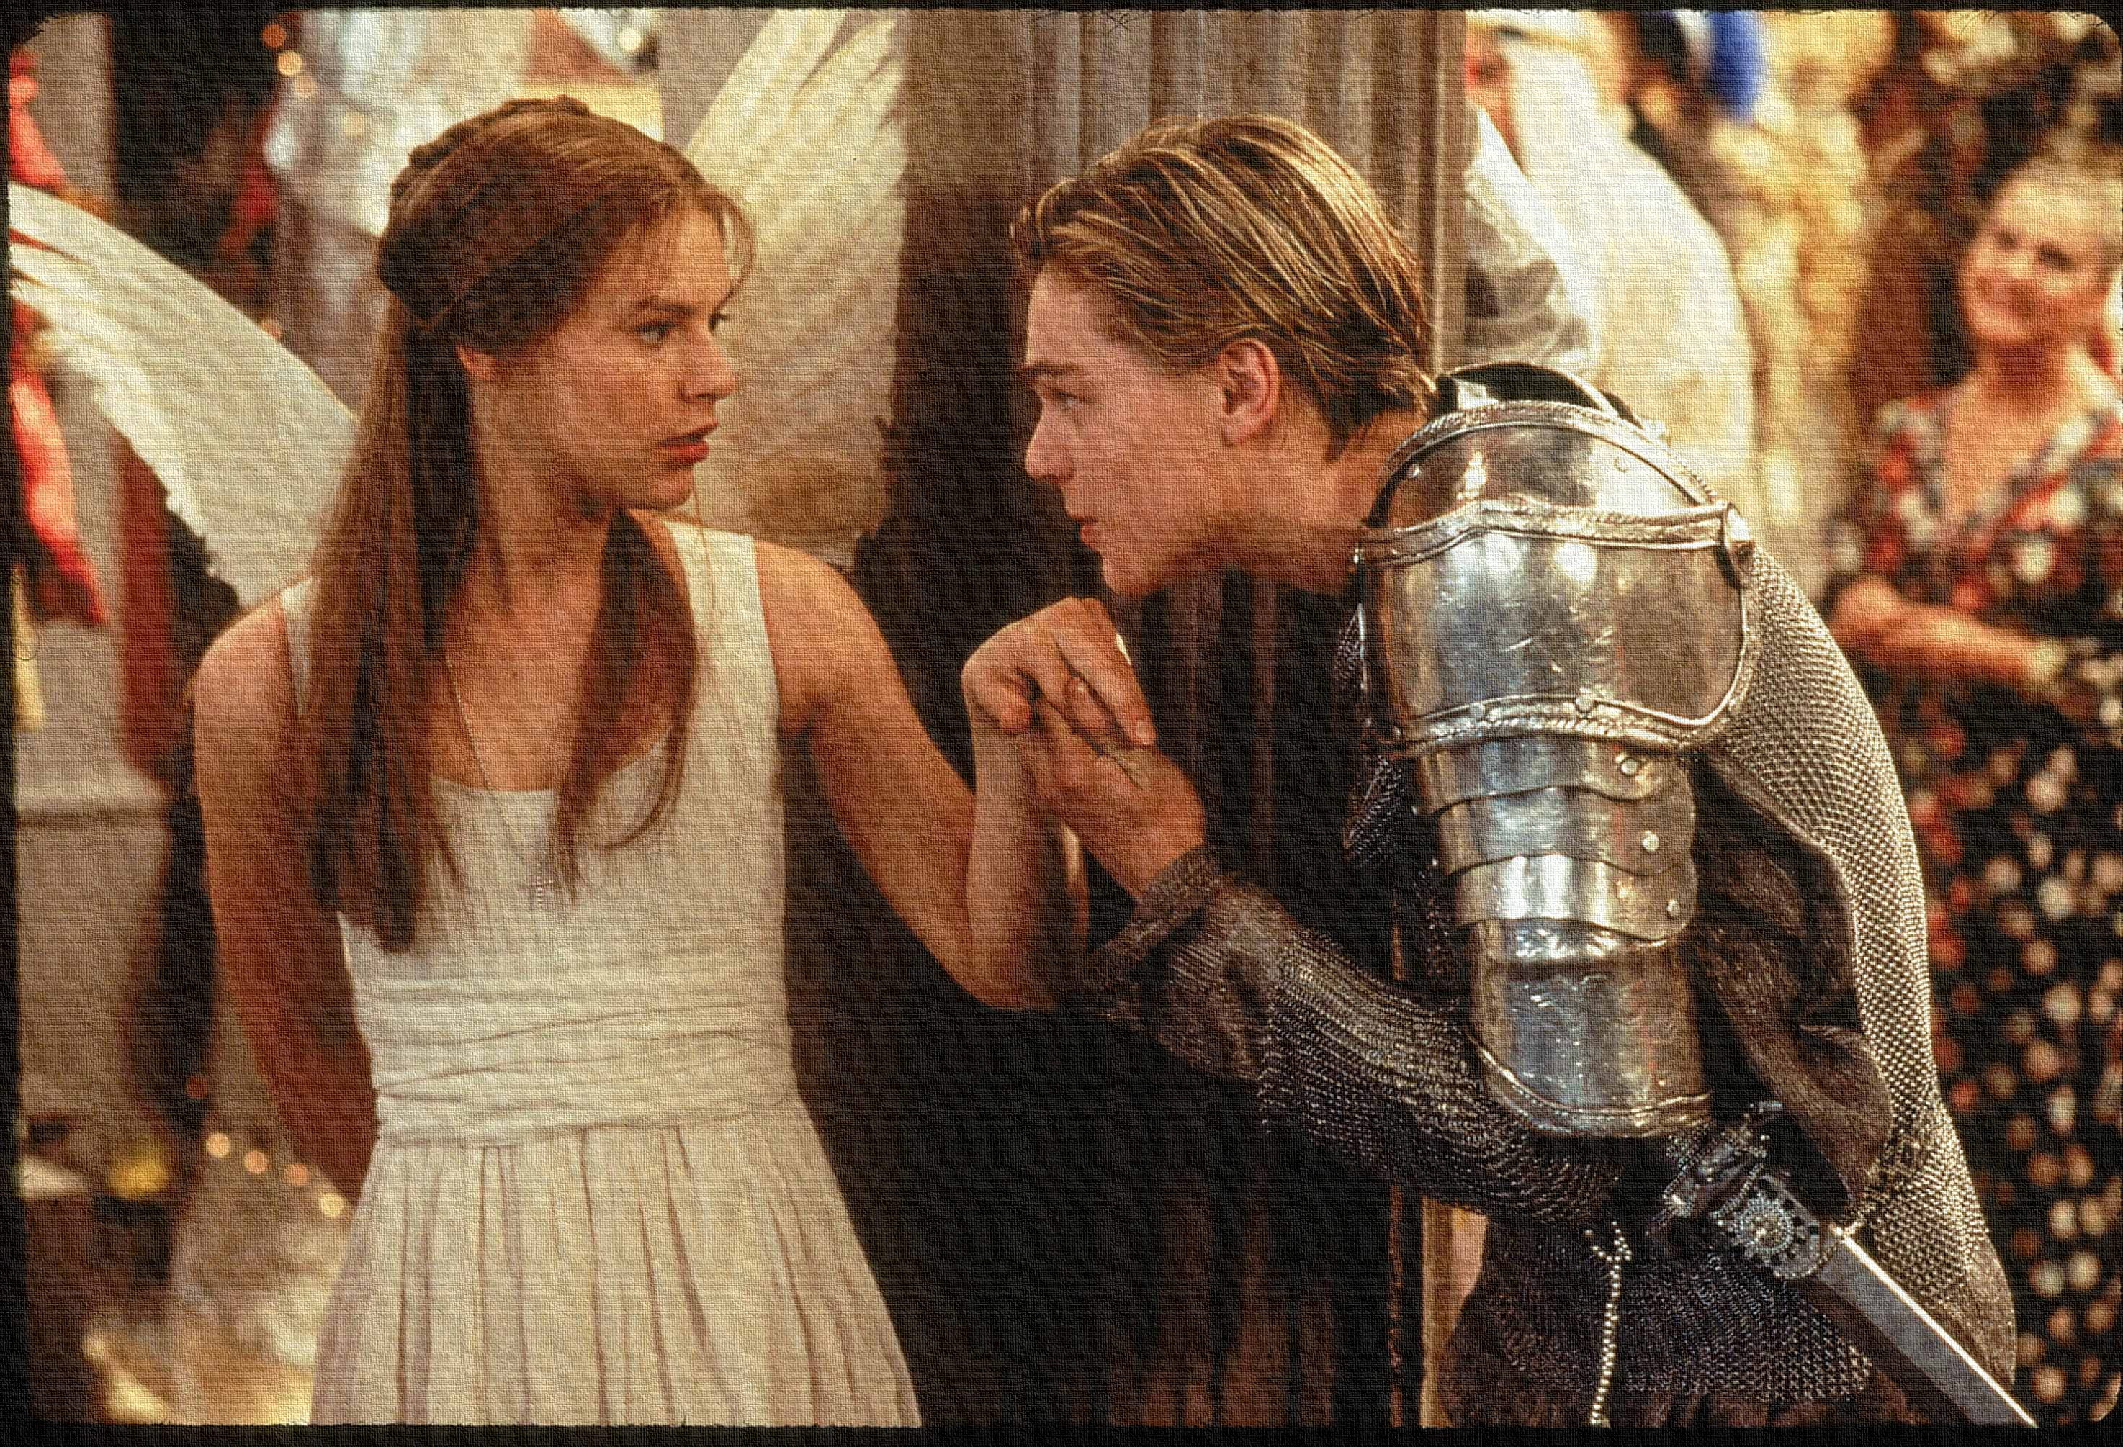
Key Words:
Questions
Conflict
Solutions
Banished
consequences
Lesson 11: Act 3, Scene 2,3 &4
Bad news travels fast
Success Criteria:
To explore how the consequences of the deaths create movement in the plot.
To explain how Shakespeare uses techniques to create tension.
To re-cap and revise the events so far.
‘Romeo + Juliet’
Learning Objective:
AO2: Analyse the language and structure used by a writer to create meanings and effects, using relevant subject terminology where appropriate.

Slide 2
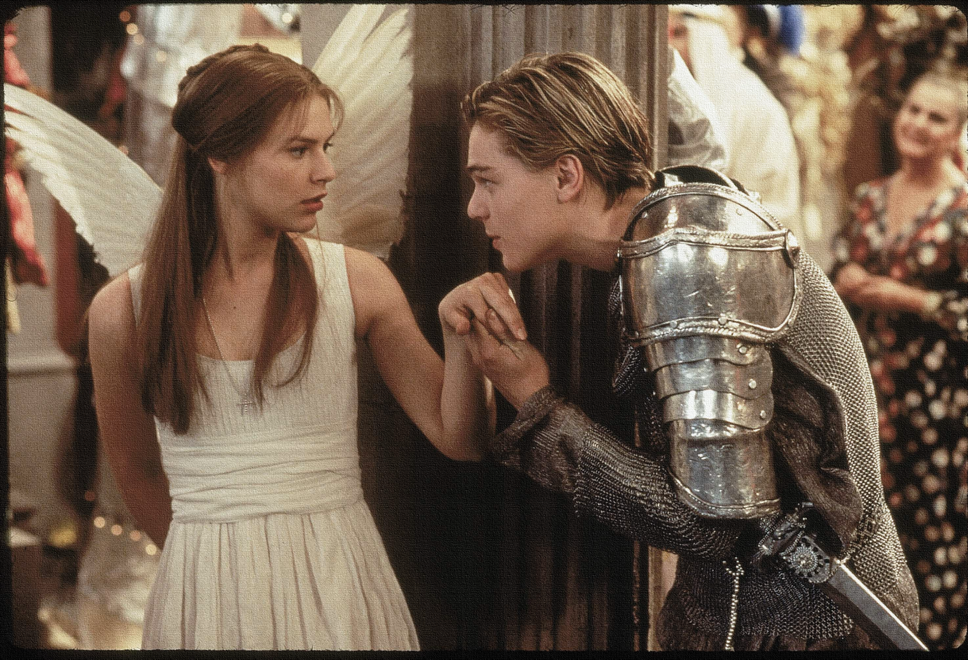
Write today’s date - Thursday, 26 March 2020 and today’s title – Romeo and Juliet Revision in your book
Write an acrostic for either Mercutio or Tybalt. Use words or phrases that you associate with this character.
M
E
R
C
U
T
I
O
T
Y
B
A
L
T
Do Now
Learning Objective:
AO2: Analyse the language and structure used by a writer to create meanings and effects, using relevant subject terminology where appropriate.
Notes:
Get students to feed back words and phrases and justify their choices to aid consolidation of knowledge.

Slide 3
Read the keywords and match their definition: Write them in your books
questions
a doubt about the truth or validity of something.
conflict
a serious disagreement or argument
solutions
Unlocking vocabulary
banished
a means of solving a problem or dealing with a difficult situation.
send (someone) away from a country or place as an official punishment.
a result or effect, typically one that is unwelcome or unpleasant.
consequences

Slide 4
Read the keywords and match their definition: Write them in your books
questions
a doubt about the truth or validity of something.
conflict
a serious disagreement or argument
solutions
Unlocking vocabulary
banished
a means of solving a problem or dealing with a difficult situation.
send (someone) away from a country or place as an official punishment.
a result or effect, typically one that is unwelcome or unpleasant.
consequences

Slide 5
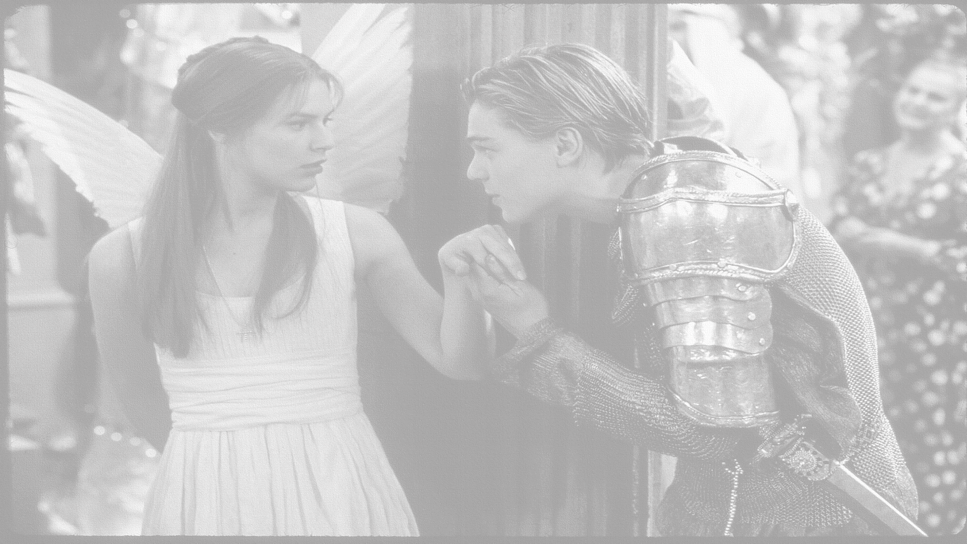
How does Shakespeare show that bad news travels fast?
In this lesson you will be mastering the following:
To explore how the consequences of the deaths create movement in the plot.
To explain how Shakespeare uses techniques to create tension.
To re-cap and revise the events so far.
Learning Content
Notes:
This – as with all aspects of the lesson – can be edited to suit your group.

Slide 6
Act 3, Scene 2 Re-cap
Scene 2: Juliet’s waiting for Romeo to come and visit her that evening. The Nurse enters and tells Juliet that Romeo killed Tybalt and has been banished to Mantua. Juliet is very upset, so the Nurse says she will find Romeo for her.
J: O God did Romeo’s hand shed Tybalt’s blood? … Beautiful tyrant, fiend angelical! Dove-feathered raven, wolvish- ravening lamb!
Thinking task: What themes could this scene link to? Family?? Love?? Hate??
Shakespeare’s technique is to use questions and exclamations to show her shock and confusion at the news.
Juliet uses oxymorons to show her conflicting feelings towards Romeo.
Consolidating learning
N: We are undone, lady, we are undone. Alack the day, he’s gone, he’s killed, he’s dead.
J: What storm is this that blows so contrary? Is Romeo slaughtered? And is Tybalt dead?
Learning Objective:
AO2: Analyse the language and structure used by a writer to create meanings and effects, using relevant subject terminology where appropriate.
Notes:
This slide can be printed off OR ask students to proactively take own notes.

Slide 7
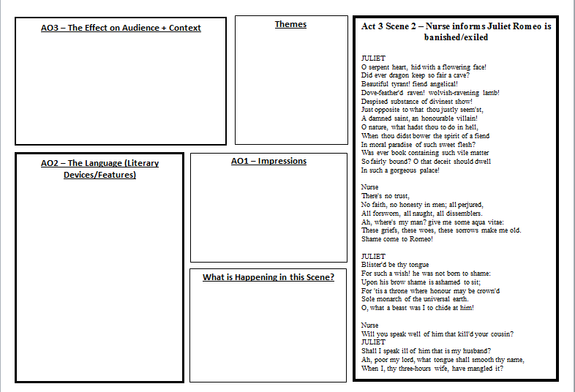
Mastery
Notes:
Print off slide or see resource folder

Slide 8
Let’s read!
Act 3 scene 1
Benvolio:
Mercutio:
Tybalt:
Romeo:
Officer:
Prince:
Lady Capulet:
Montague:
Discussion
How seriously should we take Romeo’s new found love for Juliet?
Does his language suggest that he is now genuinely in love, or is this just another infatuation?
What evidence do we have to link this to?
Reading task
Learning Objectives:
AO1: use textual references, including quotations, to support and illustrate interpretations.
AO2: Analyse the language used by a writer to create meanings and effects.

Slide 9
Act 3, Scene 3 Re-cap
Scene 3: Friar Lawrence tells Romeo he has been banished, Romeo becomes upset and irrational threatening to kill himself. The Friar calms him down. The Nurse tells Romeo how upset Juliet is but she waits for him in her room.
Friar Lawrence is the voice of reason- he reminds Romeo that banishment is better than death: The law that threatened death becomes thy friend, and turns it to exile.
The Nurse arranges for Romeo to go to Juliet that night. Romeo’s mood changes dramatically to excitement “ a joy past joy calls out on me, it were a grief, so brief to part with thee”. What does this tell us about Romeo’s behaviour?
Romeo’s character:
Drawing his dagger
He threatens to kill himself because he believes he has ruined his first moments as a married couple. This shows how impulsive he can be. Also how reckless because he doesn’t think about the effects on Juliet.
Consolidating learning
FL: From Verona art thou banished.
R: There is no world without Verona walls, but purgatory, torture, Hell itself.
Learning Objective:
AO2: Analyse the language and structure used by a writer to create meanings and effects, using relevant subject terminology where appropriate.
Notes:
This slide can be printed off OR ask students to proactively take own notes.
Romeo’s behaviour is erratic. Thus, starting to show Romeo’s hamartia is impulsive.

Slide 10
Act 3, Scene 4 Re-cap
Scene 4: Paris wants to court Juliet but Capulet tells him she is too upset about Tybalt’s death. However, Capulet has a change od heart and decides that Paris will marry Juliet on Thursday, he sends lady Capulet to give the news to Juliet.
Theme: Family
This shows the patriarchal rule of Lord Capulet – it is ironic though, because she has already disobeyed him by marrying in secret.
Thinking task: Why do you think Lord Capulet agrees to Juliet and Paris’s engagement? Why does he make it so soon?
Shakespeare’s technique is to use a very short scene to show how rushed Juliet’s engagement to Paris is. This will heighten the tension for the audience because they know that Juliet is already married. DRAMATIC IRONY!
Consolidating learning
P: These times of woe afford no time to woo.
LC: I will make a desperate tender of my child’s love: I think she will be ruled in all respects by me.
Learning Objective:
AO2: Analyse the language and structure used by a writer to create meanings and effects, using relevant subject terminology where appropriate.
Notes:
This slide can be printed off OR ask students to proactively take own notes.

Slide 11
EXTENSION TASK: ACT 3 Scene 4
Consider: Being told you are marrying in two days time.
How would you feel?
What would you do?
Would this be acceptable today?
Was it acceptable then?
How does it link to Patriarchy at the time?
Transform: Imagine you are Juliet observing this scene.
What would she be thinking?
CAPULET Monday! ha, ha! Well, Wednesday is too soon, O’ Thursday let it be: o’ Thursday, tell her, She shall be married to this noble earl. Will you be ready? do you like this haste? We’ll keep no great ado,–a friend or two; For, hark you, Tybalt being slain so late, It may be thought we held him carelessly, Being our kinsman, if we revel much: Therefore we’ll have some half a dozen friends, And there an end. But what say you to Thursday?
PARIS My lord, I would that Thursday were to-morrow.
CAPULET Well get you gone: o’ Thursday be it, then. Go you to Juliet ere you go to bed, Prepare her, wife, against this wedding-day. Farewell, my lord. Light to my chamber, ho! Afore me! it is so very very late, That we may call it early by and by. Good night.
Exeunt
Extension task
Criticise: The speed at which Capulet now wants to marry Juliet off to Paris.
What is the rush?
Link:
Other examples of Juliet being ordered to do what men tell her.
Notes:
Work as a class to answer questions or leave top sets to work independently. REVIEW PETER paragraphs!

Slide 12
Homework
Answer the following essay question: How does Shakespeare use language and dramatic devices to present violence and conflict in Romeo and Juliet?
Homework
Notes:
Homework is optional - Print off this slide to give out as homework.

