Slide 1
Language paper 1 Question A4
LO: To develop an understanding of question 4
ST: I can evaluate how a writer crafts their writing to engage a reader and support this with appropriate textual reference.

Slide 2
Question A4 – this is another HOW question.
It asks you to write about the techniques the writer has used to make the text …
YOU SHOULD WRITE ABOUT:
The writer’s use of language to create …
How the text’s structure builds …
The effects on the reader
Answers need to include examples of each of the things mentioned in the bullet points!

Slide 3
Tips to answer Q4:
Focus on the content and meaning of what the writer says first. E.g. “The writer immediately creates mystery as the reader learns Obed witnessed ‘a terrible thing’, but are not told what it is.”.
Then provide 4-5 examples to support this and explore how these ideas are shown.
Lead with content and an understanding of writer’s intention.
Include very short pieces of evidence.
Use subject terminology sensibly in conjunction with the evidence.
Look at the sequence of events / how the situation develops.

Slide 4
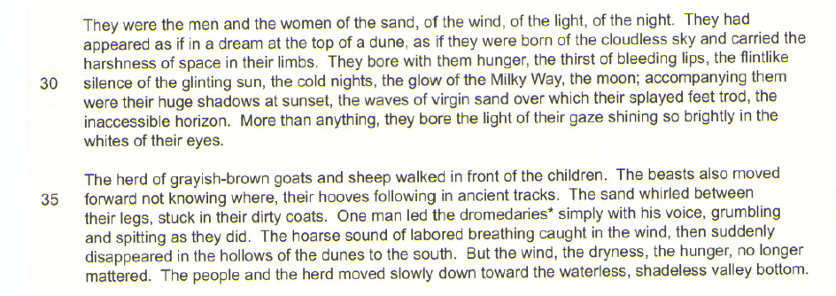
Read the extract below: How does the writer make these lines mysterious?

Slide 5
Let’s look at some graded answers. Here’s a grade 4-5 answer.

Slide 6
This is a grade 6-7 answer.

Slide 7
Here’s a grade 8-9 answer.

Slide 8
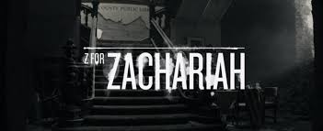
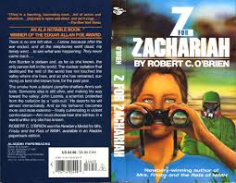
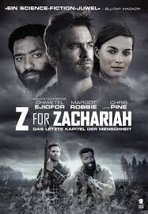
Your Turn: Read your handout, an extract taken from Z for Zachariah written by Robert O'Brien.

Slide 9
Z for Zachariah, written by Robert O’Brien (1974)
This extract, written in the form of a first person diary, is narrated by a 16 years old girl named Ann Burden who believed herself to be the only survivor in her town after a nuclear war. She thinks someone is coming and she is no longer alone. Is this person a friend or a foe?
May 20th
I am afraid. Someone is coming. That is, I think someone is coming, though I am not sure, and I pray that I am wrong. I went into the church and prayed all this morning. I sprinkled water in front of the altar, and put some flowers on it, violets and dogwood.
But there is smoke. For three days there has been smoke, not like the time before. That time, last year, it rose in a great cloud a long way away, and stayed in the sky for two weeks. A forest fire in the dead woods, and then it rained and the smoke stopped. But this time it is a thin column, like a pole, not very high.
And the column has come three times, each time in the late afternoon. At night I cannot see it, and in the morning, it is gone. But each afternoon it comes again, and it is nearer. At first it was behind Claypole Ridge, and I could see only the top of it, the smallest smudge. I thought it was a cloud, except that it was too grey, the wrong colour, and then I thought: there are no clouds anywhere else. I got the binoculars and saw that it was narrow and straight; it was smoke from a small fire. When we used to go in the truck, Claypole Ridge was fifteen miles, though it looks closer, and the smoke was coming from behind that.
Beyond Claypole Ridge there is Ogdentown, about ten miles further. But there is no one left alive in Ogdentown. I know, because after the war ended, and all the telephones went dead, my father, my brother Joseph and my Cousin David went in the truck to find out what was happening, and the first place they went was Ogdentown. They went early in the morning: Joseph and David were really excited, but Father looked serious.
When they came back it was dark. Mother had been worrying – they took so long – so we were glad to see the truck lights finally coming over Burden hill, six miles away. They looked like beacons. They were the only lights anywhere, except in the house – no other cars had come down all day. We knew it was the truck because one of the lights, the left one, always blinked when it went over a bump. It came up to the house and they got out; the boys weren’t excited any more. They looked scared, and my father looked sick. Maybe he was beginning to be sick, but mainly I think he was distressed. My mother looked up at him as he climbed down.
“What did you find?”
He said, “Bodies. Just dead bodies. They’re all dead.”
“All?”
We went inside the house where the lamps were lit, the two boys following, not saying anything. My father sat down. “Terrible,” he said, and again, “terrible, terrible. We drove around, looking. We blew the horn. Then we went to the church and rang the bell. You can hear it five miles away. We waited for two hours, but nobody came. I went into a couple of houses – the Johnsons’ the Peters’ – they were all in there, all dead. There were dead birds all over the streets.”
My brother Joseph began to cry. He was fourteen. I think I had not heard him cry for six years.

Slide 10
May 21st
It is coming closer. Today it was almost on top of the ridge, though not quite, because when I looked with the binoculars I could not see the flame, but still only the smoke – rising very fast, not far above the fire. I know where it is: at the crossroads. Just on the other side of the ridge, the east-west highway, the Dean Town Road, crosses our road. It is route number nine, a State highway, bigger than our road, which is County road 793. He has stopped there and is deciding whether to follow number nine or come over the ridge. I say he because that is what I think of, though it could be they or even she. But I think it is he. If he decides to follow the highway he will go away, and everything will be all right again. Why would he come back? But if he comes to the top of the ridge, he is sure to come down here, because he will see the green leaves. On the other side of the ridge, even on the other side of Burden Hill, there are no leaves; everything is dead.

Slide 11
When they came back it was dark. Mother had been worrying – they took so long – so we were glad to see the truck lights finally coming over Burden hill, six miles away. They looked like beacons. They were the only lights anywhere, except in the house – no other cars had come down all day. We knew it was the truck because one of the lights, the left one, always blinked when it went over a bump. It came up to the house and they got out; the boys weren’t excited any more. They looked scared, and my father looked sick. Maybe he was beginning to be sick, but mainly I think he was distressed. My mother looked up at him as he climbed down.
“What did you find?”
He said, “Bodies. Just dead bodies. They’re all dead.”
“All?”
We went inside the house where the lamps were lit, the two boys following, not saying anything. My father sat down. “Terrible,” he said, and again, “terrible, terrible. We drove around, looking. We blew the horn. Then we went to the church and rang the bell. You can hear it five miles away. We waited for two hours, but nobody came. I went into a couple of houses – the Johnsons’ the Peters’ – they were all in there, all dead. There were dead birds all over the streets.”

Slide 12
Now answer the question:
How does the writer create a sense of fear?
This question is worth 10 marks. You must comment on the writer’s use of language and structure that makes this atmosphere. You must use Point, Evidence, Technique, Explain, develop and comment on the effect it has on a Reader. Make sure that you LINK to the question.

Slide 13
Self Assess: Give yourself time to proof read and make sure that it all makes sense.
Have you explored the language and HOW it creates a sense of fear?
Have you thought about the way it has been structured and commented on the writer’s craft?
Have each of your paragraphs linked back to the focus of the question?
Have you used technical terms?
GIVE YOURSELF A TARGET.

Slide 14
Question A4 is worth 10 marks. You must explain how a writer has used language and structure to achieve their purpose and influence a reader. So, that means - analyse the writer’s methods and their effects. Use the best examples to support your points. Use Point, Evidence, Technique, Explain, Reader. Aim for 3-4 paragraphs in an exam.
AO2:Explain, comment on and analyse how writers use language and structure to achieve effects and influence readers, using relevant subject terminology to support views.

Slide 15
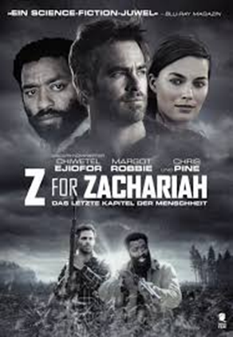
Extension: look at your target. Re-write ONE paragraph improving on your analysis.
REMEMBER! To analyse is to explain the writer’s method and the meaning behind it.

