Slide 1
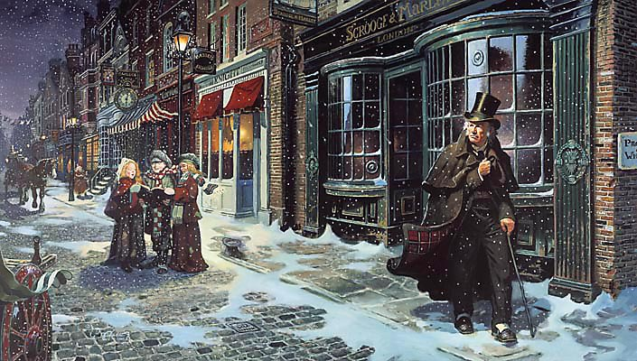
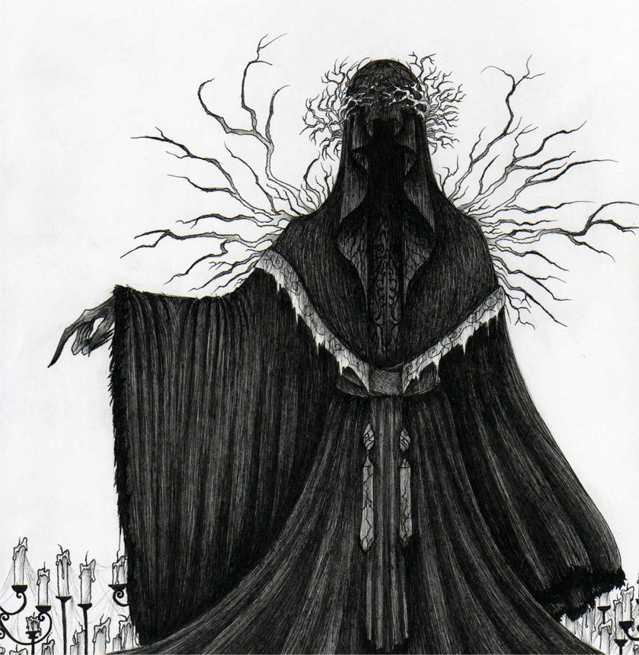
sso
THE END OF STAVE 4
Quickly recap WHY Scrooge has been shown these two events so far. What can he can learn from them?
What else do you think he will be shown?
The gentleman discussing the unidentified man’s funeral.
Mrs Dilber and Old Joe, who have stolen the items of an unidentified man.
Do Now
Today’s key questions:
Can I consider and discuss the ALLEGORICAL aspects of ‘A Christmas Carol?’
Can I explain how a writer uses language to convey key ideas?
Can I link my ideas to the social and historical context of ‘A Christmas Carol’?

Slide 2
sso
STAVE 4: The Ghost of Christmas Yet to Come
Read to the end of Stave 4.
Reading Activity
Today’s key questions:
Can I consider and discuss the ALLEGORICAL aspects of ‘A Christmas Carol?’
Can I explain how a writer uses language to convey key ideas?
Can I link my ideas to the social and historical context of ‘A Christmas Carol’?

Slide 3
sso
YOUR TASK
Look at the following quotations describing the Cratchits.
How does the language, mood and atmosphere differ from when we were first introduced to this family?
What is Dickens trying to make us feel?
‘Quiet. Very quiet. The noisy little Cratchits were as still as statues in one corner, and sat looking up at Peter, who had a book before him. The mother and her daughters were engaged in sewing. But surely they were very quiet.’
…
‘She hurried out to meet him; and little Bob in his comforter -- he had need of it, poor fellow -- came in. His tea was ready for him on the hob, and they all tried who should help him to it most. Then the two young Cratchits got upon his knees and laid, each child a little cheek, against his face, as if they said, "Don't mind it, father. Don't be grieved.”’
…
‘He left the room, and went up-stairs into the room above, which was lighted cheerfully, and hung with Christmas. There was a chair set close beside the child, and there were signs of some one having been there, lately. Poor Bob sat down in it…’
Mastery
Today’s key questions:
Can I consider and discuss the ALLEGORICAL aspects of ‘A Christmas Carol?’
Can I explain how a writer uses language to convey key ideas?
Can I link my ideas to the social and historical context of ‘A Christmas Carol’?
Notes:
Bold parts are what students should focus on.

Slide 4
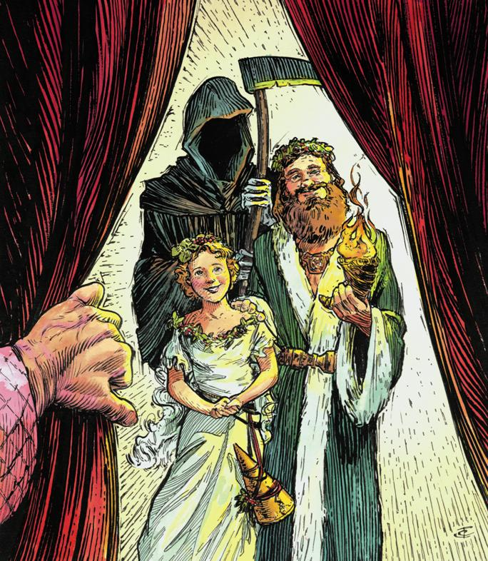
sso
DISCUSS THIS
In your opinion, which ghost has had the biggest influence on Scrooge?
Mastery
Today’s key questions:
Can I consider and discuss the ALLEGORICAL aspects of ‘A Christmas Carol?’
Can I explain how a writer uses language to convey key ideas?
Can I link my ideas to the social and historical context of ‘A Christmas Carol’?

Slide 5
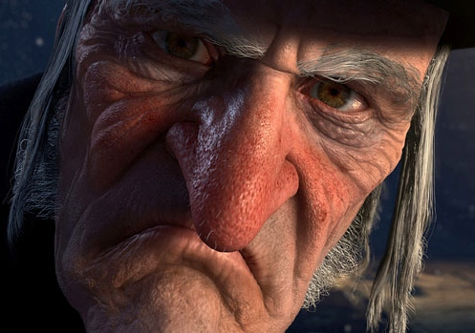
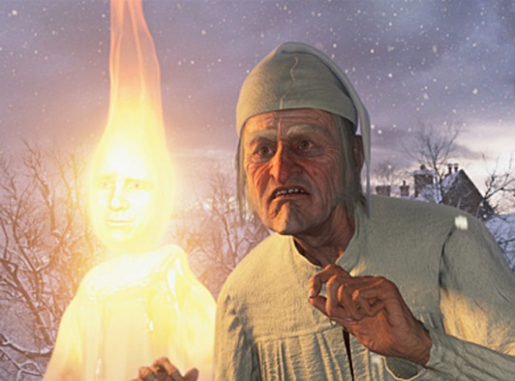
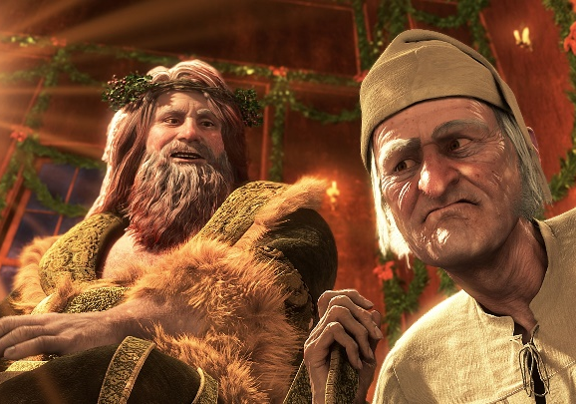
sso
TO FINISH: SCROOGE’S TRANSFORMATION
Create a flowchart of the major quotations that show Scrooge’s change. Start with Stave One and move through to Stave Four (work chronologically).
‘Solitary as an oyster… hard and sharp as flint.’
STAVE ONE
Checking Understanding
STAVE TWO
STAVE THREE

