Slide 1
Lesson 10: ‘wuthering heights’
L/O: To understand the place of women and the Gothic novel in the Victorian era

Slide 2
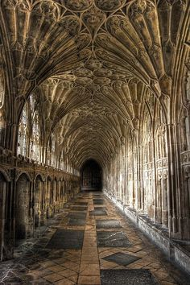
Starter
50 WORD CHALLENGE
WRITE A 50 WORD GOTHIC STORY ABOUT THIS BUILDING
Do Now
Must have:
A simile Personification 1 word sentence Rule of 3
L/O: To understand the place of women and the Gothic novel in the Victorian era.

Slide 3
Match the vocabulary to the correct definitions.
Full of grief.
Recognise/find out/distinguish
That is to be regretted or pitied.
Persistent, especially to the point of annoyance.
To believe or say that something is caused by something else.
Someone or something that holds on firmly either physically or to an idea.
Unlocking Vocabulary
Ascribed Importunate Discerned Tenacious Lamentable Doleful
L/O: To understand the place of women and the Gothic novel in the Victorian era.
Notes:
Can be printed for students

Slide 4
Check your answers:
Doleful: Full of grief.
Discerned: Recognise/find out/distinguish
Lamentable: That is to be regretted or pitied.
Importunate: Persistent, especially to the point of annoyance.
Ascribed: To believe or say that something is caused by something else.
Tenacious: Someone or something that holds on firmly either physically or to an idea.
Answers
L/O: To understand the place of women and the Gothic novel in the Victorian era.

Slide 5
Time line
Emily Bronte ‘Wuthering Heights’ (1847)
Ancient Literature
Middle Ages/ Renaissance
The Georgians & Victorians
The Twentieth Century
Representing change
Draw It
Today’s primary text is ‘Wuthering Heights’ by Emily Bronte. Emily came from a family of artists and writers. Her and her two sisters, Charlotte and Anne, are all famous for their writing. Emily published WH under the name of ‘Ellis Bell’ (a man’s name) because, as a woman, she could not get her book published. WH is inspired by the moors where the Bronte’s lived. It is a desolate and dark landscape.
L/O: To understand the place of women and the Gothic novel in the Victorian era.

Slide 6
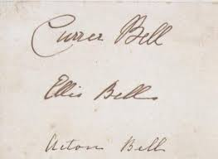
Women in Victorian literature
Female writers at the time were forced to publish a book under a man’s name for it to be respected.
If they were brave and tried to publish it under their own name, it either wasn’t published, people said their father or husband wrote it OR they declared the book to be poor because it was written by a woman.
Women were expected to behave in a ‘proper manner’ and texts such as Frankenstein and Wuthering Heights were really shocking as women should not have been discussing such gruesome ideas!
Contextual Informaiton
The Bronte sisters male signatures. They published under the male names of Currer, Ellis and Acton Bell.
L/O: To understand the place of women and the Gothic novel in the Victorian era

Slide 7
Long Term Memory Link: Year 8 Gothic
Checking Understanding
Gothic What ideas come to mind?
L/O: To understand the place of women and the Gothic novel in the Victorian era.

Slide 8
Gothic in the Victorian Era
Frankenstein
Wuthering Heights
Jekyll and Hyde
Dracula
The Picture of Dorian Grey
Jane Eyre
A Christmas Carol/ Great Expectations
Discussion Activity
L/O: To understand the place of women and the Gothic novel in the Victorian era.
Notes:
Talk through the texts, why they’re popular (science in the Victorian era etc) and what they have in common.

Slide 9
Read the extract
Annotate and highlight the extract Look for:
Language devices (metaphors, similes, adjectives, verbs etc) Punctuation – what effect does it have? Words that show gothic ideas
Reading Activity
L/O: To understand the place of women and
the Gothic novel in the Victorian era.
Notes:
Read with the class – slides 10 & 11 have the text for annotating

Slide 10
This time, I remembered I was lying in the oak closet, and I heard distinctly the gusty wind, and the driving of the snow; I heard, also, the fir bough repeat its teasing sound, and ascribed it to the right cause: but it annoyed me so much, that I resolved to silence it, if possible; and, I thought, I rose and endeavoured to unhasp the casement. The hook was soldered into the staple: a circumstance observed by me when awake, but forgotten. ‘I must stop it, nevertheless!’ I muttered, knocking my knuckles through the glass, and stretching an arm out to seize the importunate branch; instead of which, my fingers closed on the fingers of a little, ice-cold hand! The intense horror of nightmare came over me: I tried to draw back my arm, but the hand clung to it, and a most melancholy voice sobbed, ‘Let me in—let me in!’ ‘Who are you?’ I asked, struggling, meanwhile, to disengage myself. ‘Catherine Linton,’ it replied, shiveringly (why did I think of Linton? I had read Earnshaw twenty times for Linton) ‘I’m come home: I’d lost my way on the moor!’
Mastery
L/O: To understand the place of women and the Gothic novel in the Victorian era.

Slide 11
As it spoke, I discerned, obscurely, a child’s face looking through the window. Terror made me cruel; and, finding it useless to attempt shaking the creature off, I pulled its wrist on to the broken pane, and rubbed it to and fro till the blood ran down and soaked the bedclothes: still it wailed, ‘Let me in!’ and maintained its tenacious gripe, almost maddening me with fear. ‘How can I!’ I said at length. ‘Let me go, if you want me to let you in!’ The fingers relaxed, I snatched mine through the hole, hurriedly piled the books up in a pyramid against it, and stopped my ears to exclude the lamentable prayer. I seemed to keep them closed above a quarter of an hour; yet, the instant I listened again, there was the doleful cry moaning on! ‘Begone!’ I shouted. ‘I’ll never let you in, not if you beg for twenty years.’ ‘It is twenty years,’ mourned the voice: ‘twenty years. I’ve been a waif for twenty years!’ Thereat began a feeble scratching outside, and the pile of books moved as if thrust forward. I tried to jump up; but could not stir a limb; and so yelled aloud, in a frenzy of fright.
Mastery
L/O: To understand the place of women and the Gothic novel in the Victorian era.

Slide 12
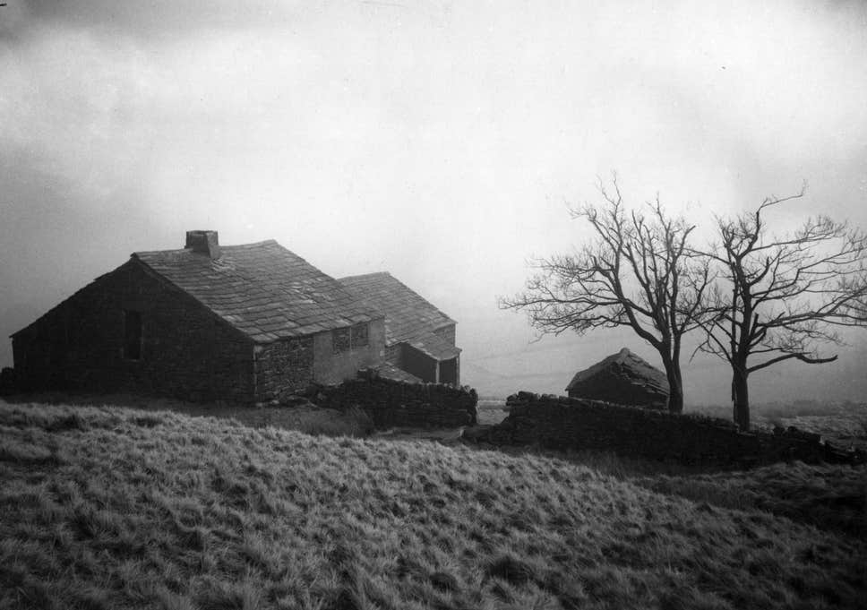
Feedback:
What made this extract gothic?
Checking Understanding
L/O: To understand the place of women and the Gothic novel in the Victorian era.

Slide 13
Task options – pick 1
1. Pick 1 language device that shows a gothic element. Explain it’s effect on the reader. Use quotes.
2. Do you think this extract is particularly gothic? Explain your response using quotes.
3. Compare Cathy’s ghost to Medusa. How are they the same/different? Use quotes to explain.
Mastery
L/O: To understand the place of women and the Gothic novel in the Victorian era.
Notes:
Can set task based on ability or students can select appropriate level.

Slide 14
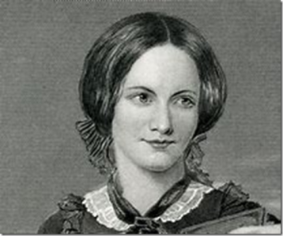
The big question
Does it make any difference to
you that a woman wrote this?
In no more than 20 words, explain your reason.
Mastery
L/O: To understand the place of women and the Gothic novel in the Victorian era.

Slide 15
“There was no moon, and everything beneath lay in misty darkness: not a light gleamed from any house, far or near all had been extinguished long ago: and those at Wuthering Heights were never visible…” Wuthering Heights Ch. 12
The house ‘Wuthering Heights’ is surrounded by vast moorland.
Create a description of the moorland so that it fits into the Gothic style.
Challenge: Adapt your language so that it is in keeping with the Extract we have studied.
Extension Task
L/O: To understand the place of women and the Gothic novel in the Victorian era.

