Slide 1
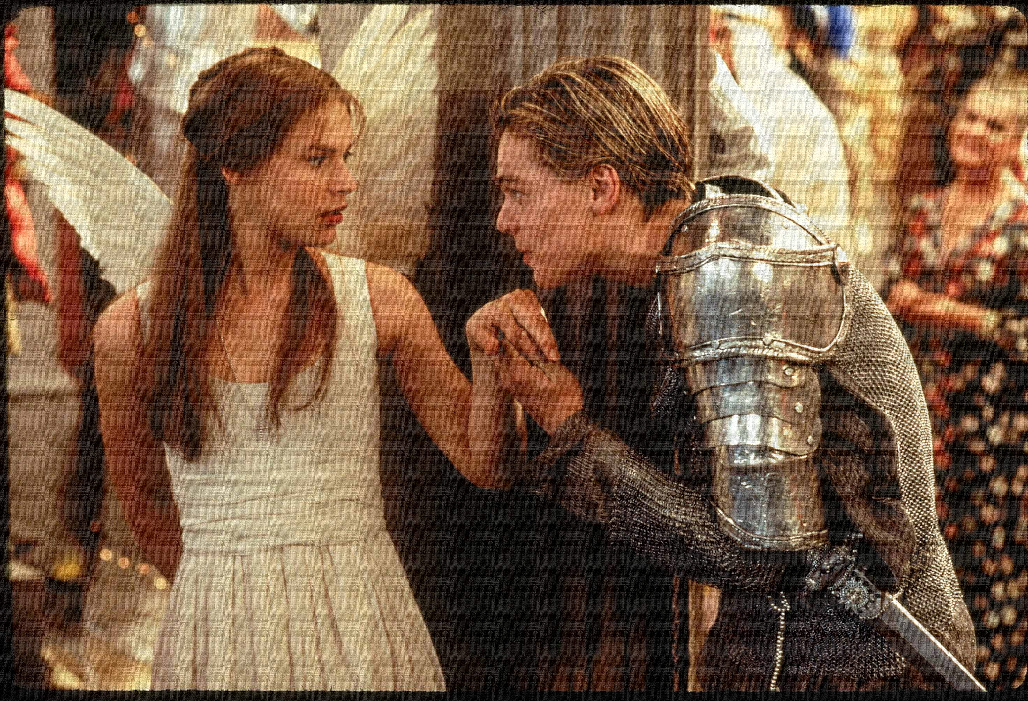
Key Words:
Revenge
Feud
Dramatic irony
Ambiguity
Plague
Lesson 10: Act 3, Scene 1
Tybalt and Mercutio are killed
Success Criteria:
To explore the use of violence and atmosphere.
To explain how Shakespeare uses techniques to create tension.
To re-cap and revise the events so far.
‘Romeo + Juliet’
Learning Objective:
AO2: Analyse the language and structure used by a writer to create meanings and effects, using relevant subject terminology where appropriate.

Slide 2
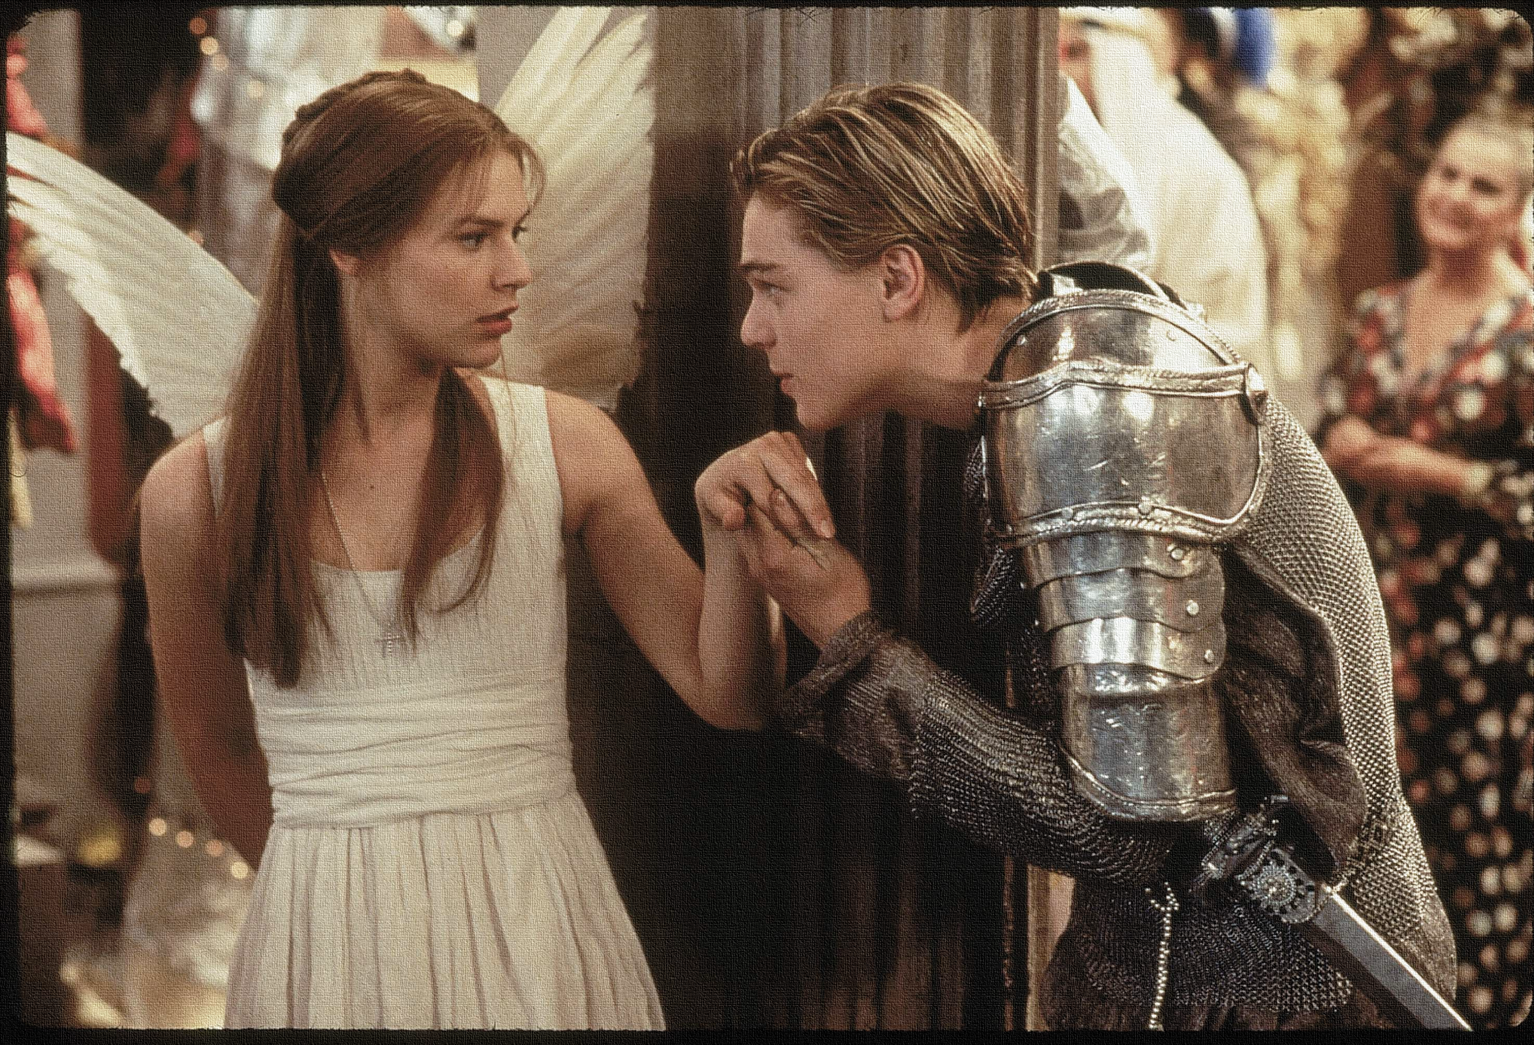
Write today’s date - Thursday, 26 March 2020 and today’s title – Romeo and Juliet Revision in your book
Act 3, Scene 1
BENVOLIO
I pray thee, good Mercutio, let’s retire.
The day is hot; the Capulets, abroad;
And if we meet we shall not ’scape a brawl,
For now, these hot days, is the mad blood stirring.
Do Now
What technique is being used here by Shakespeare? What atmosphere/ mood does this create for the audience and why?
What is it suggested that the weather does to the characters? How does this foreshadow what is about to happen?
How is this scene and the conversation like a previous scene? Why do you think Shakespeare chose to structure his play like this?
Learning Objective:
AO2: Analyse the language and structure used by a writer to create meanings and effects, using relevant subject terminology where appropriate.

Slide 3
Read the keywords and match their definition: Write them in your books
revenge
the action of hurting or harming someone in return for an injury or wrong suffered at their hands.
feud
A prolonged and bitter quarrel or dispute.
ambiguity
Unlocking vocabulary
plague
the quality of being open to more than one interpretation
any contagious disease that spreads rapidly and kills many people.
The full significance of a character's words or actions is clear to the audience or reader although unknown to the character.
Dramatic irony

Slide 4
Read the keywords and match their definition: Write them in your books
revenge
the action of hurting or harming someone in return for an injury or wrong suffered at their hands.
feud
A prolonged and bitter quarrel or dispute.
ambiguity
Unlocking vocabulary
plague
the quality of being open to more than one interpretation
any contagious disease that spreads rapidly and kills many people.
The full significance of a character's words or actions is clear to the audience or reader although unknown to the character.
Dramatic irony

Slide 5
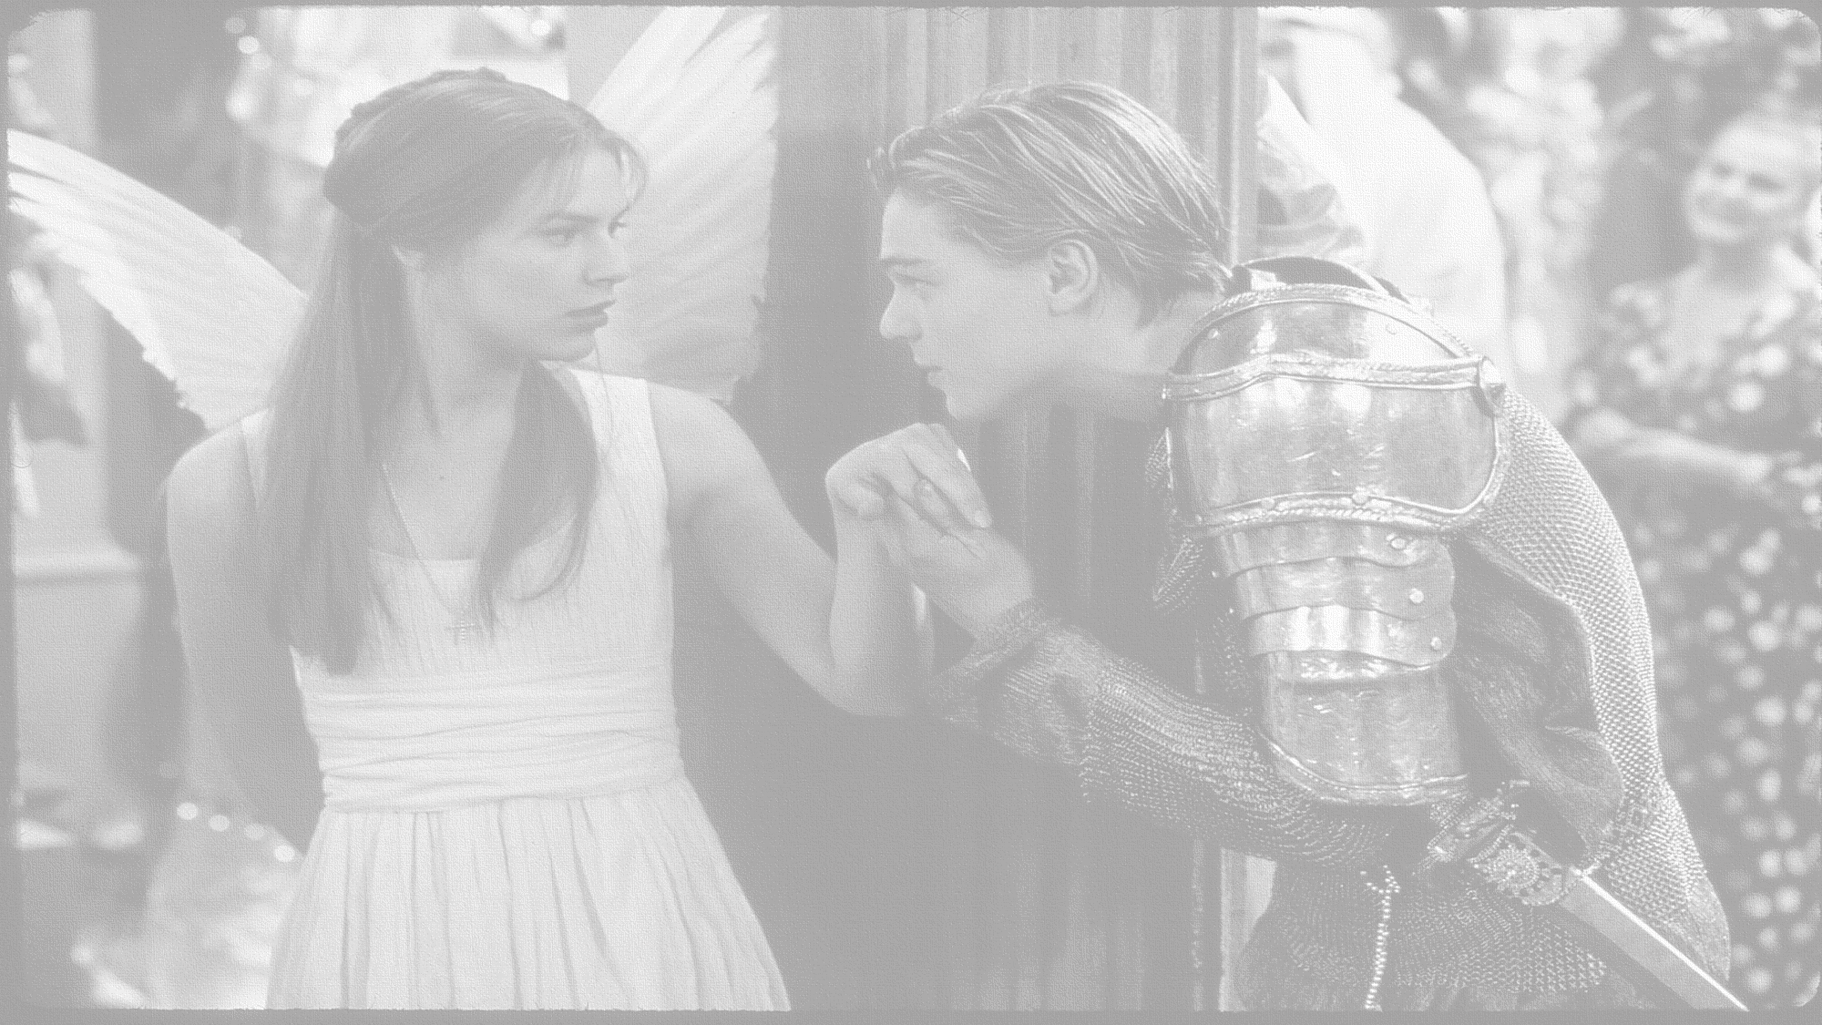
How does Shakespeare present the deaths of Mercutio and Tybalt?
In this lesson you will be mastering the following:
To explore the use of violence and atmosphere.
To explain how Shakespeare uses techniques to create tension.
To re-cap and revise the events so far.
Learning Content
Notes:
This – as with all aspects of the lesson – can be edited to suit your group.

Slide 6
Let’s read!
Act 3 scene 1
Benvolio:
Mercutio:
Tybalt:
Romeo:
Officer:
Prince:
Lady Capulet:
Montague:
Discussion
How seriously should we take Romeo’s new found love for Juliet?
Does his language suggest that he is now genuinely in love, or is this just another infatuation?
What evidence do we have to link this to?
Reading task
Learning Objectives:
AO1: use textual references, including quotations, to support and illustrate interpretations.
AO2: Analyse the language used by a writer to create meanings and effects.

Slide 7
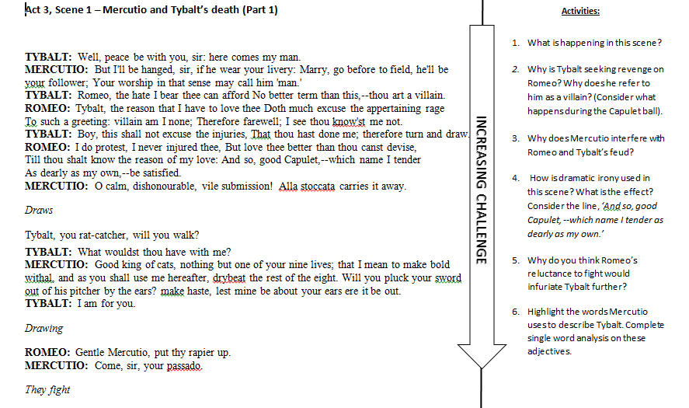
Mastery
Learning Objectives:
AO1: use textual references, including quotations, to support and illustrate interpretations.
AO2: Analyse the language used by a writer to create meanings and effects.

Slide 8
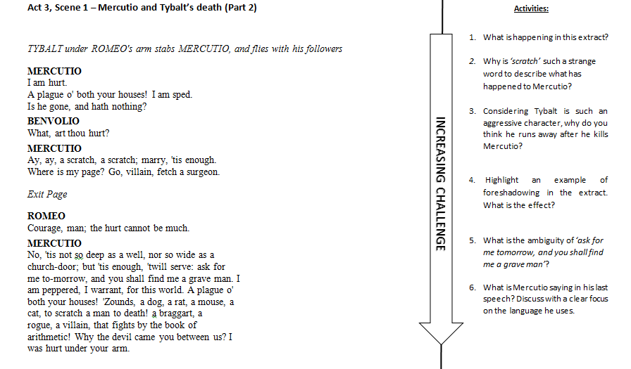
Mastery
Learning Objectives:
AO1: use textual references, including quotations, to support and illustrate interpretations.
AO2: Analyse the language used by a writer to create meanings and effects.

Slide 9
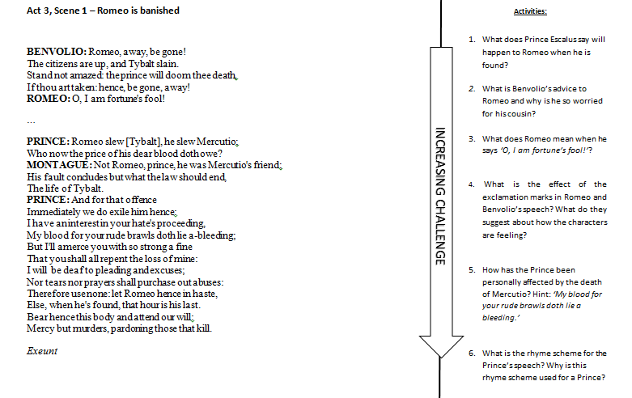
Mastery
Learning Objectives:
AO1: use textual references, including quotations, to support and illustrate interpretations.
AO2: Analyse the language used by a writer to create meanings and effects.

Slide 10
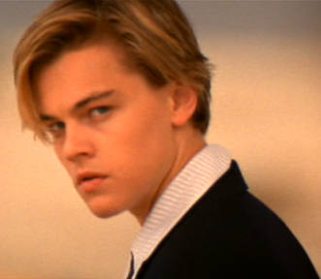
What were they thinking? What is going through the minds of these characters in the fight scene?
Tybalt
Mercutio
Romeo
Consolidating learning
Benvolio
Learning Objectives:
AO1: Use textual references, including quotations, to support and illustrate interpretations.
AO2: Analyse the language, form and structure used by a writer to create meanings and effects.

Slide 11
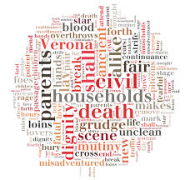
Homework
Write a letter to Juliet as if you were Romeo. Write about your thoughts and feelings and the events of the day.
Homework
Notes:
Homework is optional - Print off this slide to give out as homework.

