Slide 1
Key Stage 3 Culture Poetry
LO: To identify what culture is and begin to explore what is important to people in these cultures.
ST: I can carefully examine in detail how it is used in poetry.

Slide 2
So what do you know about poetry?
Think about what you know about poetry. Spider diagram your thoughts and ideas on what poetry is.
DO NOW!

Slide 3
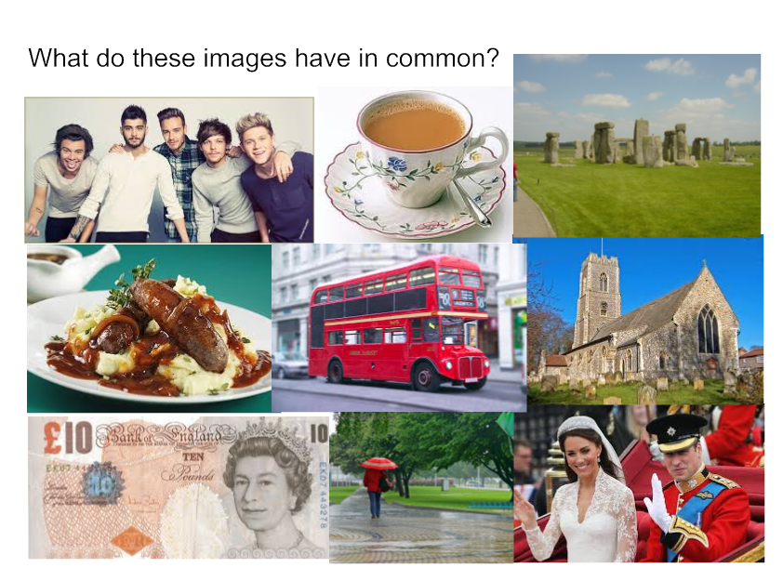
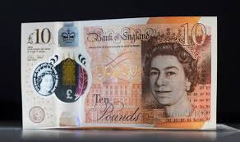
Thinking task

Slide 4
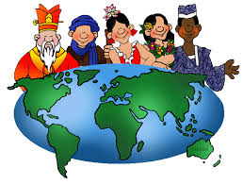
Learning context
What is
CULTURE?
Today, we will:
identify a range of different cultures
begin to explore what is important to the people in these cultures.
The behaviours and beliefs characteristic of a particular social, ethnic, or age group.

Slide 5
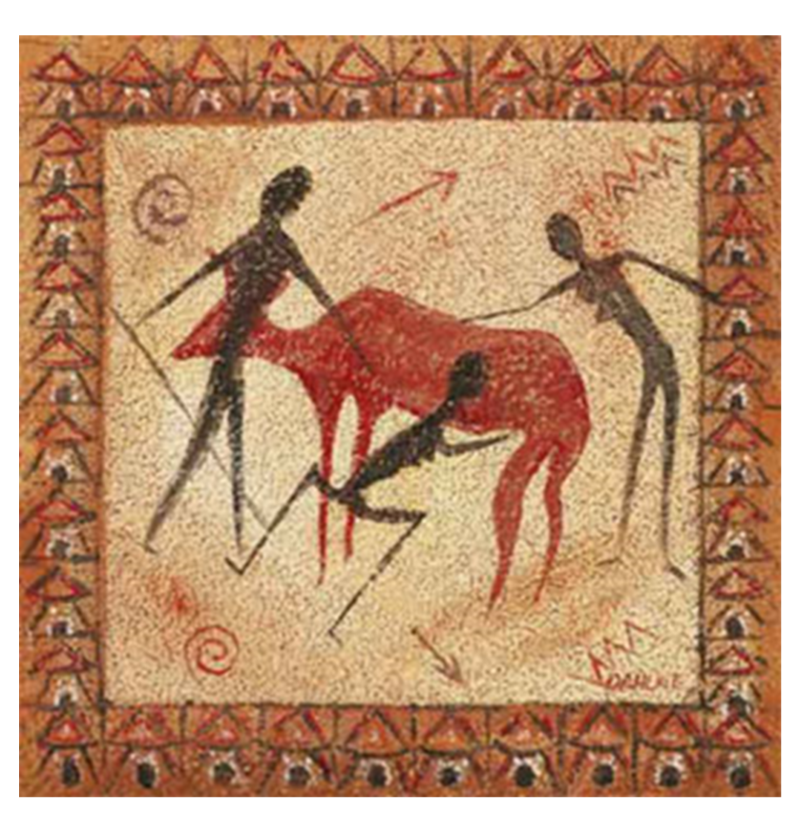
Thinking task
What sort of culture is this?
What seems to be important in this culture?

Slide 6
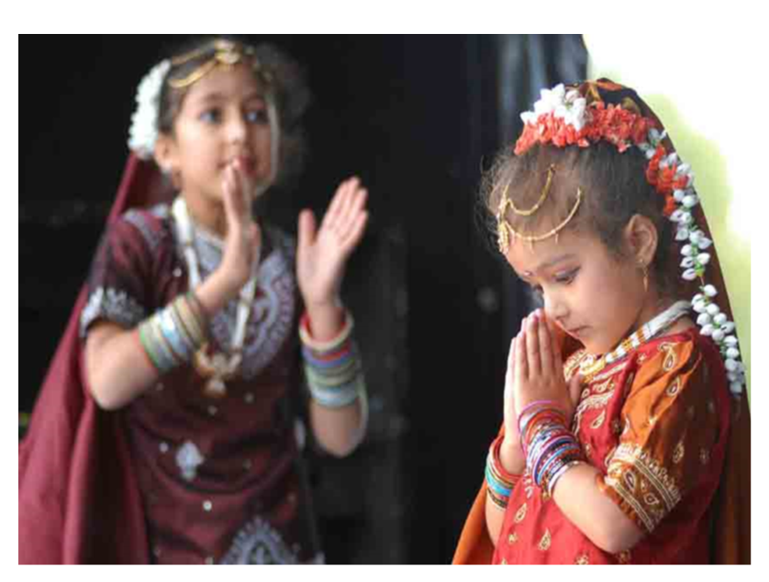
Thinking task
What sort of culture is this?
What seems to be important in this culture?

Slide 7
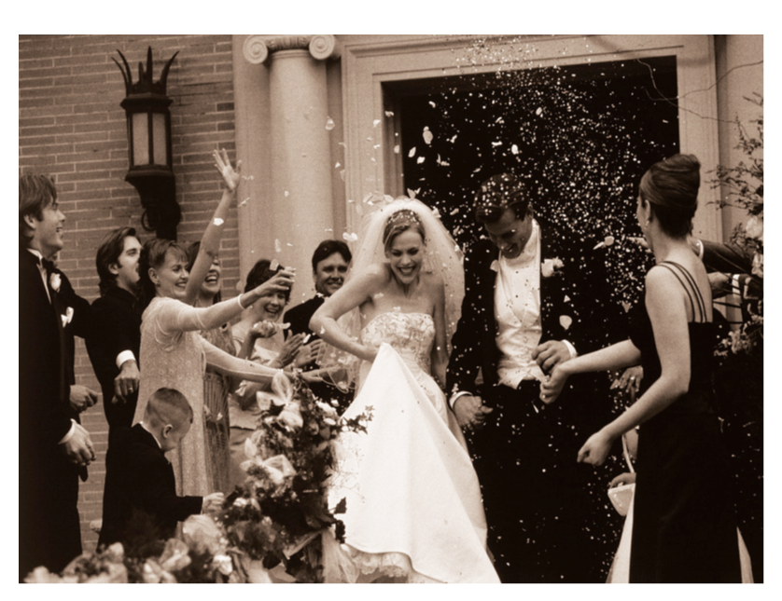
Thinking task
What sort of culture is this?
What seems to be important in this culture?

Slide 8
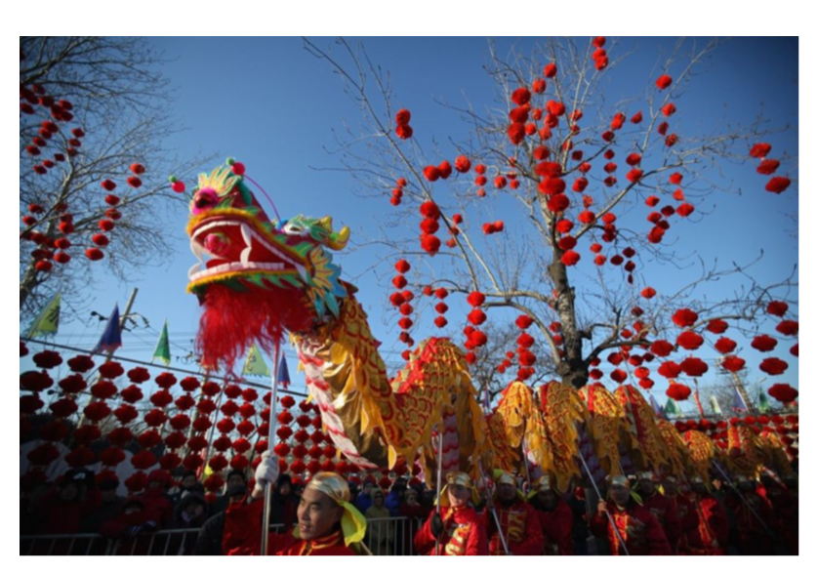
Thinking task
What sort of culture is this?
What seems to be important in this culture?

Slide 9
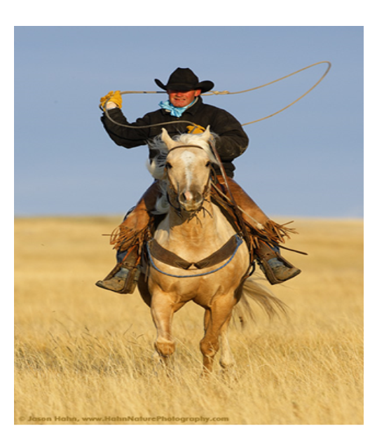
Thinking task
What sort of culture is this?
What seems to be important in this culture?

Slide 10
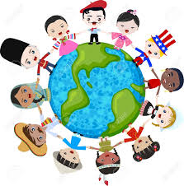
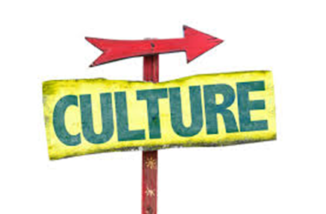
Mastery
WHAT IS
CULTURE?
Task 1: Answer these questions in a mind- map.
Language?
Traditions?
Environment?
Food & drink?
Hobbies?
Beliefs?
Celebrations?
What are the features of YOUR culture that are most important to you?
Illustrate some of your ideas!

Slide 11
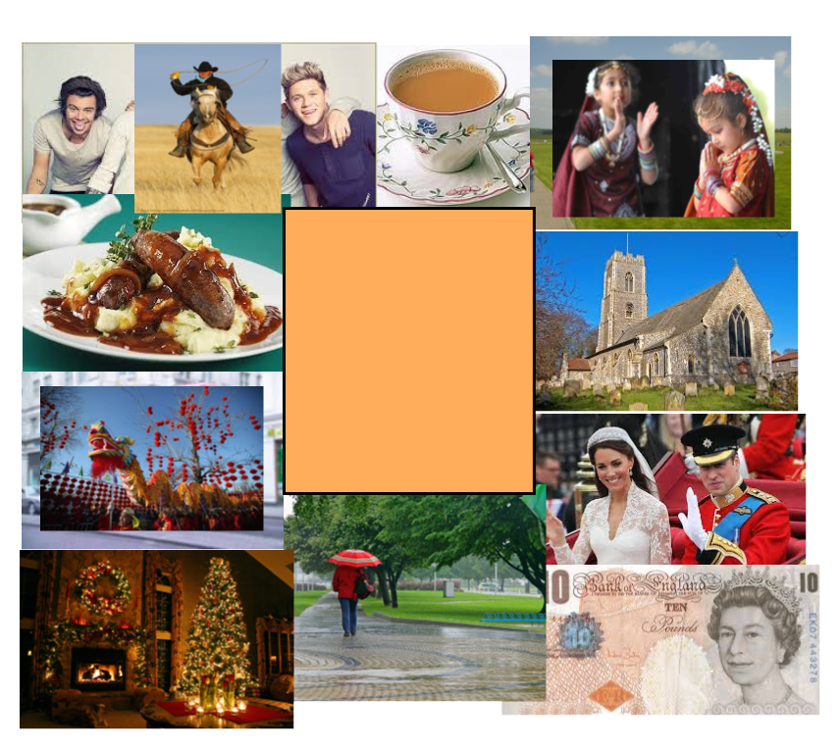
Homework
HOMEWORK:
Create a visual collage of images with an explanation OR prepare a spoken presentation based on your individual CULTURAL IDENTITY.

