Slide 1
Language paper 1 Section B Narrative Writing LO: To develop your narrative skills in response to a written prompt. ST: I can achieve AO5

Slide 2
Starter: What Makes an Interesting Story? Take a look at the quotations below. What do they tell us about telling tales? Why do you think stories are important? Discuss these questions with a partner and be ready to feedback your ideas to the class. “It's like everyone tells a story about themselves inside their own head. Always. All the time. That story makes you what you are. We build ourselves out of that story.” ― Patrick Rothfuss “After nourishment, shelter and companionship, stories are the thing we need most in the world.” ― Philip Pullman “Most of the basic material a writer works with is acquired before the age of fifteen.” - Willa Cather “Artists use lies to tell the truth. Yes, I created a lie. But because you believed it, you found something true about yourself.” ― Alan Moore

Slide 3
Task One: What are the different elements needed to create an interesting short story? Complete the mind map below with your ideas:
Interesting narratives

Slide 4
Task 2: In pairs read the beginning of the story on your handout. Highlight features that you think have made it an effective start to a short story. If you find something you haven’t yet considered, add it to your mind map.
Can I have 3 volunteers to read their story opening out to the class. What did you think was good about it?

Slide 5
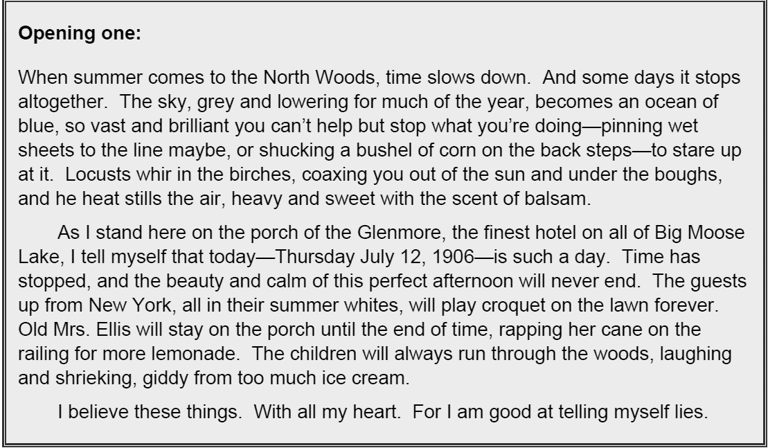

Slide 7
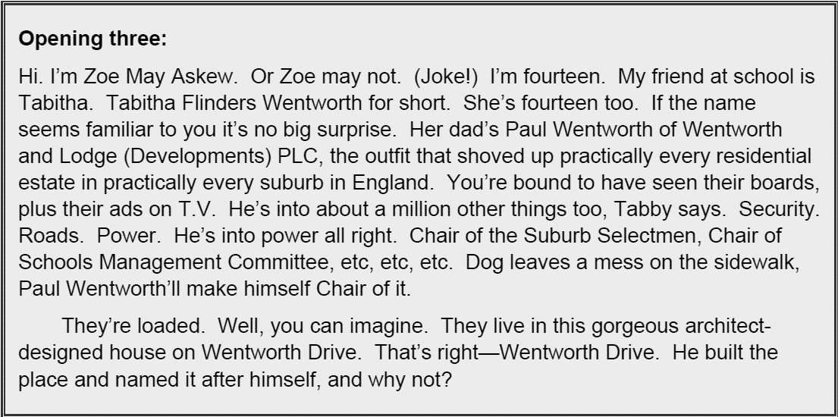

Slide 8
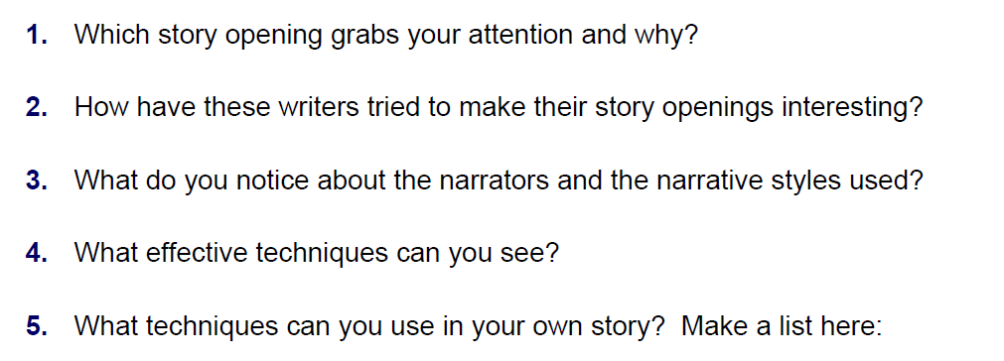
Use these questions to help you identify what is good about it.

Slide 9
Good Beginnings
Talk to the reader – use first person narrative
Shock your reader
Create a tense atmosphere
Start with something odd
Use direct speech
Start in the middle of something
Make your reader laugh
Create a very clear picture

Slide 10
Story Openings
Below are the very first sentences from various children’s novels. Look at each example of an opening sentence and discuss whether or not it would interest you as a reader. Then think about what the author has done to ‘hook’ you into his/her book. Identify and match the ‘Good Beginning’
‘Yes,’ said Tom bluntly, on opening the front door. ‘What d’you want?’
Not for the first time, an argument had broken out over breakfast at number four, Privet Drive.
It was a dark, blustery afternoon in spring, and the city of London was chasing a small mining town across the dried-out bed of the North Sea.
Once, there were four children whose names were Peter, Susan, Edmund and Lucy.
Once I was living in an orphanage in the mountains and I almost caused a riot.
It was 7 minutes after midnight.
If your teacher has to die, August isn’t a bad time of year for it.
In the light of the moon lay a little egg on a leaf.
There is no lake at Camp Green Lake.
My name is Francis Joseph Cassavant and I have just returned to Frenchtown in Monument and the war is over and I have no face.
Kidnapping children is never a good idea; all the same, sometimes it has to be done."
‘Where’s Papa going with that axe?’ said Fern to her mother as they were setting the table for breakfast.

Slide 11
Sentence Lengths
Read the following extract:
The attic door creaked open. Something rustled in the darkness. I stared, but could see nothing beyond the vague shapes of old suitcases and trunks piled high. It smelt damp. I struggled up into the attic and wedged the door open. Light poured into darkness. The darkness in the head of the house. I balanced carefully upon the floor beams. I knew that if I stepped onto plaster I could fall straight through into the room below. A cobweb brushed my face and I felt the sudden tickle of a spider crawl across my cheek. As I made my way forwards, it grew darker and colder. I was blocking the light from the attic door. There were piles of old newspapers, brown bags tied with string cardboard boxes and ancient, moth eaten rugs that smelt of mothballs. Thick dust powdered every surface. I kept thinking that I could slip and put my foot through the floor. I stopped at a pile of old camping equipment. It was a jumble of guy ropes, torn canvas, poles, wooden pegs, metal skewers and a mallet. It was there that I saw the hand. It was quite still and white, like a marble. But then it moved.
What do you notice about the sentence lengths? Why are they important?
What atmosphere is created in the passage? How does the writer build tension?
What other techniques does the writer use to create the atmosphere?

Slide 13
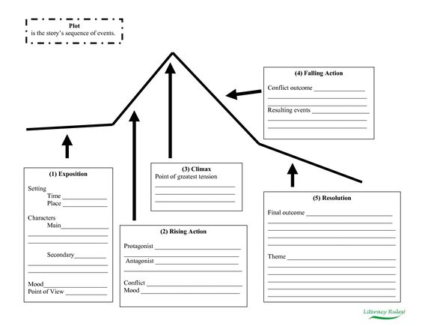

Slide 14
More theory! There are only 7 possible storylines.
Overcoming the monster – Dracula. War of the Worlds, Harry Potter
Rags to riches – Cinderella, Aladdin, Brewster’s Millions
The quest – The Lord of the rings, Indiana Jones
Voyage and return – Alice in Wonderland, Finding Nemo, The Wizard of Oz
Comedy – Bridget Jones, Sliding Doors, Mr Bean
Tragedy – Macbeth, Romeo and Juliet, Breaking Bad
Rebirth – A Christmas Carol, Beauty and the Beast, Despicable Me
Can you name at least ONE more well known book or film that fits each storyline?

Slide 15
ELEVEN WAYS TO START A SENTENCE:
An article: The man strode along the street.
A noun: Rain pelted him from above.
A pronoun: He pulled up his collar against the cold.
His shoes slapped against the wet sidewalk.
A participial phrase: Walking up the street, he tripped.
A conjunction: But then he drew a deep breath and gathered his strength.
Either he would complete his journey, or he would die trying.
An adverb: Determinedly, he trudged upward.
An adjective: Upset by all he’d endured, he tramped towards the hill’s peak.
A prepositional phrase: At the top of the road, he paused.
An infinitive phrase: To pour out his emotions to the town below was his goal.
A gerund: Screaming seemed to be the only answer.
An interjection: Oh, he thought, if only I could make the world understand.
Notes:
An infinitive = It is a verb that acts as and adjective/ adjective/ adverb always has to in front of it.
An article =a word used to modify a noun, which is a person, place, object, or idea. Technically, an article is an adjective, which is any word that modifies a noun.

Slide 16
When you write for section B in your exam, AO6 will test your range of vocabulary, sentence structure – for clarity, purpose, effect - and how accurate your spelling and punctuation is.
Using dialogue: How many synonyms can you find for ‘said’? Write down as many as you can. These are called dialogue tags.

Slide 17
Extension: Continue the story from the sentence length task or one form the handout .
The attic door creaked open. Something rustled in the darkness. I stared, but could see nothing beyond the vague shapes of old suitcases and trunks piled high. It smelt damp. I struggled up into the attic and wedged the door open. Light poured into darkness. The darkness in the head of the house. I balanced carefully upon the floor beams. I knew that if I stepped onto plaster I could fall straight through into the room below. A cobweb brushed my face and I felt the sudden tickle of a spider crawl across my cheek. As I made my way forwards, it grew darker and colder. I was blocking the light from the attic door. There were piles of old newspapers, brown bags tied with string cardboard boxes and ancient, moth eaten rugs that smelt of mothballs. Thick dust powdered every surface. I kept thinking that I could slip and put my foot through the floor. I stopped at a pile of old camping equipment. It was a jumble of guy ropes, torn canvas, poles, wooden pegs, metal skewers and a mallet. It was there that I saw the hand. It was quite still and white, like a marble. But then it moved.

