Slide 1
Language paper 1: question A2
LO: To understand the assessment objectives in the language papers. ST: I can identify the aim of assessment.

Slide 2
Language paper 1, question 2 tests:
AO2: Explain, comment on and analyse how writers use language and structure to achieve effects and influence readers.
You must use analysis: explaining in detail – possibly offering more than one interpretation.
You must use subject terminology: the specialised words to describe language use – e.g. simile, metaphor and complex sentence.

Slide 3
Starter: Read this sentence. Write it down.
The old horse was munching thoughtfully on his oats.
Identify:
Two nouns
A verb
An adjective
A preposition
An adverb

Slide 4
Task: Semantic field?
A semantic field is a set of words related in meaning. They all have a relationship which creates an overall impression.
Can you state a semantic field for the next three groups of words?
Passion, affection, adoration, heart.
Indigo, navy, aquamarine, turquoise.
Chivalry, bravery, honour, courage

Slide 5
Task: Read this an extract from To Kill a Mockingbird, 1960.
Maycomb was an old town, but it was a tired town when I first knew it. In rainy weather, the streets turned to a red slop; grass grew on the sidewalks, the courthouse sagged in the square. Somehow, it was hotter then: a black dog suffered on a summer’s day; bony mules flicked flies in the sweltering shade on the square. Men’s stiff collars wilted by nine in the morning …
Find an example of onomatopoeia
Find an example of alliteration
Can you comment on emotive language?
Choose a powerful verb used by the writer
High-light and annotate your extract.

Slide 6
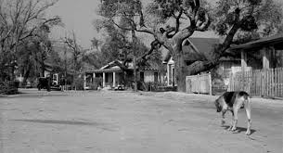
Exam practice – question A2: Explore the ways the writer has used language to set the scene?
Remember to use
P
E
T
E
R
Can you zoom in on to an individual word and extend your idea?
POINT
EVIDENCE
TERMINOLOGY
EFFECT/EXPLAIN
READER

Slide 7
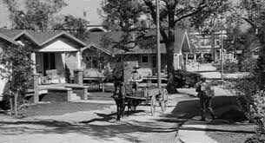
Task: Write a detailed response to the question – How has the writer used language to set the scene? Aim for at least TWO paragraphs! P.E.T.E.R.

Slide 8
Peer assessment: Swap your answer with a partner and critique their answer. Use green pen to write your feedback.
Have they used P.E.T.E.R. (Point, Evidence, Terminology, Effect/Explanation, Reader)
Have they used specific subject terminology i.e. verbs, adjective, complex sentence etc. and explained their effect?
Does their response explore and explain the language choices?
GIVE CONSTRUCTIVE FEEDBACK explaining what they have done well and how they can improve – use some of the sentence starters from the sheet.

Slide 9
Plenary: Share your best paragraph with the class.

