Slide 1
Language Paper 1 Question 1 LO: To understand the assessment objectives in the language paper. ST: I can identify the aim of the assessment.

Slide 2
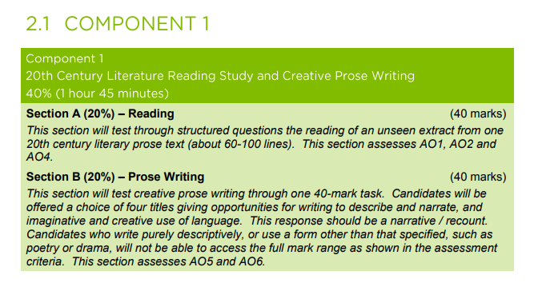
This is a summary of the assessment for Language paper 1.

Slide 3
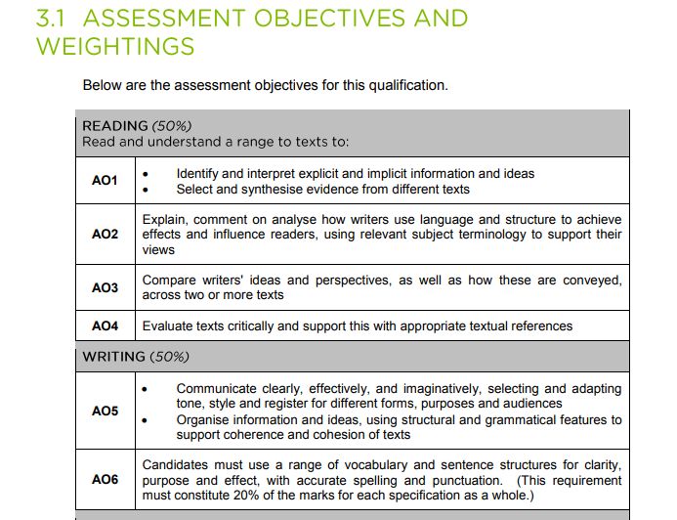

Slide 4
How is the paper set out?
A1 – Read between lines 1---? (Usually 5-10 lines only): LIST 5 THINGS YOU LEARN ABOUT… (5 Marks)
A2 – Read between lines 8-34 (Usually 20-25 lines only): HOW DOES THE WRITER SHOW …? (5 Marks) – close analysis of language is needed here!
A3 – Read between lines 35-45 (Usually 20-25 lines only): HOW DOES THE WRITER SHOW …? (10 Marks)
A4 – Read between lines 35-45 (Usually a larger section 35-45 lines only): WHAT IMPRESSIONS DO YOU GET OF …? (10 Marks)
A5 – Refer to the whole of the text. EVALUATE THE WAY …? (10 Marks)
You MUST use quotes to answer all questions!
SECTION A = 40 MARKS

Slide 6
Explicit details
Examiner tip
Question 1 will never be a trick question. It is perfectly acceptable to write down obvious points
These are details clear to all – five things/ five points revealed – five things you are sure of
You must write in full sentences: You can use your own words (paraphrase) AND/OR use quotations from the source to reinforce your answer.
Implicit details
These are details that are suggested or implied
If you are dealing with an interpretation of implicit information, it is always best to support your statement with a quotation

Slide 7
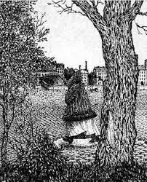

Slide 8
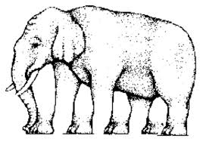

Slide 9
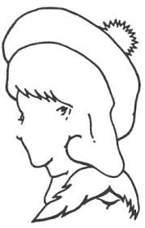

Slide 10
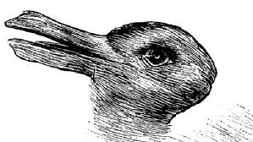

Slide 13
Q1 Finding relevant details
Paper 1 Section A (based on an extract from a 20th Century modern novel)
Question 1 is worth 5 marks
You will have to find five details in the source and list them.
Examiner tip
You will be asked about the opening section of the source – only refer to that section or your points will not be accepted.
AO1: Identify and interpret explicit and implicit information and ideas. Select and synthesise evidence from different texts.

Slide 14
Assessment Objective 1: Use the extracts on the slides that follow and complete the activities. Remember…
List five things …
Identify explicit information
Identify explicit ideas
YOU MUST WRITE IN FULL SENTENCES!

Slide 15
Extract 1: Frankenstein, Mary Shelley - list five things we learn about the creature from the extract below: I saw the dull yellow eye of the creature open; it breathed hard, and a convulsive motion agitated its limbs. How can I describe my emotions at this catastrophe, or how delineate the wretch whom with such infinite pains and care I had endeavoured to form? His limbs were in proportion, and I had selected his features as beautiful. Beautiful! – Great God! His yellow skin scarcely covered the work of muscles and arteries beneath; his hair was of lustrous black, and flowing; his teeth of a pearly whiteness; but these luxuriances only formed a more horrid contrast with his watery eyes, that seemed almost of the same colour as the dun white sockets in which they were set, his shrivelled complexion, and straight black lips.
The creature had ‘dull yellow eyes’.
It ‘breathed hard’.
It started moving; ‘agitated its limbs’.
It had yellow skin that was very thin: ‘Scarcely covered the work of muscles.’
It had black hair.
It had white teeth: ‘pearly.’
It had ‘straight black lips.’

Slide 16
Extract 2: Cider with Rosie, Laurie Lee – List five things we learn about Mother in the extract below: When she moved into his tiny house in Stroud, and took charge of his four small children, Mother was thirty and still quite handsome. She had not, I suppose, met anyone like him before. This rather priggish young man, with his devout gentility, his airs and manners, his music and ambitions, his charm, bright talk, and undeniable good looks, overwhelmed her as soon as she saw him. So she fell in love with him immediately, and remained in love for ever. And herself being comely, sensitive, and adoring, she attracted my father also. And so he married her. And so later he left her - with his children and some more of her own.
She lived in Stroud
She was thirty
She was handsome
She fell in love immediately and remained in love
She was comely
She was sensitive
She was adoring
She had children

Slide 17
Extract 3: A Wanted Man, Lee Childs – List five things that Jack Reacher does in the extract below: Jack Reacher rode for ninety nine miles and ninety minutes with a woman in a dirty grey van, and then he saw bright vapour lights up ahead at the highway Cloverleaf, with big green signs pointing west and east. The woman slowed the van, and stopped, and Reacher got out and thanked her and waved her away. She used the first ramp, west towards Denver and Salt Lake City, and he walked under the bridge and set up on the eastbound ramp, one foot on the shoulder and one in the traffic lane, and he stuck out his thumb and smiled and tried to look friendly.
Jack Reacher had been travelling for ninety nine miles
He had been travelling for ninety minutes
He left the van and thanked the woman
He walked under a bridge
He stood on the eastbound carriageway of a motorway
He thumbed a lift
He smiled and tried to look friendly

Slide 18
Extract 4: Stone Cold, Robert Swindells – List five things that effect Link on the streets: My anonymity was a comfort – at least I wasn’t going to be seen by people who knew me. Also, I was one among many. My plight could have no curiosity value for anybody who might spot me. And there was no further need to fret about next week’s rent. I felt – free, I suppose. This was before I became acquainted with some of the setbacks, like hunger pains and real cold and the problem of what to do when you have to go to the lavatory and guard your bedroom at the same time. It was this last one which got to me first and lost me my doorway and more besides.
He had hunger pains
He felt the cold
He found it difficult to find somewhere to use a lavatory
He had to guard a doorway to use as a bedroom
He could stay anonymous and wouldn’t be recognised by people he knew

Slide 19
Extract 5: Heroes, Robert Cormier – list five things about Lawrence LaSalle: Lt. Lawrence LaSalle, US Marine Corps, holder of the Silver Star for acts of heroism in the steaming jungles of Guadalcanal in the South Pacific, hero of newsreels and radio broadcasts, was coming home on furlough. He was scheduled to arrive on the 3.10p.m. train from Boston on 3 July 1943.
He was a Lieutenant in the Marines
He held a Silver Star medal for heroism
He had served in the South Pacific
He was coming home on furlough
He was due to arrive by train on 3rd July at 3.10pm

Slide 20
Plenary: Write the success criteria for answering question 1, Language paper 1

