Slide 1
Monday, 14 December 2020
Language Paper 2 – Non Fiction. Revision of skills:
Niagara falls
Question paper.
Make sure you have everything you need before you start.
Skim through the ppts first to get an idea of the task.
Information in red is to remind/explain how to go about answering the questions.
Note the marks available for each question and the success criteria (the bullet points)
NB = a note to help/explain.
This is the most difficult/most marks available paper – you will need to fully focus on these lessons and take the allotted time to complete.

Slide 2
Paper 2 Non-Fiction 5-8mins
Monday, 14 December 2020
You need: planner, equipment, highlighter
Lang P2 exercise book, dictionary/thesaurus,
Question paper and resources
Highlighter, equipment, reader
DAFOREST and Structural/ linguistic techniques information.
This paper requires a lot of focus and concentration – get organised before you begin.

Slide 3

Starter: Paper 2 Non-Fiction 5-8mins
Monday, 14 December 2020
You need: planner, equipment, exercise book, dictionary/thesaurus, Antarctic Adventure and questions, highlighter, DAFOREST linguistic techniques information.
Starter: find meaning/synonyms for:
AND/OR: Remind yourself of: DAFOREST – writing techniques

Slide 4





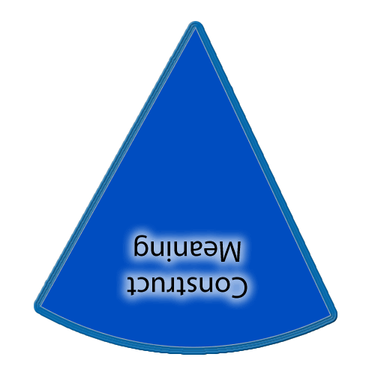
There is also a slide in each of the sections with a set of yellow boxes should you want to display learning outcomes throughout the lesson.
If you want to show on this slide only you can draw a text box and write in it. Alternatively creating a text box in the master view allows for easier duplication.
Copies of the ‘cheeses’ if you want them additionally to what is in the slide masters.
This timer (it’ll show on slideshow mode) can be copied and pasted on to any slide.

Slide 5
Learning outcomes
.
Paper 2 - 19th and 20th Century Non-fiction. 2hrs, 60%
Section A – Reading of 2 articles and answering questions about them, including comparing them. 30% 40 marks, 1 hour
Section B – Writing of 2 tasks (letter, diary, review, speech, article etc) 30% 40 marks, 1 hour.
Tip:
Section A – look for the techniques and explain the effect.
Section B- include the techniques to create an effect.
Refer to your mark scheme.
.
Refer to and use:
DAFOREST /HITS etc.
Notes:
Teachers explicitly share the purpose of the lesson/s with their students so that the students are in no doubt as to what is expected of them during the lesson. The teacher will:
Make the content, skills and thinking explicit
State clearly what the students will have learned by the end of the lesson
Share the criteria against which the learning will be assessed.
Students will be able to answer the key questions:
What are you learning?:
Why are you learning this?
How will you know if you are doing this well?
WAGOLL:
Success Criteria:

Slide 6
Lesson 2- Article
Read the article then answer:
Question A1 and A2- work through the following slides to answer these questions.

Slide 7
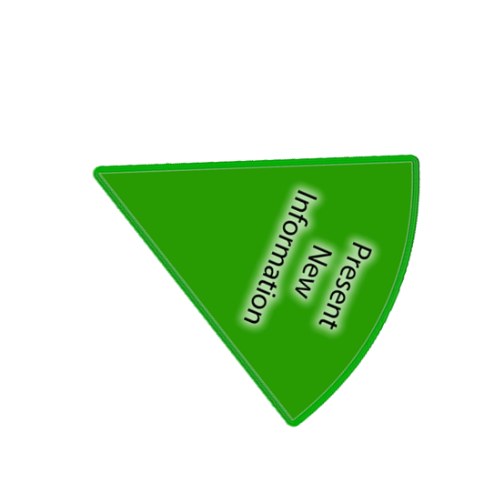
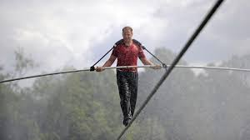
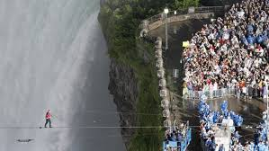
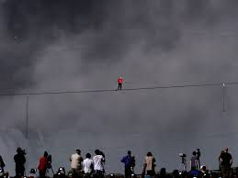
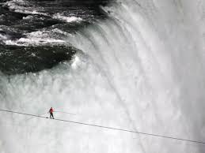
Niagara Falls
How would they feel? Spectators?
Add vocabulary to describe this experience including all the senses

Slide 8
Niagara Falls
How would they feel?
Add vocabulary to describe this environment including all the senses
https://www.youtube.com/watch?v=pK_oW62-zrc

Slide 9
The article – 10mins
Skim read the whole of the article- include title.
Answer question A1 a, b and c – the (1) mark questions.

Slide 10
Success Criteria for AO2
Explain
Comment on
Analyse:
HOW the writer uses language, structure.
Explain the effect (of the technique)
Include subject terminology.

Slide 11
A2 How does the writer of the newspaper article try to show that Ben Fogle’s expedition to the South Pole was full of danger and difficulty? (10marks)
Underline the important words in the question – what you have to do, who or what you are looking for.
You should comment on: (you WILL)
What he says
His use of language, tone and structure. What does this mean?
WHO is the question referring to? Whose language etc?
10 marks available.

Slide 12

A2 How does the writer of the newspaper article try to show that
You should comment on: (you WILL)
What he says (the writer)
His use of language, tone and structure
Highlight anything else that tells us about danger and difficulty.
Identify if they are any of these?
D
A
F
O
R
E
S
T
Success Criteria:
Explain
Comment on
Analyse HOW the writer uses language, structure.
Explain the effect
Include subject terminology. (AO2)

Slide 13
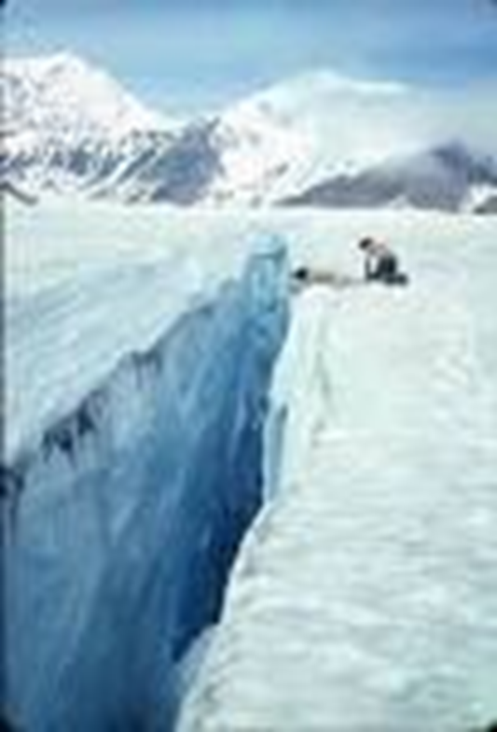
I
IT WAS the moment when Ben Fogle thought he
was going to die. The television presenter and his
fellow adventurers, James Cracknell and Ed Coats,
were deep into their gruelling expedition to the South
Pole when they realised they had strayed on to a giant
crevasse. This was a huge crack in the ice, hidden from
view by a thin cover of snow and ice.
“We were walking,” Fogle said, “when suddenly I
heard a loud boom, then another one. I realised it was
the sound of snow falling into a crevasse.”
“We had been told that there were no crevasses on
our route but I could feel the snow shifting beneath me.
“Crevasses can be a mile deep and I was terrified that
I would be dragged down. I thought, ‘I could die here’.
My mouth went dry and I started to panic.”
Fortunately, Fogle, 35, and his colleagues managed
to calm themselves enough to navigate out of danger.
The team was one of a number competing in a race to
the South Pole. They eventually finished second behind
two Norwegians.
NB: the colours of each feature match the article
Select the:
Vocabulary
Structure
Identify the tone: fearful, serious, terror
Which tells us that this trip is dangerous and difficult.
Continue through the
Article to find the rest.

Slide 14
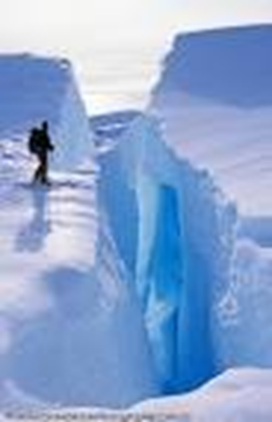
I
A2 How does the writer of the newspaper article try to show that Ben Fogle’s expedition to the South Pole was full of danger and difficulty?
.
Starter: The article has a dramatic opening sentence with the writer David Harrison, stating that he (Ben Fogle) thought ‘he was going to die.’ Immediately we are drawn in and recognise that this was a dangerous and difficult expedition. The verb ‘to die’ emphasises how it could be potentially fatal if things went wrong. The reader is …………
Success Criteria: (AO2)
Explain
Comment on
Analyse HOW the writer uses language, structure.
Explain the effect
Include subject terminology.
6/7 quotations/examples

Slide 15
Lesson 3 - Scott’s Diary
Read the Scott diary then answer:
Question A3 and A4

Slide 16

Scott’s diary-quick 1 mark questions
Skim read the whole of Robert Scott’s diary-include italics.
Answer question A3 a,b, and c – the (1) mark questions

Slide 17
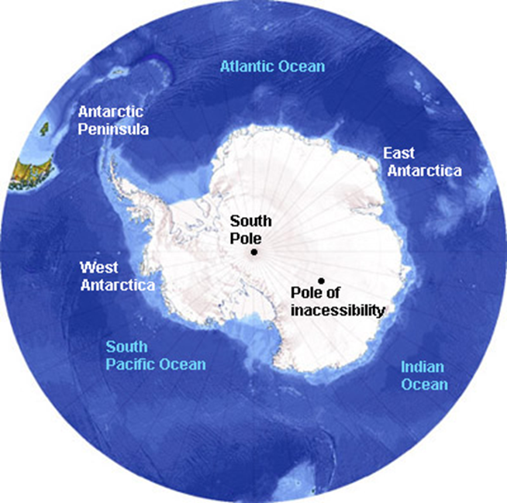
Robert Scott’s Diary
A4 How well do you think Scott’s diary captures his feelings about his journey to the South Pole?
Underline the important words in the question – what you have to do, who or what are you looking for?
You should comment on: (you WILL)
What his feelings are about the expedition over the three diary entries
How well you think his diary makes his feelings clear?
WHO is the question referring to? WHAT does a writer use to convey meanings? Clue: L & S.

Slide 18
Robert Scott’s Diary
A4 How well do you think Scott’s diary captures his feelings about his journey to the South Pole?
Underline the important words in the question – what you have to do, who or what are you looking for?
You should comment on: (you WILL)
What his feelings are about the expedition over the three diary entries
How well you think his diary makes his feelings clear?
WHO is the question referring to? WHAT does a writer use to convey meanings? Clue: L & S.

Slide 19
Lesson 3 & 4- Comparing BOTH texts.
Do question A5 and A6 together – you are finding things that are the same and/or different in each article.
Print out the comparison table OR produce a simple one of your own – quickly.
Read ‘How to approach the compare question – there is a step by step formula which may help. Read this and follow it.
You need BOTH texts side by side – draw out ALL the similarities and differences before you begin to answer using 6/7 of these things.
Lesson 3: PREPARE your answer – have a break – then Lesson 4 Write your answers to A5 and A6

Slide 20
Both texts:
A5 Explain what we learn about the food Scott and Fogle took with them on their expeditions to the South Pole. (4marks)
Underline the important words in both questions – what you have to do, who or what are you looking for?
A6. Both of these texts are about expeditions to the South Pole.
Compare:
The hardships Scott and Fogle endured on their expeditions;
How Scott and Fogle get their feelings about the hardships across to the readers. (10)
WHAT does a writer use to convey meanings? Clue: L & S.

Slide 21
Both texts:
A5 Explain what we learn about the food Scott and Fogle took with them on their expeditions to the South Pole. (4marks)
Underline the important words in both questions – what you have to do, who or what are you looking for?

Slide 22
Both texts:
A6. Both of these texts are about expeditions to the South Pole.
Compare:
Underline the important words in the question – what you have to do, who or what are you looking for?
Comparison of: | Fogle | Scott
Hardships
Feelings conveyed:
WHAT does a writer use to convey meanings? : Language & Structure.

Slide 23
Print out or produce one of your own
Comparison of: | Fogle | Scott
Hardships
Feelings conveyed:
A6. Both of these texts are about expeditions to the South Pole.
Compare:
Underline the important words in the question – what you have to do, who or what are you looking for?
WHAT does a writer use to convey meanings? : Language & Structure.

Slide 24
How to approach the compare question:
WHAT does a writer use to convey meanings? Clue: Language (L) & Structure (S).
The Formula: (This assumes you have read and understood the two articles.)
1. Underline the important words in the instructions/question (do and look for).
Write ON the extract: Structure-p/gs, punctuation etc and Lang-DAFOREST
2. Identify the aspects of language and structure that relate to what you have underlined.
(N.B. you have already found differences in food in A5- use here!)
3. Then write BRIEFLY what this means/shows.
Jot down comparative language: whereas, similarly, on the other hand etc
THEN: write your answer in the style of: PETER
4. Select the first highlighted aspect and begin to write in the PETER format 6/7 times – be concise and clear. Then the next and so on throughout the text from the beginning to the end.
You have about 13 minutes to answer this question in the exam- clear and concise 6/7 quotes.

Slide 25
How to approach the compare question:
Example:
Both of these texts show the hardships and difficulties of expeditions to the South Pole. However Ben Fogles’ experiences are documented in a newspaper article in the form of an interview which he reflected on after the event whereas Robert Scott, presents his feelings, over three consecutive days, in the diary which he wrote during the expedition.
What has this introduction done? Would you expect a difference in attitude/tone because of the time of writing these texts?
The hardships suffered by both were very similar, Scott reported in his diary ‘howling blizzards’ indicating both the strength and the noise, the adjective ‘howling’ perhaps reflecting the sound of the dogs or another animal-like noise creating a fearful image. Ben Fogle also talks about storms and ‘white-outs’ illustrating how their visibility would be seriously affected.
What senses have been referred to? How does this add to the effect? Which bullet point is being addressed?
In the first diary entry there is a build up of the situation, Scott uses a simple and straightforward sentence to paint the picture of the ‘drifts’, followed by a long complex sentence indicating the length of time they have been in this situation. The description ends with a simple sentence ‘…very, very wet.’ This further reinforces the unpleasantness of their plight.
What techniques have been commented on here?

Slide 26
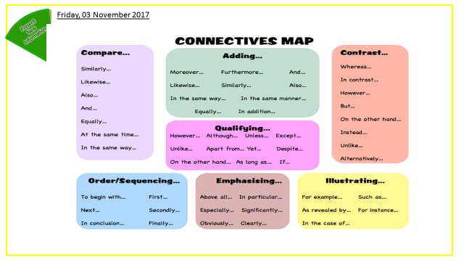
Notes:
Print out or refer to for the language to compare and contrast.

Slide 27
Both texts:
A6. Both of these texts are about expeditions to the South Pole.
Compare:
Underline the important words in the question – what you have to do, who or what are you looking for?
Comparison of: | Fogle | Scott
Hardships
Feelings conveyed:
WHAT does a writer use to convey meanings? : Language & Structure.

Slide 28
Review
What have you learnt?
How have you learnt it?
What is the value?
You may check some of your answers from the following slides. Add in a different coloured pen.
Complete the review sheet attached.
You have developed reading skills by answer the questions.
Writing skills by answering 10 mark questions as PETER paragraphs.

Slide 29
The answers
A1
a – He had walked on to a dangerous crevasse.
b- 16 hours a day
c- Listened to Andrew Marr’s History of the Modern Britain’

Slide 30
Some possible answers:
I
A2 How does the writer of the newspaper article try to show that Ben Fogle’s expedition to the South Pole was full of danger and difficulty?
.
The danger is further emphasised by the adjective ‘giant crevasse’, indicating how large it is.
The writer uses Fogle’s information but also adds other details ‘ a huge crack in the ice…’
Refers to it as ‘gruelling’ – he was ‘terrified’ when on the crevasse
Additional details about the crevasse make the reader understand the danger.
Factual details about other two suffering
Extreme conditions: bitterly cold winds, white-outs, low temperatures.
Adjectives ‘vast’ ‘hostile’ suggesting isolation.
Tone serious, factual details, no exaggeration.
Structurally - often a statement followed by Fogle giving more
details.
Success Criteria: (AO2)
Explain
Comment on
Analyse HOW the writer uses language, structure.
Explain the effect
Include subject terminology.
6/7 quotations/examples

Slide 31
Answers to: A5 (4 marks):
Possible answers
Scott had to eat pemmican, biscuits, horsemeat and they drank cocoa or tea;
• Fogle had porridge, snacked on salami, chocolate etc and had powdered food with water
– fish pie, sweet and sour chicken, spaghetti, mince and rice. They drank tea and coffee and even had Earl Grey tea bags as a treat;
• Scott describes one meal as 'thin' and talks of rations running out;
• Fogle has lots of food, which they enjoyed – food from heaven';
• Scott’s team have little choice in what they eat – often the same, but Fogle’s team have
lots of variety.
This is not a checklist and the question must be marked in levels of response.

Slide 32
Transactional Writing

