Slide 1
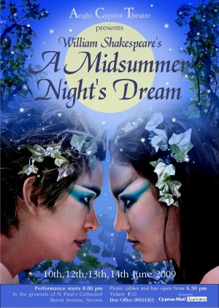
A Midsummer Night’s Dream
Learning Objectives
Understand the layout and purpose of a review.
Write a review of the play, including all important features.
Learning Content

Slide 2
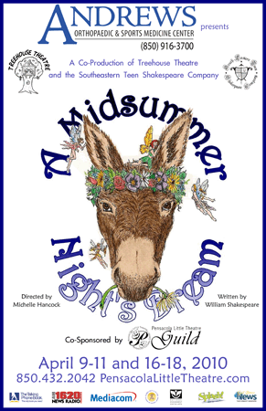
Starter: What is a review?
In exercise books, write down the term review and come up with your own definition. You can discuss this with the people around you.
What did you write?
Do Now

Slide 3
Unlocking Vocabulary
__________ – the type of writing eg: Gothic.
___________ – specific aspects of the text/play eg: plot, characters, actors, stage set, props, lighting etc.
_____________- the person who interprets the script, informs the actors how to deliver their lines and actions.
_______________– the age which the production is suitable for.
Features, Genre, Age-rating, Director
Unlocking vocabulary

Slide 4
Unlocking Vocabulary
Director- the person who interprets the script, informs the actors how to deliver their lines and actions.
Genre – the type of writing eg: Gothic.
Age Rating – the age which the production is suitable for.
Features – specific aspects of the text/play eg: plot, characters, actors, stage set, props, lighting etc.
Unlocking vocabulary

Slide 5
Features of a review
What features do you notice in the following review?
What do you notice about the layout?
What information does the review contain?
Reading & thinking Task

Slide 6
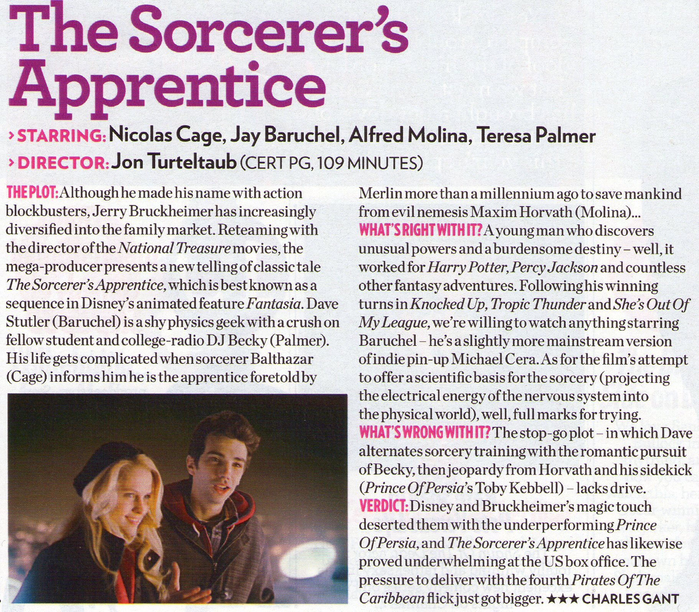

Slide 7
Title
Actors & Director
Age Rating
Model
Genre
Good Features
Plot
Bad Features
Own Opinion

Slide 8
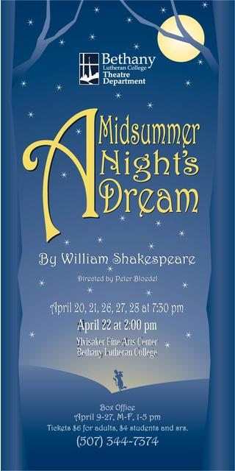
Features of a review
Include:
Title
Plot and Characters
Actors
Director
Genre
Age Rating
Own Opinion
Good Features
Bad Features
Mastery

Slide 9
Practice makes perfect
The hardest part of review writing is giving a clear opinion on the thing you are reviewing.
Many people will write “ It was good” or
“ I didn’t like it because it was boring”
You must write with more intelligence and thought. Tell me WHY you feel the way you feel.
Context

Slide 10
Write your review showing your opinion of the play ‘A Midsummer Night’s Dream’
Remember to include:
Title
Plot and Characters
Actors
Director
Genre
Age Rating
Own Opinion
Good Features
Bad Features
But don’t give too much away – the people reading don’t want it spoiling for them!.
Writing Activity

Slide 11
Sentence Starters
The characters are…
Hermia is…
Helena is…
Demetrius is…
Lysander is…
Soon…
They don’t know what they are doing…
The actors were all professional…
We are…
The plot is…
In Athens…
Earlier…
The movie was…
I can not believe…
This can’t be happening…
It is unfair that…
I have heard…
I don’t believe…
However…
This situation is…
I will follow…
I can only hope…
Tonight is the night…
The conclusion is that…
Eventually they will…
I want…
I wish…
Support

