Slide 1
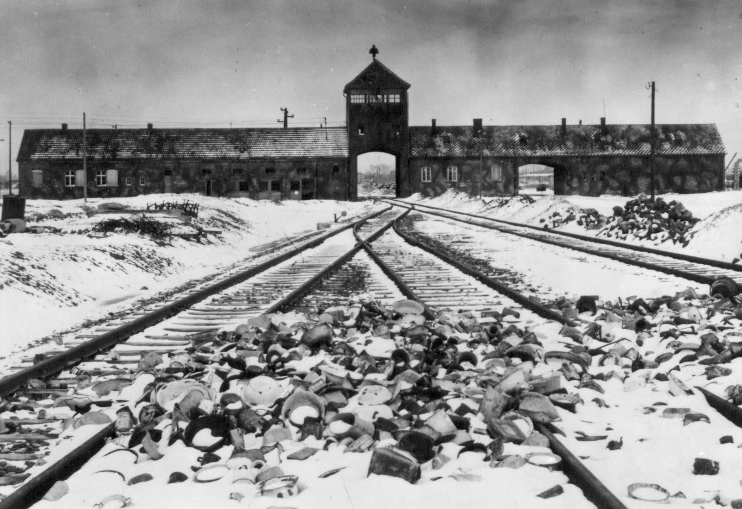
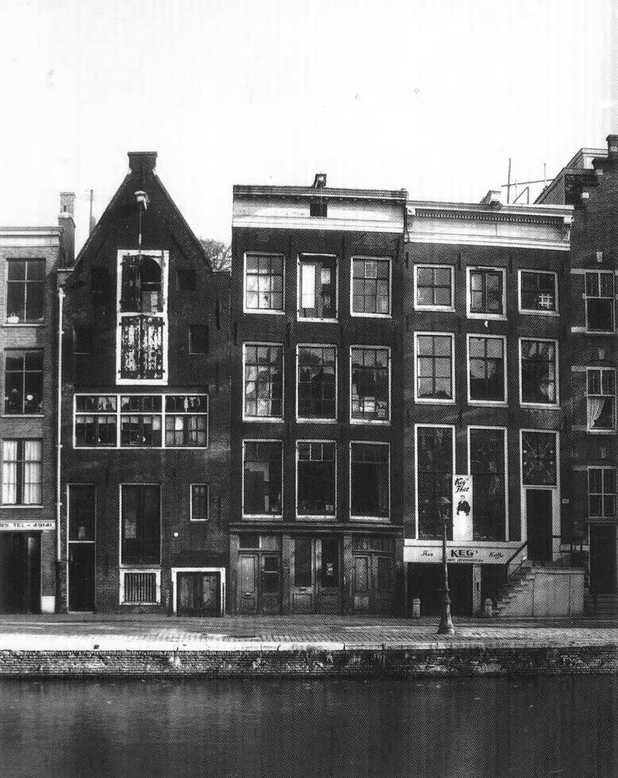
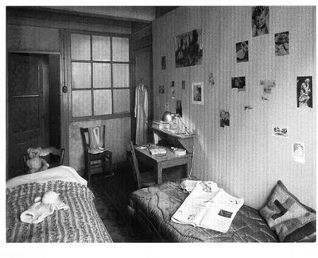
Lesson 8
Writing to describe.
What is an air raid?
Work in groups to discuss and make a list of what you would see, hear, feel in an air raid.
Do Now

Slide 2
Watch the next 15 minutes of the film. Discuss the additional dangers that the families are now facing and what problems they are having in the annex. Make a list.
Thinking Task
https://www.youtube.com/watch?v=hLylRfUbiEE

Slide 3
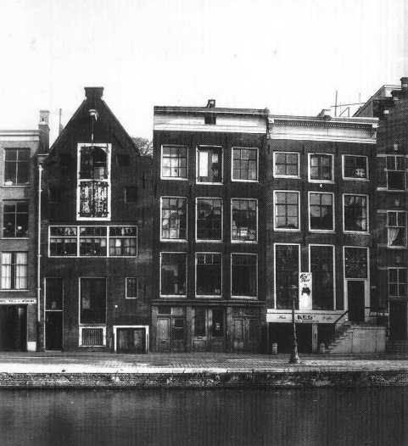
Writing to describe.
Read the text and identify what makes this an effective description.
Mastery
Bullets were flying everywhere as the sound of firing and explosions rang through the battlefield. The soldiers in the front line dropped one after another like trees being uprooted in a massive tornado. Everything seemed to happen in slow motion. The smell of blood and gunpowder was fresh in the air. I licked the blood off my mouth and surged forward with my remaining strength as I pulled the trigger of the grenade and flung it at the enemy.

Slide 4
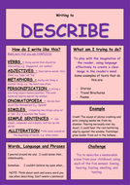
Bullets were flying everywhere as the sound of firing and explosions rang through the battlefield. The soldiers in the front line dropped one after another like trees being uprooted in a massive tornado. Everything seemed to happen in slow motion. The smell of blood and gunpowder was fresh in the air. I licked the blood off my mouth and surged forward with my remaining strength as I pulled the trigger of the grenade and flung it at the enemy.
Mastery
Use the text above and the help sheet as support.
Imagine you are caught in an air raid. Describe the scene in detail.
Make sure that you appeal to the readers’ senses and give a clear
Picture of the scene.
You should aim to write about 150-200 words.
You should write from 1st person perspective.
Aim to use a range of descriptive and precise vocabulary.
Use correct SPAG (Spelling, Punctuation and Grammar.)

Slide 5
1st person
Interesting verbs
Descriptive adjectives
Metaphors/similes
Personification
Onomatopoeia
Alliteration
Simple sentences
Complex sentences
Correct spelling
Punctuation for effect
What is good/went well?
What could be improved?
Swap books and peer assess the work.
Peer assessment

