Slide 1
Lesson 7: Marlowe and Shakespeare
LO: To explore the presentation of religion through Marlowe and Shakespeare

Slide 2
Starter – COUNTDOWN! HOW MANY WORDS CAN YOU MAKE FROM THESE LETTERS IN 2 MINUTES?
C T R O D O A U F S U T S
Do Now
LO: To explore the presentation of religion through Marlowe and Shakespeare.
Notes:
Do Now – select either slide 2 or 3.

Slide 3
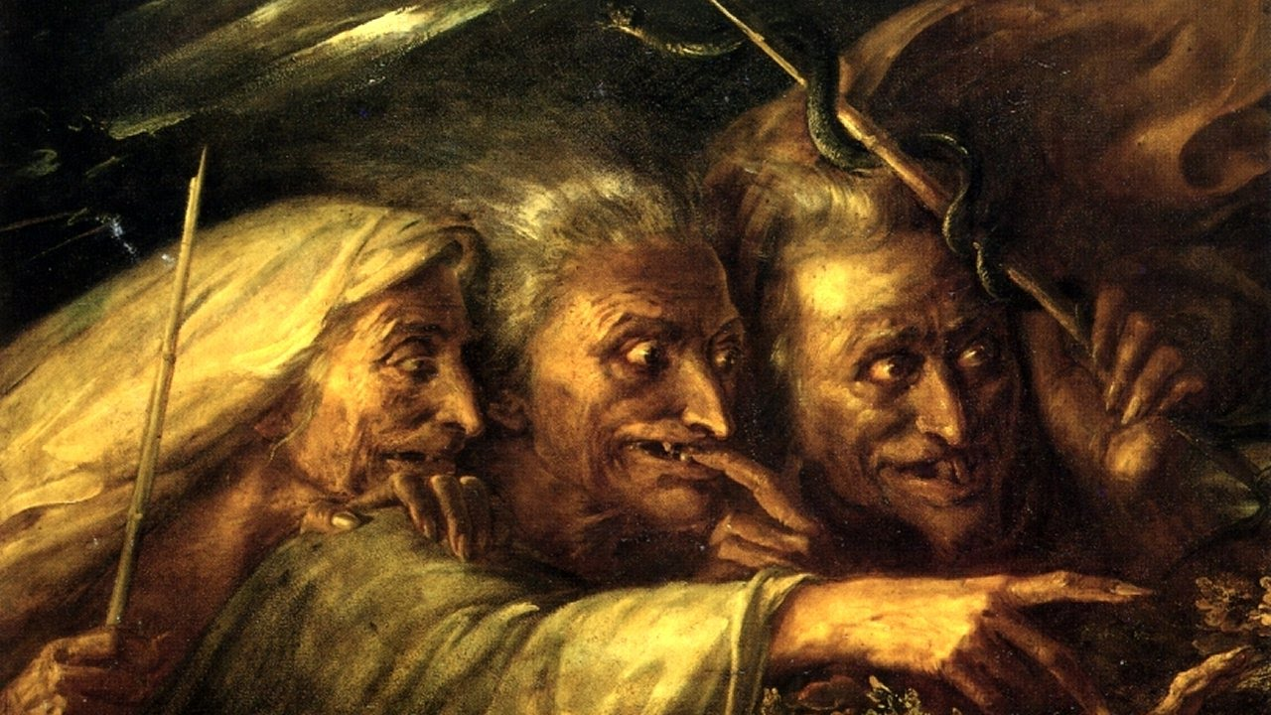
Testing your long term memory:
How many facts
can you remember
about Macbeth
from Year 8?
Do Now
LO: To explore the presentation of religion through Marlowe and Shakespeare.
Notes:
Do Now – select either slide 2 or 3.

Slide 4
Add to your timeline
William Shakespeare ‘Macbeth’ (1606)
Ancient Literature
Middle Ages/ Renaissance
The Georgians & Victorians
The Twentieth Century
Representing change
Draw It
Christopher Marlowe ‘Doctor Faustus’ (1588)
Today’s primary text is Christopher Marlowe’s play ‘Doctor Faustus’, written in 1588.
Today’s secondary text is Shakespeare’s ‘Macbeth’, written in 1606.
Due to their similar theme (magic/evil/going against religion) and the fact they were writing at the same time, these 2 plays are often compared.
LO: To explore the presentation of religion through Marlowe and Shakespeare.

Slide 5
Match the vocabulary to the correct definitions
To say formally or publicly that you no longer agree with a belief or way of behaving.
Rules in place of an absent monarch.
A concept of the Afterlife from Classical Mythology.
Here/To or towards a place
Rude and disrespectful behaviour.
Unlocking Vocabulary
Hither Abjure Elysium Arch-Regent Insolence
LO: To explore the presentation of religion through Marlowe and Shakespeare.

Slide 6
Check your answers:
Abjure: To say formally or publicly that you no longer agree with a belief or way of behaving.
Arch-Regent: Rules in place of an absent monarch.
Elysium: A concept of the Afterlife from Classical Mythology.
Hither: Here/To or towards a place
Insolence: Rude and disrespectful behaviour.
Answers
LO: To explore the presentation of religion through Marlowe and Shakespeare.

Slide 7
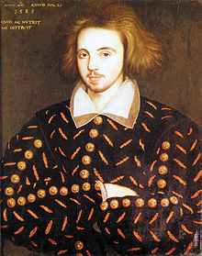
Christopher Marlowe
Christopher Marlowe (1564 –1593), was an English playwright and poet. Marlowe was the foremost Elizabethan tragedian of his day. He greatly influenced William Shakespeare, who was born in the same year as Marlowe and who rose to become the pre-eminent Elizabethan playwright after Marlowe's mysterious early death.
A warrant was issued for Marlowe's arrest on 18 May 1593. No reason was given for it, though it was thought to be connected to allegations of blasphemy—a manuscript believed to have been written by Marlowe was said to contain "vile heretical conceipts". Now, given that ‘Doctor Faustus’ was heavily edited for the stage because of it’s anti-religious message, this wasn’t unusual for him.
10 days later, he was stabbed to death. Following this, Shakespeare rose to fame. Some argue that Marlowe and Shakespeare are one and the same!
Learning Content
LO: To explore the presentation of religion
through Marlowe and Shakespeare.

Slide 8
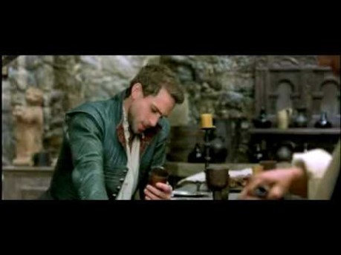
Learning Content
LO: To explore the presentation of religion through Marlowe and Shakespeare.
Notes:
https://youtu.be/foOquPn1L60

Slide 9
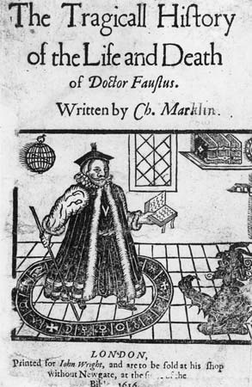
Read both the ‘Doctor Faustus’ and ‘Macbeth’ extracts.
Annotate the words you think have the most impact. What are their effects?
Create a table for similarities/ differences between the two texts.
Mastery
Similarities | Differences
LO: To explore the presentation of religion through
Marlowe and Shakespeare.
Notes:
Use the booklet on screen to model annotations.

Slide 10
How is religion presented?
Mastery
LO: To explore the presentation of religion through Marlowe and Shakespeare.
Notes:
Mindmap with their responses. Really push the idea of Macbeth being able to say Amen and the shock of Faustus summoning demons/selling his soul to the devil.

