Slide 1
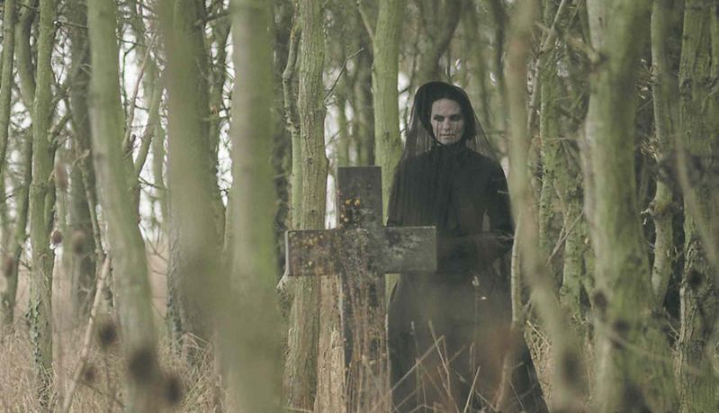
The Woman in Black
Starter Activity:
Read the first paragraph of the extract taken from ‘The Woman in Black’.
List 4 things you learn about the ruins in the first paragraph.
Do Now
Challenge: Why has the writer hinted that the ruins are ‘monastic’?
LO: To develop analysis skills.

Slide 2
Match the vocabulary to the correct definitions.
an unhealthy pale appearance.
the quality or state of being bare and unwelcoming.
severely damaged or disfigured (from age or illness).
having or showing a wish to do evil to others.
relating to monks, nuns, or others living under religious vows, or the buildings in which they live.
an abnormal and unhealthy interest in disturbing and unpleasant subjects, especially death and disease.
Monastic Bleakness Morbid Pallor Ravaged Malevolence
Unlocking Vocabulary
LO: To develop analysis skills.
Notes:
Can be printed for students

Slide 3
Check your answers:
Pallor: an unhealthy pale appearance.
Bleakness: the quality or state of being bare and unwelcoming.
Ravaged: severely damaged or disfigured (from age or illness).
Malevolence: having or showing a wish to do evil to others.
Monastic: relating to monks, nuns, or others living under religious vows, or the buildings in which they live.
Morbid: an abnormal and unhealthy interest in disturbing and unpleasant subjects, especially death and disease.
Answers
LO: To develop analysis skills.

Slide 4
In this lesson you will be mastering the following:
Selecting appropriate quotations from the text.
Commenting on how characters are presented.
Explaining how language choices link to create an overall effect.
Learning Content
LO: To develop analysis skills.

Slide 5
Can you and a partner answer the following questions?
Last Lesson: How did the writer increase tension towards the end of ‘The Red Room’?
Last Week: What is wrong with this piece of speech? – “I have never felt so alone” said James.
Last Term: How was pathetic fallacy used in Macbeth?
Last Year: What conventions do Shakespearean comedies have?
Link to Previous Learning
LO: To develop analysis skills.

Slide 6
How many Gothic conventions can you see in The Woman in Black movie trailer?
Checking Understanding
Challenge:
Which conventions were missing?
LO: To develop analysis skills.
Notes:
https://www.youtube.com/watch?v=dPYMUnJGURI

Slide 7
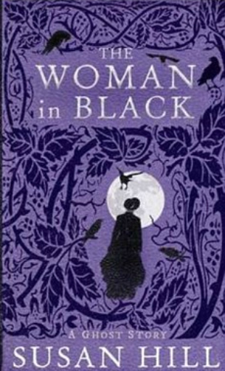
Now read the whole of the extract.
The Woman in Black is a ghost story by Susan Hill, in which Arthur Kipps relates his haunting experiences at Eel Marsh House.
In his story, a young Arthur Kipps, a junior solicitor, is sent to settle the affairs of Alice Drablow. He sees a woman dressed in black at her funeral, though apparently no one else does. At Eel Marsh House, a house beyond a causeway, Arthur is haunted by noises and sightings of the woman. Eventually a local man, Sam Daily, reveals the full story of how Alice Drablow's sister, Jennet, haunts the house. He explains that a child dies each time the woman in black is seen.
The Woman in Black is a ghost story about heartbreak and revenge.
Reading Activity
LO: To develop analysis skills.

Slide 8
How does the writer use language to make the description of the woman horrific?
In the greyness of the fading light, it had the sheen and pallor not of flesh so much as of bone itself. Earlier, when I had looked at her, although admittedly it had been scarcely more than a swift glance each time, I had not noticed any particular expression on her ravaged face, but then I had, after all, been entirely taken with the look of extreme illness. Now, however, as I stared at her, stared until my eyes ached in their sockets, stared in surprise and bewilderment at her presence, now I saw that her face did wear an expression.
Why does the writer use ‘fading light’?
Pick out works to describe the woman’s physical appearance. What are their effects?
Why does the narrator link back to the first time he saw the woman?
How are the woman’s emotions shown?
Mastery
LO: To develop analysis skills.
Notes:
Students to use the questions to prompt annotations.

Slide 9
How does the writer use language to make the description of the woman horrific?
It was one of what I can only describe – and the words seem hopelessly inadequate to express what I saw – as a desperate, yearning malevolence; it was as though she were searching for something she wanted, needed, must have, more than life itself, and which had been taken from her. And, towards whoever had taken it she directed the purest evil and hatred and loathing, with all the force that was available to her. Her face, in its extreme pallor, her eyes, sunken but unnaturally bright, were burning with the concentration of passionate emotion which was within her and which streamed from her.
Why are the hyphens used?
Pick out words to describe the woman’s emotions. What are their effects?
Why does the writer focus on the woman’s eyes?
Mastery
LO: To develop analysis skills.
Notes:
Students to use the questions to prompt annotations.

Slide 10
How does the writer use language to make the description of the woman horrific?
P: The writer uses E: It states “…” A: This shows that … The word “______” shows …
Mastery
Let’s write one as a class first!
LO: To develop analysis skills.
Notes:
Develop vocabulary by replacing the red words.

Slide 11
How has the writer structured the text to build tension?
P: The writer has built tension by starting with E: It states “…” A: This shows that … The word “______” shows … The tension then builds slightly when… The tension is at its highest when…
Extension Task
LO: To develop analysis skills.

