Slide 1
Creating Mood & Atmosphere
Starter Activity:
Read the short extract from the next part of ‘The Red Room’.
Draw arrows from the annotations to the correct parts of the text.
Do Now
LO: To comment on how mood & atmosphere is created.

Slide 2
Match the vocabulary to the correct definitions.
a soft, woollen or cotton fabric resembling felt.
a period of keeping awake during the time usually spent asleep, especially to keep watch or pray.
something that is under the earth's surface, or that is secret or concealed.
Brave and heroic.
a recess in the wall of a room or garden.
arranged or having a pattern like a net of lines and squares.
Subterranean Baize Reticulated Vigil Gallant Alcove
Unlocking Vocabulary
LO: To comment on how mood & atmosphere is created.
Notes:
Could be printed off for students.

Slide 3
Check your answers:
Baize: a soft, woollen or cotton fabric resembling felt.
Vigil: a period of keeping awake during the time usually spent asleep, especially to keep watch or pray.
Subterranean: something that is under the earth's surface, or that is secret or concealed.
Gallant: Brave and heroic.
Alcove: a recess in the wall of a room or garden.
Reticulated: arranged or having a pattern like a net of lines and squares.
Answers
LO: To comment on how mood & atmosphere is created.

Slide 4
In this lesson you will be mastering the following:
Understanding key plot events.
Commenting on how character speech and actions create mood and atmosphere.
Explaining how vocabulary choices contribute to mood and atmosphere.
Learning Content
LO: To comment on how mood & atmosphere is created.

Slide 5
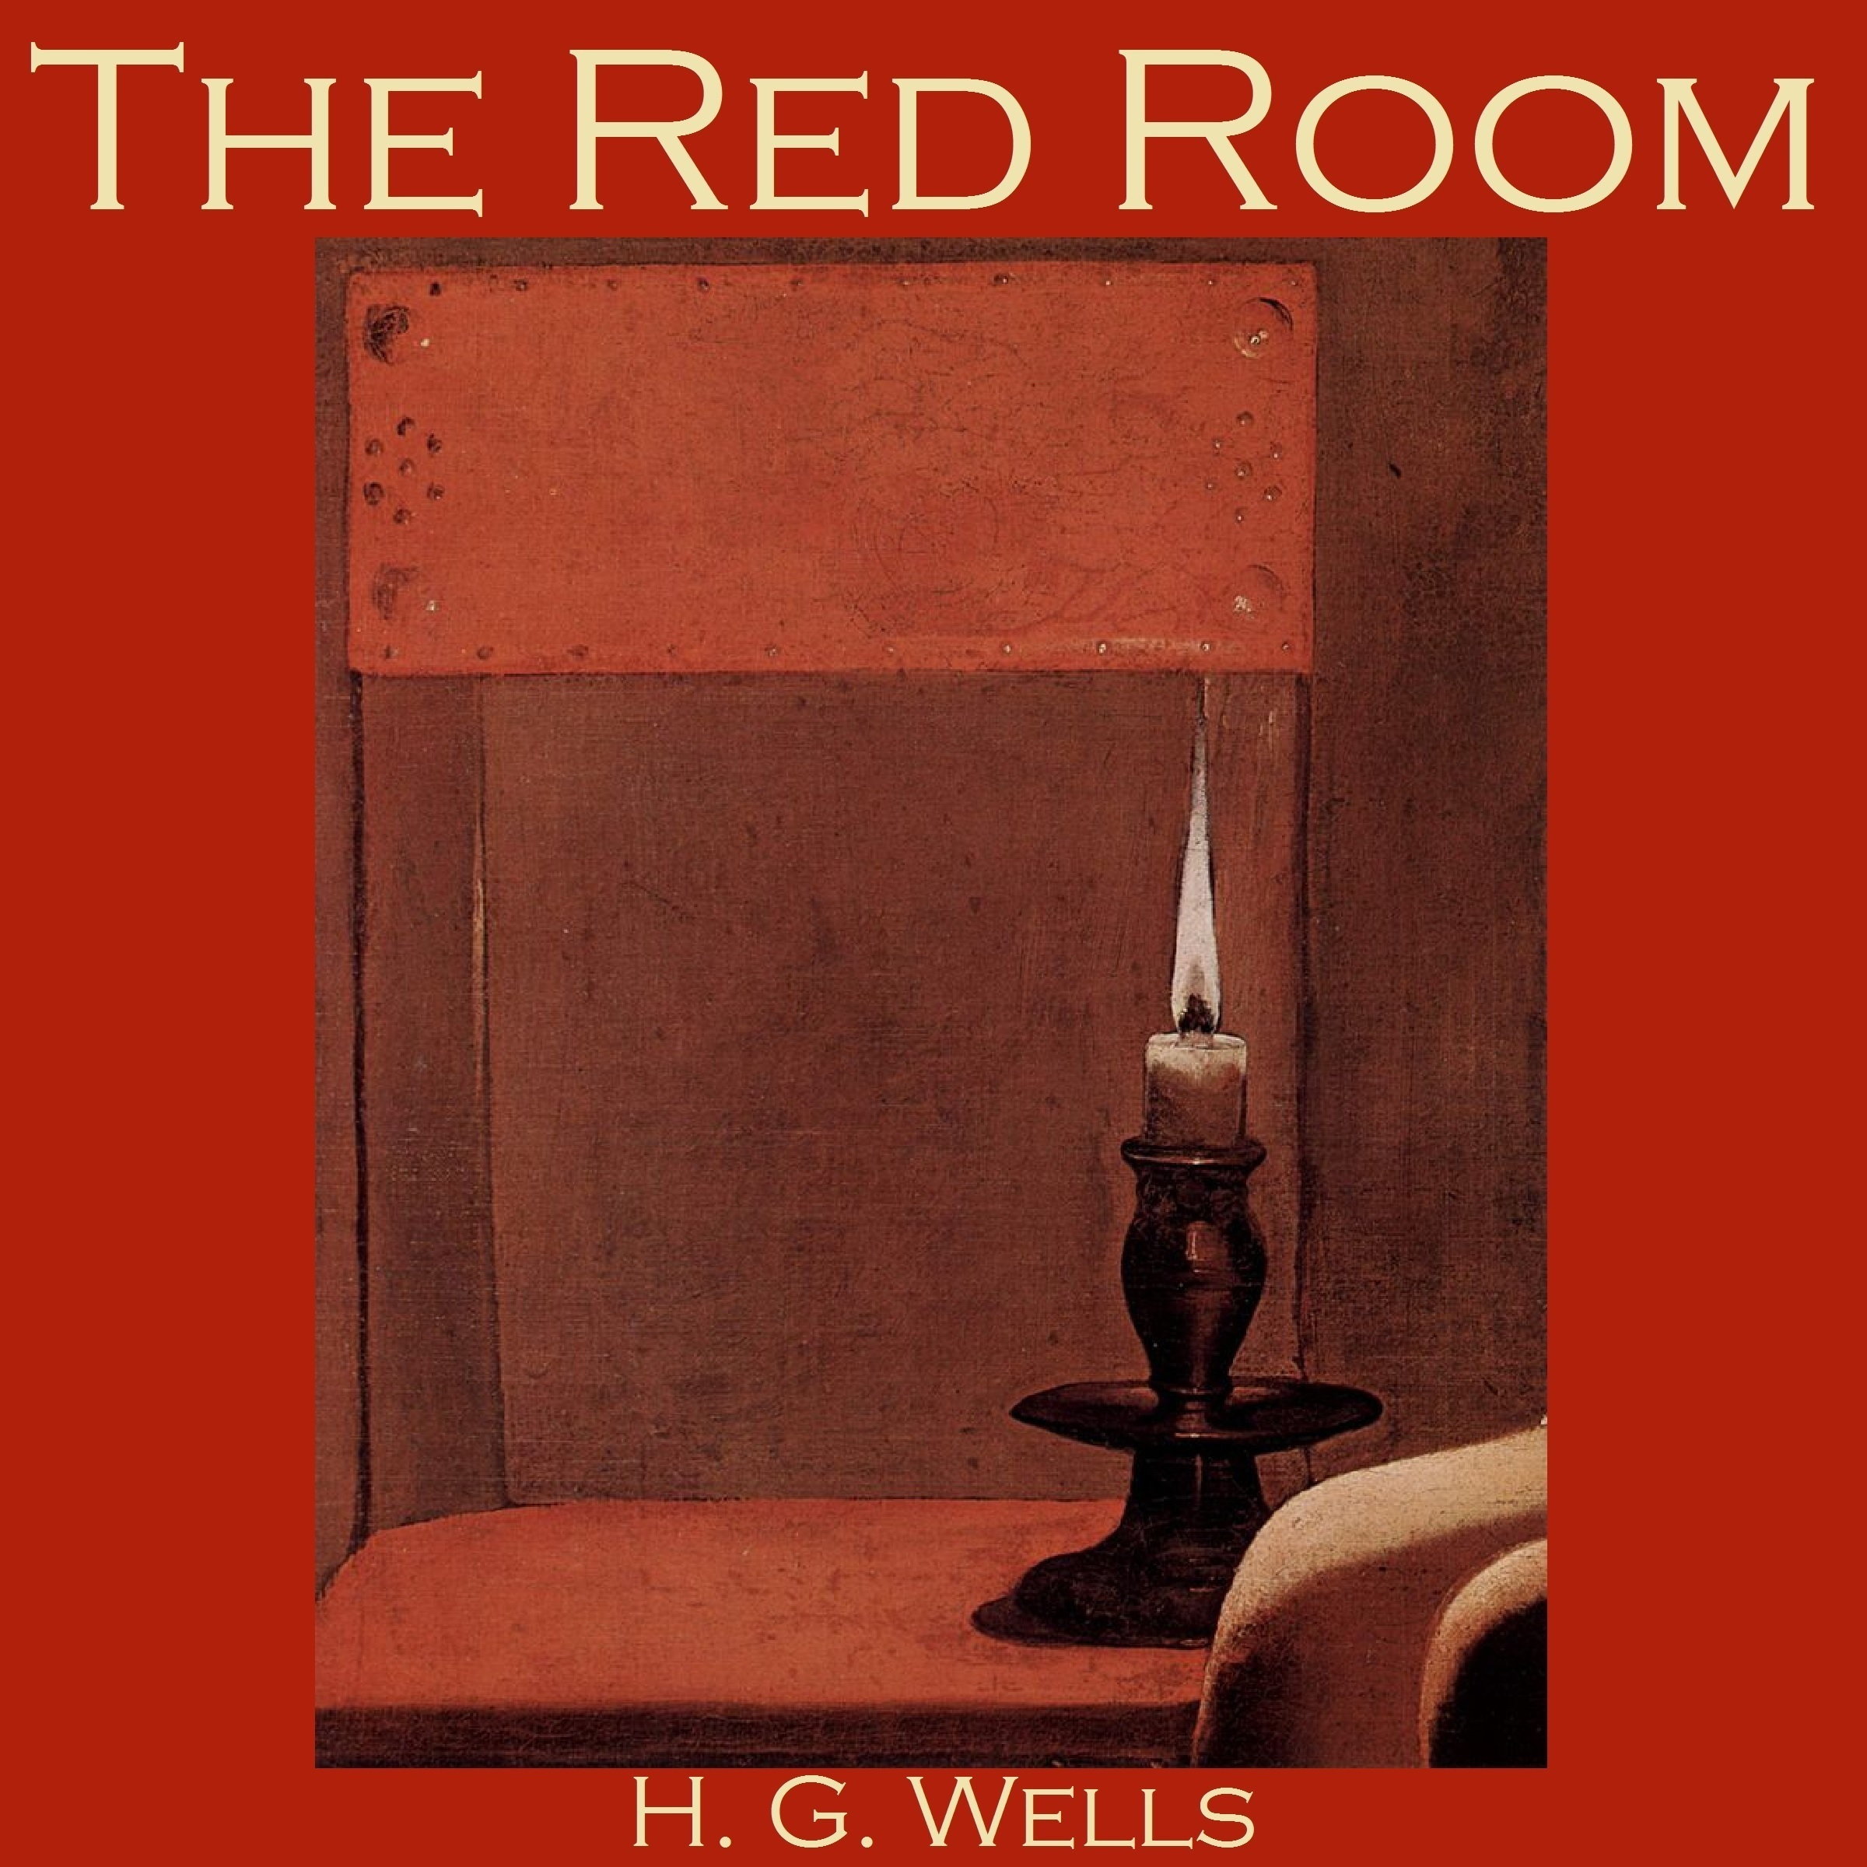
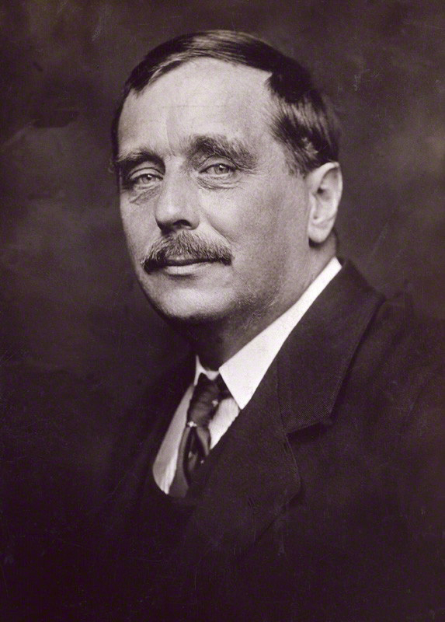
Use the word document which has the next part of the story, ‘The Red Room’. Answer the questions that focus on mood & atmosphere in the text.
Reading Activity
LO: To comment on how mood & atmosphere is created.

Slide 6
How is mood and atmosphere created?
Bronze: Answer the questions about the chosen extracts.
Silver: Answer the questions making sure you use quotations as part of your response.
Gold: Answer the questions using quotations and making comments on the effects of language choices.
Mastery
LO: To comment on how mood & atmosphere is created.
Notes:
Could be printed off for students.

