Slide 1
The Red Room
LTM Starter:
Complete the Long Term Memory Grid Challenge.
Last Lesson: Explain what a determiner is and give examples.
Last Week: Create a list of as many Gothic conventions as you can.
Last Term: What Gothic conventions can also be seen in Macbeth?
Last Year: Create examples of a simile, metaphor and personification.
Do Now
LO: To comment on the presentation of characters.

Slide 2
Match the vocabulary to the correct definitions.
a person who has responsibility for taking care of or protecting something i.e. a building.
shrunken or wrinkled from age or disease.
speak boringly in a dull monotonous tone.
with an attitude or look of suspicion or disapproval.
noticeable by touch.
looking thin, bony or sickly.
Tangible Withered Askance Droning Custodians Gaunt
Unlocking Vocabulary
LO: To comment on the presentation of characters.
Notes:
Could be printed off for students.

Slide 3
Check your answers:
Custodians: a person who has responsibility for taking care of or protecting something i.e. a building.
Withered: shrunken or wrinkled from age or disease.
Droning: speak boringly in a dull monotonous tone.
Askance: with an attitude or look of suspicion or disapproval.
Tangible: noticeable by touch.
Gaunt: looking thin, bony or sickly.
Answers
LO: To comment on the presentation of characters.

Slide 4
In this lesson you will be mastering the following:
Selecting appropriate quotations from a text.
Commenting on the presentation of different characters
Explaining how vocabulary and structural choices contribute to mood and atmosphere.
Learning Content
LO: To comment on the presentation of characters.

Slide 5
Can you add the correct punctuation to the speech?
I can assure you said I that it will take a very tangible ghost to frighten me And I stood up before the fire with my glass in my hand.
It is your own choosing said the man with the withered arm, and glanced at me askance.
Eight-and-twenty years said I I have lived, and never a ghost have I seen as yet
Checking Understanding
LO: To comment on the presentation of characters.

Slide 6
Check your answers. Do you need to make any corrections?
“I can assure you,” said I, “that it will take a very tangible ghost to frighten me.” And I stood up before the fire with my glass in my hand.
“It is your own choosing,” said the man with the withered arm, and glanced at me askance.
“Eight-and-twenty years,” said I, “I have lived, and never a ghost have I seen as yet.”
Answers
LO: To comment on the presentation of characters.

Slide 7
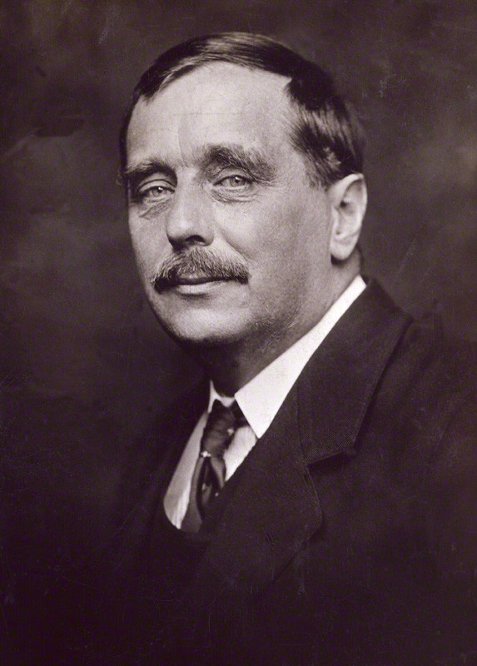
Read page 1 of ‘The Red Room’.
"The Red Room" is a short gothic story written by H. G. Wells in 1894. It was first published in the March 1896 edition of The Idler magazine.
Reading Activity
LO: To comment on the presentation of characters.

Slide 8
What is effective about starting the story with speech? What does it reveal about the characters and plot?
“I can assure you,” said I, “that it will take a very tangible ghost to frighten me.” And I stood up before the fire with my glass in my hand.
“It is your own choosing,” said the man with the withered arm, and glanced at me askance.
“Eight-and-twenty years,” said I, “I have lived, and never a ghost have I seen as yet.”
The old woman sat staring hard into the fire, her pale eyes wide open. “Ay,” she broke in; “and eight-and-twenty years you have lived and never seen the likes of this house, I reckon. There’s a many things to see, when one’s still but eight-and-twenty.” She swayed her head slowly from side to side. “A many things to see and sorrow for.”
I half suspected the old people were trying to enhance the spiritual terrors of their house by their droning insistence. I put down my empty glass on the table and looked about the room, and caught a glimpse of myself, abbreviated and broadened to an impossible sturdiness, in the queer old mirror at the end of the room. “Well,” I said, “if I see anything to-night, I shall be so much the wiser. For I come to the business with an open mind.”
Mastery
LO: To comment on the presentation of characters.

Slide 9
What are your initial impressions of the narrator and the elderly people he is staying with?
Paired Discussion
Discuss your ideas with a partner and be ready to feedback.
LO: To comment on the presentation of characters.

Slide 10
Draw the following mind map in your books.
Narrator
Character Presentation
Elderly Hosts
Speech
Mastery
Appearance &
Actions
Speech
Appearance &
Actions
LO: To comment on the presentation of characters.
Notes:
Students needs to find quotes for the various categories and annotate for the effects created.

Slide 11
Draw the following mind map in your books.
Narrator
Character Presentation
Elderly Hosts
“it will take a very tangible ghost to frighten me.”
Speech
Self-assured
Overly confident
Foreshadowing
Mastery
Appearance &
Actions
Speech
Appearance &
Actions
Challenge: Can you zoom in on individual language choices in the quotes?
LO: To comment on the presentation of characters.
Notes:
Add quotations and analysis – model first.

Slide 12
Opening a narrative with speech.
Can you create the opening of a narrative that focuses on speech?
You need two characters.
Show the reader that the protagonist is arrogant and overly confident and the other character doubts their abilities.
Extension Activity
LO: To comment on the presentation of characters.

