Slide 1
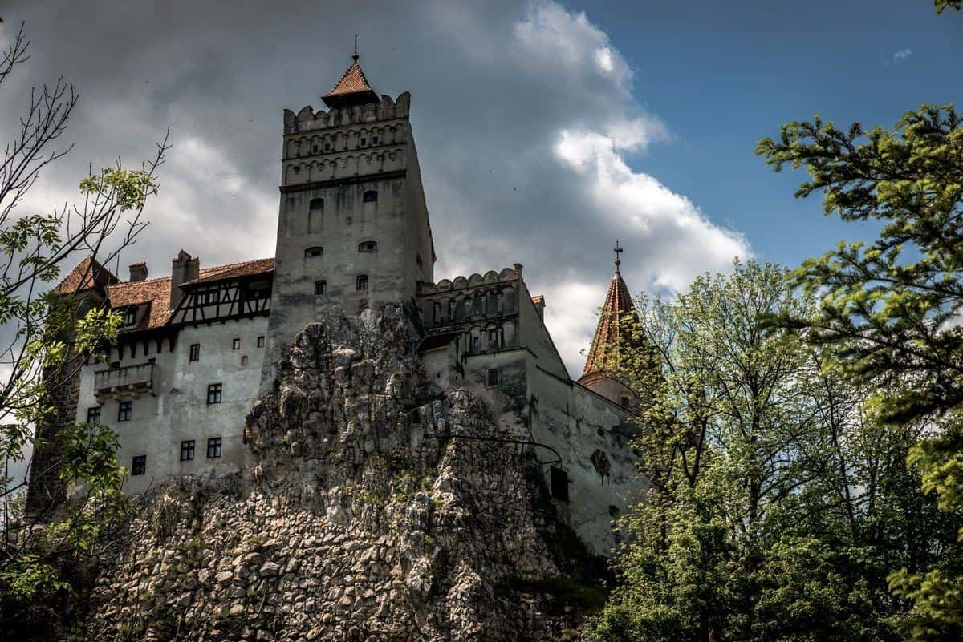
Describing Gothic Settings
Determiners: a word that is used before a noun to show which particular example of the noun you are referring to.
Literacy Discussion: How is the meaning of a sentence changed if you use demonstratives or possessives instead of articles?
Do Now
LO: To use a range of vocabulary and sentence structures when describing settings.

Slide 2
Match the vocabulary to the correct definitions.
relating to sight, especially in relation to the action of light.
enclosed or confined.
with rough, sharp points protruding.
(of a dog, especially a large one) bark or howl loudly.
Hemmed in Baying Optical Jagged
Challenge: Create your own definition for the ‘The Sublime’.
Unlocking Vocabulary
LO: To use a range of vocabulary and sentence structures when describing settings.
Notes:
Can be printed off for students.

Slide 3
Match the vocabulary to the correct definitions.
Optical: relating to sight, especially in relation to the action of light.
Hemmed in: enclosed or confined.
Jagged: with rough, sharp points protruding.
Baying: (of a dog, especially a large one) bark or howl loudly.
Unlocking Vocabulary
LO: To use a range of vocabulary and sentence structures when describing settings.

Slide 4
In this lesson you will be mastering the following:
Using a variety of sentence structures.
Using ambitious vocabulary to develop descriptions.
Using literary devices to create effects.
Learning Content
LO: To use a range of vocabulary and sentence structures when describing settings.

Slide 5
Dracula: Bram Stoker
Jonathan Harker is a newly qualified solicitor who is travelling to Count Dracula’s castle on a business trip. He has to travel through the mountains while the sound of wolves howling surrounds his carriage.
Reading Activity
LO: To use a range of vocabulary and sentence structures when describing settings.

Slide 6
Bram Stoker’s Language and Structural Choices
Soon we were hemmed in with trees, which in places arched right over the roadway till we passed as through a tunnel; and again great frowning rocks guarded us boldly on either side. Though we were in shelter, we could hear the rising wind, for it moaned and whistled through the rocks, and the branches of the trees crashed together as we swept along. It grew colder and colder still, and fine, powdery snow began to fall, so that soon we and all around us were covered with a white blanket. The keen wind still carried the howling of the dogs, though this grew fainter as we went on our way. The baying of the wolves sounded nearer and nearer, as though they were closing round on us from every side. I grew dreadfully afraid, and the horses shared my fear. The driver, however, was not in the least disturbed; he kept turning his head to left and right, but I could not see anything through the darkness.
Reading Activity
How does Stoker create a sense of feeling trapped or confined?
Can you find any literary devices?
How do we a get a sense that Jonathan is in danger?
LO: To use a range of vocabulary and sentence structures when describing settings.

Slide 7
Bram Stoker’s Language and Structural Choices
Suddenly, away on our left, I saw a faint flickering blue flame. The driver saw it at the same moment; he at once checked the horses, and, jumping to the ground, disappeared into the darkness. I did not know what to do, the less as the howling of the wolves grew closer; but while I wondered the driver suddenly appeared again, and without a word took his seat, and we resumed our journey. I think I must have fallen asleep and kept dreaming of the incident, for it seemed to be repeated endlessly, and now looking back, it is like a sort of awful nightmare. Once the flame appeared so near the road, that even in the darkness around us I could watch the driver’s motions. He went rapidly to where the blue flame arose—it must have been very faint, for it did not seem to illumine the place around it at all—and gathering a few stones, formed them into some device. Once there appeared a strange optical effect: when he stood between me and the flame he did not obstruct it, for I could see its ghostly flicker all the same. This startled me, but as the effect was only momentary, I took it that my eyes deceived me straining through the darkness. Then for a time there were no blue flames, and we sped onwards through the gloom, with the howling of the wolves around us, as though they were following in a moving circle.
4. How is a sense of uncertainty created?
5. How does Stoker use hyphens?
Reading Activity
LO: To use a range of vocabulary and sentence
structures when describing settings.

Slide 8
How could this simple sentence be developed?
The castle was dark and gloomy.
Mastery
Could you:
Add more ambitious adjectives?
Create a complex sentence?
Add an embedded subordinate clause?
Add a literary device such as personification or a simile?
Start the sentence with adjectives, a verb or an adverb?
LO: To use a range of vocabulary and sentence structures when describing settings.

Slide 9
Continue the extract. Create a description of Dracula’s castle.
Writing Task
Criteria – Can you use:
Ambitious vocabulary?
Complex sentence structures?
Embedded subordinate clauses (with hyphens)?
Literary devices such as personification or a simile?
Start sentences with adjectives, verbs and or adverbs?
LO: To use a range of vocabulary and sentence structures when describing settings.

Slide 10
Analyse your own or a partner’s work!
Identify where you have used gothic conventions.
What sort of atmosphere have you created? Give examples of effective vocabulary choices.
How have you used sentence structures or punctuation for effect?
How does the piece make the reader feel? Explain why.
Extension Task
LO: To use a range of vocabulary and sentence structures when describing settings.

