Slide 1
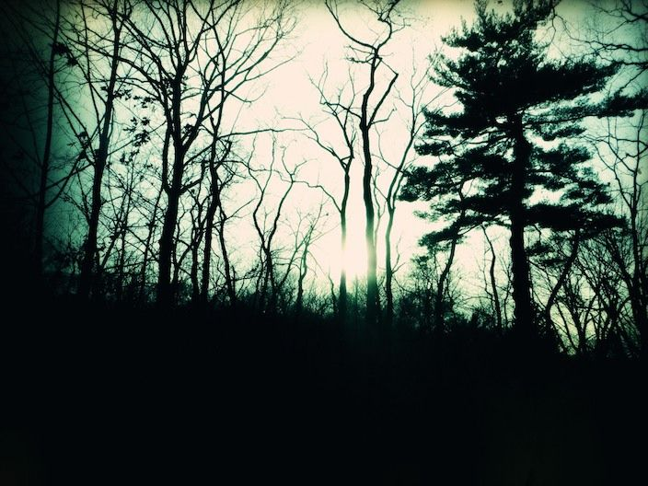
Gothic Settings
Starter Activity: Read the extract from ‘Rebecca’.
BRONZE: Highlight quotations that show the extract has a gothic style.
SILVER: Identify any literary devices the writer has used.
GOLD: Annotate the quotations to comment on the effects being created.
Do Now
LO: To comment on how writers create gothic settings.

Slide 2
FEEDBACK: Rebecca
The woods, always a menace even in the past, had triumphed in the end. They crowded, dark and uncontrolled, to the borders of the drive. The beeches with white, naked limbs leant close to one another, their branches intermingled in a strange embrace, making a vault above my head like the archway of a church. And there were other trees as well, trees that I did not recognize, squat oaks and tortured elms that straggled cheek by jowl with the beeches, and had thrust themselves out of the quiet earth, along with monster shrubs and plants, none of which I remembered.
The drive was a ribbon now, a thread of its former self, with gravel surface gone, and choked with grass and moss. The trees had thrown out low branches, making an impediment to progress; the gnarled roots looked like skeleton claws. Scattered here and again amongst this jungle growth I would recognize shrubs that had been landmarks in our time, things of culture and grace, hydrangeas whose blue heads had been famous.
No hand had checked their progress, and they had gone native now, rearing to monster height without a bloom, black and ugly as the nameless parasites that grew beside them. On and on, now east now west, wound the poor thread that once had been our drive. Sometimes I thought it lost, but it appeared again, beneath a fallen tree perhaps, or struggling on the other side of a muddied ditch created by the winter rains. I had not thought the way so long. Surely the miles had multiplied, even as the trees had done, and this path led but to a labyrinth, some choked wilderness, and not to the house at all. I came upon it suddenly; the approach masked by the unnatural growth of a vast shrub that spread in all directions, and I stood, my heart thumping in my breast, the strange prick of tears behind my eyes.
Checking Understanding
LO: To comment on how writers create gothic settings.

Slide 3
Match the vocabulary to the correct definitions.
of very great excellence or beauty.
slowing decaying, especially due to neglect.
a large, imposing building
a feeling of brooding sadness, typically with no obvious cause.
a state of complete emptiness or destruction.
a very steep rock face or cliff, especially a tall one.
Melancholy Mouldering Sublime Edifice Precipice Desolation
Unlocking Vocabulary
LO: To comment on how writers create gothic settings.
Notes:
Can be printed out for students.

Slide 4
Check your answers:
Sublime: of very great excellence or beauty.
Mouldering: slowing decaying, especially due to neglect.
Edifice: a large, imposing building
Melancholy: a feeling of brooding sadness, typically with no obvious cause.
Desolation: a state of complete emptiness or destruction.
Precipice: a very steep rock face or cliff, especially a tall one.
Answers
LO: To comment on how writers create gothic settings.

Slide 5
In this lesson you will be mastering the following:
The ability to select relevant quotations from texts.
Explaining how texts are in keeping with gothic conventions.
In depth analysis of language choices with clear comments on the effects created.
Learning Content
LO: To comment on how writers create gothic settings.

Slide 6
The Sublime: What sort of settings do you think could fit the idea of the Sublime?
The Sublime in literature refers to use of language and description that excites thoughts and emotions beyond ordinary experience.
Edmund Burke writes about the Sublime in A Philosophical Inquiry into the Origin of Our Ideas of the Sublime and Beautiful (1757).
Burke defines the sublime as "whatever is fitted in any sort to excite the ideas of pain and danger...”
Burke believed that the sublime was something that could provoke terror in the audience, for terror and pain were the strongest of emotions. However, he also believed there was an inherent "pleasure" in this emotion.
Anything that is great, infinite or obscure could be an object of terror and the sublime, for there was an element of the unknown about them.
Mastery
LO: To comment on how writers create gothic settings.
Notes:
Discuss as a class – can consider mountain landscapes, castles etc. to fit into The Mysteries of Udolpho

Slide 7
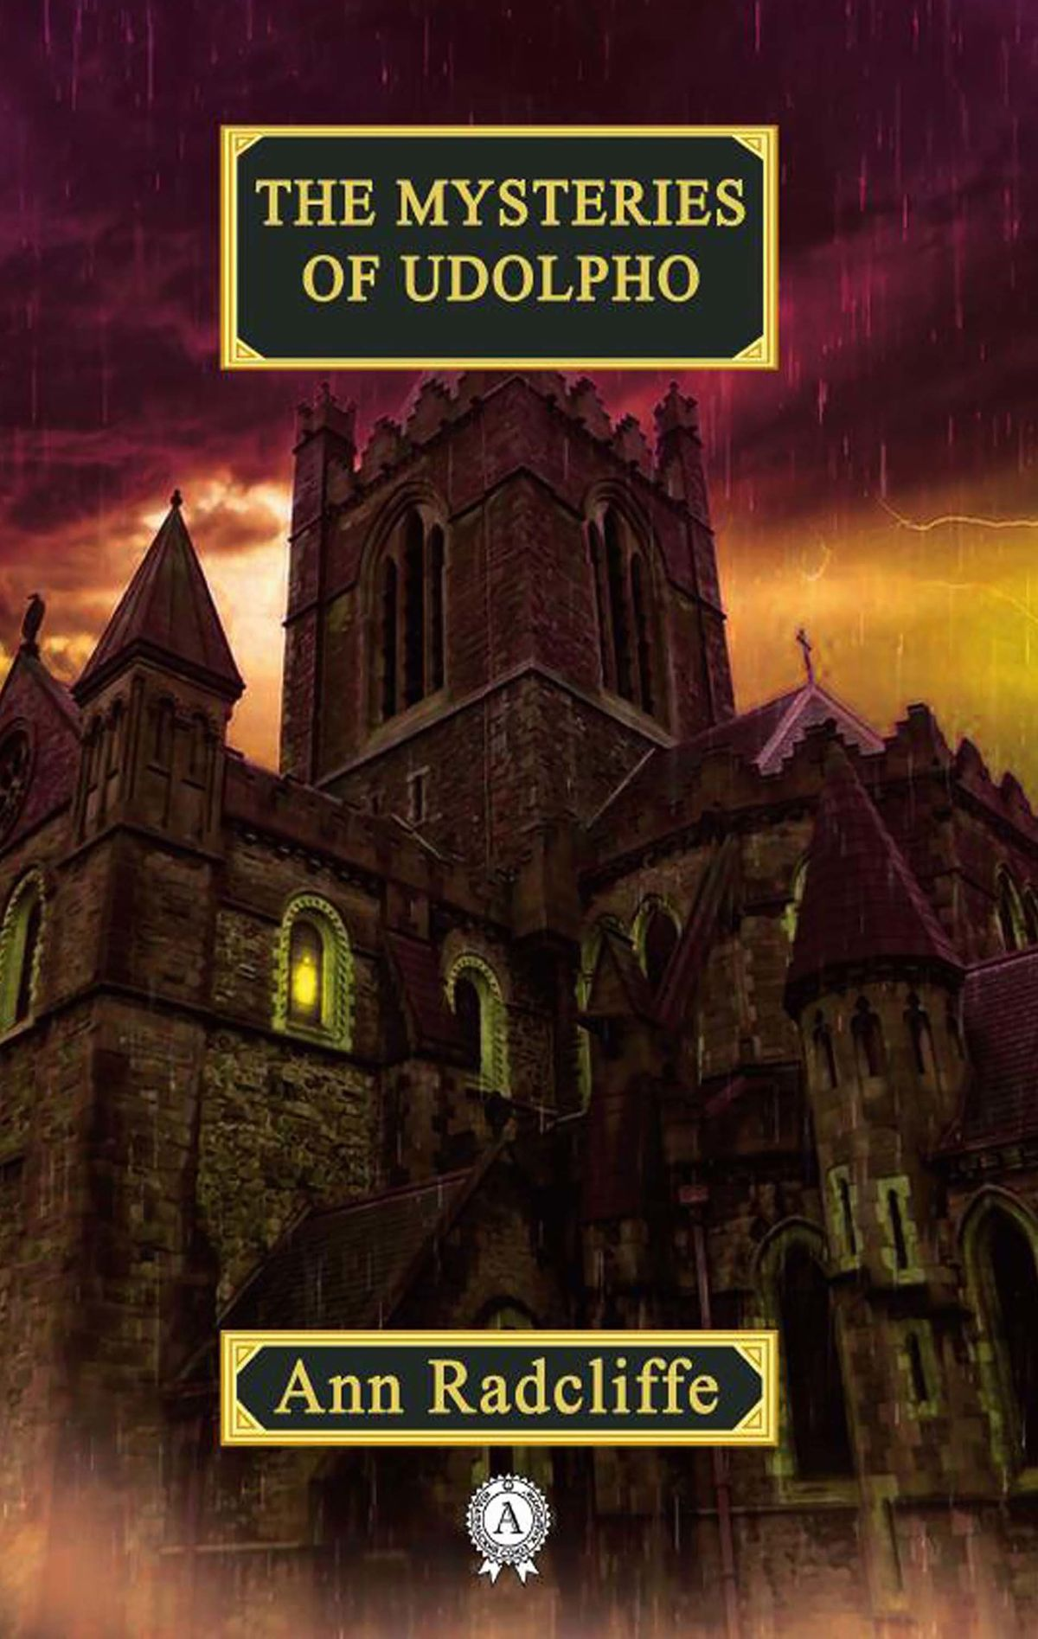
The Mysteries of Udolpho
The Mysteries of Udolpho is a Gothic novel by Ann Radcliffe, published in 1794. It was one of the most popular novels of the late 18th and early 19th centuries. It was then and continues to be widely regarded as a key text in the development of the Gothic genre.
The Mysteries of Udolpho is set in France and Italy in the late 16th century. The main character is Emily St. Aubert, a beautiful and virtuous young woman. When her father dies, the orphaned Emily goes to live with her aunt. Her aunt’s husband, an Italian nobleman called Montoni, tries to force Emily to marry his friend. Montoni is a typical Gothic villain. He is violent and cruel to his wife and Emily, and locks them in his castle. Eventually Emily escapes, and the novel ends happily with Emily’s marriage to the man she loves.
Reading Activity
LO: To comment on how writers create gothic settings.
Notes:
Discuss as a class – can consider mountain landscapes, castles etc. to fit into The Mysteries of Udolpho

Slide 8
How does the extract create a gothic atmosphere?
“There,” said Montoni, speaking for the first time in several hours, “is Udolpho.”
Emily gazed with melancholy awe upon the castle, which she understood to be Montoni’s; for, though it was now lighted up by the setting sun, the gothic greatness of its features, and its mouldering walls of dark grey stone, rendered it a gloomy and sublime object. As she gazed, the light died away on its walls, leaving a melancholy purple tint, which spread deeper and deeper, as the thin vapour crept up the mountain, while the battlements above were still tipped with splendour. From those, too, the rays soon faded, and the whole edifice was invested with the solemn duskiness of evening. Silent, lonely, and sublime, it seemed to stand the sovereign of the scene, and to frown defiance on all, who dared to invade its solitary reign. As the twilight deepened, its features became more awful in obscurity, and Emily continued to gaze, till its clustering towers were alone seen, rising over the tops of the woods, beneath whose thick shade the carriages soon after began to ascend.
Reading Activity
Challenge: How does the extract incorporate ideas of the Sublime?
LO: To comment on how writers create gothic settings.
Notes:
Model first section (on this slide) - long extract that can be shortened for less able groups or to zoom in one on particular section

Slide 9
How does the extract create a gothic atmosphere?
The extent and darkness of these tall woods awakened terrific images in her mind, and she almost expected to see bandits start up from under the trees. At length, the carriages emerged upon a heathy rock, and, soon after, reached the castle gates, where the deep tone of the portal bell, which was struck upon to give notice of their arrival, increased the fearful emotions, that had assailed Emily. While they waited till the servant within should come to open the gates, she anxiously surveyed the edifice: but the gloom, that overspread it, allowed her to distinguish little more than a part of its outline, with the massy walls of the ramparts, and to know, that it was vast, ancient and dreary. From the parts she saw, she judged of the heavy strength and extent of the whole. The gateway before her, leading into the courts, was of gigantic size, and was defended by two round towers, crowned by overhanging turrets, embattled, where, instead of banners, now waved long grass and wild plants, that had taken root among the mouldering stones, and which seemed to sigh, as the breeze rolled past, over the desolation around them. The towers were united by a curtain, pierced and embattled also, below which appeared the pointed arch of a huge portcullis, surmounting the gates: from these, the walls of the ramparts extended to other towers, overlooking the precipice, whose shattered outline, appearing on a gleam, that lingered in the west, told of the ravages of war.—Beyond these all was lost in the obscurity of evening.
Checking Understanding
LO: To comment on how writers create gothic settings.
Notes:
Class feedback/discussion

Slide 10
How does the extract create a gothic atmosphere?
While Emily gazed with awe upon the scene, footsteps were heard within the gates, and the undrawing of bolts; after which an ancient servant of the castle appeared, forcing back the huge folds of the portal, to admit his lord. As the carriage-wheels rolled heavily under the portcullis, Emily’s heart sunk, and she seemed, as if she was going into her prison; the gloomy court, into which she passed, served to confirm the idea, and her imagination, ever awake to circumstance, suggested even more terrors, than her reason could justify.
Another gate delivered them into the second court, grass-grown, and more wild than the first, where, as she surveyed through the twilight its desolation—its lofty walls, overtopped with briony, moss and nightshade, and the embattled towers that rose above,—long-suffering and murder came to her thoughts. One of those instantaneous and unaccountable convictions, which sometimes conquer even strong minds, impressed her with its horror. The sentiment was not diminished, when she entered an extensive gothic hall, obscured by the gloom of evening, which a light, glimmering at a distance through a long perspective of arches, only rendered more striking. As a servant brought the lamp nearer partial gleams fell upon the pillars and the pointed arches, forming a strong contrast with their shadows, that stretched along the pavement and the walls.
Checking Understanding
LO: To comment on how writers create gothic settings.
Notes:
Class feedback/discussion

Slide 11
How does the extract create a gothic atmosphere?
P: One way the gothic atmosphere is created is…
E: When the writer states “…”
A: it creates a sense of …
By using the word class “…” it implies…
This could also link to the Sublime because…
Mastery
LO: To comment on how writers create gothic settings.
Notes:
Option to write a class model first.

Slide 12
Compare the presentation of settings in ‘Rebecca’ and ‘The Mysteries of Udolpho’.
Rebecca
The Mysteries of Udolpho
Extension Task
LO: To comment on how writers create gothic settings.
Notes:
Similarities in the middle – difference on the edges

