Slide 1
Do Now: What do these sentences have in common?
Burnt and bloodied blisters began to gnaw at his arms, as the pain deepened.
The sky was a bright, dazzling blue.
Sawdust was all he could taste as he fell through the roof.
A chirp, chirp, chirping came from the bird box.
A noxious stench clung to his clothing.

Slide 2
HOMEWORK:
TASK: Describe two versions of a character: as a baddie AND a protagonist. Consider two ways of describing that SHOWS the character’s personality.
Challenge target: try to use different styles of punctuation and sentence structures to show a completely different twist on the character.
Example:
Santa: His nose was a lightbulb of pure, radiant red, as his great white beard shook with grunts of amusement, chortles of joy and pure resounding laughter of unbridled excitement.
Evil Santa: His bulbous nose was a sack of old potatoes. Clenched, beneath a great shroud of beard, his teeth grated in hate. All laughter — guillotined. All joy had been amputated from his tight, hard lips.

Slide 3
Paper 1: Writing
You need:
Glue
Do now
Coloured image for setting
Character profile- read out
Character description – read out
Class objective: EVERYONE makes one positive contribution of their work to the class.

Slide 4
Paper 1: Writing
Lo: To develop character and introduce into exposition
How:
Describe using show not tell
Select character traits-read out
Develop character profile – read out
Write into exposition- read out

Slide 5
Setting
You need to be able to use sophisticated devices and detail to set a strong atmosphere and tone for the opening of a story
What does this mean?

Slide 6
Ing verbs to introduce the atmosphere
Metaphor to describe the colours (paint easel, buckets of paint, cascade of fireworks….etc.)
Sounds – or Challenge: describe the silence.
Smells
Prepositions:
Beyond the horizon,…
Above the towering…
Under the glassy water,…
Unusual details – the distant ambulance sirens, the soaring gulls, etc.
Similes and alliteration adjectives: a silky silhouette of the city was like a…
Colours – describe them all (visual imagery) (red) ochre, cerulean blue, amber (yellow), gold, turquoise blue, etc.

Slide 7
Glowing vividly against the cerulean blue sky, bold buildings, white clouds, striking and majestic. Twilight. A myriad of colour mirroring the vibrant city.

Slide 8
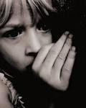
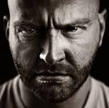
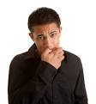
Character Development
What emotions do you think these people are feeling? How did you decide?
LO: To develop the use of 'show' not 'tell' in character descriptions.
TASK: Choose 1-2 characters to describe their feelings – DON’T TELL No: Glaring in anger,…
YES: Gritting his teeth, glaring, his eyes were smouldering embers of death.

Slide 9
Write a comment and a target for your partner based on the criteria below.
Assessment Criteria
Detailed description – 5 senses
Uses 'show' not 'tell consistently
Varied vocabulary
Use of complex sentence structures
Challenge: some alliteration, similes and imagery detail used

Slide 10
Characters
Understand how to show not tell
Able to begin making character

Slide 11
Which of the descriptions are more engaging? Why? Circle what is good.
Challenge: Which one gives you more insight into the character?
Running down the street, a sense of urgency filled the girl leading to a further increase in her speed. Her hair cascaded down her back, hints of gold glittering as the sun hit it; her pace had caused it to become loose from the bobble she had carefully put in earlier.
The girl had long blond hair and blue eyes. She was fairly tall and was involved in a range of different sports. She was very popular at school and was always texting on her phone.

Slide 12
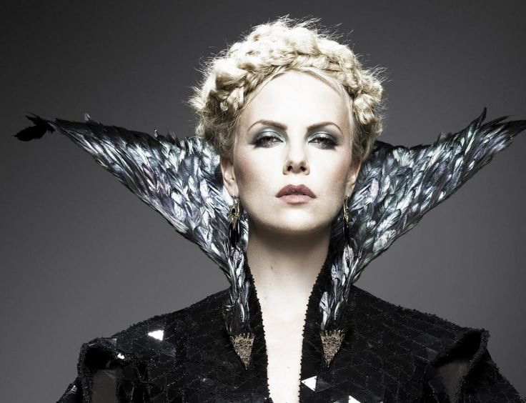
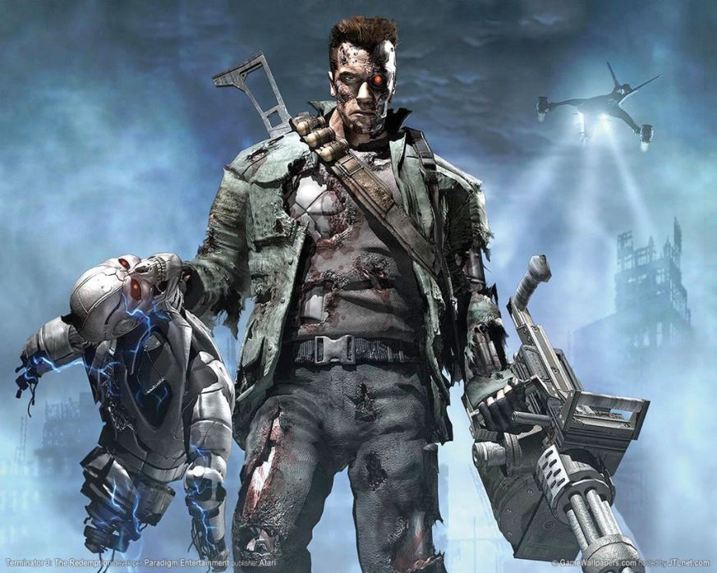
TASK: which character is being described? Find three techniques used in all three descriptions.
Bulbous eyes protruded from an emaciated, face. Long, slender fingers always strayed, twitching, taunting like trying to catch an insect. His/her teeth were stubs in his/her gums.
A chord of static, a discharge of electrical power surged through his/her ferocious frame beneath leathery skin, dangling, like mouldy lettuce. like rusty barbed wire.
His/her milk-white skin was pulled taut like a drum-head ready to snap. Eye-lashes whispered in the moonlight, tauntingly whispering a poisonous promise.

Slide 13
Character trait Paragraph
Bulbous eyes protruded from an emaciated, face. Long, slender fingers always strayed, twitching, taunting like trying to catch an insect. His/her teeth were stubs in his/her gums.
A chord of static, a discharge of electrical power surged through his/her ferocious frame beneath leathery skin, dangling, like mouldy lettuce. stabbing like rusty barbed wire.
His/her milk-white skin was pulled taut like a drum-head ready to snap. Eye-lashes whispered in the moonlight, tauntingly whispering a poisonous promise.
similes
personification
Alliteration
adjectives

Slide 14
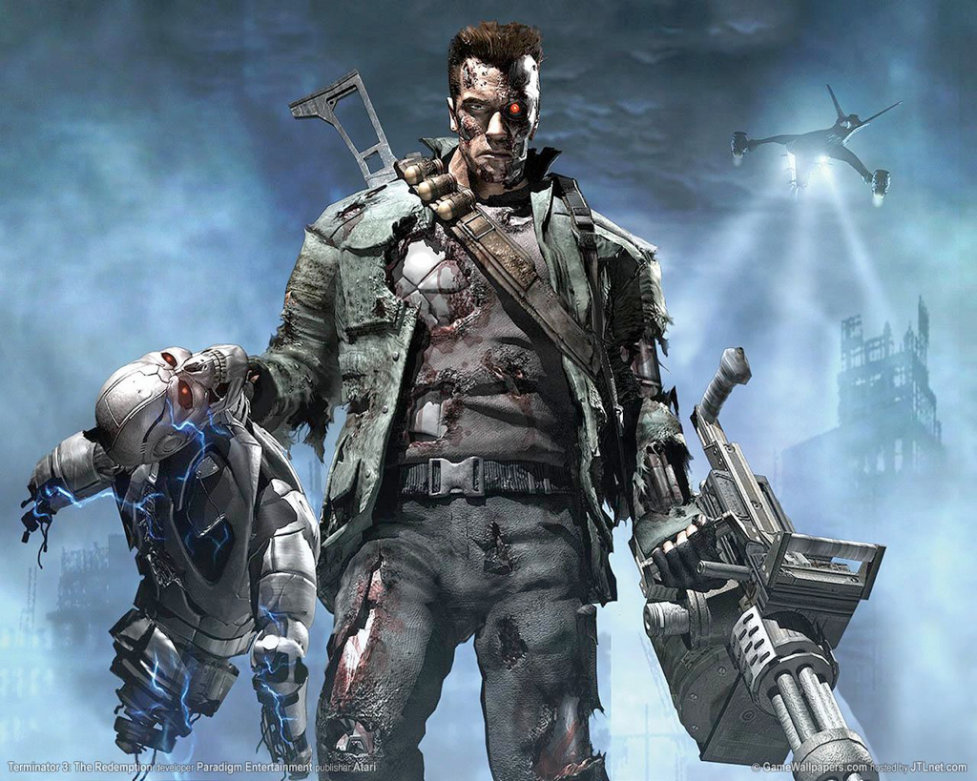
TASK: Describe the different parts of your character to show it seems serious, cruel, unstoppable and invincible.
eyes
Face
Voice
Skin
Body
Arms

Slide 15
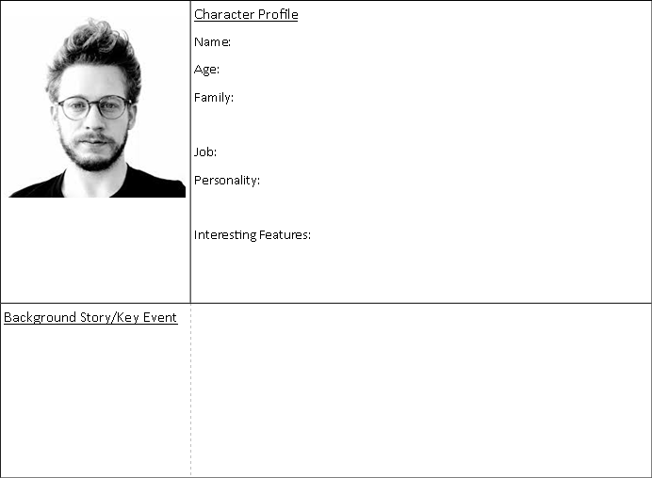
Complete the character profile cards.
Leave the background story box blank for now.

Slide 16
TASK: Now, create an opening for your character that hints at their personality.
Angry character – describe their burning colour of eyes
Gentle – describe their pale, vulnerable skin or hair
Sneaky – describe their shifting movements, and twitching, darting eyes
Evil – use references to torture, blood, violence – His eyes were two bruises on his face…
Godlike and Good: describe their “golden” appearance – give the impression of an aura or HALO around them. His white teeth glistened like a stained-glass church window…
Challenge!
If your main characters are in love in your story, you could flash back to their first meeting in a park where they were both (separately) walking their dogs and they became interested in each other first.
If your characters are close brothers and one of them will later betray the other, you could flash back to them as children playing a game where one cheats and makes the other cry.

