Slide 1
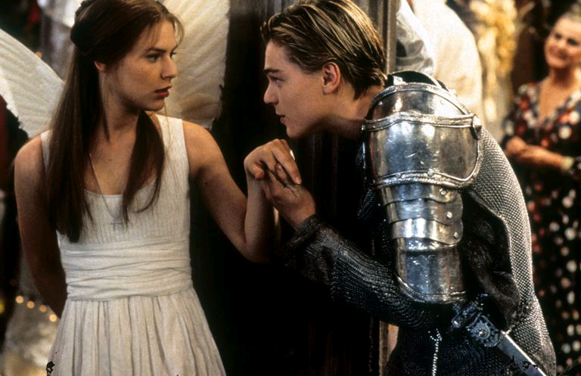
Key Words:
Play
Prologue
Sonnet
Iambic pentameter
(Penta means five, so a line of iambic pentameter consists of five iambs - five sets of unstressed and stressed syllables.)
Rhyming couplets
Foreshadow
Foretell
Predict
Memory and embedding knowledge
Starter: read the knowledge organiser and highlight key information
CHALLENGE: dual coding
Draw a symbol/symbols to represent the 5 acts in the play/knowledge organiser
Learning Objective: to revise the plot of Romeo and Juliet
AO1 Read, understand and respond to texts. Students should be able to: • maintain a critical style and develop an informed personal response • use textual references, including quotations, to support and illustrate interpretations.
AO2 Analyse the language, form and structure used by a writer to create meanings and effects, using relevant subject terminology where appropriate.
AO3 Show understanding of the relationships between texts and the contexts in which they were written.

Slide 2

Act | PLOT
1 Fights and a Party | Prologue: Family feud & fatal consequences for 2 young lovers There is a fight between two rival families (Montagues and Capulets) which is stopped by the Prince. Romeo is unhappy because Rosaline doesn’t love him. Paris asks Capulet for Juliet’s hand in marriage, but Capulet tells him she’s not ready. Capulet throws a ball. Mercutio is invited to the ball, but Benvolio and Romeo crash it. This enrages Tybalt. Romeo and Juliet meet, talk, fall in love at first sight and kiss.
2 A Secret Marriage | In the Capulets’ garden, Romeo overhears Juliet thinking aloud about how much she likes Romeo but is the son of her family’s enemy. Romeo talks to her and they decide to get married. Romeo asks Friar Lawrence for help – he agrees to marry them. Romeo meets Mercutio and Benvolio, and they tease the Nurse who gives a message to Romeo from Juliet. After the Nurse tells Juliet the plan to marry that afternoon, they get married in secret.
3 Deaths | Tybalt kills Mercutio in a fight; in revenge, Romeo kills Tybalt. The Prince exiles Romeo from Verona as punishment. R & J spend the night together before R leaves the city. Juliet’s parents tell her that she must marry Paris in two days but she tells them she can’t. during an intense argument.
4 Plans and Potions | Juliet asks the friar to help, whose plan involves faking her death. Using Friar Lawrence’s potion, Juliet fakes her own death. Friar Lawrence sends Romeo a letter telling him about the plan and to rescue her from her family tomb. Juliet’s family think she’s dead so bury her in the family tomb.
5 Un-happy Ending | R doesn’t get the Friar’s letter. He believes J to be dead and goes to her tomb to kill himself after buying some poison. Paris sees Romeo going to the tomb, they fight and R kills Paris. R places P’s body in the tomb, lies next to Juliet and drinks the poison. Friar Lawrence finds out that R didn’t get the letter so goes to the tomb. As Friar Lawrence arrives, Juliet wakes up. Juliet refuses to go with him and he doesn’t want to get into trouble for Romeo’s death, so the Friar leaves. When Juliet realises that Romeo is dead, she kills herself. Everyone comes to the tomb, where the friar has to explain what has happened. Grieving, Montague and Capulet realise that their feud has caused the suicides of their children so agree to make peace.
ENG LIT PAPER 1
1 hr 45 mins
Section A: Romeo & Juliet – 50 mins. Detailed response to extract and then text as a whole
THEMES
LOVE: R & J fall in true love at first sight. Their young love is genuine but impulsive and destructive. Romeo’s ‘love’ for Rosaline is an passing infatuation and Romeo learns what true love is. There are numerous puns and jokes about sex, and R&J’s relationship reflects physical desire too.
CONFLICT & HONOUR: Personal and family reputation was crucial in the 16th century. Honour is important to all the characters – they can’t ignore insults and have to defend the honour of their family. Characters like Benvolio and the Prince show how difficult it is to avoid the violence of the family feud. The violence gets worse in the second half of the play and the feud only stops because of the deaths of R & J.
GENDER: Women in the play are able to exert little influence. Capulet sees Juliet as his property and feels that she should be grateful for the match with Paris he has arranged. Juliet very aware that virtue and chastity were more important and valuable to women than men as they had to be chaste to secure a good marriage.
FAMILY & MARRIAGE: Wealthy people often married not for love but for money, power and status; arranged marriages were common; Capulet tries to use Juliet as a ‘bargaining chip’. The family was society in microcosm with the father as ‘governor’. Juliet is torn between duty to her family and desire for personal happiness. R & J willing to give up their families for marriage. The young were expected to obey the old and Shakespeare celebrates the passion and independence of R & J.
FATE: The prologue establishes the idea that fate, not just the characters’ actions, is to blame for the catastrophes. Many instances of luck impact on the characters such as the servant inviting Romeo to the ball, Friar John and his message being detained, Paris being at the Capulet tomb when Romeo arrives
RELIGION: A powerful influence in the 16th century and it provided a set of moral rules to live by. Represented by Friar Lawrence who is trusted by all. R & J had to marry in order to be together. Religious imagery and references often used by characters.
CONTEXT
Verona: R & J set in Verona in the fourteenth century. Verona was a rich, lively, cultured city but had been afflicted by violence for centuries. Political leaders clashed with religious leaders for power, status and wealth and many people were obliged to take sides.
Women: Society in the 16th century was patriarchal: men were dominant and women were inferior and expected to marry as young as 12. Noblewomen like Juliet would have received some education but there was little freedom in most areas of life for women. Lower class women received no education and would have worked as some sort of servant.
Queen Elizabeth I: Provided a powerful example of a strong female in a male-dominated society, living by rules established by men. She was not representative of women in wider English society and was celebrated as an exceptional woman. Admired by Shakespeare and led England to great wealth, prosperity and national confidence.
Tragic Hero: Romeo and Juliet is a tragedy and the characters of Romeo and Juliet can be seen as tragic heroes (main character whose downfall brought about by own actions or tragic flaw). Both are guilty of loving too much and too quickly and acting too rashly.
The Plague: Elizabethan England and Renaissance Verona were badly affected by outbreaks of the painful, deadly and contagious ‘black death’. Many parents (including Shakespeare) lost children to the plague and it provides a metaphor for Mercutio’s final curse as the Montagues and Capulets all lose children. Romeo doesn’t get Friar Lawrence’s letter because Friar John s detained for fear he may have the plague.
VOCABULARY
Belligerent: Aggressive and hostile | Dutiful: Acts obediently | Impulsive: Acts without thinking | Despair: total loss of hope
Idolatry: Extreme admiration or love | Conflict: A struggle between opposites | Melancholy: Feeling of thoughtful sadness | Infatuation: Obsession
Banishment: Exile | Tyrannical: treats people cruelly | Tormented: experience great suffering | Confidant: A trusted person
Notes:
EDIT TO INCLUDE MORE KEY VOCABULARY, CONVENTIONS OF ELIZAB. DRAMA, ANALYTICAL SKILLS ETC. LESS FOCUS ON QUOTATIONS

Slide 3
ROMEO
Well-respected Montague. Falls in love with the daughter of his family’s enemy and marries her in secret – kills her cousin in a rage and commits suicide wrongly believing Juliet to be dead.
Initially knows more about love from books than experience: “thy love did read by rote” (Friar Lawrence)/ “Love is a smoke raised with the fume of sighs…a fire…a sea…a madness” / “young waverer” (Friar Lawrence) / “you kiss by th’ book” (Juliet) Emotional, passionate and has to deal with rejection by Rosaline: “Is love a tender thing? It is too rough,. Too rude, too boisterous, and it pricks like thorn.” Fears fate & future: “O! I am Fortune’s fool!” Falls overwhelmingly in love with Juliet at first sight: “what light through yonder window breaks? It is the east and Juliet is the sun.” / “speak again bright angel” / “O, she doth teach the torches to burn bright” / “Did my heart love till now?”/“faithful vow” Challenges barriers to Juliet: “with love’s light wings did I o’erperch these walls” Tries to avoid fighting but worries that he’s less manly: “good Capulet, which name I tender / As dearly as my own, be satisfied“ / “O sweet Juliet, Thy beauty hath made me effeminate And in my temper softened valor’s steel!” Hot-headed, enraged by the killing of Mercutio: “fire-ey’d fury be my conduct now!” Devastated by exile to Mantua: “Ha, banishment! Be merciful, say ‘death’…Heaven is here, Where Juliet lives” Horrified by news of Juliet’s death and decides to commit suicide: “I defy you stars…Juliet, I will lie with thee tonight.” Gives violent warning to Balthazar not to interfere with his suicide: “I will tear thee joint by joint And strew this hungry churchyard with thy limbs.” Urges Paris not to challenge him outside the Capulet tomb: “I beseech thee, youth, Put not another sin upon my head By urging me to fury.” Sees Juliet is still beautiful in ’death’: “Death, that hath sucked the honey of thy breath, Hath had no power yet upon thy beauty. Thou art not conquered.” Dies as he began the play, by expressing love: “Thus with a kiss I die.”
JULIET
13-year-old Capulet. Defies family and gender expectations to marry the son of her family’s enemy – overcome by grief at Romeo’s death and commits suicide
Young and innocent: “My child is yet a stranger in the world. She hath not seen the change of fourteen years.” Idolised by her father: “She’s the hopeful lady of my earth.” / “My will to her consent is but a part” Falls in love with Romeo at first sight: “Then have my lips the sin that they have took.” / “If he be married, My grave is like to be my wedding bed.” Cautious about her love for Romeo: “It is too rash, too unadvised, too sudden, Too like the lightning,” Conflicted between family loyalty and love for Romeo: "O Romeo, Romeo! wherefore art thou Romeo?“ / "What's in a name? That which we call a rose, By any other word would smell as sweet.“ / “My only love sprung from my only hate!” Prepared to defy her family and the feud: “Deny thy father and refuse thy name..be but sworn my love, And I’ll no longer be a Capulet.” Commits herself to Romeo: “my true love is grown to such excess I cannot sum up sum of half my wealth.” Impatient to be with Romeo after wedding: “Spread thy close curtain, love-performing night” / O, I have bought the mansion of a love, But not possessed it, and though I am sold, Not yet Conflicted about Romeo after he kills Tybalt: “O serpent heart hid with a flowering face!” / “Beautiful tyrant! Fiend angelical!” Refuses father’s order to marry Paris: “Delay this marriage for a month, a week. Or, if you do not, make the bridal bed In that dim monument where Tybalt lies.” Angry at Nurse for her advice to marry Paris: “Ancient damnation! O most wicked fiend” Brave - prepared to risk Friar Lawrence’s plan: “Give me, give me! O, tell not me of fear!” Brave – does not fear death: “O happy dagger, This is thy sheath: there rust, and let me die.”
CAPULET
Feuding with Capulet. Begins as doting father but becomes aggressive & controlling
Initially calm and easy-going: “Content thee, gentle coz. Let him alone.” Angered by Juliet’s defiance: “Hang thee, young baggage! Disobedient wretch!” Verbally attacks Nurse for defending J: “Peace, you mumbling fool!” Juliet’s death changes him: “O brother Montague, give me thy hand.”
MERCUTIO Romeo’s friend, playful, witty but aggressive – gets caught in the middle of the feud
Tells Romeo to get over Rosaline: “If love be rough with you, be rough with love.” Appalled by Romeo’s refusal to fight Tybalt: "O calm, dishonorable, vile submission“ Dies cursing both families: "A plague o' both your houses”
FRIAR LAWRENCE
Like a father to Romeo – wise, trusted, tries to help but actions lead to R & J deaths
Sees opportunity to resolve feud: “For this alliance may so happy prove, To turn your households' rancour to pure love.” Worries about consequences of R&J’s love: “These violent delights have violent ends” Criticises Romeo’s reaction to exile: “Art thou a man? … Thy tears are womanish.” / “Unseemly woman in a seeming man” / “A pack of blessings light upon thy back”
NURSE Devoted nanny to Juliet – talkative, silly well-meaning but irresponsible
Thinks the world of Juliet: “Thou wast the prettiest babe that e’er I nurs’d” / “lamb” / “ladybird” Makes vulgar jokes about sex: “You shall bear the burden soon at night” Wishes J to be emotionally and physically content with R: “happy days to happy nights” Appears more devastated than J’s family when J ‘dies’: “O woeful, woeful, woeful day…Never was seen so black a day as this.”
BENVOLIO Romeo’s loyal cousin, peacemaker and opposite to Tybalt
Cares for Romeo: “What sadness lengthens Romeo’s hours?” Protects Romeo after slaying of Tybalt: “Be gone, away! ... The Prince will doom thee death” Contrasts with Tybalt’s hostility: “I do but keep the peace, put up thy sword.”
TYBALT Juliet’s cousin – aggressive and consumed with hatred for the Montagues
Hateful, angry: “peace? I hate the word, As I hate hell, all Montagues, and thee.” / “…a Montague. Fetch me my rapier, boy.” / “To strike him dead I hold it not a sin.” Obsessed with family honour: “Now by the stock and honour of my kin” Determined to kill Romeo: “Boy, this shall not excuse the injuries That thou hast done me. Therefore turn and draw.”

Slide 4
Key Words:
Play
Prologue
Sonnet
Iambic pentameter
(Penta means five, so a line of iambic pentameter consists of five iambs - five sets of unstressed and stressed syllables.)
Rhyming couplets
Foreshadow
Foretell
Predict
Memory and embedding knowledge
Self quizzing …
At the start, who does Romeo love?
Who asks to marry Juliet?
What is Capulet’s response?
Who throws a masked ball?
Why is Tybalt angered at the ball?
Who falls In love at the ball?
Learning Objective: to revise the plot of Romeo and Juliet
AO1 Read, understand and respond to texts. Students should be able to: • maintain a critical style and develop an informed personal response • use textual references, including quotations, to support and illustrate interpretations.
AO2 Analyse the language, form and structure used by a writer to create meanings and effects, using relevant subject terminology where appropriate.
AO3 Show understanding of the relationships between texts and the contexts in which they were written.

Slide 5
Key Words:
Play
Prologue
Sonnet
Iambic pentameter
(Penta means five, so a line of iambic pentameter consists of five iambs - five sets of unstressed and stressed syllables.)
Rhyming couplets
Foreshadow
Foretell
Predict
Memory and embedding knowledge
Self quizzing …
At the start, who does Romeo love? Rosaline
Who asks to marry Juliet? Paris
What is Capulet’s response? No, wait a while
Who throws a masked ball? Capulet
Why is Tybalt angered at the ball? Romeo et al arrive
Who falls In love at the ball? R and J
Learning Objective: to revise the plot of Romeo and Juliet
AO1 Read, understand and respond to texts. Students should be able to: • maintain a critical style and develop an informed personal response • use textual references, including quotations, to support and illustrate interpretations.
AO2 Analyse the language, form and structure used by a writer to create meanings and effects, using relevant subject terminology where appropriate.
AO3 Show understanding of the relationships between texts and the contexts in which they were written.

Slide 6
Key Words:
Play
Prologue
Sonnet
Iambic pentameter
(Penta means five, so a line of iambic pentameter consists of five iambs - five sets of unstressed and stressed syllables.)
Rhyming couplets
Foreshadow
Foretell
Predict
The Prologue
The prologue is written in a sonnet. What can you remember about sonnets?
Learning Objective: to revise the plot of Romeo and Juliet
AO1 Read, understand and respond to texts. Students should be able to: • maintain a critical style and develop an informed personal response • use textual references, including quotations, to support and illustrate interpretations.
AO2 Analyse the language, form and structure used by a writer to create meanings and effects, using relevant subject terminology where appropriate.
AO3 Show understanding of the relationships between texts and the contexts in which they were written.

Slide 7
1. What is the purpose of the prologue?
HA THE PROLOGUE
Two households, both alike in dignity,
In fair Verona, where we lay our scene,
From ancient grudge break to new mutiny,
Where civil blood makes civil hands unclean.
From forth the fatal loins of these two foes
A pair of star-cross'd lovers take their life;
Whose misadventured piteous overthrows
Do with their death bury their parents' strife.
The fearful passage of their death-mark'd love,
And the continuance of their parents' rage,
Which, but their children's end, nought could remove,
Is now the two hours' traffic of our stage;
The which if you with patient ears attend,
What here shall miss, our toil shall strive to mend.
2. How does the prologue serve as an introduction to the play? What does the prologue tell us about? What facts do we learn?
3. What do we learn about the 2 families?
4. What is an ‘ancient grudge’??
5. What is the ‘new mutiny’?
6. What does the repetition of ‘civil’ tell us about the battles?
7. What does ‘star-cross’d’ suggest about their love? How is the theme of fate established?
9. What does it take to resolve the conflicts?
8. What does ‘foes’ reveal about the families? Why is ‘civil’ repeated?
10. Which themes are revealed in the prologue?
11. List words associated with the lexical field of tragedy
12. Where is foreshadowing evident in the prologue?
13. Why does Shakespeare reveal the events, ideas and themes at ThE start of the play?
14. How are the conventions of a tragedy indicated?
Conflict
Love
Fate
Tragedy
CHALLENGE: 1) what will the audience think, feel or imagine?
2) What are the key themes presented?

Slide 8
1. What is the point of the prologue?
2. How does the prologue serve as an introduction to the play? What does the prologue tell us about? What facts do we learn?
LA THE PROLOGUE
Two households, both alike in dignity,
In fair Verona, where we lay our scene,
From ancient grudge break to new mutiny,
Where civil blood makes civil hands unclean.
From forth the fatal loins of these two foes
A pair of star-cross'd lovers take their life;
Whose misadventured piteous overthrows
Do with their death bury their parents' strife.
The fearful passage of their death-mark'd love,
And the continuance of their parents' rage,
Which, but their children's end, nought could remove,
Is now the two hours' traffic of our stage;
The which if you with patient ears attend,
What here shall miss, our toil shall strive to mend.
3. What 2 things do we learn about the 2 families?
4. If ‘ancient’ means old, what is a ‘ grudge’?
5. What is the ‘ mutiny’?
6. What does the repetition of ‘civil’ tell us about the battles?
7. What does ‘star-cross’d’ suggest was always going to happen?
9. What ‘D’ does it take to resolve the conflicts?
8. What does ‘foes’ reveal about the families?
10. Which themes are revealed in the prologue?
11. List 6 words associated with the theme of tragedy
12. Where is prediction evident in prologue?
13. Why does Shakespeare reveal the events, ideas and themes at the start of the play?
14. How are the features of a tragedy indicated? What does Shakespeare use in his prologue?
Conflict
Love
Fate
Tragedy
CHALLENGE: 1) what will the audience think, feel or imagine?
2) What are the key themes presented?

Slide 9
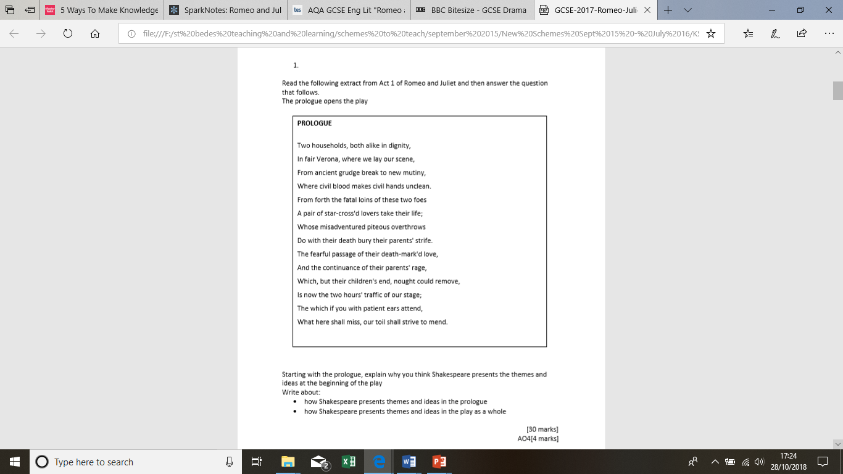
STEP by STEP guide
1. select quotes
2.consider themes presented
Explore and analyse why, their importance and how they relate to the rest of the play
Explore the EFFECT of the structure-Sonnet- and it’s importance (mention how the play ends with a sonnet- spoken by the fathers/Prince and what they remind us of)
Link to the themes across the play/key quotes
KEY WORDS:
Foreshadow/ing
Foretell
Predicts
Indicates
Reflects
Informs
prepares
KEY WORDS:
Entertains
Bemuses
Shocks
Engages
Conflict
Love
Retribution
Fate

Slide 10
Key Words:
Play
Prologue
Sonnet
Iambic pentameter
(Penta means five, so a line of iambic pentameter consists of five iambs - five sets of unstressed and stressed syllables.)
Rhyming couplets
Foreshadow
Foretell
Predict
WAGOLL
Cleverly, Shakespeare conveys the important themes that occur throughout the play from the very start. As a result of this, he informs audiences about what to expect and what to observe as the play is performed which prepares them for key events and themes.
Effectively, the prologue is constructed to be informative in, ‘two households both alike in dignity’ so that the audience is aware the warring families are both equal in terms of status, wealth, reputation and ambition. Furthermore, it establishes the setting in ‘Verona’ and the repetition of ‘civil’ indicates regular feuds exist within this city between the local citizens.
Without doubt, the prologue establishes the main theme of fate in, ‘ a pair of star cross’d lovers take their life’ and so advises the audience that the main characters’ love is doomed and predestined before it has begun. The idea of fate is clearly stated and is ‘hanging in the stars’ from the onset and their untimely, ‘death-marked love’ cannot be avoided as the adjective ‘death’ connotes the severe outcomes of the play.
EVEN BETTER IF
Cleverly, Shakespeare conveys the important themes that occur throughout the play from the very start. As a result of this, he informs audiences about what to expect and what to observe as the play is performed which prepares them for key events and themes.
Effectively, the prologue is constructed to be informative in, ‘two households both alike in dignity’ so that the audience is aware the warring families are both equal in terms of status, wealth, reputation and ambition. Furthermore, it establishes the setting in ‘Verona’ and the repetition of ‘civil’ indicates regular feuds exist within this city between the local citizens. Clearly, the prologue serves as an introduction to events and ides present in the play and Shakespeare crafts the prologue with the sole purpose of revealing what the play is about before it even begins. This creates a sense of anticipation within the audience as they are both expectant and eager to witness the feuding events hinted at in the prologue. From the onset, the prologue foreshadows the theme of conflict which occurs consistently throughout the play and from the very beginning of act one, like the start of the prologue.
Without doubt, the prologue establishes the main theme of fate in, ‘ a pair of star cross’d lovers take their life’ and so advises the audience that the main characters’ love is doomed and predestined before it has begun. The idea of fate is clearly stated and is ‘hanging in the stars’ from the onset and their untimely, ‘death-marked love’ cannot be avoided as the adjective ‘death’ connotes the severe outcomes of the play. The verb ‘hanging’ implies a self made death and reflects how Romeo and Juliet plot their own suicide in revenge for their ‘parents’ strife’ It creates a feeling of panic and curiosity within the audience and encourages them to reflect on gender inequality and patriarchal ideals of their time.
Clear point
Quote
Analysis
Language
Purpose/effect/structure
Impact on audience
How could this be made better?
What contextual links can be made?
Which parts could be explained in more detail?

Slide 11

Review: 5 in 5 Romeo & Juliet
What is the “ancient grudge”?
What is a “mutiny”?
How does it “break to new mutiny”?
Who are the two opposing sides and what are they like?
How do we know the two protagonists ultimate fate?
Notes:
Prologue 5 in 5

Slide 12
Key Words:
Establishes
Conflict
Plot
Foreshadows
Foretells
Predicts
Tragedy
Themes
Starter
Starter: read the examiner’s report on summer 2019 lit (R&J) exam and highlight key information
CHALLENGE: create a TOP TIPS box for yourself!
TOP TIPS
Learning Objective: to revise the plot of Romeo and Juliet
AO1 Read, understand and respond to texts. Students should be able to: • maintain a critical style and develop an informed personal response • use textual references, including quotations, to support and illustrate interpretations.
AO2 Analyse the language, form and structure used by a writer to create meanings and effects, using relevant subject terminology where appropriate.
AO3 Show understanding of the relationships between texts and the contexts in which they were written.

Slide 13
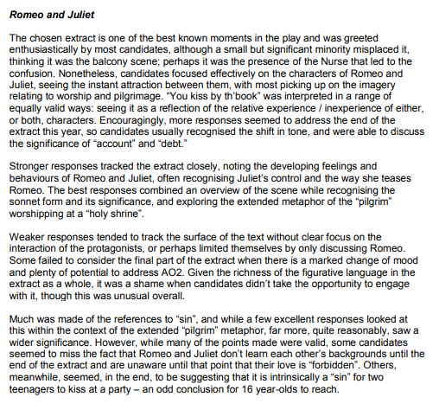
Key Words:
Examiner’s evaluation of exam answers summer 2019
Learning Objective: to revise the plot of Romeo and Juliet
AO1 Read, understand and respond to texts. Students should be able to: • maintain a critical style and develop an informed personal response • use textual references, including quotations, to support and illustrate interpretations.
AO2 Analyse the language, form and structure used by a writer to create meanings and effects, using relevant subject terminology where appropriate.
AO3 Show understanding of the relationships between texts and the contexts in which they were written.

Slide 14
Self-quizzing … Romeo
Key Words:
Establishes
Conflict
Plot
Foreshadows
Foretells
Predicts
Tragedy
Themes
Which ‘I’ shows Romeo is obsessed with Juliet and Rosaline?
Which ‘D’ reveals Romeo is melancholy when Rosaline rejects his love?
Which ‘R’ describes Romeo’ actions and love for Juliet?
Which ‘I’ describes Romeo’s attitude towards love?
Which ‘P’ describes Romeo’s personality?
Which ‘I’ describes Romeo’s speed at falling in love?
Which ‘E’ describes Romeo’s character and reactions throughout the play?
Which ‘S’ describes Romeo’s love?
Which ‘I’ describes Romeo’s romantic view of love and relationships?
Which ‘B’ describes Romeo’s state of mind at the start when Rosaline has rejected his love?

Slide 15
Self-quizzing … Romeo
Which ‘I’ shows Romeo is obsessed with Juliet and Rosaline? Infatutation
Which ‘D’ reveals Roemo is melancholy when Rosaline rejects his love? Depressed
Which ‘R’ describes Romeo’ actions and love for Juliet? Reckless
Which ‘I’ describes Romeo’s attitude totards love? Immature
Which ‘P’ describes Romeo’s personality? Passionate
Which ‘I’ describes Romeo’s speed at falling in love? Impulsive
Which ‘E’ describes Romeo’s character and reactions throughout the play? Emotional
Which ‘S’ describes Romeo’s love? Superficial
Which ‘I’ describes Romeo’s romantic view of love and relationships? Idealistic
Which ‘B’ describes Romeo’s state of mind at the start when Rosaline has rejected his love? Brooding

Slide 16
STEP by STEP guide
1. select quotes
2.consider themes presented
Explore and analyse why, their importance and how they relate to the rest of the play
Explore the EFFECT of the structure-Sonnet- and it’s importance (mention how the play ends with a sonnet- spoken by the fathers/Prince and what they remind us of)
Link to the themes across the play/key quotes
KEY WORDS:
Foreshadow/ing
Foretell
Predicts
Indicates
Reflects
Informs
prepares
KEY WORDS:
Entertains
Bemuses
Shocks
Engages
Conflict
Love
Retribution
Fate

Slide 17
WAGOLL (I, We, You do)
Cleverly, Shakespeare conveys the important themes that occur throughout the play from the very start. As a result of this, he informs audiences about what to expect and what to observe as the play is performed which prepares them for key events and themes.
Effectively, the prologue is constructed to be informative in, ‘two households both alike in dignity’ so that the audience is aware the warring families are both equal in terms of status, wealth, reputation and ambition. Furthermore, it establishes the setting in ‘Verona’ and the repetition of ‘civil’ indicates regular feuds exist within this city between the local citizens. Clearly, the prologue serves as an introduction to events and ides present in the play and Shakespeare crafts the prologue with the sole purpose of revealing what the play is about before it even begins. This creates a sense of anticipation within the audience as they are both expectant and eager to witness the feuding events hinted at in the prologue. From the onset, the prologue foreshadows the theme of conflict which occurs consistently throughout the play and from the very beginning of act one, like the start of the prologue.
In the middle of the extract, Shakespeare launches the theme of conflict as he states there has been an ‘ancient grudge’.
In the middle of the extract, Shakespeare launches the theme of conflict as he states there has been an ‘ancient grudge’. The adjective ‘ancient’ indicates there is a long standing, historic conflict between the two warring families which has now developed into a ‘new mutiny’. The noun ‘mutiny’ implies there is another uprising of conflict between the Capulets and Montagues and this suggests the romantic tragedy will be abundant in fights and violence.
Without doubt, the prologue establishes the main theme of fate in, ‘ a pair of star cross’d lovers take their life’ and so advises the audience that the main characters’ love is doomed and predestined before it has begun. The idea of fate is clearly stated and is ‘hanging in the stars’ from the onset and their untimely, ‘death-marked love’ cannot be avoided as the adjective ‘death’ connotes the severe outcomes of the play. The verb ‘hanging’ implies a self made death and reflects how Romeo and Juliet plot their own suicide in revenge for their ‘parents’ strife’ It creates a feeling of panic and curiosity within the audience and encourages them to reflect on gender inequality and patriarchal ideals of their time.
Cleverly, Shakespeare conveys the important themes that occur throughout the play from the very start. As a result of this, he informs audiences about what to expect and what to observe as the play is performed.
Effectively, the prologue is constructed to be informative in, ‘two households both alike in dignity’ so that the audience is aware the warring families are both equal in terms of status, wealth, reputation and ambition. Furthermore, it establishes the setting in ‘Verona’ and the repetition of ‘civil’ indicates regular feuds exist within this city between the local citizens. Clearly, the prologue serves as an introduction to events and ides present in the play and Shakespeare crafts the prologue with the sole purpose of revealing what the play is about before it even begins. This creates a sense of anticipation within the audience as they are both expectant and eager to witness the feuding events hinted at in the prologue.
feuds
Without doubt, the prologue establishes the main theme of fate in, ‘ a pair of star cross’d lovers take their life’ and so advises the audience that the main characters’ love is doomed and predestined before it has begun. The idea of fate is clearly stated and is ‘hanging in the stars’ from the onset and their untimely, ‘death-marked love’ cannot be avoided as the adjective ‘death’ connotes the severe outcomes of the play. It creates a feeling of panic and curiosity within the audience….

Slide 18
WAGOLL (I, We, You do)
YOUR TURN
1. Start with a summary of the extract
2. track the text- identify ¾ themes/points to write about
3. write about them in order e.g. order of extract
4. link to the wider aspects of the play
OR
5. write about the wider aspects of the play after the extract
Key Words:
Establishes
Conflict
Plot
Foreshadows
Foretells
Predicts
Tragedy
Themes
SUCCESS CRITERIA
Summary
PETER (embed short quotes within your explanation/analysis)
Track the text
Refer to the wider text
Zoom in on language/techniques and context

Slide 19
Review: 5 in 5 Romeo & Juliet
What is the “ancient grudge”?
What is a “mutiny”?
How does it “break to new mutiny”?
Who are the two opposing sides and what are they like?
How do we know the two protagonists ultimate fate?
Notes:
Prologue 5 in 5

Slide 20
Key Words:
Melancholy
Rejected
Oxymoron (a figure of speech in which apparently contradictory terms appear in conjunction (e.g. faith unfaithful kept him falsely true ))
Atypical
(not stereotypical)
Starter
complete the 5 and day MEMORY and RECALL
Learning Objective: to revise how Romeo Is presented in 1:1
AO1 Read, understand and respond to texts. Students should be able to: • maintain a critical style and develop an informed personal response • use textual references, including quotations, to support and illustrate interpretations.
AO2 Analyse the language, form and structure used by a writer to create meanings and effects, using relevant subject terminology where appropriate.
AO3 Show understanding of the relationships between texts and the contexts in which they were written.

Slide 21
5 in 5 Romeo & Juliet
What is the exposition of Act 1?
How does Shakespeare reinforce patriarchy in Act 1?
What action takes place and who is involved 1:1?
4. Who represents the law and how do they do this?
5. What is the outcome for both families of this action?
Notes:
A1 S1 – The fight at the start and Prince Escalus intervenes

Slide 22
5 in 5 Romeo & Juliet
What is the exposition of Act 1? Prologue
How does Shakespeare reinforce patriarchy in Act 1? Paris and Capulet’s discussion about Juliet being ready to marry or not
3. What action takes place and who is involved 1:1?
Servants of both families meet, quarrel and Tybalt fights
4. Who represents the law and how do they do this? Prince Escalus and he makes threats
5. What is the outcome for both families of this action? Banishment or death or imprisonment
Notes:
A1 S1 – The fight at the start and Prince Escalus intervenes

Slide 23
MEMORY AND RECALL
Self-quizzing …
Key Words:
Melancholy
Rejected
Oxymoron (a figure of speech in which apparently contradictory terms appear in conjunction (e.g. faith unfaithful kept him falsely true ))
Atypical
(not stereotypical)
Which ‘I’ describes Romeo’s love for Rosaline?
Which ‘D describes Romeo at the start of the play?
Which ‘B’ describes his dwelling on Rosaline’s rejection?
Which ‘E’ describes Romeo’s state of being?
Which ‘R’ describes Romeo’s view of relationships?

Slide 24
Self-quizzing …
Key Words:
Melancholy
Rejected
Oxymoron (a figure of speech in which apparently contradictory terms appear in conjunction (e.g. faith unfaithful kept him falsely true ))
Atypical
(not stereotypical)
Which ‘I’ describes Romeo’s love for Rosaline? Infatuation
Which ‘D describes Romeo at the start of the play? Depressed
Which ‘B’ describes his dwelling on Rosaline’s rejection? Brooding
Which ‘E’ describes Romeo’s state of being? Emotional
Which ‘R’ describes Romeo’s view of relationships? Romantic

Slide 25
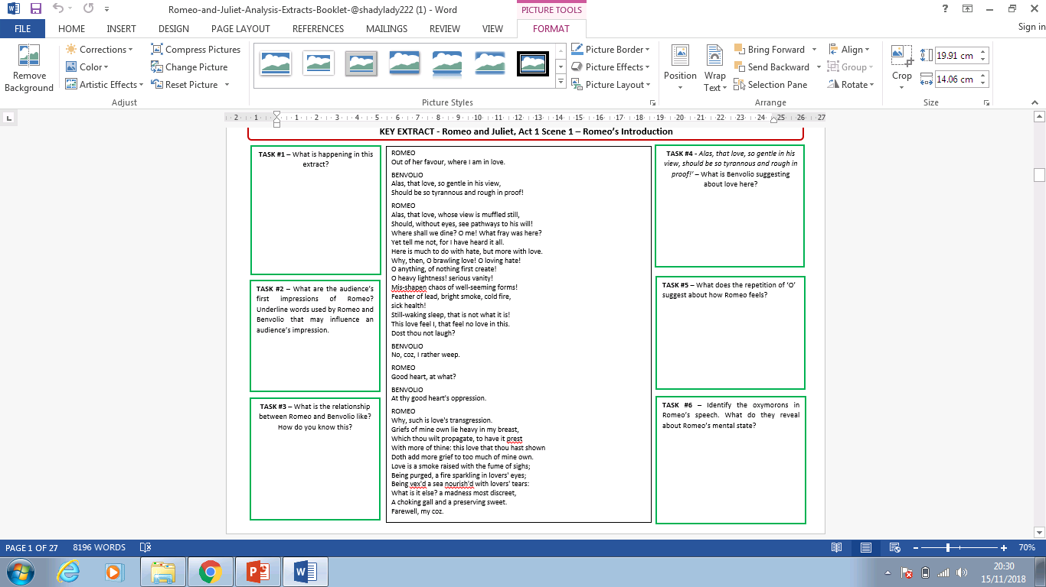
How is Romeo presented in the extract and throughout the whole play?
What, how, why
Key vocab:
Rejected
Scorned
Spurned
Rebuffed
Appears
Different
Reality
Mournful
Sad
Sorrowful
Woeful
Grief-stricken
Despondent
Contradictory
Glum
Depressed
Dismayed
Disappointed

Slide 26
Feedback: How is Romeo presented in the extract and throughout the whole play?
Romeo feels rejected and rebuffed as he is ‘out of favour’. Rosaline as rebuffed his advances and he is shocked, saddened and melancholy at her dismissal of his feelings
Love appears kind and romantic but is actually difficult and challenging so be harsh with love and don’t become so embroiled in it
Romeo struggles to understand the complexities of love-he believes love and hate co-exist and are borne out of one another. He thinks love and loyalty are important but can exist with hate and passion.
Benvilio is disturbed at Romeo’s depression and dismay caused through love. He is worried that love seems to be dominating Romeo and being cruel to his heart.
Love is a smoke made out of lovers’ sighs but when it clears the fire symbolises passion and love in your lovers’ eyes. Love is sweet but can choke you too- emotionally

Slide 27
WAGOLL (I, We, You do)
At the start of the play, Romeo appears forlorn and love –sick. This is exemplified when he meets Juliet and realises their love is doomed. By the end of the play, his emotions are highlighted when he takes his life to be with Juliet.
From the beginning of the extract, Romeo is presented as an emotional character in, ‘out of her favour where I am in love’ as he is saddened by Rosaline’s rejection of his love for her. He feels rebuffed by her as the phrase ‘out of her favour’ implies he is not in her future plans or thoughts; she does not hold affection for him. He is confused by her denial as the verb ‘muffled’ suggests he is perplexed by her response. He seems love-sick and grief-stricken at her rejection. During this period, it was a patriarchal society and so men were expected to be masculine, emotionless, strong and fierce. Violence was used to confirm a man’s status and masculinity. At this point, Romeo does not conform to this stereotype as he is in a heightened state of emotion and displaying feelings atypical to men of that period.
Structuring a response:
Track through the extract from start, middle, end
Clear points
Quotes
Analysis meaning and effects
Refer to lang and structure where relevant
Link to context

Slide 28
WAGOLL (I, We, You do)
At the start of the play, Romeo appears forlorn and love –sick. This is exemplified when he meets Juliet and realises their love is doomed. By the end of the play, his emotions are highlighted when he takes his life to be with Juliet.
From the beginning, Romeo is presented as an emotional character in, ‘out of her favour where I am in love’ as he is saddened by Rosaline’s rejection of his love for her. He feels rebuffed by her as the phrase ‘out of her favour’ implies he is not in her future plans or thoughts; she does not hold affection for him. He is confused by her denial as the verb ‘muffled’ suggests he is perplexed by her response. He seems love-sick and grief-stricken at her rejection.
As the extract progresses, Romeo appears distressed by love in a series of oxymorons, ‘o brawling love, o loving hate’ which show he feels believes love and hate co-exist and that one feeling is borne from another feeling. Clearly, this relates to the loyalty and love each clan have which leads to bitter feuds and disdain. The repetition of ‘O’ imitates Romeo’s whining , mourning sound as he pines for Rosaline’s unrequited love and it shows he is suffering and in emotional turmoil. The images of love and fighting are juxtaposed and symobolise Romeo’s internal struggle with his emotions and evokes pity and sympathy in an audience as they witness how troubled he is. Also, this foreshadows the love he will feel for Juliet yet the hate he feels for her family and the oxymoron, ‘feather of lead’ reveals how burdened he will become as their relationship progresses.
Structuring a response:
Track through the extract from start, middle, end
Clear points
Quotes
Analysis meaning and effects
Refer to lang and structure where relevant
Link to context

Slide 29
WAGOLL (I, We, You do)
Structuring a response:
Track through the extract from start, middle, end
Clear points
Quotes
Analysis meaning and effects
Refer to lang and structure where relevant
Link to context
P) As the extract progresses, Romeo appears distressed by love in,
E)
T)
E)
R)
The context behind Romeo using oxymorons in this scene is the fight that his cousin Benvolio has just been a part of. Romeo isn't necessarily talking about Rosaline at this point because he is lecturing Benvolio for choosing to be a fighter rather than a lover. Romeo is angry that the rivalry between the Capulets and the Montagues continues. He does not like it and he wishes that Benvolio would stop it, It's as if he recognizes that when life is "heavy" we tend to take things too lightly. We get caught up in vanity and pride which twists reality in our minds which can bring chaos from what we believe are good intentions (or well-seeming forms). Hence, Romeo isn't confused about love, or Rosaline, in this passage, he is condemning the choices that people make to fight, but also recognizes that life is confusing and comes at us like an oxymoron.
Depressed, melancholy, brooding, dismayed, upset, emotional, atypical, patriarchal

