Slide 1
Creative Prose Writing:
You need: exercise book, planner/equipment, Starter task, glue, sentence/VCOP mats.
Title: Effective Sentences

Slide 2
Creative Prose Writing: write down a few ideas – keep it small eg: car keys down the drain
conflict/issue/problem

Slide 3
Title: Effective Sentences
Ob: able to use different sentence-lengths effectively to craft and shape my work.
Why? To be able to develop the rising conflict of your story
Extension: able to include a range of punctuation to further enhance my effects.

Slide 4
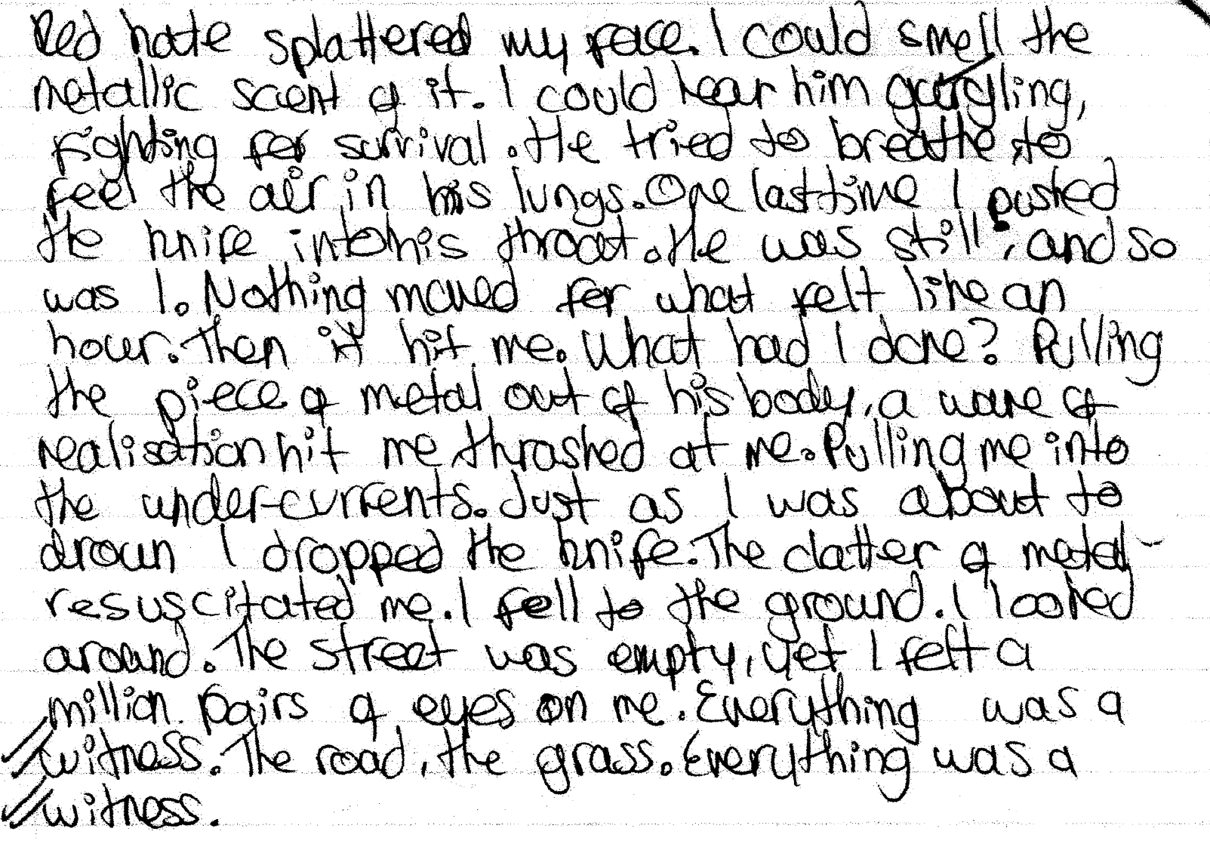
Rising Tension - Showing, not Telling
What sentences SHOW he is angry?
What sentences SHOW the character is suddenly realising their mistake?
What sentences SHOW the character is feeling guilty?

Slide 5
Rising Tension - Showing, not Telling
TASK: find THREE interesting techniques to show and not tell – write down the examples in your book.
What sentences SHOW the character is suddenly realising their mistake?
What sentences SHOW the character is feeling guilty?

Slide 6
Which sentence is more effective and WHY? Consider the syntax and order, consider the added, unnecessary words.
In pairs discuss – then write out the most effective sentence(s) and explain.
1. What TYPE ? (Simple, compound, complex)
2. What effect does it give?(tension, panic, relaxed)
3. Which punctuation further develops the panicked effect? How?
He took a deep breath that shuddered. He just barely managed to pass it through the hatch. There was a thunderous howl that nearly made him drop everything but yet he then managed to attach it.
Taking a deep, shuddering breath… he finally managed to pass the string through the hatch and secure it— another thunderous howl nearly made him drop everything— but he managed to attach it!

Slide 7
REVIEW
fragments – Silent screams! Panic! Game over! Drip. Drip. Drip. Dripping.
Simple sentence - “I leapt for the handhold.” (subject/predicate)
Compound sentence - two simple sentences (but, and, or connecting them)
Complex sentence - ing, ly, preposition, connective, sub-clause, main clause (simple sentence) “Waiting for place in line, I noticed he was watching me.”
complex-compound sentence (followed by a fragment)
Example: As the dog howled, one cat sat on the fence; the other licked its paws. Totally unconcerned.

Slide 8
REVIEW
fragments – Silent screams! Panic! Game over! Drip. Drip. Drip. Dripping.
Simple sentence - “I leapt for the handhold.” (subject/predicate)
Compound sentence - two simple sentences (but, and, or connecting them)
Complex sentence - ing, ly, preposition, connective, sub-clause, main clause (simple sentence) “Waiting for place in line, I noticed he was watching me.”
complex-compound sentence (followed by a fragment)
Example: As the dog howled, one cat sat on the fence; the other licked its paws. Totally unconcerned.

Slide 9
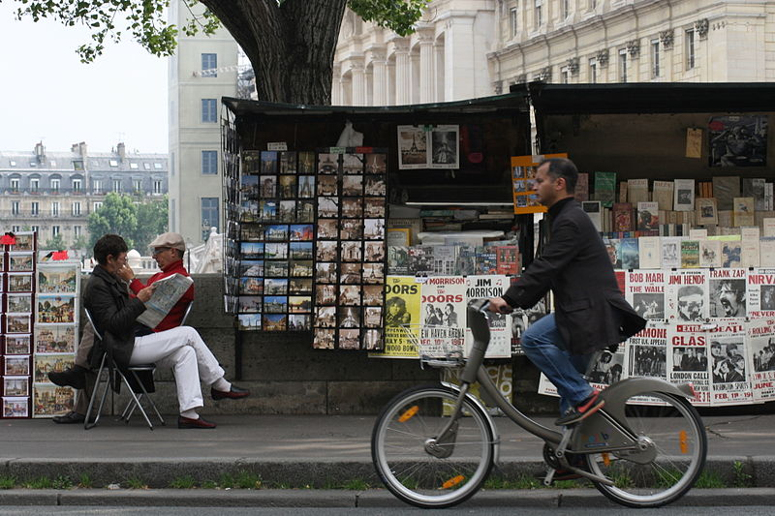
Write 3 – 5 sentences based on this image
Fragments – Silent screams! Panic! Game over! Drip. Drip. Drip. Dripping.
Simple sentence - “I leapt for the handhold.”
Compound sentence - two simple sentences (FANBOYS to connect)
Complex sentence – ( ing, ly, sub-clause, main clause-simple sentence) “Waiting for a place in line, I noticed he was watching me.”

Slide 10
Less Challenge:
Use several simple sentences in a row for effect.
Her head was aching. Her lungs: burning. Her heart was pounding. But her teeth were gritted in determination.
Use a … with a fragment to create effect.
She nodded to the stranger whom she had saved... Redemption was sweet!
Use a complex sentence with a simple sentence for effect.
Beyond the horizon, she could finally see the clouds part to reveal a heavenly curtain of light. It was the last time she would ever see the sunrise…
More Challenge:
Overuse commas in a list to speed up your pace.
Nearly gasping for air, churning water, splashing, surfacing, thrashing, going under… drowning. He hadn’t expected his day to end like this.
Use a ; mark to create longer pauses to slow the pace.
He checked his nearly damaged watch; it was nearly time. Any minute now, this door would open, and death would follow; it was inevitable.
Use a complex-compound sentence.
Waiting in anticipation for his mum to finally arrive, he thought he heard his mother’s voice; it was someone else…
Most Challenging Sentences:
Polysyndenton (overuse the word and for effect). He scraped and clutched and gasped and grasped each handhold as he ascended up the side of the cliff.
Use a — (dash) to create a sudden interruption and then use a long list to make the pace faster. He was tired, sore and his hands— were bound! He thrashed, kicked, clawed and bucked at the ropes holding him fast.
Try to include a fragment for effect.
He stumbled, fell, lurched to his knees, to his feet; tumbled. Flailing at nothing. Just air.

Slide 11
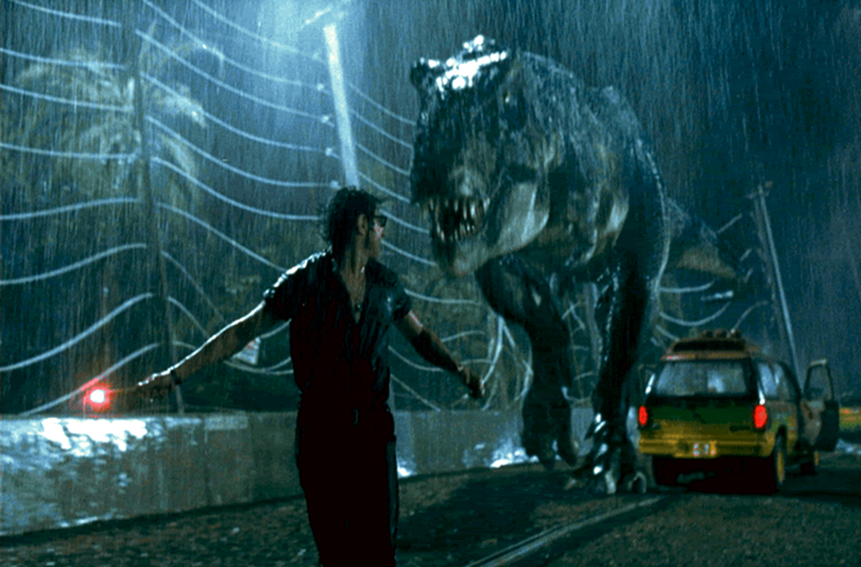
Sub heading: ‘Must go faster’ rising action
Ob
Have your sentence types in front of you. You are going to watch a ‘rising action’ scene. YOU are going to write what you: see, hear, experience etc – using sentences to create the effect SHOWN on screen.
What atmosphere can you create with a ”chase scene”?
What types of sentences would you begin to use?
How might you use punctuation effectively?

Slide 12
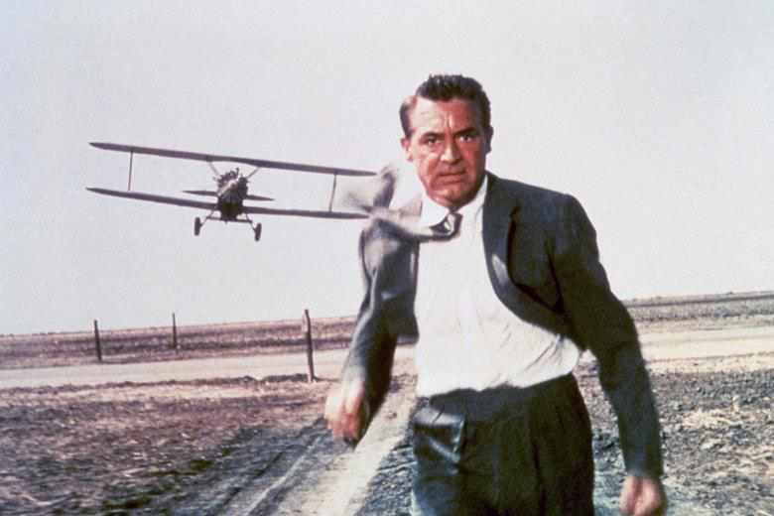
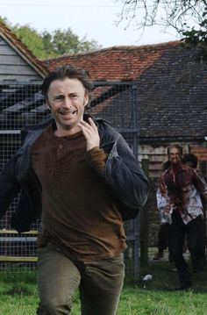
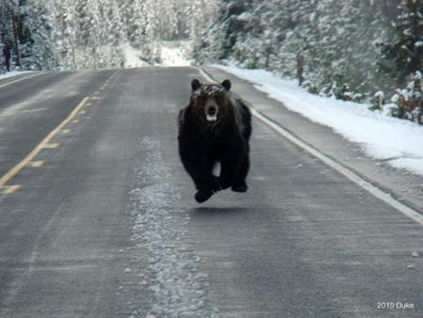
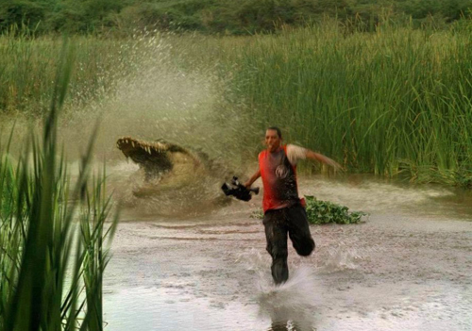
https://www.youtube.com/watch?v=rxqHVoZ0fzc

Slide 13
Less Challenge:
Use several simple sentences in a row for effect.
Her head was aching. Her lungs: burning. Her heart was pounding. But her teeth were gritted in determination.
Use a … with a fragment to create effect.
She nodded to the stranger whom she had saved... Redemption was sweet!
Use a complex sentence with a simple sentence for effect.
Beyond the horizon, she could finally see the clouds part to reveal a heavenly curtain of light. It was the last time she would ever see the sunrise…
More Challenge:
Overuse commas in a list to speed up your pace.
Nearly gasping for air, churning water, splashing, surfacing, thrashing, going under… drowning. He hadn’t expected his day to end like this.
Use a ; mark to create longer pauses to slow the pace.
He checked his nearly damaged watch; it was nearly time. Any minute now, this door would open, and death would follow; it was inevitable.
Use a complex-compound sentence.
Waiting in anticipation for his mum to finally arrive, he thought he heard his mother’s voice; it was someone else…
Most Challenging Sentences:
Polysyndenton (overuse the word and for effect). He scraped and clutched and gasped and grasped each handhold as he ascended up the side of the cliff.
Use a — (dash) to create a sudden interruption and then use a long list to make the pace faster. He was tired, sore and his hands— were bound! He thrashed, kicked, clawed and bucked at the ropes holding him fast.
Try to include a fragment for effect.
He stumbled, fell, lurched to his knees, to his feet; tumbled. Flailing at nothing. Just air.

Slide 14
Review
Ob
Why do we care about different sentence-lengths?
Why use different sentences?
What effects can be created?
How does punctuation add to the effect?

Slide 15
Using these images to help – or an idea of your own:
WRITE: a rising action scene to build up the panicked tension in your own writing.
Try to use a RANGE of punctuation for even more crafted effect.
EDIT: Carefully reconstruct sentences you’ve already used if they are not effective enough.
Follow the suggestions given to you to enhance your writing.

Slide 16
TASK:
You should now have just two possible stories to work on.
Choose one and:
WRITE: continue to build up the panicked tension in your own writing. Try to use a RANGE of punctuation for even more crafted effect.
OR
EDIT: Carefully reconstruct sentences you’ve already used if they are not effective enough.
Follow the suggestions given to you to enhance your writing.

Slide 17
REVIEW
fragments – Silent screams! Panic! Game over! Drip. Drip. Drip. Dripping.
Simple sentence - “I leapt for the handhold.” (subject/predicate)
Compound sentence - two simple sentences (but, and, or connecting them)
Complex sentence - ing, ly, preposition, connective, sub-clause, main clause (simple sentence) “Waiting for place in line, I noticed he was watching me.”
complex-compound sentence (followed by a fragment)
As the dog howled, one cat sat on the fence; the other licked its paws. Totally unconcerned.

Slide 18
TASK:
WRITE: Now continue to build up the panicked tension in your own writing. Try to use a RANGE of punctuation for even more crafted effect.
OR
EDIT: Carefully reconstruct sentences you’ve already used if they are not effective enough.
Follow the suggestions given to you to enhance your writing.

Slide 19
ASSESSMENT PREPARATION

Slide 20
What part of the narrative is this? (exposition – setting, exposition – character, conflict, rising action, resolution, denouement)?
Which of these story parts are better?
Challenge: what atmosphere are these authors trying to create? Which is better and why?
It stood, quietly looking at me. It’s feathers were grey and it was a pigeon waiting in the darkness.
I wasn’t scared, I was trying to kill it with my catapult sling-shot. I was smiling a sneaky smile, taking aim, when suddenly, the bird jumped off and began falling towards me.
It’s on me now at top speed like a cheetah, it’s claws ready to kill….
It tore a gaping hole into his face…
Perched in silence, grey feathers obscured a silhouette of a fat, stubby creature, cooing softly. A midnight serenade.
Playing at the corners of his lips, a twitch of a smile touched the hunter below – yet his eyes seethed with pale hatred. Pulling back the leather thong, holding a perfectly round pebble, his eyes were lasers locked onto the prey – a flurry of feathers, a plummeting shape fell to earth like a meteor, piercing the air, shattering the silence of the night.
Dribbling blood pooled at his feet…

Slide 21
Ob: able to plan and develop a story
Attention-grabbing opening – short, and sharp. (one complex sentence)
Exposition: Describe your setting: - pick an interesting setting.
Challenge: Make sure it sets an atmosphere to foreshadow the conflict
Use the 5 senses and colours. (“damp grey drizzle…”)
A sentence to describe the wide-angle picture.
A sentence or two to describe the smaller details (moving in)
A sentence to describe a TINY detail, to pull us right into the space.
Exposition: Describe your Character:
Tiny, unusual details
Use similes/metaphors
Choose words that describe their face, skin, eyes, hair, actions.
It must suggest their personality.
“hands twitched” shows nervousness
“a heavy stride” shows confidence
“a sideways glace” they’re sneaky
Conflict:
- One sentence:
HINT at the conflict – a problem – something going wrong
Use detailed describing to show not tell
Change the setting/atmosphere
Describe the rising action:
Consider pace by using complex sentences or short, simple sentences
Action verbs NO adverbs (use leaped = not quickly jumped)
Overuse commas for effect or overuse “and” (Polysyndeton)
Denouement:
Add a plot twist
Add a cliffhanger
A one-sentence or even a fragment would word (“Game over.”)
Resolution:
Slow the pace down – add a one-sentence paragraph for effect
- Describe and don’t TELL what has happened

Slide 22
Ob: able to plan and develop a story
Attention-grabbing opening
“Be wary of friends, be more wary of enemies. You never know which will stab you in the back. Or try to peck our your eyes, from the front. I had made friends with a pigeon.”
Exposition: Describe your setting:
“Squealing wind tormented the leaves in the trees, as they convulsed, shackled to their branches.”
Exposition: Describe your Character:
“A twitch of a smile played at the corners of his lips – yet his eyes seethed with pale anger.”
Conflict:
“But it was alive. Stalking him. Waiting…”
Describe the rising action:
“A flurry of feathers, a plummeting shape fell to earth like a meteor, piercing the air, shattering the silence of the night with a “squawk!”
Resolution:
“It was simply a pigeon.” “A cooing echoed in the darkness, as a bobbing grey head gazed back at me.”
Denouement:
“It’s eyes were red, rabid, hunting. And another flock of his hunting party stood behind him…”

Slide 23
Ob: able to plan and develop a story
Attention-grabbing opening
Exposition: Describe your setting:
Exposition: Describe your Character:
Conflict:
Describe the rising action:
Resolution:
Denouement: (optional)

