Slide 1
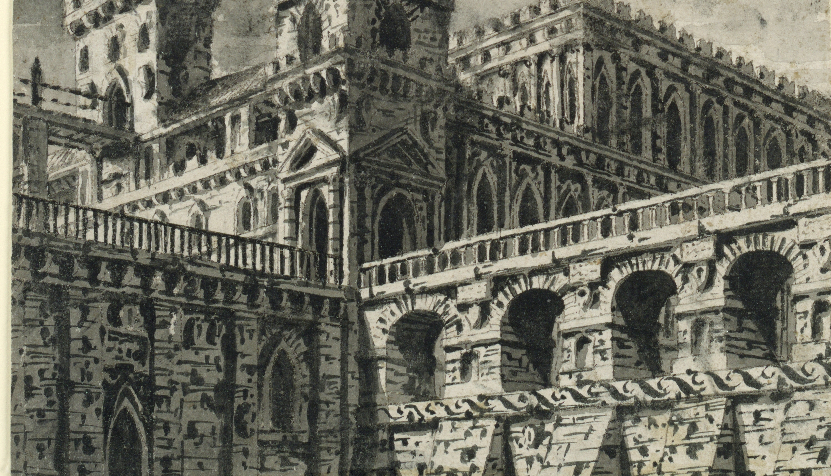
Gothic
Previous Knowledge
How many books from before 1914 can you list?
Write a sentence for each of their plots.
Do Now
LO: To be able to identify Gothic conventions.

Slide 2
Can you match the vocabulary to their definitions?
an introduction to a book, typically stating its subject, scope, or aims.
a person living in solitude as a religious discipline.
a person legally entitled to the property or rank of another on that person's death.
a book, document, or piece of music written by hand rather than typed or printed.
takes a position of power or importance illegally or by force.
a prediction of what will happen in the future.
Manuscript Preface Prophecy Hermit Heir Usurped
Unlocking Vocabulary
LO: To be able to identify Gothic conventions.
Notes:
Can be printed out for students.

Slide 3
Check your answers:
Preface: an introduction to a book, typically stating its subject, scope, or aims.
Hermit: a person living in solitude as a religious discipline.
Heir: a person legally entitled to the property or rank of another on that person's death.
Manuscript: a book, document, or piece of music written by hand rather than typed or printed.
Usurped: takes a position of power or importance illegally or by force.
Prophecy: a prediction of what will happen in the future.
Answers
LO: To be able to identify Gothic conventions.
Notes:
Can be printed out for students.

Slide 4
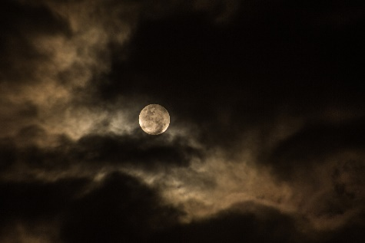
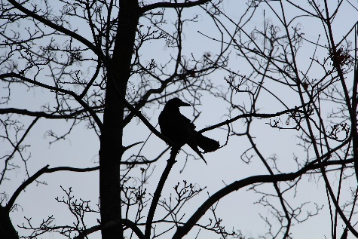
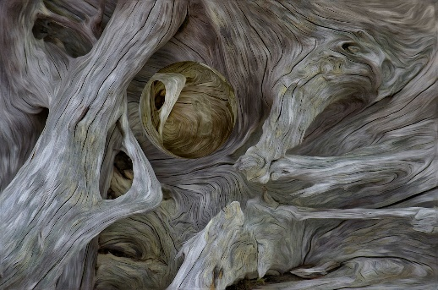
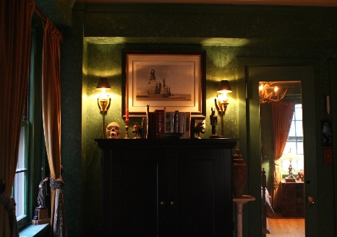
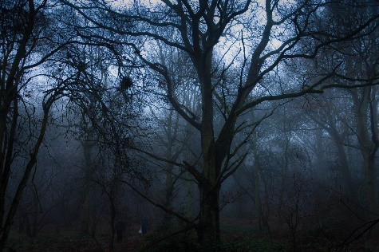
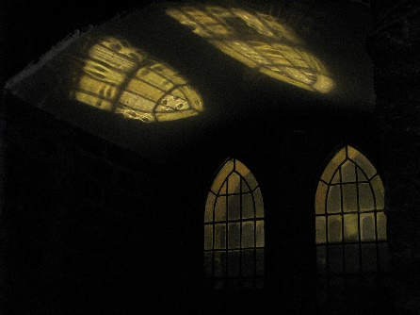
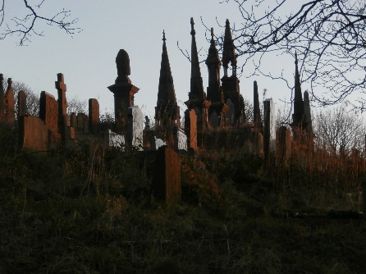
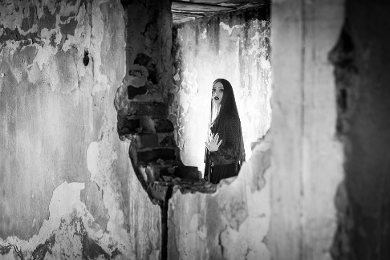
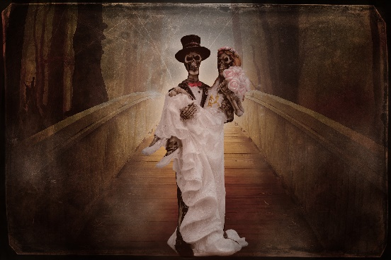
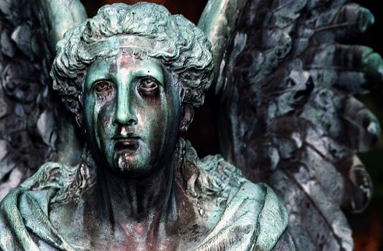
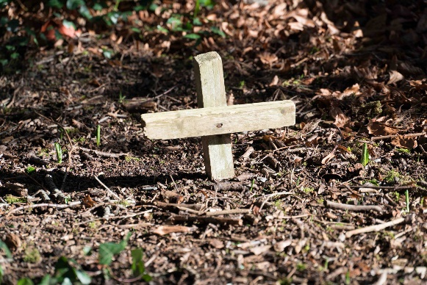
SNAP: Pair the images according to their shared traits. Give a reason for each pair.
1
2
3
4
Paired Discussion
5
6
7
8
9
10
11
12
LO: To be able to identify Gothic conventions.
Notes:
PDF copy available so students can see images clearly.

Slide 5
Gothic
What do you associate with the word Gothic? Make a mind map.
Checking Understanding
LO: To be able to identify Gothic conventions.

Slide 6
What do you associate with the word Gothic? Make a mind map.
Gothic
a medieval style of architecture characterised by pointed arches and ornate stone-masonry;
a gloomy, morbid genre of music popular in the early 1980s;
a gloomy, morbid style of fashion and make up dominated by the colour black;
a genre of literature focused on terror that was first popularised in the 18th century by Horace Walpole’s ‘The Castle of Otranto’.
Checking Understanding
LO: To be able to identify Gothic conventions.

Slide 7
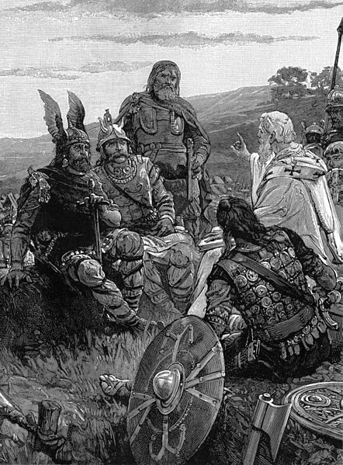
Etymology
The Goths were an East Germanic tribe who helped to bring about the fall of the Roman Empire, ushering in the Medieval period.
They had a fierce reputation as being violent and barbaric. However, despite initially practising paganism, they converted to Christianity during the 4th century.
Developing Vocabulary
LO: To be able to identify Gothic conventions.

Slide 8
Gothic Conventions
Create a list of elements you think a gothic story might have.
Consider:
Plot
Setting
Characters
Themes
Mastery
LO: To be able to identify Gothic conventions.

Slide 9
Mastery
LO: To be able to identify Gothic conventions.
Notes:
Slide could be printed and stuck in exercise books so students can refer back during the scheme.

Slide 10
The Castle of Otranto
Read the plot summary of ‘The Castle of Otranto’. Highlight the gothic conventions that you see.
Remember to look for :
Plot Events
Setting
Characters
Themes
Mastery
LO: To be able to identify Gothic conventions.
Notes:
Plot summary on word document

Slide 11
The Castle of Otranto
How many gothic conventions did you identify?
Plot Events
Setting
Characters
Themes
Checking Understanding
LO: To be able to identify Gothic conventions.
Notes:
Plot summary on word document

Slide 12
Which texts from Pre-1914 would you now consider Gothic? Explain why.
Link to Previous Learning
LO: To be able to identify Gothic conventions.

