Slide 1
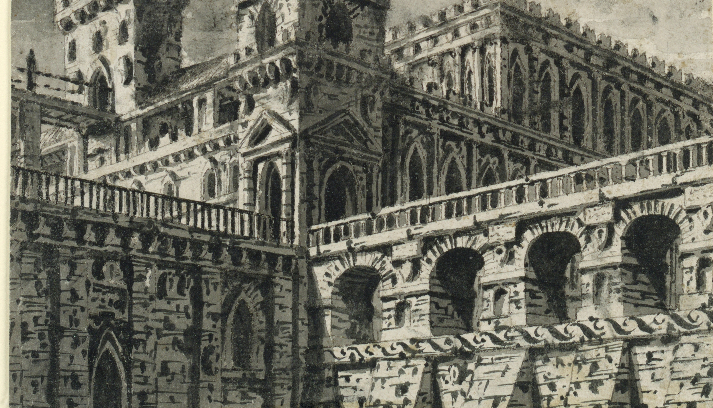
Gothic
LTM Starter
What can you remember about the pre-1914 texts you studied in Year 7?
Which level will you reach? Bronze? Silver? Gold?
Do Now
LO: To be able to identify Gothic conventions.

Slide 2
Can you match the vocabulary to their definitions?
an introduction to a book, typically stating its subject, scope, or aims.
a person living in solitude as a religious discipline.
a person legally entitled to the property or rank of another on that person's death.
a book, document, or piece of music written by hand rather than typed or printed.
takes a position of power or importance illegally or by force.
a prediction of what will happen in the future.
Manuscript Preface Prophecy Hermit Heir Usurped
Unlocking Vocabulary
LO: To be able to identify Gothic conventions.
Notes:
Can be printed out for students.

Slide 3
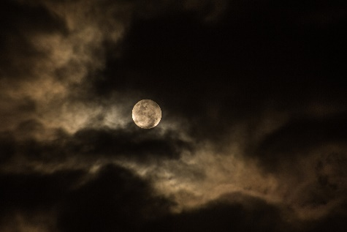
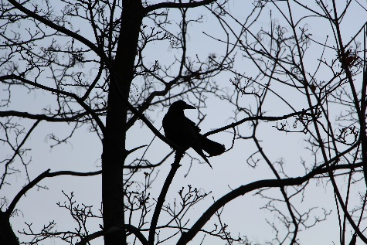
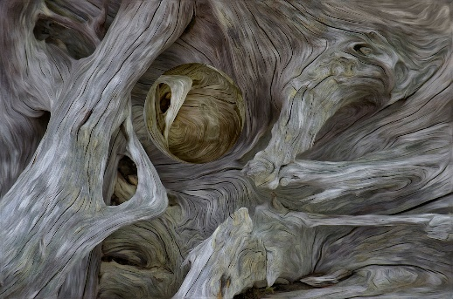
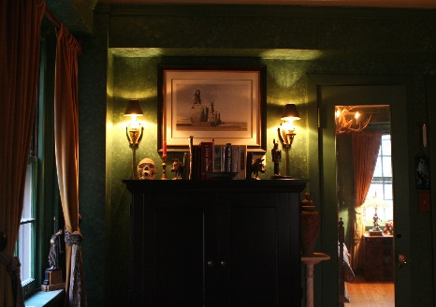
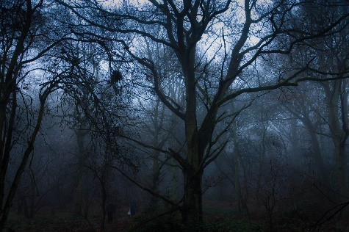
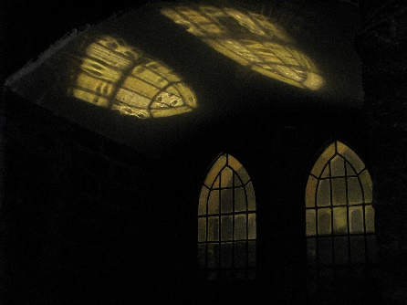
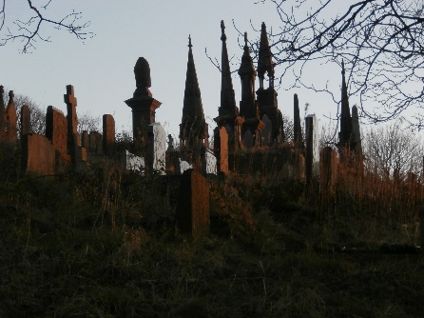
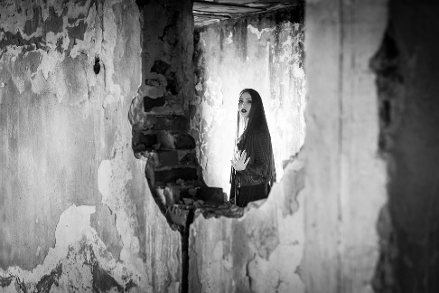
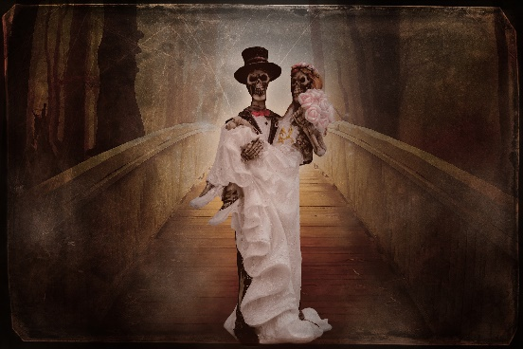
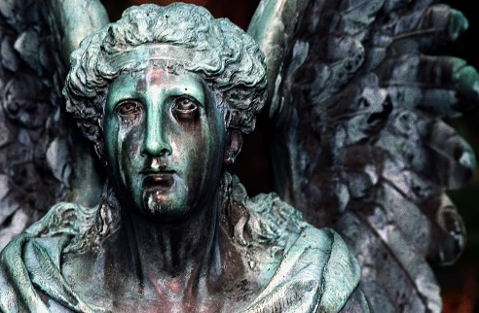
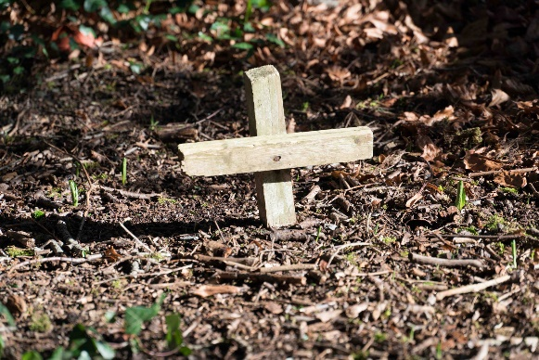
SNAP: Pair the images according to their shared traits.
1
2
3
4
Paired Discussion
5
6
7
8
9
10
11
12
LO: To be able to identify Gothic conventions.
Notes:
PDF copy available so students can see images clearly.

Slide 4
In this lesson you will be mastering the following:
An understanding of what the term Gothic means.
An understanding of a variety of different Gothic conventions.
The ability to identify Gothic conventions in texts.
Learning Content
LO: To be able to identify Gothic conventions.

Slide 5
Gothic
What do you associate with the word Gothic? Make a mind map.
Checking Understanding
LO: To be able to identify Gothic conventions.

Slide 6
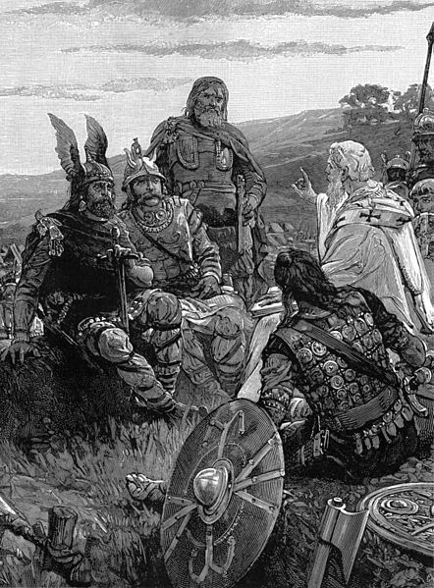
Etymology
The Goths were an East Germanic tribe who helped to bring about the fall of the Roman Empire, ushering in the Medieval period.
They had a fierce reputation as being violent and barbaric. However, despite initially practising paganism, they converted to Christianity during the 4th century.
Developing Vocabulary
LO: To be able to identify Gothic conventions.

Slide 7
Gothic Conventions
Create a list of elements you think a gothic story might have.
Consider:
Plot
Setting
Characters
Themes
Mastery
LO: To be able to identify Gothic conventions.

Slide 8
The Castle of Otranto
Read the plot summary of ‘The Castle of Otranto’. Highlight the gothic conventions that you see.
Remember to look for :
Plot Events
Setting
Characters
Themes
Mastery
LO: To be able to identify Gothic conventions.
Notes:
Plot summary on word document

Slide 9
The Castle of Otranto – Summary
Walpole presents The Castle of Otranto as the English translation of a recently discovered manuscript. The preface to the first edition suggests that the manuscript was written sometime between 1095 and 1243 (during the Crusades), “or not long afterwards,” and subsequently printed in Naples in 1529. The manuscript tells the story of Manfred, a prince of Otranto. At the beginning of the story, Manfred impatiently awaits the marriage of his sickly son, Conrad, to the princess Isabella. Manfred’s subjects note his impatience. They suspect that Manfred has arranged the marriage in the hope of avoiding an ancient prophecy that predicted his castle and his rulership of Otranto “should pass from the present family, whenever the real owner should be grown too large to inhabit it.”
The wedding date is set for Conrad’s birthday. On the day of the nuptials, however, Manfred’s son is nowhere to be found. In the courtyard a servant discovers that an enormous helmet has fallen from the sky and crushed Conrad to death. Upon realizing that his only male heir is dead and his wife can no longer bear children, Manfred decides to marry Isabella himself. He approaches Isabella with this proposition. When she refuses to marry him, Manfred seizes her. Fortunately, a series of supernatural events, including an appearance by the ghost of his grandfather, distract Manfred, and Isabella manages to wrestle free. As she makes her escape to the nearby church of St. Nicholas (with the help of a peasant named Theodore), Manfred is confronted by his guards, who claim to have seen a giant armoured leg in the gallery. Later he and his guards are joined by a group of knights seeking Isabella on behalf of her father, the Marquis of Vicenza.
Outside the castle grounds, Theodore bravely defends Isabella from a knight. He wounds the knight and discovers—much to his dismay—that the wounded knight is actually Isabella’s father, Frederic. Together, Theodore, Frederic, and Isabella return to the castle. Frederic recovers and explains to Manfred’s wife, Hippolita, how exactly he came to be in Otranto: while away at war, Frederic had a vision warning him that his daughter was in danger. The vision directed him to a forest where he met a hermit. The hermit directed him to a gigantic sword inscribed with a prophecy:
Where’er a casque that suits this sword is found,
With perils is thy daughter compass’d round;
Alfonso’s blood alone can save the maid,
And quiet a long restless Prince’s shade.
Manfred, suddenly observing the resemblance between Theodore and the hero Alfonso, tries again to secure Isabella’s hand in marriage. This time he proposes to Frederic that they marry each other’s daughters. At first Frederic agrees, but he is haunted by the ghost of the hermit from the forest and ultimately decides not to go through with the double marriage.
Manfred is furious—and more so after he learns that Theodore is meeting a lady in Alfonso’s tomb. Manfred, convinced that Isabella is having an affair with Theodore, sneaks into the tomb and fatally stabs the lady. In horror, Manfred realises that he has slain not Isabella but his own daughter, Matilda. Moments after Matilda’s death, the castle wall behind Manfred crumbles, revealing a gigantic vision of Alfonso. The image of Alfonso declares that his grandson, Theodore, is the true heir of Otranto. Manfred thereupon reveals that his grandfather poisoned Alfonso and usurped his throne. In an attempt to atone for his wrongdoing, Manfred agrees to abdicate the throne. The novel ends with Frederic offering Isabella’s hand in marriage to Theodore. Although he eventually agrees to marry Isabella, Theodore mourns the loss of his true love, Matilda, for many years.

Slide 10
The Castle of Otranto
How many gothic conventions did you identify?
Plot Events
Setting
Characters
Themes
Challenge Question: Can you make any links to the Context information you were given?
Checking Understanding
LO: To be able to identify Gothic conventions.
Notes:
Plot summary on word document

Slide 11
Which texts from the Year 7 Pre-1914 scheme would you now consider Gothic? Explain why.
Link to Previous Learning
LO: To be able to identify Gothic conventions.

Slide 12
Read the following plot summaries. What gothic conventions do they have? How do they compare to ‘The Castle of Otranto’?
‘The Mezzotint’
In the highly original ‘The Mezzotint’, by M. R. James, a picture keeps changing, revealing details of a terrible crime that is either about to be committed or which has already been committed. The man who buys the picture shows it to a number of his colleagues and they all realise that something very strange is happening. When the mystery is finally revealed, the picture stops changing.
‘The Thing in the Upper Room’
In this short story, an unnamed narrator rents a room in an older section of Paris with tragic repercussions. The lodger, Attwater, cannot sleep in the room and after struggling through the nights, he is finally awoken by cries outside. He is covered in blood and is fully dressed. The face that looks back out of the mirror is of The Thing in the Upper Room.
Extension Task
LO: To be able to identify Gothic conventions.

