Slide 1
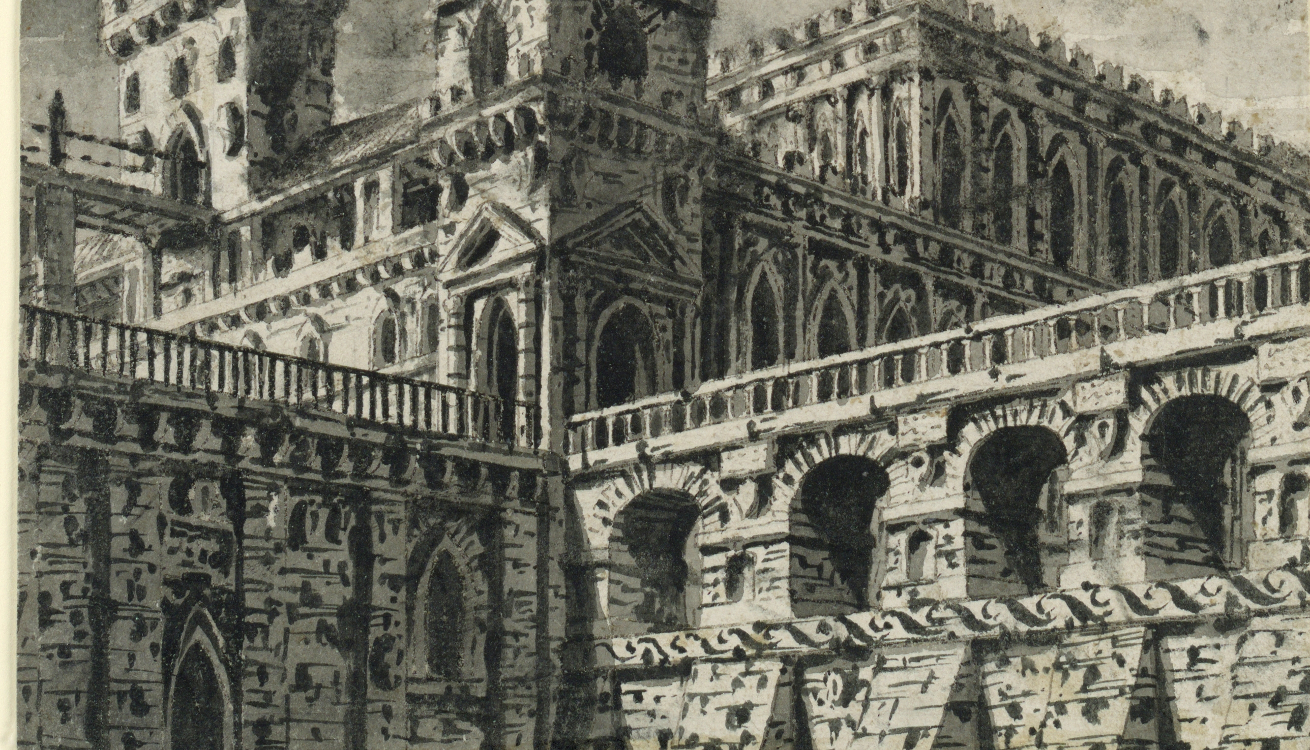
Gothic
LTM Starter
What can you remember about the pre-1914 texts you studied in Year 7?
Do Now
LO: To be able to identify Gothic conventions.

Slide 2
Can you match the vocabulary to their definitions?
an introduction to a book, typically stating its subject, scope, or aims.
a person living in solitude as a religious discipline.
a person legally entitled to the property or rank of another on that person's death.
a book, document, or piece of music written by hand rather than typed or printed.
takes a position of power or importance illegally or by force.
a prediction of what will happen in the future.
Manuscript Preface Prophecy Hermit Heir Usurped
Unlocking Vocabulary
LO: To be able to identify Gothic conventions.
Notes:
Can be printed out for students.

Slide 3
Check your answers:
Preface: an introduction to a book, typically stating its subject, scope, or aims.
Hermit: a person living in solitude as a religious discipline.
Heir: a person legally entitled to the property or rank of another on that person's death.
Manuscript: a book, document, or piece of music written by hand rather than typed or printed.
Usurped: takes a position of power or importance illegally or by force.
Prophecy: a prediction of what will happen in the future.
Answers
LO: To be able to identify Gothic conventions.
Notes:
Can be printed out for students.

Slide 4
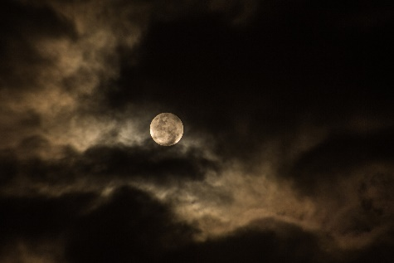
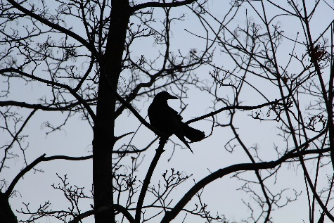
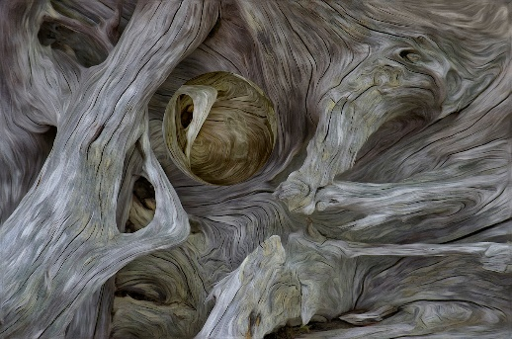
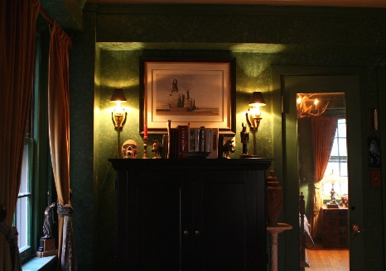
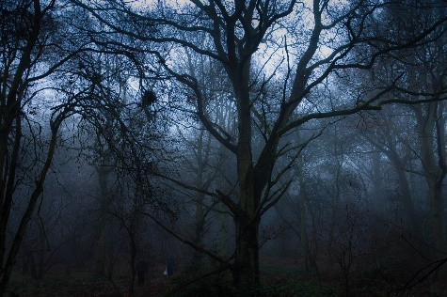
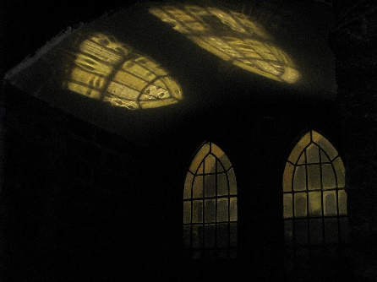
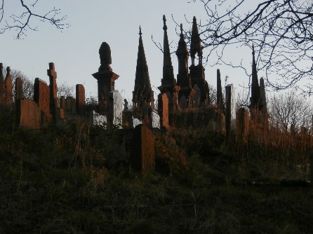
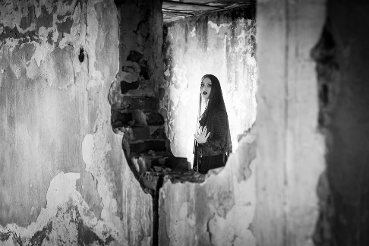
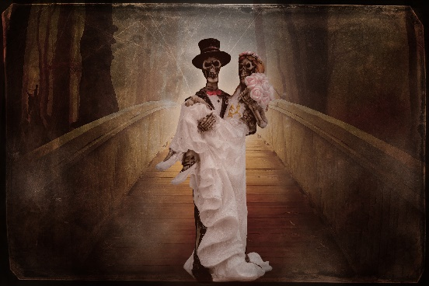
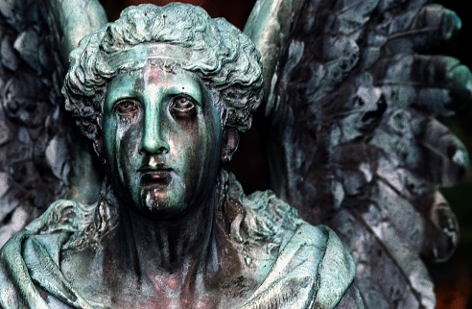
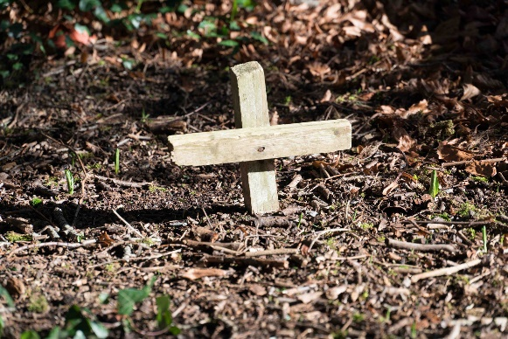
SNAP: Pair the images according to their shared traits.
1
2
3
4
Paired Discussion
5
6
7
8
9
10
11
12
LO: To be able to identify Gothic conventions.
Notes:
PDF copy available so students can see images clearly.

Slide 5
In this lesson you will be mastering the following:
An understanding of what the term Gothic means.
An understanding of a variety of different Gothic conventions.
The ability to identify Gothic conventions in texts.
Learning Content
LO: To be able to identify Gothic conventions.

Slide 6
Gothic
What do you associate with the word Gothic? Make a mind map.
Checking Understanding
LO: To be able to identify Gothic conventions.

Slide 7
What do you associate with the word Gothic? Make a mind map.
Gothic
a medieval style of architecture characterised by pointed arches and ornate stone-masonry;
a gloomy, morbid genre of music popular in the early 1980s;
a gloomy, morbid style of fashion and make up dominated by the colour black;
a genre of literature focused on terror that was first popularised in the 18th century by Horace Walpole’s ‘The Castle of Otranto’.
Checking Understanding
LO: To be able to identify Gothic conventions.

Slide 8
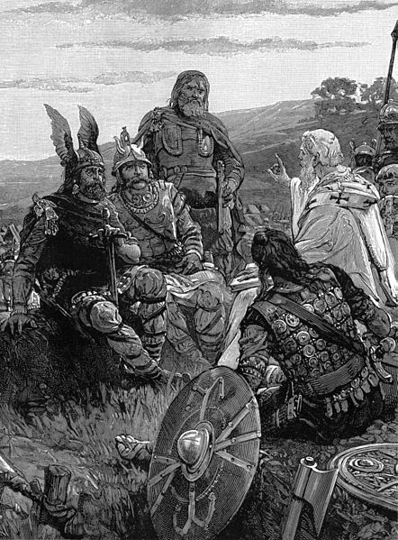
Etymology
The Goths were an East Germanic tribe who helped to bring about the fall of the Roman Empire, ushering in the Medieval period.
They had a fierce reputation as being violent and barbaric. However, despite initially practising paganism, they converted to Christianity during the 4th century.
Developing Vocabulary
LO: To be able to identify Gothic conventions.

Slide 9
Gothic Conventions
Create a list of elements you think a gothic story might have.
Consider:
Plot
Setting
Characters
Themes
Check your list against the next slide
Mastery
LO: To be able to identify Gothic conventions.

Slide 10
Mastery
LO: To be able to identify Gothic conventions.
Notes:
Slide could be printed and stuck in exercise books so students can refer back during the scheme.

Slide 11
The Castle of Otranto
Read the plot summary of ‘The Castle of Otranto’. Highlight the gothic conventions that you see.
Remember to look for :
Plot Events
Setting
Characters
Themes
Mastery
LO: To be able to identify Gothic conventions.
Notes:
Plot summary on word document

Slide 12
The Castle of Otranto
How many gothic conventions did you identify?
Plot Events
Setting
Characters
Themes
Checking Understanding
LO: To be able to identify Gothic conventions.
Notes:
Plot summary on word document

Slide 13
Which texts from the Year 7 Pre-1914 scheme would you now consider Gothic? Explain why.
Link to Previous Learning
LO: To be able to identify Gothic conventions.

Slide 14
Read the following plot summaries. What gothic conventions do they have? How do they compare to ‘The Castle of Otranto’?
‘The Mezzotint’
In the highly original ‘The Mezzotint’, by M. R. James, a picture keeps changing, revealing details of a terrible crime that is either about to be committed or which has already been committed. The man who buys the picture shows it to a number of his colleagues and they all realise that something very strange is happening. When the mystery is finally revealed, the picture stops changing.
‘The Thing in the Upper Room’
In this short story, an unnamed narrator rents a room in an older section of Paris with tragic repercussions. The lodger, Attwater, cannot sleep in the room and after struggling through the nights, he is finally awoken by cries outside. He is covered in blood and is fully dressed. The face that looks back out of the mirror is of The Thing in the Upper Room.
Extension Task
LO: To be able to identify Gothic conventions.

