Slide 1
Paper 1: Creative Prose Writing
What does it involve?
Assesses your prose writing skills. (Narrative Writing)
You will have a choice of 4 questions to pick from. You only pick one question to answer.
The options could include: titles of stories; the opening/ending lines of stories; a topic/event to write about; a picture to take inspiration from.

Slide 2
Paper 1: Creative Prose Writing
LO: To develop imaginative narrative considering structure.
Why: so as to develop creative prose writing skills.
How:
Produce outline plan using narrative structure
Alternative scenario
SHOW not tell examples
Write exposition with detailed description.

Slide 4
Paper 1 Section 2: Narratives
Learning Objective: To develop imaginative texts considering structure.
You have been given a title to a narrative. Around the title, write ideas about what the storyline will be.
You will then swap with others to add to your title.
You will use this for your exposition (setting)

Slide 5
The Process:
Opening: setting, characters
Conflict/Crisis
Rising Action
Climax
Resolution
Denouement

Slide 6
Narrative Arcs
4. Climax - the moment when it is determined whether the protagonist solves the problem or not.
3. Rising Action - a series of increasingly challenging obstacles arise that have to be overcome.
5. Resolution - the result of what happens after the climax.
6. Optional – Denouement, a twist
2. Conflict - the problem the protagonist has to overcome.
1. Exposition - introduces setting, character, background information etc.
Select one of the ideas that have been added to your title and write about 80-100 words of an outline plan of a possible story – in the narrative arc structure.

Slide 7
SHOW not tell
Telling/informing: They stood close and wrapped their arms round each other in a passionate embrace, so that she became aware that he had been riding, and then that he was as nervous as she was.
Showing/evoking: They gripped each other and the tweed of his jacket was rough under her cheek. His hand came up to stroke her hair; she smelled leather and horses on the skin of his wrist. He was trembling.

Slide 8
Man wakes up from a coma
Man leaves a bar drunk
Create your own scenario
Man leaves a bar drunk
Experiences a flashback of being attacked
Experiences a flashback of being attacked
Sees the face of his attacker
Sees the face of his attacker
Man wakes up from a coma
Recognises a face in the room
Recognises a face in the room
2) All of these re-arrangements would create valid narratives. Which would interest the reader more? How would it surprise them?

Slide 9
Man wakes up from a coma
Man leaves a bar drunk
Man leaves a bar drunk
Man leaves a bar drunk
Experiences a flashback of being attacked
Sees the face of his attacker
Experiences a flashback of being attacked
Man wakes up from a coma
Sees the face of his attacker
Experiences a flashback of being attacked
Sees the face of his attacker
Man wakes up from a coma
Recognises a face in the room
Recognises a face in the room
Recognises a face in the room
2) All of these re-arrangements would create valid narratives. Which would interest the reader more? How would it surprise them?

Slide 10
LO: To write engaging description through SHOW description rather then TELL
Always SHOW never TELL- copy two
His face was ashen and lifeless. Sunken in their sockets, his eyes darted in all directions. Normal coordination evaded him. No sound escaped his vice like mouth.
He was scared
They were best mates
The sky burned with the golden embers of the sunrise. They locked hands, locked eyes and faced the future: together.
They were happy
The Sgt. handed his last cigarette to the baby-faced soldier. He winked, the faintest of wry smiles curling the corner of his top lip. There were no words; none were needed.

Slide 11
Write your own for one of the following:
She was ecstatic!
We were distraught.
He was grief-stricken.

Slide 12
Peer Assessment
Write a comment and a target for your partner based on the criteria below.
Assessment Criteria
Detailed description – 5 senses
Uses 'show' not 'tell consistently
Varied vocabulary
Use of complex sentence structures
Challenge: some alliteration, similes and imagery detail used

Slide 13
Setting
You need to be:
able to use sophisticated devices and detail to set a strong atmosphere and tone for the opening of a story
What does this mean?

Slide 14
The Setting
You have three minutes to consider and decide what you would describe in this setting - what details would we zoom in on?
Remember the skills we’ve worked on. Look at the senses, what mood are we trying to create?

Slide 15
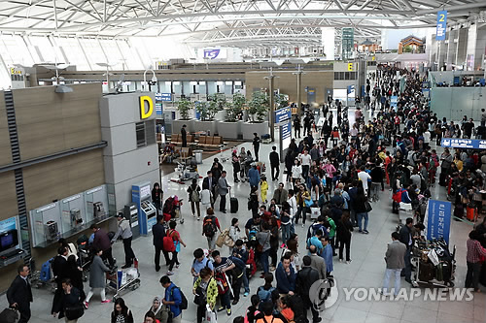
Ob
What can we see, hear, smell, heat/cold, what do you taste?
What mood are we trying to create?

Slide 16
BETTER!
Example:
Boring!
Frantic, sweaty hands clutch boarding passes, clutch miserable, red-eyed children, clutch hard metal handles on hard plastic suitcases, handing over hard plastic passports — a break in the queue, a shuffle forward. Pause.
The people pushing and shoving seemed like a washing machine churning bags and tickets and passports.

Slide 17
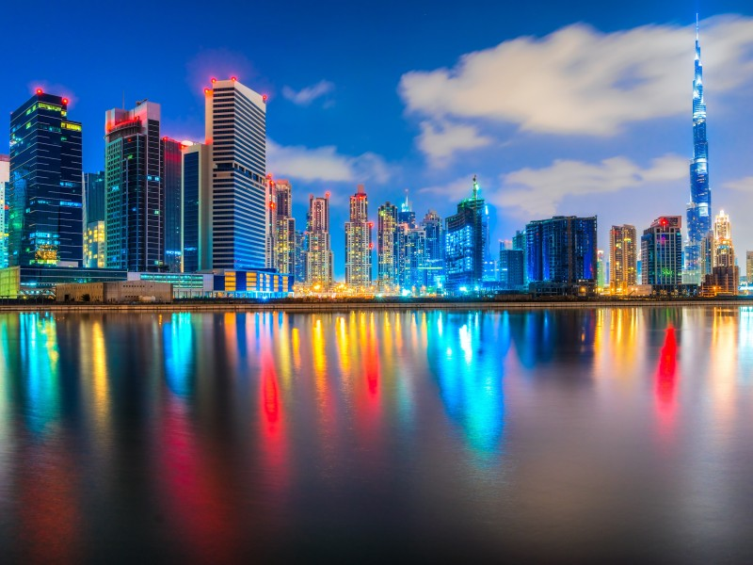
Ing verbs to introduce the atmosphere
Metaphor to describe the colours (paint easel, buckets of paint, cascade of fireworks….etc.)
Sounds – or Challenge: describe the silence.
Smells
Prepositions:
Beyond the horizon,…
Above the towering…
Under the glassy water,…
Unusual details – the distant ambulance sirens, the soaring gulls, etc.
Similes and alliteration adjectives: a silky silhouette of the city was like a…
Colours – describe them all (visual imagery) (red) ochre, cerulean blue, amber (yellow), gold, turquoise blue, etc.

Slide 18
Glowing vividly against the cerulean blue sky, bold buildings, white clouds, striking and majestic.

Slide 19
Examples!
Ob
1. The air was heavy among the branches. (boring!)
The lucidly indistinct air grappled softly with the dead branches..
2. The sky was a bright blue! (Nope. Not even close!)
Opaque cerulean blue sky dripped from the canvas of creamy hues, falling among the leaves.
3. The sun was bright. (This sucks!)
Dappled with moist sunlight, the windows glistened a vermillion dew.

Slide 20
Lapping gently against the soft, white sands, the calm sea, silent and peaceful. Paradise Bay. It was early, around 5.30am perhaps, early enough for no one to be up. Rushing through the treetops, hundreds of seabirds emerged, hungry and desperate for their morning catch.

Slide 21
Lapping gently against the soft, white sands, the calm sea, silent and peaceful. Paradise Bay. It was early, around 5.30am perhaps, early enough for no one to be up. Rushing through the treetops, hundreds of seabirds emerged, hungry and desperate for their morning catch.

Slide 22
Write the opening of to the title you received at the beginning.
Use all the information given during the lesson.
Include:
Simile
Metaphor
Personification.
Detailed description – 5 senses
Uses 'show' not 'tell consistently
Varied vocabulary
Use of complex sentence structures
Challenge:
Relative clauses (who/which/what/that)
Adjectival pairs (double adjective joined by 'and')
Verbs/adjectives modified by adverbs (verb/adverb or adj/adverb)
Prepositional phrases (as, by, next, with, in, at, from, under, along)
Non-finite clauses (start with an 'ing' verb)
Subordinate clauses (start with a connective)
Are there any you haven't included?
Create a target for yourself.

Slide 23
Peer assess
Are there any you haven't included?
Create a target for yourself.
i.e. I need to start another sentence using a non-finite clause.
Relative clauses (who/which/what/that)
Adjectival pairs (double adjective joined by 'and')
Verbs/adjectives modified by adverbs (verb/adverb or adj/adverb)
Prepositional phrases (as, by, next, with, in, at, from, under, along)
Non-finite clauses (start with an 'ing' verb)
Subordinate clauses (start with a connective)

Slide 24
Peer Assessment
Write a comment and a target for your partner based on the criteria below.
Assessment Criteria
Detailed description – 5 senses
Uses 'show' not 'tell consistently
Varied vocabulary
Use of complex sentence structures
Challenge: some alliteration, similes and imagery detail used

