Slide 1
Why ACC?
In LITERATURE exam
Paper 2
Section B (20%) 19th Century Pros

Slide 2
Prior Assessment task
Think about:
Who
Where
When
What
Why
Author
Time period
Life in the time period
Anything else you know!
What do you already know about A Christmas Carol?

Slide 3
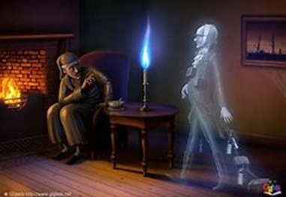
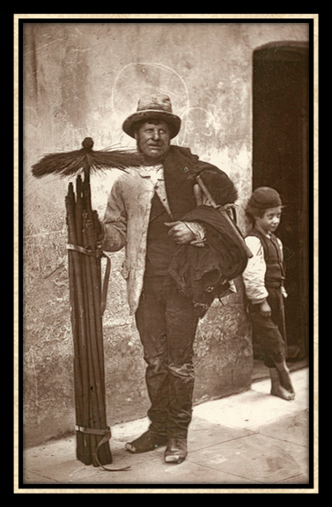
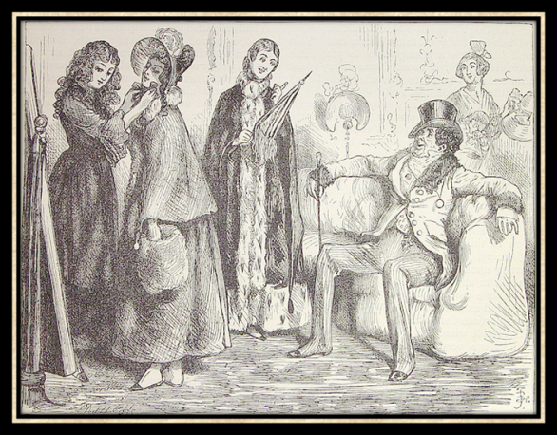
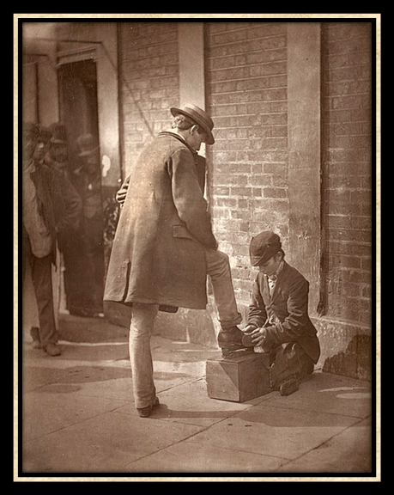
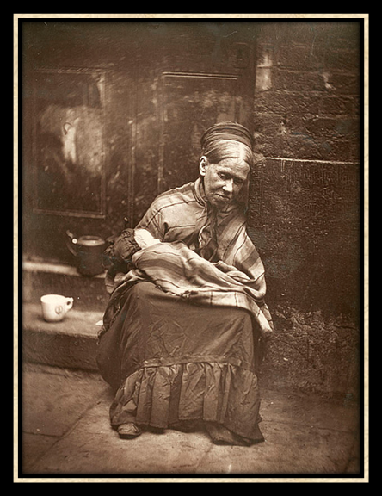
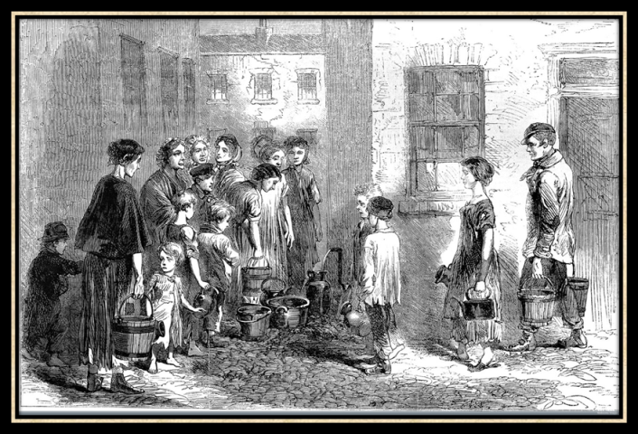
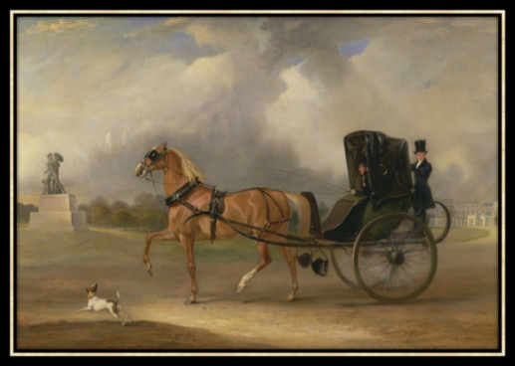
Key Words:
The Poor Law
Victorian Britain
Conditions
Poverty
Workhouse
Dickensian London Aristocracy
Gentry
Industrial Revolution Social injustice Inequality
Ghost story
Moral tale
Allegory
A Christmas Carol: CONTEXT
TASK: Using the images below, what can you infer about life in the 19th century?
CHALLENGE: list 5 words to describe the life of a POOR child
Learning Objective: to understand the CONTEXT (time period) of the NOVELLA
AO1 Read, understand and respond to texts. Students should be able to: • maintain a critical style and develop an informed personal response • use textual references, including quotations, to support and illustrate interpretations.
AO3 Show understanding of the relationships between texts and the contexts in which they were written.

Slide 4
Key Words:
The Poor Law
Victorian Britain
Conditions
Poverty
Workhouse
Dickensian London Aristocracy
Gentry
Industrial Revolution Social injustice Inequality
Ghost story
Moral tale
Allegory
CONTEXT
PAIRED/INDIVIDUAL TASK:
Read the context sheets
Make notes from each sheet (do not copy every word)
Create a visual poster for each of the 6 categories in your books (use 1 page each, colourful, bullet points, grids, etc)
Learning Objective: to understand the CONTEXT (time period) of the NOVELLA
AO1 Read, understand and respond to texts. Students should be able to: • maintain a critical style and develop an informed personal response • use textual references, including quotations, to support and illustrate interpretations.
AO3 Show understanding of the relationships between texts and the contexts in which they were written.

Slide 5
Key Words:
The Poor Law
Victorian Britain
Conditions
Poverty
Workhouse
Dickensian London Aristocracy
Gentry
Industrial Revolution Social injustice Inequality
Ghost story
Moral tale
Allegory
CONTEXT
Poverty:
Class inequality:
Religion and Christmas:
Workhouses:
Social injustice:
Dickens:
Learning Objective: to understand the CONTEXT (time period) of the NOVELLA
AO1 Read, understand and respond to texts. Students should be able to: • maintain a critical style and develop an informed personal response • use textual references, including quotations, to support and illustrate interpretations.
AO3 Show understanding of the relationships between texts and the contexts in which they were written.

Slide 6
Key Words:
The Poor Law
Victorian Britain
Conditions
Poverty
Workhouse
Dickensian London Aristocracy
Gentry
Industrial Revolution Social injustice Inequality
Ghost story
Moral tale
Allegory
Review- what do you know?
Link back to key words
A Christmas Carol has been described as a morality tale.
Why?
How was Dickens affected by what he saw?
What was crime like in the Victorian period?
Which penalties were used as punishments for crimes?
What was the class system?
What was a workhouse?
What was social injustice?
What do you think led him to writing A Christmas Carol?
Learning Objective: to understand the CONTEXT (time period) of the NOVELLA
AO1 Read, understand and respond to texts. Students should be able to: • maintain a critical style and develop an informed personal response • use textual references, including quotations, to support and illustrate interpretations.
AO3 Show understanding of the relationships between texts and the contexts in which they were written.

