Slide 1
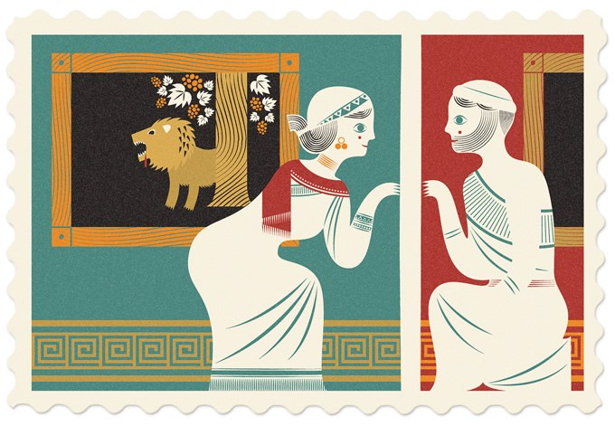
Lesson Objective:Language Analysis
A Midsummer Night’s Dream Act 5
By the end of this lesson you will:
Be able to recognise a number of techniques Shakespeare uses to create humour in the play-within-a –play.
Understand audience reaction to the performance of Pyramus and Thisbe.
Learning Content

Slide 2
Progress Indicators:
Expected Progress: Find examples of the devices Shakespeare uses to create humour.
Good Progress: Identify ways in which Pyramus and Thisbe might be unsuitable for a wedding celebration.
Outstanding Progress: Identify ways in which the play-within-a-play is an ironic commentary on what the two pairs of young lovers have gone through earlier.
Learning Outcomes

Slide 3
Starter:
Create an event ladder for Act 4.
What are the main things that have happened? Start at the bottom of the ladder.
You have 5 minutes.
Ready?
Do Now
GO!
Notes:
Pupils should have a copy of the events ladder.

Slide 4
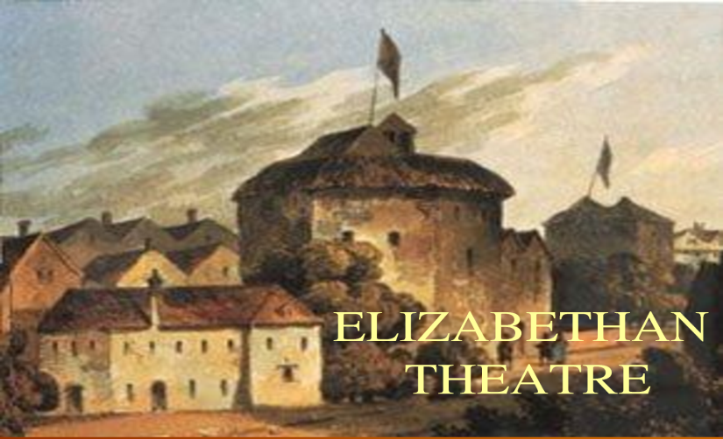
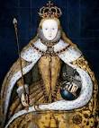
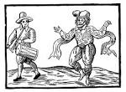
Did you know?
Elizabethans, rich and poor, enjoyed live entertainment.
Nobles could afford to have live performers come to their homes.
Every year, one of England’s great theatre companies would be chosen to appear at the court of Queen Elizabeth I.
No expense was spared for the final production which included elaborate sets and costumes.
Context

Slide 5
Vocabulary
___________________A writers’ technique which compares one aspect directly with another.
___________________The repetition of a letter, usually at the beginning of the word.
___________________Misprononouncing a word.
____________________deceptive impression of reality which deceives the eye.
____________________Repeating a word or phrase for effect.
Malapropism
Illusion
Repetition
Alliteration
Metaphor
Unlocking vocabulary

Slide 6
Vocabulary Answers
Metaphor- A writers’ technique which compares one aspect directly with another.
Alliteration - The repetition of a letter, usually at the beginning of the word.
Malapropism - Mistaken use of a a word, often for comedic effect.
Illusion- deceptive impression of reality which deceives the eye.
Repetition - Repeating a word or phrase for effect.
Malapropism
Illusion
Repetition
Alliteration
Metaphor
Unlocking vocabulary

Slide 7
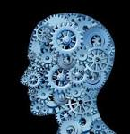
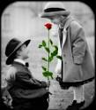
Shakespeare’s Relevance
Shakespeare was a keen observer of human psychology.
His characters and themes still speak to today’s audiences.
He skillfully illustrates the feelings and actions experienced by two young lovers.
He also shows how silly and ridiculous those actions may seem to someone who does not share these feelings.
Context
What evidence of this can you see in Act 5 and the play as a whole?

Slide 8
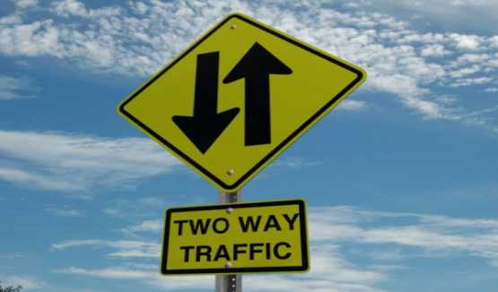
Active Reading: Two-way traffic
A live theatrical performance is a two-way relationship between the performers and the audience.
Pay attention to how Theseus, Hippolyta and the other members of the audience react to the performance of Pyrmaus and Thisbe.
Note how the performers react to the audience.
Reading & thinking Task
Audience Reactions | Performers Reactions

Slide 9
Draw this table
Audience Reactions | Performers Reactions
Reading & thinking Task

Slide 10
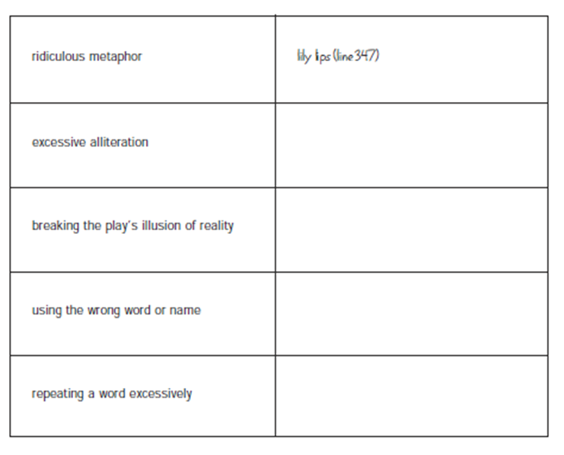
Active Reading
Shakespeare uses a
number of different
techniques to create
humour in the play-
within-a-play.
Use the graphic
organiser to indicate
some of his comic
devices.
Reading & Writing Task

Slide 11
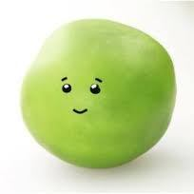
Question – Bottom often appears clueless to the audience. How does he demonstrate this.?
You have 20 minutes to answer the question with evidence and solid explanations in the form of a P.E.A. paragraph.
Mastery
Notes:
The timing of 20 minutes can be teacher/class dependent

Slide 12
Question – Bottom often appears clueless to the audience. How does he demonstrate this.?
Bottom often appears clueless in ‘A Midsummer Night’s Dream’. The audience knows that it would be very difficult for one actor to play all the parts in their performance of ‘Pyamus and Thisbe’ yet Bottom wants to do just that. This is clear when he says, “let me play Thisbe too” and “Let me play the Lion too.” By Bottom saying these things the audience finds humour and regards him as confused and lacking understanding of what a play actually is.
Bottom also demonstrates his ignorance when he meets Titania’s fairies and takes their names literally. Upon meeting Peaseblossom he requests she “commend me to Mistress Squash … and to Master Peascod.” When Bottom refers to her parents as vegetables it indicates that he is mystified by the living beings name. He links her name with the plant world even though he can see she is alive which proves how clueless he actually is.
Model

Slide 13
Questions for Discussion
What does Theseus think of the lover’s adventure? Is this a reaction you would expect?
Why does Hippolyta initially seem hesitant to watch the play?
Why does Snug, who plays the Lion, make a fuss about proclaiming his true identity?
Checking Understanding

