Slide 1
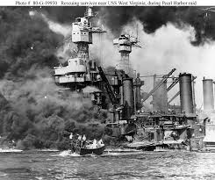
Chapter 9 - Heroes by Robert Cormier

Slide 2
Starter: What qualities do you associate with a role model?
Passion and Ability to Inspire [have the capacity to infect others with their passion]
Clear Set of Values [people who act in ways that support their beliefs]
Commitment to Community [freely giving of their time and talents to benefit people]
Selflessness and Acceptance of Others [acceptance of others who were different from them]
Ability to Overcome Obstacles [the skills and abilities of initiative ]

Slide 3
Let’s read Chapter 9

Slide 4
Task: Write a diary entry imagining that you are Francis as a child, describing the events of chapter nine. You should include: *The outbreak of war *Your relationship with Nicole *Your feelings about Larry LaSalle’s award for bravery *Your plans for the future

