Slide 1
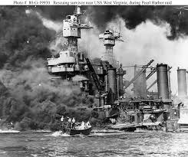
Chapter 8 - Heroes by Robert Cormier

Slide 2
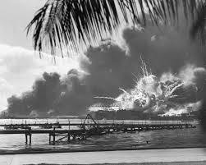
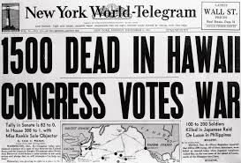
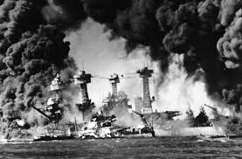
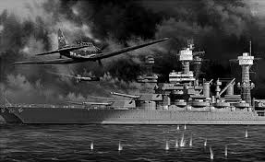
Starter: Why is 7th December 1941 significant?
https://www.youtube.com/watch?v=P-ZSem5F08M
Notes:
Clip 1 = Japanese from Pearl harbour movie
Clip 2 = American retaliation from Pearl Harbour movie

Slide 3
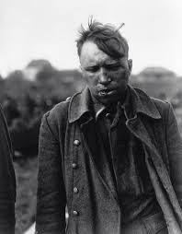
Task: Let’s read Chapter 8
The aftermath of war
We see Arthur very differently in chapter 8. Why does Cormier present him this way?
How does the quote “We weren’t heroes. We were only there…” make you feel?
Do you think Cormier is right in portraying war like this? Why?

Slide 4
Narrative essay: Describe what it would be like to be under attack.
Rules - it must be in FIRST person.
Have a range of sentence structures for effect
High Level of vocabulary
Deep sensory description (SHOW DON’T TELL)
Paragraphs for effect
WORD BANK:
200-300 WORDS

