Slide 1
Key Quotation: Make Notes
Consolidating knowledge
“Look like the innocent flower, but be the serpent under’t”
The renaissance audience would automatically associate the serpent with the Garden of Eden and the Fall of Man
Lady Macbeth is encouraging her husband to disregard his chivalric code of honour
Like the witches, Lady Macbeth tempts Macbeth with power and uses her words (considered a woman’s weapon) to manipulate him

Slide 2
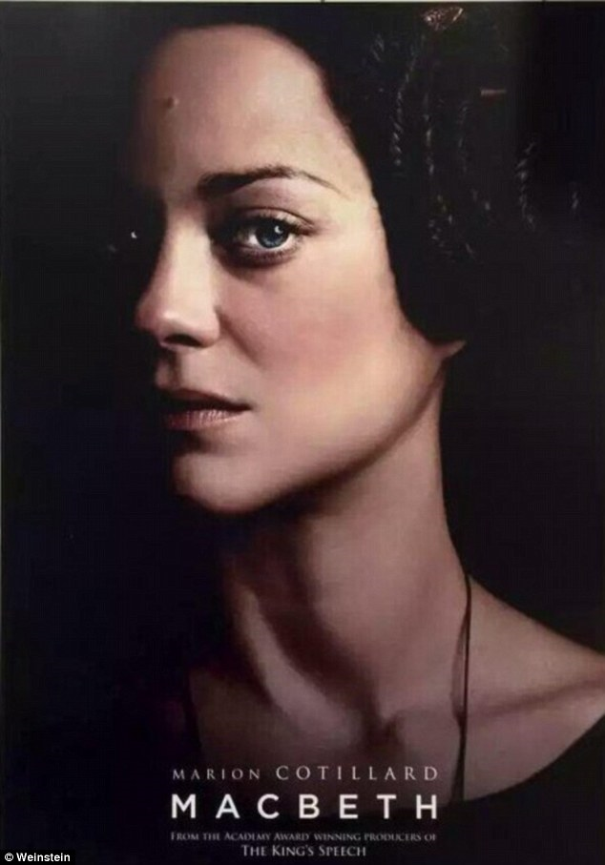
Context Question
Mastery
Read the context question and highlight at least five key aspects of the speech that reveal Lady Macbeth’s character.
Consider her words in relation to how women were expected to act at the time.
Lady Macbeth conjures up strong imagery in this extract – does that remind you of any other character(s) we have met so far?

Slide 3
Context question: Act 1, Scene 5 What do we learn about LM in this extract?
Mastery
LADY MACBETH
The raven himself is hoarse
That croaks the fatal entrance of Duncan
Under my battlements. Come, you spirits
That tend on mortal thoughts, unsex me here,
And fill me from the crown to the toe top-full
Of direst cruelty! Make thick my blood;
Stop up the access and passage to remorse,
That no compunctious visitings of nature
Shake my fell purpose, nor keep peace between
The effect and it! Come to my woman's breasts,
And take my milk for gall, you murdering ministers,
Wherever in your sightless substances
You wait on nature's mischief! Come, thick night,
And pall thee in the dunnest smoke of hell,
That my keen knife see not the wound it makes,
Nor heaven peep through the blanket of the dark,
To cry 'Hold, hold!'
Notes:
Annotate with students on the board

Slide 4
Task: Now answer the question in 2-3 paragraphs using the quotations you have highlighted.
Mastery
What do we learn about LM in this extract?
Notes:
Reinforce use of PEA

Slide 5
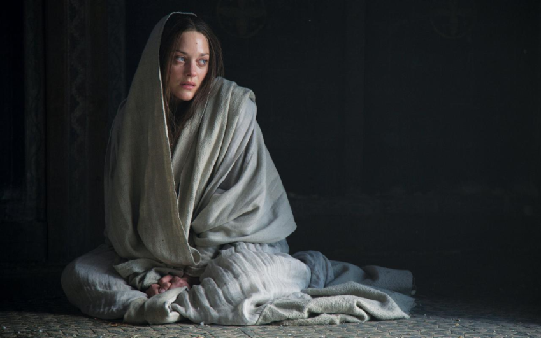
Women in the 1600s
Extension task
Stick the role of women worksheet into your exercise book
Highlight the top five interesting facts about women at the time of the play
What are your expectations about Lady Macbeth based on the role of women at the time?

Slide 6
Thinking questions
Consolidating knowledge
What does Macbeth’s letter to his wife reveal about what he is feeling/thinking?
Why is Lady Macbeth not shocked at hearing about the witches and their predictions? What does this suggest about her character?
How does Lady Macbeth feel about her husband’s nature?

Slide 7
Plenary: Cloze Summary (Act 1)
Consolidating knowledge
The play opens on a battlefield. Three witches set the dark atmosphere and uses ____________ to create a sense of moral confusion. Macbeth’s reputation as a loyal and valiant gentleman is established before he is awarded the title ________________ for his heroism in battle.
Macbeth and his loyal friend, __________, meet the witches who offer prophecies: Macbeth will be promoted and then become King, but Banquo’s children will be Kings also.
After the battle, King Duncan names Malcolm, The Prince of Cumberland, his heir. In a ______________, Macbeth reveals he would kill to become the King.
His wife receives his letter and states that he is ambitious, but too ___________. She calls upon spirits to make her strong and convinces her husband that they should rule together.
King Duncan arrives at Macbeth’s castle and Macbeth decides to go no further in the murder plot. Lady Macbeth questions Macbeth’s ______________, so they decide the murder will happen.
The play opens on a battlefield. Three witches set the dark atmosphere and uses paradoxes to create a sense of moral confusion. Macbeth’s reputation as a loyal and valiant gentleman is established before he is awarded the title Thane of Cawdor for his heroism in battle.
Macbeth and his loyal friend, Banquo, meet the witches who offer prophecies: Macbeth will be promoted and then become King, but Banquo’s children will be Kings also.
After the battle, King Duncan names Malcolm, The Prince of Cumberland, his heir. In a soliloquy, Macbeth reveals he would kill to become the King.
His wife receives his letter and states that he is ambitious, but too honest. She calls upon spirits to make her strong and convinces her husband that they should rule together.
King Duncan arrives at Macbeth’s castle and Macbeth decides to go no further in the murder plot. Lady Macbeth questions Macbeth’s masculinity, so they decide the murder will happen.
Notes:
This could be used as a DO NOW next lesson.

Slide 8
Notes:
Resources: Printable slide for students

