Slide 1
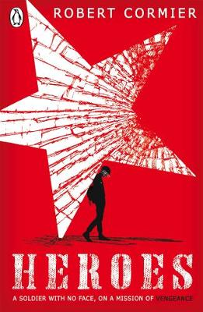
LESSON 3

Slide 2
The ‘Wreck’ Centre
What are the connotations of WRECK?
Do Now

Slide 3
Read Chapter 5. page 20-25
Reading Activity

Slide 4
Task: Summarise the ‘Wreck’ centre’s history in no more than 25 words. What does the violent history suggest about the place?
Checking Understanding

Slide 5
Re-read the description of the wreck centre. What does the language suggest? What atmosphere and mood is created and how?
In the next few days the men worked frantically, scraping and painting, replacing doors and windows, tarring the roof. But the work was haphazard. Workers dropped hammers, spilled paint, stumbled over each other and occasionally pulled brown paper bags from their pockets and took quick gulps from hidden bottles…
When the workers finally completed the job , the building still looked unfinished. The white paint didn't completely cover the dark patches of mildew on the clapboards and the shutters sagged next to the windows.
Mastery
Rushed, trying to complete quickly
Lots of jobs to be completed – shows it must be in bad disrepair
the men worked frantically, scraping and painting, replacing doors and windows, tarring the roof.
The use of the list adds to the sense of rushing/quickness

Slide 6
How is Francis portrayed as a young boy in Chapter 5? What do we learn about his early life? Mind map your ideas and support each one with a quote from the chapter.
Checking Understanding

