Slide 1
LESSON 2

Slide 2
Re-cap starter: Chapter Three
Comprehension Questions
1. Find the sentence ‘I stare at the final proof that Nicole has gone away’ (page 10). How does the writer move from one time period to another here?
2. In the page following this (page 11), what is suggested about Nicole, and how she changed after Francis left?
3. In the section beginning ‘I can never trace the moment …’ (page 15), how does the writer move from one time period to another?
4. In the section beginning ‘I don’t want to think about them’ (page 15), in what ways is it suggested that the soldiers are not heroes? How is it suggested that war is brutal and nasty rather than heroic?
Do Now

Slide 3
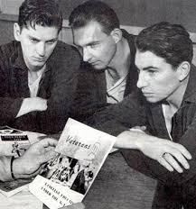
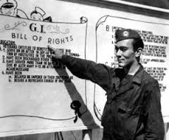
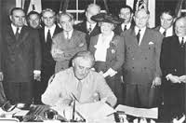
Now read Chapter 4 (page 17-20).
Why is the Wreck Centre so important to Francis?
What was the GI Bill?
Why was Arthur Rivier famous in Frenchtown before the war?
The legislation provided a range of benefits for returning World War II veterans, including funding for college, home loans and unemployment insurance.
GI = ‘Government issue’
Reading Activity

Slide 4
Before and After
In chapter four Francis meets an old friend, Arthur Rivier. How has Arthur changed since the war?
Before the war | After the war
‘a star first baseman for the Frenchtown Tigers.’ | ‘His eyes are bleary and bloodshot’
Reading Activity
Why do you think Cormier includes this character?
What could his story represent?

Slide 5
Heroism
In the novel Cormier presents different types of heroes. Francis is a decorated war hero and Arthur was a sporting hero before the war. However in chapter four Francis says that he is not the hero that others think he is.
What does he mean by this?
What does this reveal about Francis’s self esteem?
Why doesn’t Francis join in the drinking and conversation?
What is the topic of conversation in the St Jude club?
What are Francis’s plans for the future?
What could this suggest?
Checking Understanding

